Slide 1

Vaccine Economics for NITAGs – Beginner training
These slides were developed by the University of Melbourne with inputs from the GNN, NITAG members and academic experts in vaccine economics
Endorsed by the GNN in January 2025
Notes:
N/B – Image has CC license and free to reuse without restrictions
Updated February 2025

Slide 2

Pre-Module/Background understanding
https://q.surveys.unimelb.edu.au/jfe/form/SV_79Q2637LpGFbP82
Notes:
Link: https://q.surveys.unimelb.edu.au/jfe/form/SV_79Q2637LpGFbP82

Slide 3

Learning Objectives
On completion of this training, you will be able to:
Explain why economic evidence can be useful in developing immunization recommendations
  Recognize which elements of the Evidence to Recommendation (ETR) framework link to economic evidence
  Identify economic question(s) that may be of relevance to the NITAG
  Link different types of economic assessments to specific economic questions relevant to NITAGs
  Interpret the results of a cost-effectiveness analysis for decision-making

Slide 4
Module overview
Why and how to consider economic evidence in developing immunisation recommendations?
Costing studies and budget impact analysis
Introduction to economic evaluation
Additional resources and takeaways
1
2
3
4

Slide 5
Why and how to consider economic evidence in developing immunization recommendations?

Slide 6

Overview of Health Economics
Health economics is concerned with issues related to efficiency, effectiveness, value and behaviour in the production and consumption of health and healthcare.
Economic evaluation is the systematic process of identifying, measuring and valuing the costs and outcomes (effects) of an intervention in comparison with an alternative to provide evidence on the value for money given scarcity of resources.

Slide 7
NITAGs role in making immunization recommendations
The NITAG makes recommendations for immunization policy-making
The policy questions that the NITAG must answer can be broad questions, such as:
  Should the rotavirus vaccine be introduced in the National Immunisation Programme?
  Should rotavirus vaccine or Pneumococcal Conjugate Vaccine (PCV) introduction be prioritised?
  Should the number of doses of Human Papilloma Virus (HPV) vaccine be reduced from two to one?
  Should the existing PCV be replaced with a lower-cost or higher-cost, different valent vaccine option?
  Should the combination of tetravalent and Hib stand-alone vaccine be replaced by the pentavalent vaccine?
Why is it useful to consider economic evidence

Slide 8
Why consider economic aspects of vaccines?
Resources are constrained (limited budgets, human resources, etc.) relative to need
Difficult decisions need to be made on how to spend the health budget, given the current context:
  More vaccines coming onto the global market
  Newer vaccines can be more expensive than currently used vaccines
  Low- and middle-income countries (LMICs) are graduating from Gavi support
  Donors are strategizing their priorities in global public health
  Countries are more fiscally constrained
Why is it useful to consider economic evidence
Notes:
Additional notes for trainer:
Resources are constrained, and therefore we can’t include all vaccines in an immunization schedule. Decision makers should try to maximise the benefits from the available resources.
Economic and financial aspects (such as vaccine price, cost-effectiveness and budget constraints) can also be of primary importance, especially when substantial amounts of money are being considered. For example, new vaccines, such as the rotavirus vaccine, the Pneumococcal Conjugate Vaccine (PCV), and the Human Papilloma Virus Vaccine (HPV) are much more expensive than traditional vaccines of the Expanded Programme on Immunization (EPI), as are most future vaccines expected to be. Decisions about their introduction can have a tremendous impact on the National Immunization Programme budget, and possibly on the health budget.

Slide 9
How economic considerations can support NITAG recommendations
Whether NITAG recommendations are taken forward by MoH can be related to economic considerations
Economic evidence can support recommendations by considering:
  Estimated impact on budgets to ensure adequate planning and resource mobilization
  Whether a vaccine program is affordable given existing fiscal space
  Whether a vaccine program is efficient, or good value for money in comparison to other interventions or programs
    For example, we may be asked “Why should MOH pay for this program?” Relevant economic evidence may be that “It will prevent #### hospitalizations per year, amounting to $ #### of savings per year.”
Having formalised mechanisms around what is good value for money can also help with price negotiations (drive price down)
Why is it useful to consider economic evidence
Notes:
Resource Allocation: Economic evaluations help decision-makers allocate resources efficiently by comparing the costs and benefits of vaccination programs against other healthcare interventions. This aims to ensure ensure that funds are directed towards interventions that provide the most value for money.

Slide 10
Health Opportunity Costs
A new or changed vaccination program may need to meet certain conditions, including demonstrating cost-effectiveness.
Demonstrating cost-effectiveness does not imply that a new or changed vaccine program will save money.
“Cost-effective” implies delivering more health than what would be generated if resources were spent elsewhere in the health system (health opportunity costs).
This ensures that other priorities for population health are considered (in a fair and consistent manner) alongside the benefits of a vaccination program.
Opportunity Cost: Resources spent in one way cannot be spent elsewhere.
Example.
When electing to introduce PCV first instead of rotavirus vaccine, the opportunity cost of introducing PCV is what you would otherwise have gained from the rotavirus vaccine (or the next best use of those resources)
Why is it useful to consider economic evidence

Slide 11
Which economic aspects to consider?
Given the concept of opportunity costs, it is therefore sensible to search for a good, if not the optimal, use of resources, to have the greatest public health impact
When considering vaccine recommendations, there are different economic considerations that may be relevant:
  Vaccine price
  Vaccine affordability
  Impact on National Immunisation Programme (NIP) budget
  Impact on health budget (and other government budgets)
  Value for money, or cost-effectiveness
  Impact on inequalities
Why is it useful to consider economic evidence
Notes:
Additional notes for trainer:
Because of the scarcity of resources, the economic and financial impact of decisions should be considered, and it is sensible to search for a good, if not the best, use of the money, for the optimal public health impact.
Economic and financial aspects (such as vaccine price, cost-effectiveness and budget constraints) can be of primary importance, especially when substantial amounts of money are being considered. For example, new vaccines, such as the rotavirus vaccine, the Pneumococcal Conjugate Vaccine (PCV), and the Human Papilloma Virus Vaccine (HPV) are much more expensive than traditional vaccines of the Expanded Programme on Immunization (EPI), as are most future vaccines expected to be. Decisions about their introduction can have a tremendous impact on the National Immunization Programme budget, and possibly on the health budget.
Economic evaluation of vaccines is essential to allocate resources to achieve the greatest health outcomes.
Examples of the kinds of questions that could be informed by economic evaluation include: (WHO guide for standardization of economic evaluations of immunization programmes)
Should an under-utilized or new vaccine be introduced, e.g. Hib or rotavirus?
For which new vaccine(s) should Gavi, the Vaccine Alliance, open a window of funding? What is the maximum price that should be paid for a vaccine?
What delivery strategy should be used to increase vaccination coverage, e.g. fixed sites, mobile teams or campaigns?
Is targeted or universal vaccination more efficient, e.g. during an influenza pandemic should vaccination be targeted at risk groups or offered to everybody?
If there are multiple vaccines that are directed against the same disease (e.g. human papillomavirus, rotavirus, pneumococcal and influenza vaccines), which one should be used, and at what price differential are they equivalent?
Should a current vaccine be replaced with another directed to the same condition and population but with different characteristics, e.g. should live oral polio vaccine (OPV) be replaced with risk-free inactivated polio vaccine (IPV) or the currently used measles vaccine replaced with a thermostable measles vaccine?
Is a combination vaccine more efficient than a combination of vaccines, e.g. DPT-HepB or DPT and HepB separately?
What would be the cost-effectiveness of introducing a new vaccine alone compared to introducing it in combination with other existing preventive health interventions, e.g. HPV vaccine alone vs. in combination with cancer screening, or malaria vaccines alone vs. in combination with insecticide-treated bed-nets?
Is there an investment case for developing a new vaccine e.g. against a disease with pandemic potential such as SARS?

Slide 12
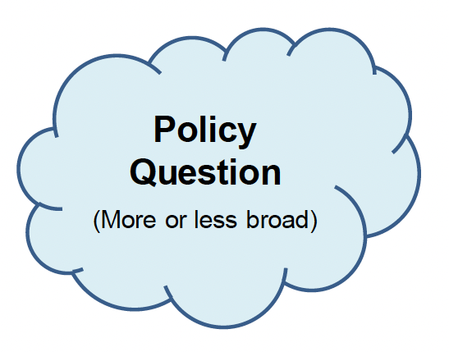

Evidence-Based NITAG Recommendations
Question is asked to the NITAG (by MoH, NITAG, or other)
EVIDENCE-BASED
NITAG members advise based on the best available evidence and identify need for additional data or research
Economic aspects may be included alongside other criteria considered within recommendation framework
Why is it useful to consider economic evidence
Notes:
Recall the objective and scope of NITAG Functions: (1) Advisory (Final decision made by national authorities); (2) Independent (NITAG not in charge of implementation and no interests); (3) Evidence-based (NITAG members advise based on best available evidence and identify need for additional data or research) → In order to issue recommendations on any topic concerning vaccines and vaccination in general such as:
-Optimal immunization policies and strategies
-Monitoring immunization program impact
-Collection of data and information

Slide 13
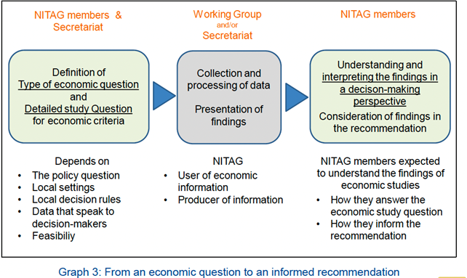
The role of the NITAG in defining the economic question and understanding the economic findings
Why is it useful to consider economic evidence
Notes:
The NITAG should first consider the type of economic question and detailed study question for economic criteria. This question will depend on the policy brought forward, the local setting, local decision rules, what data is available and feasibility.
From here, a working group or secretary from within the NITAG may collect and process economic data relevant to the study question.
This process will be different depending on whether the NITAG is a user of the economic information or a producer of the economic information.

Slide 14
Economic question(s) of interest
It is the responsibility of the NITAG to consider whether it is relevant to include economic aspects in the recommendation framework related to the topic under discussion
The choice of the most relevant type of economic question to answer is driven by several factors:
  The general policy question to be informed by the NITAG.
  The local setting, such as national priorities for health and immunization, the financing of the health systems and of the immunization programs, or available fiscal space.
  The decision rules, whether they are formally written or not, applied in the country (these can be economic or financial indicators or thresholds that are considered).
  The evidence that speaks to decision-makers, and to which they are sensitive when making a decision (if known)
Why is it useful to consider economic evidence

Slide 15
Role of the NITAG in using and producing economic evidence
Most NITAG members are not health economists, and are not in charge of conducting economic analyses
Analyses can be conducted by a Working Group, chaired by the health economist(s) of the NITAG, or conducted by external group(s), including industry or academic organisations
NITAG members should be able to:
  Understand and agree on the research protocol especially if the study is commissioned by the NITAG or conducted by one of the members.
  Determine the feasibility of collecting and analyzing data, and answering the economic question(s)
  Understand the findings of economic studies, how they answer the question and inform the recommendation.
Why is it useful to consider economic evidence

Slide 16
Defining specific economic question(s) of interest
If the NITAG considers it to be relevant, the NITAG can define one or more economic question(s) to answer
There are many different economic questions that may be relevant to investigate, for example:
  What is the cost of the intervention?
  What are the health benefits of the intervention?
  What is the impact of an intervention on the budget, including any cost savings?
  Is the intervention good value for money? (i.e. Is it cost-effective?)
  At what price would a particular vaccine
  represent good value?
Further reading
(See Table 1) Hutubessy, R. et al. The Full Value of Vaccine Assessments (FVVA): a framework for assessing and communicating the value of vaccines for investment and introduction decision-making. BMC Med 21, 229 (2023). https://doi.org/10.1186/s12916-023-02929-0
Why is it useful to consider economic evidence

Slide 17
Different economic tools answer different questions
What are the monetary consequences of the intervention?
Is the intervention cost-effective? Are the additional costs worth the outcomes?
Intervention versus comparator
What are the costs associated with disease?
Intervention versus comparator
No intervention
What is the cost of an intervention?
One intervention
“The cost of the vaccine program is $15 per vaccinated girl.”
“Vaccination costs $2 million a year but will save the health system $500,000 a year.”
“Vaccination costs $10,000 per death prevented.”
Costs only
Costs only
Costs and outcomes
Costs only, including costs associated with outcomes
“The cost of disease is estimated at $1.3 billion.”
Costing study (Cost of illness)
Economic burden
Costing study
(Intervention cost)
Cost composition
Budget impact analysis
Affordability
Sustainability
Full economic evaluation
Value for money
Efficiency
Costing Studies and Budget Impact Analysis
Notes:
Trainer to provide handouts as examples from other NITAGs.
(1): Indonesia NITAG case study on Rotavirus (slides)

Slide 18
Recall Checklist
Suggested sections for the MoH report
✅ Policy question
✅ Disease burden
✅ Vaccine efficacy and risks
✅ Economics
✅ Programmatic considerations
✅ Values
✅ Recommendation specifying vaccine, age groups, number of doses and schedule, if relevant
Why is it useful to consider economic evidence

Slide 19
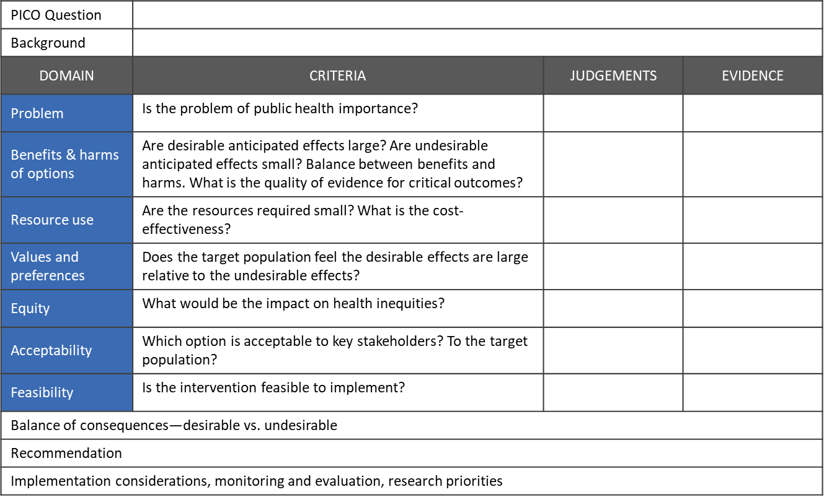
Evidence to Recommendation (EtR) Framework:
Where does economic evidence fit in?
Type of economic analysis
✅
Cost of illness / Economic burden
☑️
Burden of disease study
✅
Costi of intervention/ Economic evaluation
☑️
Equity-informative economic evaluation
✅
Economic feasibility or affordability / Budget impact
Why is it useful to consider economic evidence
Notes:
Figure adapted from Mod 1 SOP Template
From EtR Facilitator’s Toolkit
https://rise.articulate.com/share/r3-raAhIyubfz0x9YPr7hqJh8vRV34us#/lessons/d1OloFbIepPjW2mAMmKWREtN7G9ULj_D

Slide 20
Considering the policy question
Defining the appropriate economic question(s) depends on the general policy question to be informed by the NITAG
It may differ depending on several factors such as:
  The number of alternatives compared (e.g. “should we prioritise the introduction of the rotavirus or PCV in the EPI?” – such a question may raise the issue of value for money, and thus of cost-effectiveness).
  The features of the disease burden (typically the incidence of morbidity and mortality) and the existence and cost of alternative strategies for prevention and/or treatment.
  The characteristics of the vaccine (for example, its efficacy or whether it is an additional antigen in a combined vaccine or a new vaccine requiring additional visits), and the impact of the intervention on the existing situation (e.g. impact on the number of injections/visits, etc.).
Why is it useful to consider economic evidence

Slide 21
Components of the PICO question
Acronym | Name of component | Types of evidence for each component
P | Target Population | Characteristics such as age range, medical conditions, disease severity or level or risk
I | Vaccine Intervention | Product, doses, schedule
C | Comparison | Placebo, no vaccination, control, standard care, existing vaccine, other prevention options
O | Outcomes - Anticipated benefits or harms | Reduction in mortality/morbidity Serious adverse events
While the policy question can be quite broad, the study question for the economic evaluation is expected to be more specific.
Why is it useful to consider economic evidence
Notes:
For the NITAG, the study question should be consistent with the recommendation framework, and hence related to the PICO of the policy question.
That is focusing on the same P (population/patient/problem), the same I (intervention), the same C (comparator), and possibly on the same O (outcome) if relevant for an economic evaluation.
A study question can for instance be: “Is the introduction of the rotavirus vaccine in the EPI for infants cost-effective compared to the current standard practice?”

Slide 22
Defining the Population of interest
Considerations:
  The size of the target population
  Risk profiles of the target population (disease severity, level of risk)
  The rate over time of uptake of the intervention
  Herd immunity/natural immunity
  Number of episodes
  Age demographic
These must be considered with respect to the intervention (e.g., new vaccine), and comparator (e.g., current situation)
The economics of vaccines can look different across different populations of interest
Why is it useful to consider economic evidence
Notes:
The target population, that is the group intended to receive the intervention. It can be defined by different elements (age, health state, socio-economic groups, geographical location, etc.).
The analysed population is all individuals whose health is affected by the intervention. It can be a wider population than the target population, as non-vaccinated individuals can benefit from the immunized status of the vaccinated population (herd immunity).

Slide 23
Defining the Intervention
Usually, one “intervention of interest” (to be evaluated) and a “comparator”, to which the intervention is compared
A vaccination intervention description must include:
  Vaccine format (single or multi-dose vial)
  Dosage
  Number and timing of doses
  Delivery schedule and mechanism(s)
When framing an economic evaluation, a detailed description of the intervention helps to identify the relevant costs and consequences to consider
Why is it useful to consider economic evidence
Notes:
As an example, the evaluation of interest can be the vaccination of infants compared to the current situation (without vaccination).
The intervention under analysis must be well described.
Where and how the intervention is delivered.

Slide 24
Defining the Comparator
The compactor also needs careful consideration and a thorough definition
Choices of comparator:
  The current strategy or situation (could be ‘do nothing’ or no vaccine)
  Could be a single intervention or mix of interventions used in current practice
  The best available alternative
Economic evaluation analyses can include several comparisons
If a vaccine can be implemented according to different strategies (e.g., different levels of coverage, different number of doses, etc.), then these alternatives can also be compared
Why is it useful to consider economic evidence
Notes:
Similarly, the situation to which the intervention is compared must be clearly identified and described.
The choice of comparator has a strong impact on the type of evaluation to conduct, the approach to data collection and the interpretation of the findings.
The comparator of interest could be:
The current strategy/situation (for instance, no vaccination but treatment of cases, or no vaccination and no care for cases). This is often the most relevant comparator, as it reflects the context in which the intervention of interest would be implemented. Current practice can be either a single intervention or a mix of interventions, and various practices may co-exist. The current practice may also be a “do-nothing” approach.
The current strategy with improvement (for instance, better care of cases and/or better cover of treatment).
The best available alternative. It can be a low-cost option, or an alternative as represented by clinical guidelines.
Economic evaluation analyses can include several comparisons. In particular, if a vaccine can be implemented according to different immunization strategies (different targets, different levels of coverage, different number of doses, etc.), the different alternatives can be compared.

Slide 25
Defining the Outcomes
Outcomes to be considered are related to the expected effects of the intervention
Many different outcomes are possible depending on the type of economic evaluation being considered
These could be:
  Natural outcomes, eg: number of infections, number of deaths, cases of severe disease
  Health-adjusted outcomes that combine morbidity and mortality, eg: quality-adjusted life years/disability-adjusted life years
  Anticipated benefits or harms eg: community trust, adverse events
  Caregiving, productivity impacts, time off work
  Monetary values of the above outcomes
Why is it useful to consider economic evidence
Notes:
The expected effect of the intervention, primarily related to the safety, efficacy, effectiveness, and indirect effects of vaccination (on one or several diseases).

Slide 26
Facilitated Discussion (20 min)
What are some of the broad policy questions your NITAG is facing?
Is it relevant to include economic aspects in the recommendation framework related to any of these questions?
  If so, what are some of the relevant (and specific) economic questions to consider that could be answered by one of the methods introduced?
Recall the types of questions that could be answered:
  What are the costs associated with a disease?
  What is the cost of vaccination?
  Is an intervention cost-effective?
  Is it affordable? What are the financial consequences of introducing a new vaccine?
Facilitated discussion

Slide 27
Costing Studies and
Budget Impact Analysis

Slide 28
Recall:
Different economic tools answer different questions
What are the monetary consequences of the intervention?
Is the intervention cost-effective? Are the additional costs worth the outcomes?
Intervention versus comparator
What are the costs associated with disease?
Intervention versus comparator
No intervention
What is the cost of an intervention?
One intervention
“The cost of the vaccine program is $15 per vaccinated girl.”
“Vaccination costs $2 million a year but will save the health system $500,000 a year.”
“Vaccination costs $10,000 per death prevented.”
Costs only
Costs only
Costs and outcomes
Costs only, including costs associated with outcomes
“The cost of disease is estimated at $1.3 billion.”
Costing study (Cost of illness)
Economic burden
Costing study
(Intervention cost)
Cost composition
Budget impact analysis
Affordability
Sustainability
Full economic evaluation
Value for money
Efficiency
Costing Studies and Budget Impact Analysis

Slide 29
Cost of Illness Study & Cost of Intervention Study
What is the cost of an intervention?
Cost of illness
Cost of Intervention
Cost of illness
Health burden
Health burden
What are the costs associated with an illness?
No Intervention
Intervention
Further reading
Levin A, et al. WHO-led consensus statement on vaccine delivery costing: process, methods and findings. BMC Med 20, 88 (2022) https://doi.org/10.1186/s12916-022-02278-4
Costing Studies and Budget Impact Analysis
Notes:
Two main types of costing studies: Cost of Illness & Cost of Intervention

Slide 30
Costing: Perspectives
Provider
Payer
Societal
Costs to the healthcare provider (could be: Federal and State Governments, private health insurers)
Why?
  Easier to measure costs
  Can be easier for audience to understand
  May be more relevant to decision-maker or budget holder
Costs to the payers (e.g., government or an external partner)
Why?
  May be less relevant but can provide the costs paid by doners
All costs to all payers, including: health sector, family/patient out-of-pocket costs, travel costs, productivity losses
Why?
  Provides a more detailed and holistic understanding of costs incurred by all
BUT…can be harder to measure
Costing Studies and Budget Impact Analysis
Notes:
An additional criteria from PICO which should also be considered when formulating the question to be analysed is the perspective of the analysis.
The perspective of the analysis dictates which costs should be considered. Generally, and economic evaluation there are two main perspectives: the health sector perspective and the societal perspective.
The health sector perspective considers only direct costs to the health system. This could be different levels of government, private insurance and out of pockets costs to individuals.
This perspective is often chosen because it is easiest to measure costs and therefore can be easier for audiences to understand. For example, it may be more relevant for policymakers to only considered health spending when making decisions which affect the health budget.
The other main perspective, the societal perspective is more rigorous and considers costs to all. This includes cost of the health sector, out-of-pocket costs, travel time and productivity losses due to illness and caregiving. Understanding all of these costs allows a more holistic approach to considering costs. The societal perspective while more rigorous and holistic, is hard to measure and potentially more difficult for policymakers to understand.
When designing and economic evaluation the perspective is equally as important as all PICO criteria.
More info: Sanders, G.D., Neumann, P.J., Basu, A., Brock, D.W., Feeny, D., Krahn, M., Kuntz, K.M., Meltzer, D.O., Owens, D.K., Prosser, L.A. and Salomon, J.A., 2016. Recommendations for conduct, methodological practices, and reporting of cost-effectiveness analyses: second panel on cost-effectiveness in health and medicine. Jama, 316(10), pp.1093-1103.

Slide 31
Cost of Illness study (CoI)
Answers the policy question “What is the economic burden that a vaccine-preventable disease or condition imposes on society?”
  including direct costs (e.g., hospitalisation, outpatient visits, medication, diagnostics)
  and indirect costs (e.g., lost productivity),
Conveys ‘the size of the problem’, so often used for advocacy​
Partial analysis – does not consider what should be done about the problem or how much of the problem is modifiable
Should provide context of cost of disease in relation to overall health expenditure
Further reading
Larg A and Moss JR. Cost-of-Illness Studies. Pharmacoeconomics. 2011; 29:653–671.
doi: 10.2165/11588380-000000000-00000
Costing Studies and Budget Impact Analysis

Slide 32
Cost of Illness study (CoI)
Answers the policy question “What is the economic burden that a vaccine-preventable disease or condition imposes on society?”
  including direct medical costs (e.g., hospitalisation, outpatient visits, medication, diagnostics)
  direct non-medical costs (e.g., expenses on travel and meal during healthcare seeking)
  and indirect costs (e.g., lost productivity),
Conveys ‘the size of the problem’, so often used for advocacy​
Partial analysis – does not consider what should be done about the problem or how much of the problem is modifiable
Should provide context of cost of disease in relation to overall health expenditure
Further reading
Larg A and Moss JR. Cost-of-Illness Studies. Pharmacoeconomics. 2011; 29:653–671.
doi: 10.2165/11588380-000000000-00000
Costing Studies and Budget Impact Analysis

Slide 33
Cost Components for Cost of Illness study
Direct medical costs
Direct non-medical costs
Indirect costs
Hospitalizations (all costs included; per bed day or per episode)
Outpatient visits (including emergency department)
Primary care presentations
Medical supplies, treatments and procedures
Diagnostic tests
Healthcare workers’ time
Travel costs
Out of pocket non- medical costs (e.g., food)
Costs to other sectors
Productivity losses associated with
potential earnings forgone from illness or caregiving
Costing Studies and Budget Impact Analysis
Notes:
Direct medical costs: Resources used specifically for a medical treatment
Direct non-medical costs: Resources directly linked to the treatment but not for providing medical care itself
Indirect costs: Related to the economic consequences of the illness
Note to presenter: These categories and costs can be introduced briefly, the next slide is an example of the cost components used in a cost of illness study.

Slide 34
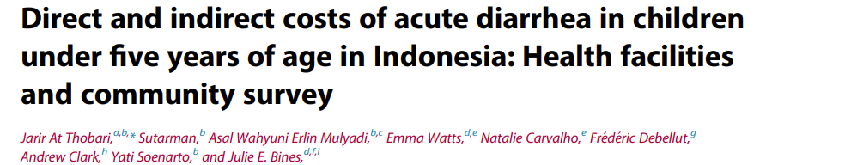

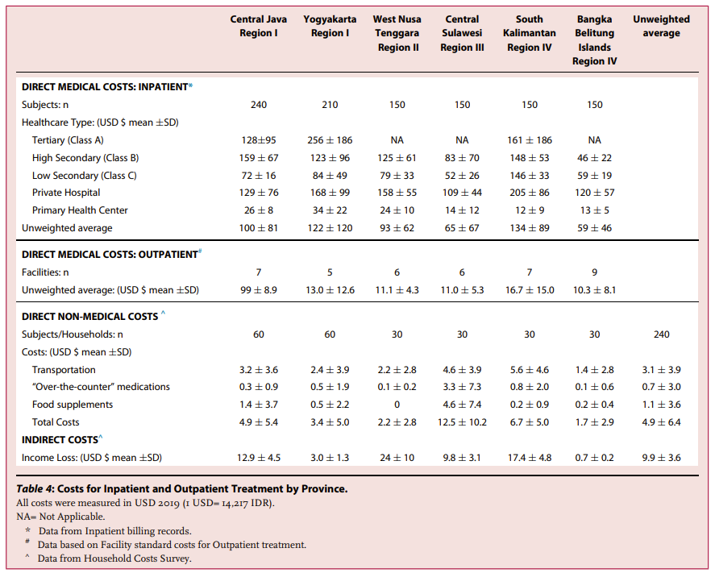
Cost Components for Cost of Illness study
Example from a study of the cost of childhood acute diarrhea in Indonesia
Direct medical costs
Included registration fee (outpatient), room costs (inpatient), professional medical fees, diagnostic test costs, and medication costs.
Direct non-medical costs
Included transportation, “over-the-counter” medications, and food supplements
Indirect costs
Lost income when accessing healthcare and caring for ill child
Costing Studies and Budget Impact Analysis
Notes:
Additional notes for the trainer:
Direct medical costs are often calculated for different visit types (i.e. inpatient vs outpatient visit) and also at different levels of care (ie primary health centers through to tertiary hospitals).
Presenter can pose the question to the group – what other types of costs might not be included here and how might that influence how this evidence is interpreted when forming recommendations

Slide 35
Costing study (Cost of Intervention)
Answers the policy question “What is the value of resources consumed in the implementation of an intervention?”
Useful to understand the cost of introducing a new vaccine, or changing vaccine schedule in relation to existing immunization budget
Results often shown as cost per dose, cost per infant vaccinated, cost per fully-immunized child
Cost composition considers contribution of different cost components (e.g., vaccine and supplies, cold chain, human resources, training or community mobilization) to overall costs
Costing tools can facilitate conducting costing studies
Key questions may include, e.g., “Can the vaccine be co-administered with other vaccine(s)?”
Costing Studies and Budget Impact Analysis
Notes:
Note to Trainer in regards to last point: Adding onto current schedule (EPI), for example, through co-administration, is much easier than adding into another schedule ex: adolescent. Not just cost but also implementation

Slide 36
Cost categories for Intervention Costing Study
Intervention costs
Activities include
Administration & program management
Training
Communication
Community mobilization
Vaccine administration
Indirect costs
Cost of the vaccine(s)
  Vaccine dose
  Consumables (syringes, gloves, etc...)
Cost of vaccination activities
  Cold chain equipment & maintenance
  Human resources
  Transport (vehicles, fuel, etc…)
  Physical space (including electricity, etc…)
  Other consumables (e.g., vaccine cards)
Productivity losses associated with
potential earnings forgone from travel time and vaccination
Adverse event-related costs
Surveillance and reporting of adverse events
Treatment of adverse events
Costing Studies and Budget Impact Analysis

Slide 37
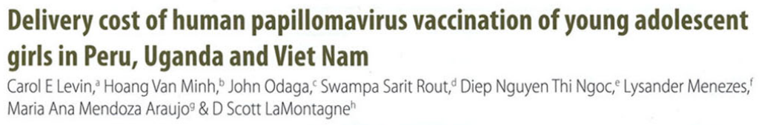
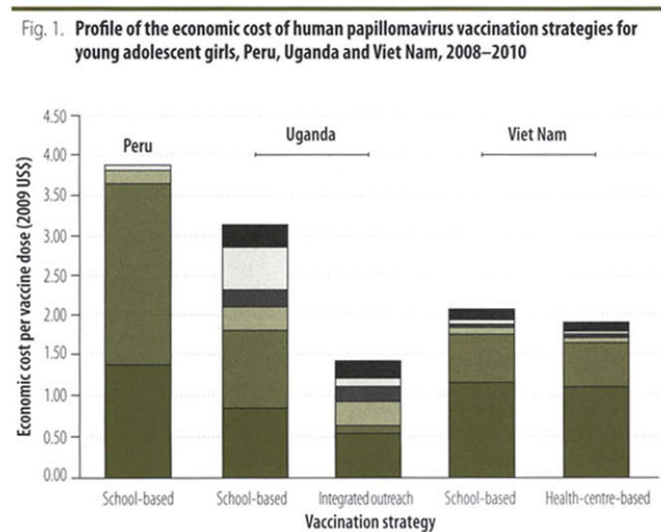
Cost categories in costing studies - Example
Example from an analysis of the costs of HPV vaccination in Peru, Uganda and Vietnam
Start-up activities: Included microplanning, information / education / communication, training of health workers, community mobilization and sensitization
Personnel: Included salaries and allowances for staff delivering vaccination
Supplies: Included injection devices and supplies, waste and disposal.*
Cold chain equipment: Depreciation of cold chain equipment
Vehicles and transportation: Vaccine transport, storage and distribution, depreciation of vehicles
Other
Costing Studies and Budget Impact Analysis
*Study scope was limited to delivery costs - vaccine dose costs not included
Notes:
Example from the literature of different cost components included in a cost of intervention study.
Presenter can discuss how the scope of what cost components are included may vary. For example, vaccine dose costs were not included here as this study was focused specifically on the delivery costs rather than the full intervention cost. This may be useful for certain policy questions, such as choosing between different delivery strategies for a single vaccine, but may be limited in supporting decisions about adopting one vaccine over another.
Total costs and the relative contribution of cost components can vary significantly between countries – eg school based programs in Peru vs Vietnam have very different overall costs and cost break-down. There is also variation within a country for different delivery strategies – eg Uganda integrated approach compared to school-based programs

Slide 38
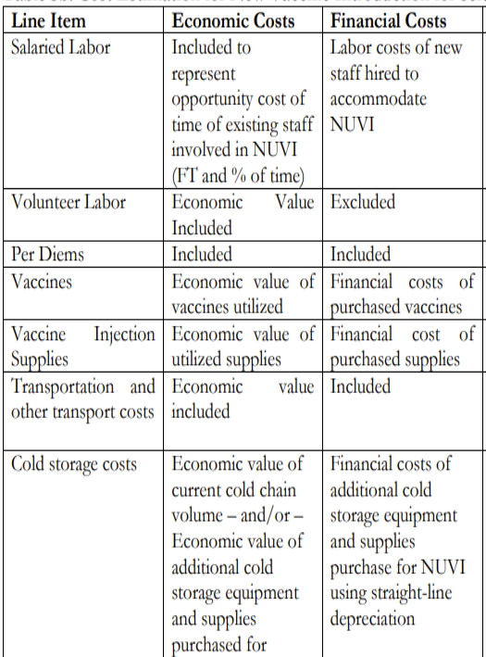
Costing type: Financial vs Economic
Financial cost is the total monetary expenses required to achieve a goal
  Useful for planning and budgeting
  Incremental financial costs: answers the question “how much money would I need to pay to implement the intervention?”
Economic cost is the value of all resources utilized, regardless of the source of financing
  Relates to opportunity cost: what must be sacrificed in order to achieve a goal
  The value of all the resources in their next best use
  Incremental economic costs: answers the question “how many additional resources should I use to implement the intervention?”
Source: Brenzel, L. Common approach for the costing and financing analyses of routine immunization and new vaccine introduction costs (EPIC). Working Paper, Mimeo (2014).
Costing Studies and Budget Impact Analysis
Notes:
Examples of the difference between financial and economic costs highlighted in the table - .
An example for vaccine implementation, is whether volunteer labour is considered as a cost or not. If only the financial costs are considered, the volunteer costs would be excluded in a vaccine program. However, if these volunteers were not working on this program, employed personnel would be required to achieve the same goal.
Another good example is when people tell us something would be 'free' because the nurses/doctors would be paid anyway.
Additionally, considering the economic cost of a vaccine rather than the price the vaccine has previously purchased at which may change over time, could greatly impact results.
Brenzel L, Young D, Walker DG. Costs and financing of routine immunization: approach and selected findings of a multi-country study (EPIC). Vaccine. 2015 May 7;33:A13-20.

Slide 39
Costing approach: Full vs Incremental
Full cost approach: Costs of all resources (baseline and additional) that are used for the intervention are included. (The full cost approach is in general a full economic cost approach, not a financial one).
Incremental cost approach: Costs of additional resources used directly by the intervention in relation to a baseline (typically no intervention, current practice, or another vaccination programme) are included. Existing structures are not considered.
  For example, when considering introducing a new vaccine, upgrades to storage and cold chain systems may be needed.
Whether considering a full or incremental cost approach will be dictated by the existing schedule, infrastructure, and policies.
Costing Studies and Budget Impact Analysis
Notes:
A full costing approach considers the cost of all resources that are used for the intervention. Generally, this will include economic costs not only financial costs.
This may include costing entire program, as if they weren’t already infrastructure and scheduling to add to when implementing a new vaccine.
In contrast an incremental approach refers to the cost of additional inputs and resources incurred directly by the intervention in relation to baseline.
In an incremental cost approach, there is already an existing vaccination schedule which can be utilise to implement a new vaccine. Therefore, only considering the additional costs from the intervention.
Notes to trainer:
inclusion of existing resources will depend on assumptions made about excess capacity (i.e., whether resources are underemployed; if there are no slack resources (e.g., all personnel time is fully
allocated before the addition of the new service/intervention), then their use for the new service or intervention incurs an opportunity cost that should be included – either by measurement or assumption).

Slide 40
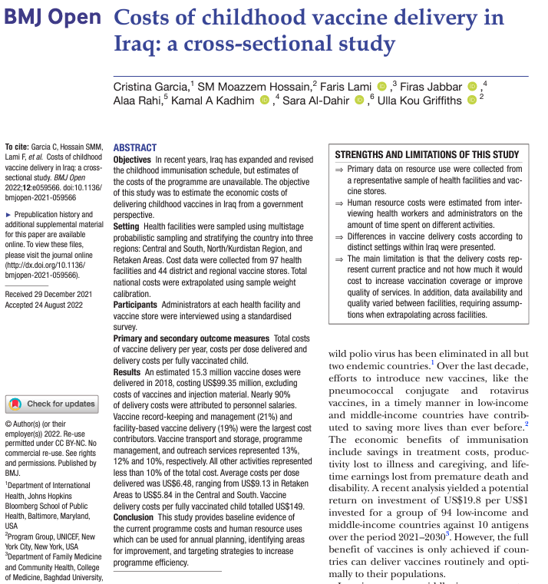
Full costing approach - Example
Example from an analysis of the costs of childhood vaccination delivery in Iraq
Strengths
  Primary data on resource use collected from a representative sample of health facilities and vaccine stores.
  Human resource (time) costs estimated from interviewing health workers and administrators
  Differences in vaccine delivery costs according to distinct settings within Iraq were presented.
Limitations
  Delivery costs represent current practice and not how much it would cost to increase vaccination coverage or improve quality of services.
Further reading
World Health Organization. (‎2022)‎. Standard terminology and principles for vaccine delivery costs. https://www.who.int/publications/i/item/9789240052475
Costing Studies and Budget Impact Analysis

Slide 41
Budget Impact Analysis
What are the additional costs and savings associated with an intervention?
What is the impact on health (or immunisation) budgets?
Cost of illness
Cost of intervention
Cost of illness
Health burden
Health burden
Further reading
Sullivan SD, et al. Report of the ISPOR 2012 Budget Impact Analysis Good Practice II Task Force. Value in Health. 2014; 17(1):5-14. doi: 10.1016/j.jval.2013.08.2291
No Intervention
Intervention
Costing Studies and Budget Impact Analysis
Notes:
Sullivan SD, Mauskopf JA, Augustovski F, Jaime Caro J, Lee KM, Minchin M, et al. Budget Impact Analysis—Principles of Good Practice: Report of the ISPOR 2012 Budget Impact Analysis Good Practice II Task Force. Value in Health. 2014;17(1):5-14. doi: https://doi.org/10.1016/j.jval.2013.08.2291.

Slide 42
Why is budget impact analysis a useful financial tool?
Essential part of a comprehensive economic assessment of a health care intervention ​
Addresses the financial consequences (i.e. expected changes in the expenditure) to a health care system after the adoption of a new intervention ​(e.g., vaccine introduction) to help understand the financial feasibility and sustainability of an intervention
While an intervention may be an efficient use of funds (i.e. cost-effective), it may be unaffordable due to the impact of the intervention adoption on the healthcare budget​
Note that health care decision-makers often require evidence on both cost-effectiveness analysis and budget impact assessment
Costing Studies and Budget Impact Analysis

Slide 43
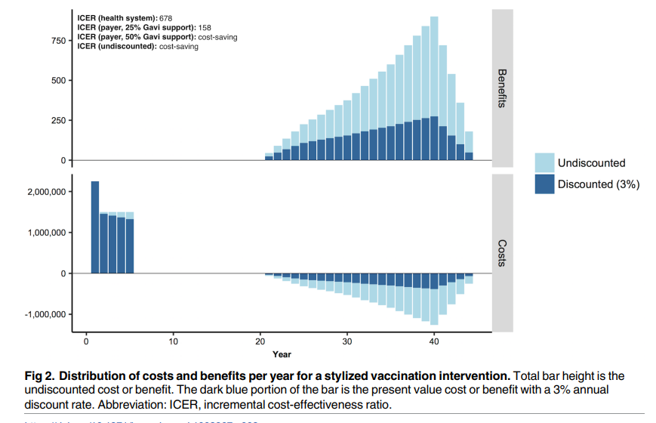
Why is budget impact analysis a useful - Example
Stylized example of HPV vaccination in 5 cohorts, each of 100,000 10-year-old girls in a low-income country
Costs effectiveness analysis shows vaccination would be considered good ‘value for money’ in most countries.
But budget impact analysis shows that all costs are borne upfront and would require substantial (possibly unaffordable) increases in immunization budgets.
Costing Studies and Budget Impact Analysis
Source: Bilinski A. et. al. When cost-effective interventions are unaffordable: Integrating cost-effectiveness and budget impact in priority setting for global health programs. PLoS Med 2017; 14(10): e1002397.

Slide 44
Budget Impact Analysis
Perspective from budget holder: separate external/donor funding​
Eligible population: need actual demographic data​
Costs: Financial rather than economic​
Time horizon: generally, 1 to 5 years (relevant to the budget holder, in accordance with their budgeting process and periods (e.g., monthly, quarterly, and annual))​
Time dependencies: consider, for example, anticipated changes in vaccine price over time or % co-payment; estimated uptake over time; eligible remaining population
Uncertainty analyses: scenario analyses particularly relevant (e.g., different roll-out scenarios)
Costing Studies and Budget Impact Analysis

Slide 45
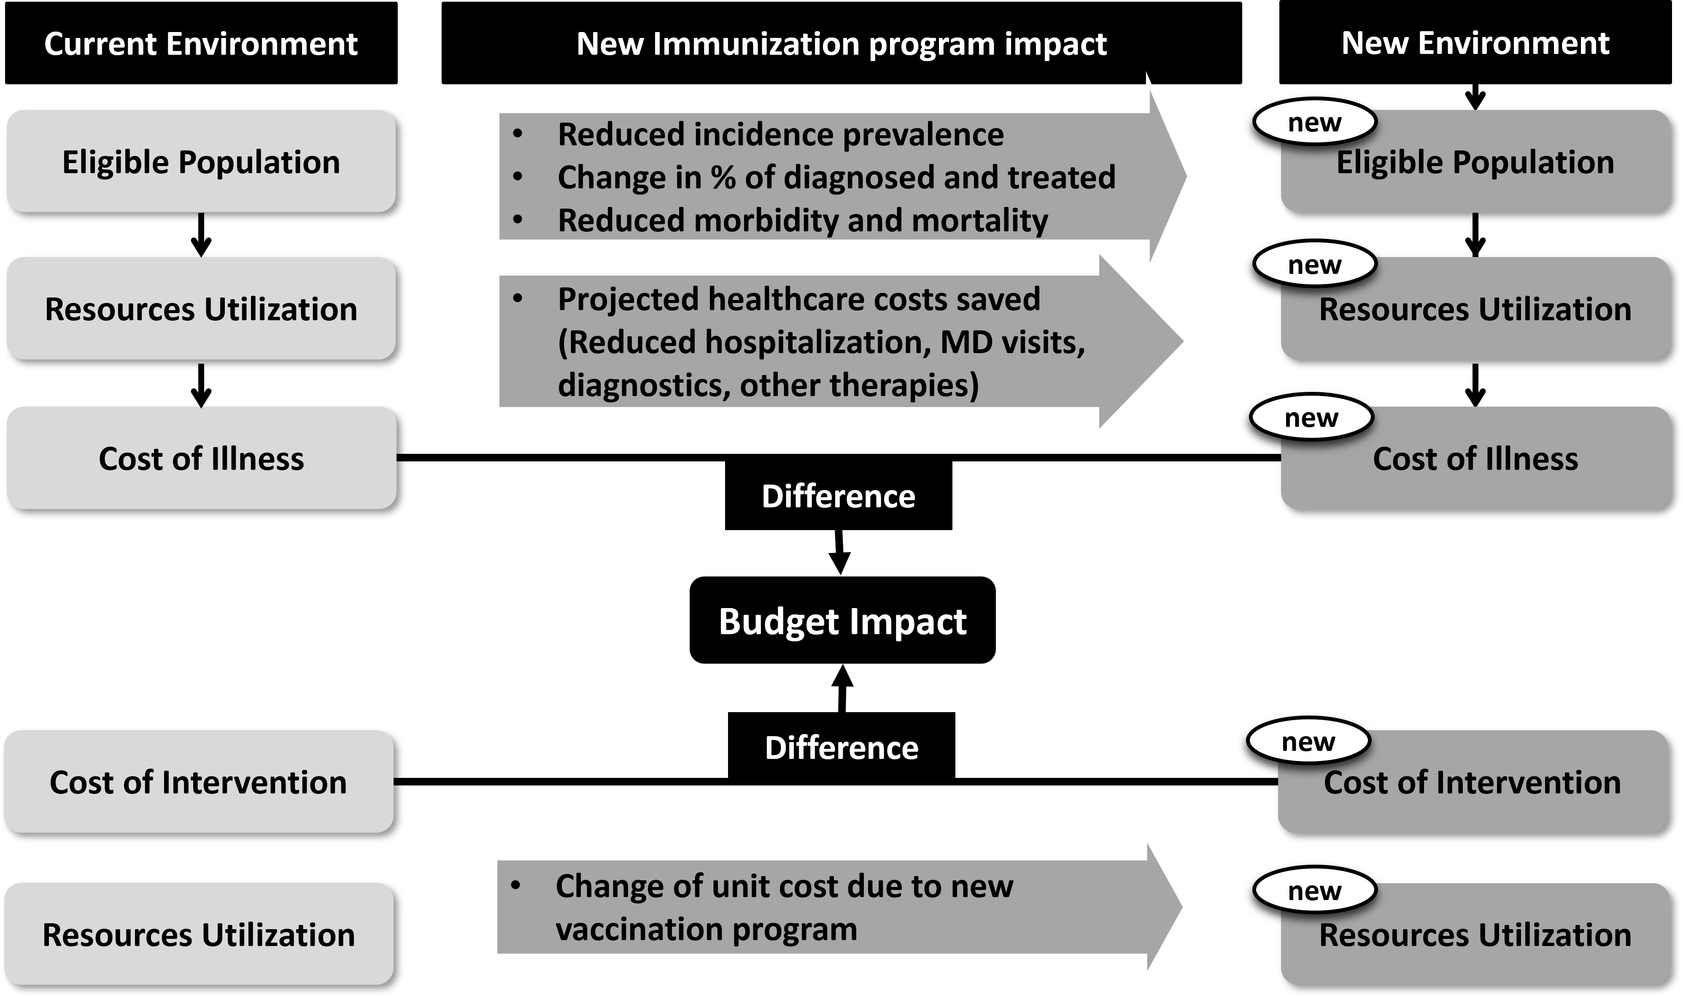
Budget Impact Analysis
Budget should be sought from local payer
Presented as cost of vaccination, and the projected healthcare costs saved
May be more relevant to policy makers
Shows change in budget over years
Adapted from
Source: Sullivan, et al. Budget Impact Analysis Good Practice II. https://doi.org/10.1016/j.jval.2013.08.2291
Costing Studies and Budget Impact Analysis

Slide 46
Costing case study
This case study will walk through an example of estimating the costs associated with a vaccination program.
Consider an example of a country that is graduating through the accelerated transition phase of GAVI support in 2025, and is expecting to fully self-fund its immunization program from 2029 onwards (Increasing 10% each year).
To ensure the sustainability of the program, the country is seeking a way to optimize the budget allocation of the existing rotavirus (RV) program. Currently in the national immunization program (NIP) is Rotasiil (Serums Institute, India) 3 dose (2 doses per vial). You can also consider a scenario where only Rotasiil 1 dose per vial is available.
Costing Case Study

Slide 47
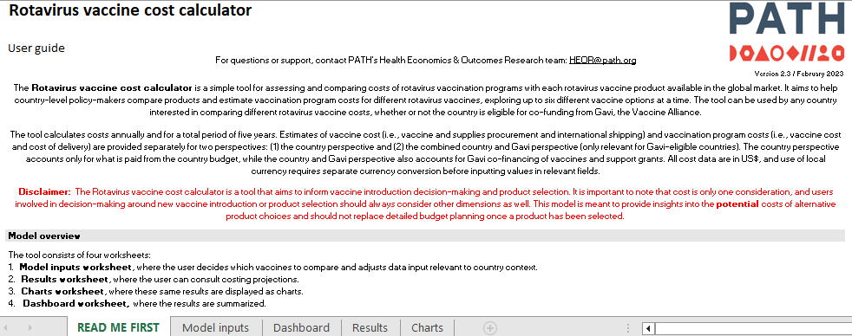
Costing case study
The PATH cost calculator tool can be useful to provide vaccination program cost over a 5-year time frame
https://www.path.org/our-impact/resources/rotavirus-vaccine-cost-calculator/
Costing Case Study
Notes:
Instructor to specify that this is just intended to be an example of a tool, rather than encourage the use of this specific tool.
The instructor should emphasize this PATH cost calculator is more for comparison of different vaccine products, but not ingredients approach for vaccine delivery costing.

Slide 48
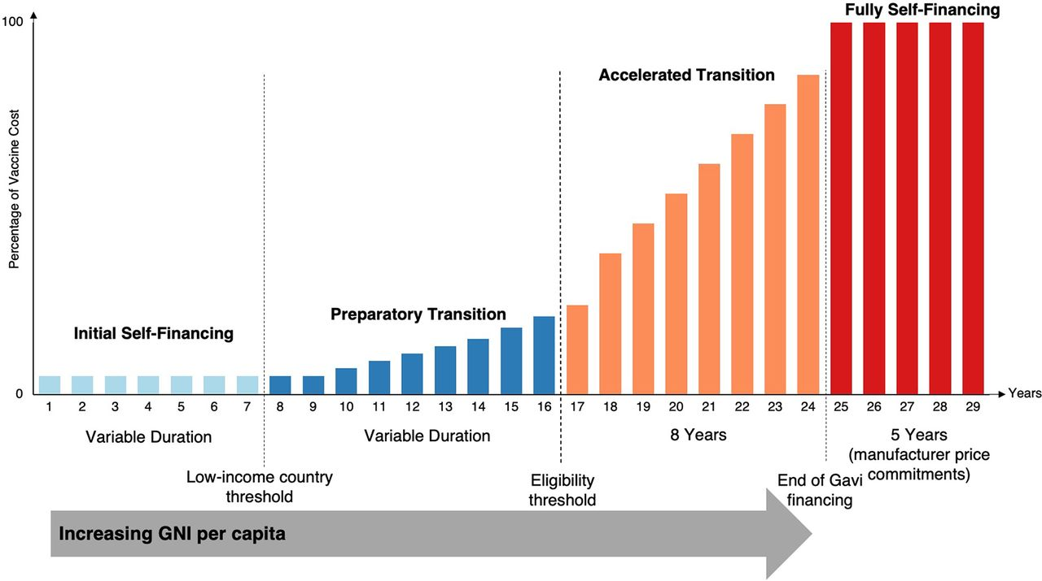
Source: Kolesar RJ, Tsheten T. Evaluating country performance after transitioning from Gavi assistance: an applied synthetic control analysis. Global Health: Science and Practice. 2023 Aug 28;11(4).
Costing Case Study
Notes:
Kolesar RJ, Tsheten T. Evaluating country performance after transitioning from Gavi assistance: an applied synthetic control analysis. Global Health: Science and Practice. 2023 Aug 28;11(4).

Slide 49
Case study - RV cost calculator model inputs I
Variable | Value | Sources
Start year | 2025
Target population | 400,000
Annual population growth rate | 1.40%
Expected coverage dose 1 | 87%
Expected coverage dose 2 | 83%
Expected coverage dose 3 | 78%
Co-financing and financial support | Country fraction
2025 | 60%
2026 | 70%
2027 | 80%
2028 | 90%
2029 | 100%
Costing Case Study
Notes:
For facilitator: To discuss potential values for each variable, and possible sources for each
Key Assumptions
The country will assume 10% increase in financing each year from 2025 (accelerated transition phase)
The country will still access the Gavi price through UNICEF procurement but will not be eligible for subsidisation by the end of the transition

Slide 50
Case study - RV cost calculator model inputs II
Vaccines price | ROTASIIL Thermo 2 dose/vial, lyophilised (VVM + 250) | ROTARIX 1 dose/plastic tube, liquid (multi-monodose of 5 single tubes connected by a bar) | ROTAVAC 5 doses/vial, frozen | ROTASIIL Thermo 1 dose/vial, lyophilised (VVM + 250)
 | $1.25 | $1.79 | $0.70 | $1.85
No. of doses in schedule | 3 | 2 | 3 | 3
Cold chain vol./dose (cm³) | 10.50 | 11.80 | 4.20 | 17.60
Wastage rate | 9% | 4% | 5% | 4%
International handling | 5% | 5% | 5% | 5%
International transportation | 7% | 7% | 7% | 7%
Safety box/bag price | $0.80 | $0.80 | $0.80 | $0.80
Safety box/bag volume | 100 | 100 | 100 | 100
One-time intro/switch costs | $0.00 | $0.00 | $0.00 | $0.00
Incr. delivery cost/dose | $1.00 | $1.00 | $1.00 | $1.00
Costing Case Study

Slide 51
Case study - Results
Over a 5-year time horizon:
Switching from current option ROTASIIL Thermo to ROTARIX will lead to savings of $2,306,935
Switching from current option ROTASIIL Thermo to ROTAVAC will lead to savings of $2,920,442
Switching from current option ROTASIIL Thermo 2 dose to ROTASIIL Thermo 1 dose will lead to additional spending of $2,538,283
Costing Case Study
Notes:
For facilitator – these are example results that could be updated in real time depending on values and sources used.

Slide 52
Case study - Interpretation
How could this information be useful? What might we need to know next?
What are the main drivers of the differences in costs between the vaccine options?
What costs might be missing?
Costing Case Study
Notes:
First discuss in small groups – then as a whole group.
Answers:
(1) For Facilitator to stress how this information could be used:
-to plan budgets
-to help with justifying changes in schedule
-as a starting point to think about whether extra value of vaccines are worth extra cost. How much benefit would we need to achieve for an additional $2.5m to be worth it for example, how many lives or hospitalisation would need to be saved to make this worthwhile?
(2): Vaccine price; Wastage rate; Differences in cold chain requirements
(3) Switch costs; Cold chain improvements? Any costs associated with differences in outcomes (not a budget impact)

Slide 53
Case study - Interpretation II
Is this information enough to make a recommendation to switch between different options ?
What other information will you need to make a recommendation?
Costing Case Study
Notes:
Many possible answers including:
What proportion of total immunisation budget are these costs?
How feasible is switch?
What are training, and other requirements?

Slide 54
Introduction to
Economic Evaluation

Slide 55

WHO Guide on Standardization of Economic Evaluations
Economic evaluation of immunisation programmes is becoming increasingly important due to the growing number of vaccine options and high costs of newer vaccines.
Vaccine-preventable diseases have special characteristics that need to be adequately taken into account in economic evaluations.
WHO guidelines on economic evaluations of immunization programmes are being updated to reflect changes in WHO thinking as well as methodological developments in the vaccine and economics world
https://www.who.int/immunization/newsroom/news_guidance_stadard_economic_eval_imm_programmes/en/
Introduction to Economic Evaluation

Slide 56
Recall:
Different economic tools answer different questions
What are the monetary consequences of the intervention?
Is the intervention cost-effective? Are the additional costs worth the outcomes?
Intervention versus comparator
What are the costs associated with disease?
Intervention versus comparator
No intervention
What is the cost of an intervention?
One intervention
“The cost of the vaccine program is $15 per vaccinated girl.”
“Vaccination costs $2 million a year but will save the health system $500,000 a year.”
“Vaccination costs $10,000 per death prevented.”
Costs only
Costs only
Costs and outcomes
Costs only, including costs associated with outcomes
“The cost of disease is estimated at $1.3 billion.”
Costing study (Cost of illness)
Economic burden
Costing study
(Intervention cost)
Cost composition
Budget impact analysis
Affordability
Sustainability
Full economic evaluation
Value for money
Efficiency
Costing Studies and Budget Impact Analysis

Slide 57
Economic evaluation
Is the change in costs justified by the change in outcomes?
What is the value for money, or cost-effectiveness, of an intervention (relative to a comparator)?
Health burden
Cost of Intervention
Cost of illness
Health burden
Cost of illness
Further reading
Turner HC, et al. An Introduction to the Main Types of Economic Evaluations Used for Informing Priority Setting and Resource Allocation in Healthcare. Frontiers in Public Health. 2021;9. doi:10.3389/fpubh.2021.722927
No Intervention
Intervention
Introduction to Economic Evaluation

Slide 58
Questions that economic evaluation can answer:
Are the (health) benefits worth the additional costs of the intervention?
Is the intervention good value for money?
Is the intervention cost-effective?
What is the cost-effectiveness of the intervention?
Introduction to Economic Evaluation

Slide 59
Cost-effectiveness Analysis
Compares costs and outcomes of two or more interventions
Outcomes are natural (health) units (e.g., cases of disease or deaths)
Results can be presented as:
  (Incremental) Cost per additional fully vaccinated child
  Cost per infection averted
  Cost per death averted
  Cost per vaccine delivered
Difficulty in comparing across diseases
Hard to know how much countries are willing to pay per outcome
Introduction to Economic Evaluation
Notes:
A cost-effectiveness analysis is a type of economic evaluation which considers outcomes of the intervention and comparator in natural units. The cost of illness and cost of intervention are considered, as well as the health burden in both the intervention and comparator scenarios.
These natural units of “outcome” could be how many children were vaccinated, the infections averted, the number of lives that the vaccine saved, or the number of vaccines delivered.
The results of the cost effectiveness analysis could be cost per life saved or cost per infection averted. Through these measures we could compare two different vaccines and prioritise depending on which has the smaller cost per outcome achieved.

Slide 60
Cost Utility Analysis (CUA)
Type of cost-effectiveness analysis​
Compares costs and outcomes of two or more interventions
Outcomes measured using health adjusted years of life which capture both morbidity (quality of life) and mortality (length of life)
Results can be presented as:
  (Incremental) Cost per quality-adjusted life year (QALY) gained
  (Incremental) Cost per disability-adjusted life years (DALY)​ averted
QALYs and DALYs can be compared across disease areas
Countries may have an indication of how much they are willing to pay per QALY gained/DALY averted
Introduction to Economic Evaluation
Notes:
Cost utility analysis is a special case of cost-effectiveness analysis. Here the “outcomes” also consider health related quality of life. Through this measure we can compare both the quality and quantity of life between an intervention and comparator. We consider this health-related utility.

Slide 61
Relationship between QALYs and DALYs
QALYs represent healthy years of life in full health (we want to maximize QALYs)
DALYs represent lost years of life and time spent with illness (we want to minimize DALYs)
Profile with intervention
1 QALY = 0 DALY
Quality or disability weight
DALYs lost from disease/QALYs gained by intervention
Profile without intervention
1 DALY = 0 QALY
Life years lived
Introduction to Economic Evaluation
Notes:
Reminder
QALY = Quality Adjusted Life Year
DALY = Disability Adjusted Life Year
CUA = Cost Utility Analysis

Slide 62
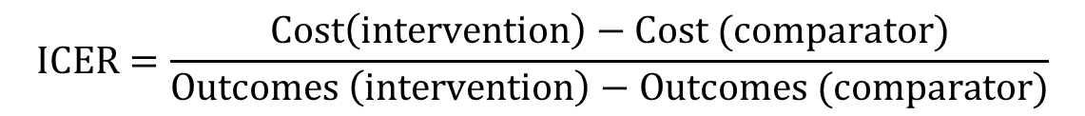
Incremental Cost Effectiveness Ratio (ICER)
Example of a vaccine program compared with no vaccine
Cost of vaccination program Cost of illness with no vaccination + Cost of illness with vaccination
Deaths or cases of disease or Deaths or cases of disease or DALYs/QALYs with vaccination DALYs/QALYs with no vaccination
$$ICER=\frac{Cost\left(intervention\right)−Cost (comparator)}{Outcomes \left(intervention\right)−Outcomes (comparator)}$$
Introduction to Economic Evaluation
Notes:
The incremental cost effectiveness ratio forms the backbone of cost effectiveness and cost utility analysis. Through this ratio, health economists can determine the overall costs and benefits (health outcomes) of an intervention compared to a comparator.
In this example we compare a situation where a country doesn’t have a vaccine to a situation, to one where a vaccine has been introduced.
In the comparator situation (without a vaccine) there is a high cost of illness and a high burden of illness.
In the intervention (vaccine program) there is a smaller cost of illness due to reduced medical costs, however there is also high costs from a vaccine program. The ICER also considers morbidity and mortality measures, estimated in disability adjusted life years.

Slide 63
Interpreting CEA/CUA findings:
Cost-effectiveness plane
Cost difference
CET = Cost-effectiveness threshold
+
NW – reduces health and costs more – “dominated”
NE – improves health but costs more –
is it worth it?
–
C
Effect difference
+
Quadrants of cost-effectiveness plane:
NE = Northeast
SE = Southeast
NW = Northwest
SW = Southwest
SW – reduces health but saves money – is it worth it?
SE - improves health and saves money – “dominates” or “cost-saving”
–
Introduction to Economic Evaluation
Notes:
This plane considers both costs and effectiveness of an intervention compared to a comparator. Costs on our Y axis and effectiveness on the X axis.
Effectiveness could be many measures such as infections averted, QALYs gained, or DALYs averted
In this diagram, the comparator labelled “C” forms the origin of the plane. When considering an intervention, there are four options:
An intervention could be more effective and cost less money than the comparator. In this instance, the intervention would “dominate” the comparator, and would be in the Southeast quadrant.
An intervention could be less effective and cost more money than the comparator. In this case, the intervention would be “dominated” by the comparator, and it lays in the northwest quadrant.
In both these instances, decision-making is easy! If the intervention is cheaper and more effective, we would fund, and if an intervention was more expensive and had worse health outcomes, we would not consider funding.
However, most often when considering a new vaccine, it will be more expensive and more effective than the comparator. It is here in our northeast quadrant where Economic Evaluation becomes particularly useful.
But how to decide if something is cost-effective? A country-specific threshold must be applied.
Here we introduced the concept of the threshold. The threshold represents a dollar per QALY value below which we believe is cost effective, and potentially worth funding.
Thresholds very by setting, thus having understanding of the local context is very important here.
If only funding interventions below this at threshold we are essentially trying to make the most of our Limited resources.
It is also important to note that this thresholds and the cost effectiveness outcome it’s not the only decision criterion.
Please note the decisions in the southwest quadrant will be addressed in further trainings

Slide 64
PCV example
 | Current situation (no vaccination program) | With vaccination program
Cost of illness | $1,500,000 | $500,000
Cost of intervention | $0 | $2,200,000
Total | $1,500,000 | $2,700,000
Cost difference | Vaccine program is $1,200,000 more expensive
Total QALYs | 4,000 | 5,000
Incremental QALYs | Vaccination program gained 1000 more QALYs than the current (comparator) scenario
ICER | $1,200,000 / 1,000 = $1,200/QALY gained
Introduction to Economic Evaluation
Notes:
Question 1: What information for you need to know if this estimate is cost effective in your country?
What if the cost of the vaccine program could be reduced to $1,000,000 – What would happen to the ICER?
Is this new ICER more, or less cost effective than the original?
What if the QALYs gained decreased from 1000 to 10 - What would happen to the ICER?
Is this new ICER more, or less cost effective than the original?

Slide 65
Cost effectiveness plane
Introduction to Economic Evaluation
-

Slide 66
Cost-effectiveness thresholds
Are the incremental benefits associated with the treatment good value for money given the incremental costs?
How do we answer this?
Compare the ICER to a country-specific cost-effectiveness (or willingness-to-pay) threshold
Historically cost-effectiveness thresholds were tied to 1-3 x GDP/capita. Now considered likely to be too high, particularly in lower-income settings, and thought to be context specific.
Further reading
Bertram et al. Cost–effectiveness thresholds: pros and cons. Bull World Health Organ. 2016. doi: 10.2471/BLT.15.164418
Introduction to Economic Evaluation
Notes:
Currently, WHO has no CE threshold recommendations

Slide 67
Cost effectiveness plane
CET: $2,000 / QALY gained
Introduction to Economic Evaluation
-
Notes:
This threshold represents the dollar per QALY value. If our ICER falls under this threshold, it is cost-effective and if it is over this this threshold it is not cost-effective.
At a cost-effectiveness threshold of $2000/QALY, the ICER of the vaccination is under the CE threshold implying it is cost effective.
What else should we consider?

Slide 68
Cost effectiveness plane
With a lower cost-effectiveness threshold
CET: $1,000 / QALY gained
Introduction to Economic Evaluation
-
Notes:
If the cost effectiveness threshold is $1000/QALY, the ICER of the vaccination strategy is over the CE threshold: it is not considered cost effective.

Slide 69
Use of cost-effectiveness results
Cost-effectiveness information should be used alongside other economic (e.g., budget impact, cost of intervention, affordability and financial sustainability) and non-economic considerations (e.g., acceptability, availability, political aspects) in a transparent, deliberative decision-making process (such as NITAG) rather than based on a single threshold value
Introduction to Economic Evaluation

Slide 70
Cost-effectiveness thresholds - considerations
Is there a country-specific cost-effectiveness threshold?
If not, consider relying on evidence from the literature on health opportunity costs
  Recall: opportunity costs – using the resources in their next best use
  Often tied to a percentage of GDP/capita
  Conduct sensitivity analyses using different threshold values
It is difficult to determine whether an intervention is cost-effective if no threshold
Other options: Compare ICER with that of other vaccines (or other healthcare interventions) that have been implemented (or not) in the country
Introduction to Economic Evaluation

Slide 71
Small group exercise (see Handout)
Consider the following scenario:
MoH has requested a recommendation on whether to introduce Rotavirus vaccine (RVV) into the routine immunization schedule.
Your NITAG is presented with results of a cost-effectiveness analysis of RVV introduction for your country, compared to the current status (no vaccination) to help inform your recommendation.
Introduction to Economic Evaluation
Notes:
Slides that follow show an example of Rotavirus Vaccine. Other options can be considered by NITAGs to walk through as an exercise.
(PCV, RSV, HPV)

Slide 72
Interpreting the ICER
 | Current situation (no vaccination program) | With vaccination program
Cost of illness | $2,000,000 | $500,000
Cost of intervention | $0 | $5,000,000
Total | $2,000,000 | $5,500,000
Cost difference | Vaccine program is $3,500,000 more expensive
Total DALYs | 4,000 | 1,000
DALYs averted | Vaccination program averts 3000 more DALYs than the current (comparator) scenario
ICER | $3,500,000 / 3,000 = $1,166.67/DALY averted
Introduction to Economic Evaluation
Notes:
Step 1: Calculate incremental costs, and incremental DALYs

Slide 73
Interpreting RV ICER
CET: $1,500 / DALY averted
CET: $750 / DALY averted
Introduction to Economic Evaluation
Notes:
Compared to your countries 0.5x GDP per capita threshold, is the ROTAVAC vaccine cost effective? Plot this on the Cost-Effectiveness Plane.
At the CET of $1500 per DALY averted (1xGDP per capita), RV vaccination appears to be cost effective, as it falls below this threshold ($1166/DALY).
At the CET of $750 per DALY averted (0.5xGDP per capita), RV vaccination appears to NOT be cost effective, as it is above this threshold ($1167/DALY).
For Trainer: Further interpretation question for consideration: If CET = $750, what might make this vaccine cost-effective in your setting? Lowered price of vaccine; less wastage (Almost everything an be cost effective if the price is low enough)

Slide 74
Additional resources and takeaways

Slide 75
Understanding expectations and feasibility around economic analyses
Recommendations target final decision-makers
NITAG bases recommendations on evidence
Understanding decision-makers' needs and expectations
Aligning evidence with decision-making rules in the country
Choosing data and indicators that resonate with decision-makers
Additional resources and takeaways
Notes:
The expectations of the decision-makers and the local setting should therefore, among other elements, guide the definition of the question to address, and help to select:
The type of economic analysis to conduct. For instance: If fiscal space is very small and/or budget negotiations are very tight, it is likely that the monetary consequences (BIA) are of primary importance.
If the country routinely uses economic evaluation with a threshold under which interventions are seen as cost-effective and usually implemented, NITAG should in priority consider a Cost-Utility Analysis.
Specific indicators to consider in the analysis. For instance, the number of hospitalisations prevented (thanks to vaccination) will be more relevant in a setting where hospital under capacity is a key issue.

Slide 76
Final points around economic evidence for vaccine recommendations
Economic aspects may be included alongside other criteria considered within recommendation framework
Not all NITAGs consider economic evidence in the recommendation process
It is the responsibility of the NITAG to consider whether it is relevant to include economic aspects in the recommendation framework related to the topic under discussion
NITAGs should also consider what sort of economic evidence is relevant to the local context and policy question (e.g. cost-effectiveness analyses can answer different questions to a budget impact analysis)
Additional resources and takeaways

Slide 77
Resources and next steps
GNN Training Module: Vaccine Economics for NITAGs – Handouts
  Key Definitions
  Key References and relevant resources list (also includes resources relevant to Advanced training module – see below)
GNN Training Module: Vaccine Economics for NITAGs – Advanced Module
Additional resources and takeaways
Notes:
Trainer to emphasize caveat with list of tools/resources provided – some correspond to the Advanced Module

Slide 78

Post-module Quiz
Let’s test what you’ve learned from this training
https://q.surveys.unimelb.edu.au/jfe/form/SV_eWmu6FCqYYVW9Om?Q_CHL=qr
Notes:
https://q.surveys.unimelb.edu.au/jfe/form/SV_eWmu6FCqYYVW9Om?Q_CHL=qr

Slide 79
Thank you

