Slide 1



VPOP – Introductory module

Slide 2
Executive summary
The rapid expansion of vaccine options, combined with declining global and domestic funding for immunization, is increasing the complexity and urgency of vaccine-related decision-making for countries
In March 2025, WHO’s Strategic Advisory Group of Experts on Immunization (SAGE) called on countries to consider both the prioritization of future new vaccine introductions and the optimization of existing immunization schedules and portfolios, using structured and evidence-informed approaches
Prioritization and optimization serve distinct but complementary purposes:
Prioritization guides decisions on which new vaccines to introduce and how to sequence them
Optimization strengthens the performance, efficiency and sustainability of vaccines already in use through adjustments to products, schedules, presentations or delivery strategies
Both processes are jointly led by National Immunization Technical Advisory Groups (NITAGs) and Expanded Programme on Immunization (EPI) teams, promoting national ownership
Both approaches are underpinned by multi-criteria decision analysis (MCDA) and guided by shared principles of transparency, evidence use, adaptability and iteration
The processes follow a common three-phase structure:
Framework adaptation (scope, questions, criteria)
Appraisal and sequencing using evidence and deliberation
Recommendations and documentation for policy and planning.
Key outputs differ by process:
Prioritization outputs include evidence-based rankings of candidate vaccines and recommended introduction sequencing scenarios
Optimization outputs include a set of preferred options for each optimization question and a sequenced roadmap for implementing portfolio changes
A holistic approach integrating prioritization and optimization improves feasibility, sequencing and sustainability of immunization investments and aligns naturally with National Immunization Strategy (NIS) development, budgeting and other planning cycles, while remaining responsive to fiscal, programmatic and global policy triggers
Dedicated tools support implementation, including the NVI-PST for prioritization and tailored optimization tools for portfolio review, criteria selection and sequencing

Slide 3
Glossary
Term | Definition
Booster Dose | Additional dose given after the primary series to sustain or enhance immunity
Candidate Vaccines | Vaccines being considered for future introduction as part of a prioritization exercise
EPI (Expanded Programme on Immunization) | The national program responsible for implementation, monitoring, and optimization of immunization schedules
MCDA (Multi-Criteria Decision Analysis) | A structured method for comparing options using multiple evidence-based criteria
NIS | National Immunization Strategy
NITAG (National Immunization Technical Advisory Group) | Independent expert body providing evidence-based recommendations on vaccine prioritization
Optimization process | Systematic structured process of improving performance, efficiency and cost-effectiveness of immunization services through changes in vaccine products and vaccination schedules
Optimization Change | The option selected for an optimization question when it differs from the current practice or configuration within the national immunization programme (e.g. switch of product, change of schedule)
Optimization Options | The possible solutions to an optimization question, assessed against criteria like cost, feasibility, and impact
Optimization Question | A specific issue raised during a portfolio review that requires appraisal (e.g., add a booster, switch a product)
Portfolio Review | Comprehensive assessment of all vaccines and schedules currently in a program, serving as the starting point for optimization
Prioritization process | Systematic structured process of identifying, assessing, and ranking new or upcoming vaccines for possible introduction
Product Switch | Transition from one vaccine product to another
Schedule Adjustment | Modification to timing, frequency, or combination of doses
Sequencing | Ordering implementation of prioritized interventions (vaccine introductions and/or) switches over time, ensuring feasibility within financial and programmatic limits

Slide 4
Agenda
Why: rationale and purpose
1
What: core concepts and benefits
2
When: triggers for action
3
How: principles and process
4
Configuration 1: focus on prioritization
5
Configuration 2: focus on optimization
6
Configuration 3: doing prioritization and optimization
7

Slide 5
The multiplication of vaccine options and the global decrease of funding negatively impacts vaccine-related decision-making
Under pressure, immunization programs are forced to make biased, fragmented and reactive decisions
Global Public Health Megatrends
Strong decrease in global funding (from 30% to 40% between 2023 and 2025) with increased public health pressure due complex agendas
Ambitious objectives, including on introductions of new vaccines, in a context of stagnating DTP coverage
Global
Global funding decrease
Complexification of agendas
Diversification of vaccine options
Program performance stagnation
Emerging diseases/outbreaks
Increased pressure on immunization programs
Do more with less to improve the value for money of EPI: countries need to rely less on external funding and need to prioritize
Improve coverage and program efficiency while maximizing heath impact and disease control
Financial
Operational
Political
Poor decision-making
Unsustainable programs due to overly ambitious roadmaps hindering ability to deliver and creating competition for resources
Limited evidence-based recommendations underlying key immunization decisions
Reactive priority setting limiting strategic and longer-term planning
Unsustainable
Fragmented
Backwards
Reactive
Biased
Country

Slide 6
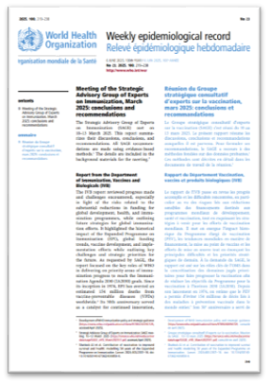

In March 2025, WHO SAGE called on countries to consider prioritization of future NVIs and optimization of their schedules and portfolios
“In the context of an increasing number of available vaccines, SAGE emphasized that each country should be empowered to prioritize these vaccines (…). These decisions should be made using a systematic, country-owned process based on the local context.”
SAGE called on countries to engage their NITAG in providing recommendations on the prioritization of new vaccines for introductions and optimization of vaccination schedules and portfolios in close consultation with their respective national immunization programmes.
These recommendations need to be aligned and integrated with the priorities in their NIS and health sector strategy and regularly updated”
Meeting of the Strategic Advisory Group of Experts on Immunization, March 2025: Conclusions and recommendations​

Slide 7
SAGE recommendation encourages countries to rely on a structured process to review and conduct evidence-based prioritization and optimization
Under pressure, immunization programs are forced to make biased, fragmented and reactive decisions
Using a country-owned process helps topple the pyramid to strengthen immunization strategic planning (prioritization & optimization)
Global feedback loops
Global Public Health Megatrends
Market signals
Product preferences
Funding needs
Increased pressure on immunization programs
Optimized strategic-planning
Comprehensive planning
Financial sustainability
Programmatic improvements
Embedded in NIS, strategic planning and budget cycles
Poor decision-making
Evidence-based recommendations
Country-owned
Country-specific
Unbiased
Structured process
Proactive
Comprehensive
Country led

Slide 8
Agenda
Why: rationale and purpose
1
What: core concepts and benefits
2
When: triggers for action
3
How: principles and process
4
Configuration 1: focus on prioritization
5
Configuration 2: focus on prioritization
6
Configuration 3: doing prioritization and optimization
7

Slide 9


Optimization and prioritization serve different purposes: the former shapes the future vaccine pipeline, while the latter strengthens today’s portfolio
OPTIMIZATION
PRIORITIZATION
Improving the use of already introduced vaccines by adjusting products, schedules, presentations, or target groups to maximize the impact, efficiency, and coverage
Sequencing decisions on not yet introduced vaccines, determining which to introduce first or delay based on impact, feasibility, and resources
Decision to switch from PCV 13 to PCV 10 in the context of the new PCV product tender in 2024
2025 recommendation by a NITAG to introduce hexavalent, followed by rubella, M5CV and RSV
Examples

Slide 10
In practice, prioritization and optimization both involve the EPI and the NITAG, with both processes complementing each other
OPTIMIZATION
PRIORITIZATION
What does it cover? | Reviewing products, schedule, targets, presentation, use/administration, serogroup coverage | Prioritizing and sequencing vaccines (antigens) to be added to the routine immunization schedule
What is not included? | Trade-offs of delivery modes (campaign vs. routine) | Campaign-only vaccine introductions
What are the expected benefits? | Programmatic improvement (coverage, vaccine wastage, cold chain, patient/HR experience) Program cost aligned with fiscal space and optimized value for money (allowing for potential reinvestment) Inform strategic planning Secured and sustainable access to vaccine Better disease control | Adequation of immunization program to country context, priorities and national goals Maximized health impact Improved planning and coordination (realistic introduction pace) Early alignment on financial and supply implications to guarantee feasibility
Who should do it? | EPI & NITAG (adapting to national context) | EPI & NITAG (adapting to national context)
What is the time horizon considered? | Short to medium term (1 to 5 years) | Medium to long term (5 to 10 years)

Slide 11


Examples of policy questions
Example of policy questions
Prioritization
Optimization
Why?
Should the country switch from PCV13 to PCV10? When?
Reducing valency to reduce cost on an already introduced vaccine
Should we switch from measles only to measles-rubella (MR) vaccine? When?
Adding a new vaccine and antigen, simply combined with a preexisting one
Should we introduce typhoid conjugate vaccine (TCV) in place of the polysaccharide vaccine used during outbreaks? When?
Introduction of a new antigen in the routine calendar
Should we replace the current DTP+IPV vaccines with a hexavalent vaccine? When?
Combining already introduced vaccines into the same vaccine
Should we move from 10-dose MCV vials to 5-dose vials? When?
Changing presentation to an already introduced vaccine to achieve higher coverage
Should we add booster doses of DTP-containing vaccines? When?
Adding a dose to an already introduced vaccine to achieve better disease control
Should we introduce the malaria vaccine as part of the routine EPI schedule in 2026?
Introducing a new vaccine in the routine schedule
Should the country introduce multivalent meningitis conjugate vaccine (MMCV / Men5CV)? When?
Prioritization if no Men vaccine in program, optimization if MenA already introduced

Slide 12




A holistic approach that integrates vaccine prioritization and optimization brings several operational, financial, and strategic advantages
OPTIMIZATION + PRIORITIZATION
Joint planning and improved coordination for a balanced roadmap
Synchronization between new introductions and ongoing program improvements, ensuring feasibility within existing system capacities
Recommendations for realistic and sequenced roadmaps that are practical, costed, and aligned with national immunization goals
Reduced duplication of planning efforts across NITAG, EPI, and partners
Facilitating informed trade-offs
A holistic process for trade-off discussions relying on MCDA deliberative approach and weighing potential health impact, cost, feasibility, and equity across interventions
Transparent assessment of which vaccines or optimizations yield the greatest value for resources invested
Improved and justified sequencing decisions, consensus building
Comprehensive
budget planning
Budget impact analysis of NVI and optimization opportunities
Potential reinvestment of savings from optimization into new introductions or system strengthening
Alignment with NIS and broader prioritization of immunization and health interventions
Optimized
interactions
Understanding the impact of decisions on the broader system workload, cold chain, training, and data systems
Integration of NVI in the context of existing schedules and delivery structure
Consider opportunities e.g to align contact / delivery points
Optimization of existing programs can make future introductions smoother and more efficient beyond just costs, e.g. by decrowding 1YL schedule

Slide 13
Agenda
Why: rationale and purpose
1
What: core concepts and benefits
2
When: triggers for action
3
How: principles and process
4
Configuration 1: focus on prioritization
5
Configuration 2: focus on optimization
6
Configuration 3: doing prioritization and optimization
7

Slide 14






Many potential triggers can lead countries to launch optimization or prioritization work
Strategic planning
NIS preparation
NIS Update
Funding
New budgeting/funding cycle (e.g. Gavi holistic grant application)
Procurement
Tender
Tender
Operational
EPI review
EPI review
EPI review
Global events
New SAGE Recommendation
New GAVI policy
New vaccine / PQ
New product
PRIORITIZATION
OPTIMIZATION
Full prioritization exercise
Prioritization update
Portfolio review
Vaccine-specific review
Recommended
Optional

Slide 15
Both prioritization and optimization fit naturally into broader strategic and budget planning, such as the NIS
Strategic planning
NIS preparation
NIS update
Funding
New budgeting/funding cycle (e.g. GAVI holistic grant application)
Procurement
The NIS preparation phase is the most appropriate time to conduct full prioritization and optimization exercises, aligning the timeframe with the NIS time horizon. Evidence and information on potential future EPI constraints can be drawn from the “Situational Analysis” of the NIS. The outcomes of the prioritization and optimization exercises should then inform the Strategy Development, Resource Estimates and Budget Dialogue.
Tender
Tender
Operational
EPI review
EPI review
EPI review
Global events
New Sage Recommendation
New GAVI policy
New vaccine / PQ
New product
Ideally, the budgeting and strategic planning cycles should be aligned. If they are not, countries should ensure decisions on optimization and prioritization are closely linked to budgeting, fiscal space and sustainability considerations
PRIORITIZATION
Any intermediary update can serve as an opportunity to update and refine the recommendations made during the full exercise.
OPTIMIZATION
If these processes have been carried out recently, a simple update can be made using the most recent available information.
Full prioritization exercise
Prioritization update
Portfolio review
Vaccine-specific review
Recommended
Optional

Slide 16
At the same time, specific triggers may justify initiating one or the other outside of the usual planning cycle
Strategic planning
NIS preparation
NIS Update
Funding
New budgeting/funding cycle (e.g. holistic grant application)
Procurement
Tender
Tender
Operational
EPI review
EPI review
EPI review
Global events
New Sage Position Paper
New GAVI policy
New vaccine / PQ
Regular EPI reviews offer a good opportunity to assess program performance. They can highlight issues such as coverage gaps, supply challenges, or changing population needs, which can trigger discussions on vaccine optimization to enhance efficiency and impact
PRIORITIZATION
Tenders provide an opportunity to assess market options, pricing, and program needs, helping ensure that procurement decisions support efficient and sustainable vaccine use
OPTIMIZATION
Full prioritization exercise
Prioritization update
Portfolio review
Vaccine-specific review
Recommended
Optional

Slide 17
Global events can also trigger an update of prioritization and/or optimization outcomes
Strategic planning
NIS preparation
NIS Update
Funding
New budgeting/funding cycle (e.g. holistic grant application)
Procurement
Tender
Tender
Operational
EPI review
EPI review
EPI review
Global events
New SAGE Recommendation
New GAVI policy
New vaccine / PQ
New product
The release of a new SAGE position paper or SAGE recommendation can prompt a review of national policy to ensure alignment with global recommendations and identify opportunities for vaccine optimization or prioritization. Example: SAGE concluded that 3-dose schedule of Hexavalent is adequate
When a new vaccine enters the market and/ or a new vaccine is prequalified, it offers a chance to review existing routine schedule and potentially introduce this new vaccine. Example: prequalification of Malaria vaccines in 2022-23
PRIORITIZATION
A new Gavi policy, or funding window can trigger a reassessment of national priorities and related funding opportunities. Example: GAVI removing the 80% coverage on Measles condition to access Measles-Rubella funding in 2025
The availability of a new product—different, presentation, or manufacturer—can prompt evaluation of costs, logistics, and program suitability.
Example: New HPV2 vaccine available
OPTIMIZATION
Full prioritization exercise
Prioritization update
Portfolio review
Vaccine-specific review
Recommended
Optional

Slide 18
Agenda
Why: rationale and purpose
1
What: core concepts and benefits
2
When: triggers for action
3
How: principles and process
4
Configuration 1: focus on prioritization
5
Configuration 2: focus on optimization
6
Configuration 3: doing prioritization and optimization
7

Slide 19

NITAGs and EPIs need to work together to deliver on-point prioritization and optimization recommendations
 | EPI | NITAG
In general | Assess program performance (coverage, equity, CCE, HR, parent satisfaction, vaccination hesitancy) Plan and implement immunization strategies and service delivery Allocate and optimize resources within national plans and budgets Set operational priorities (campaigns, logistics, outreach) Communicate with immunization stakeholders | Review evidence and data (burden of disease, cost-effectiveness, safety) Develop and recommend policies for vaccine introduction and use Formulate independent, transparent recommendations to MoH and EPI
Prioritization / optimization | Act as NITAG secretariat Help with workshops and logistics Lead data collection Share programmatic constraints and uncertainties (including budget impact analysis) Draft documents | Support data collection Facilitate workshops Prioritize options and propose sequencing Review and finalize documents
TECHNICAL ASSISTANCE

Slide 20

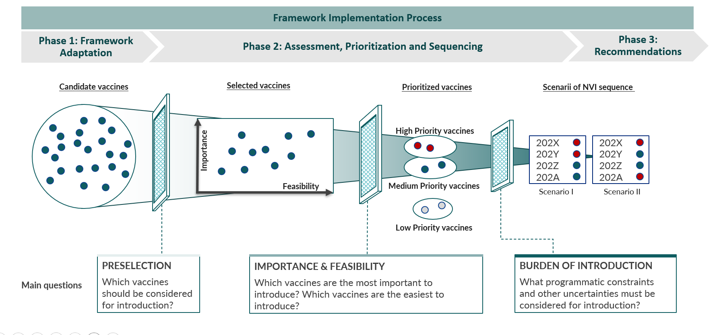

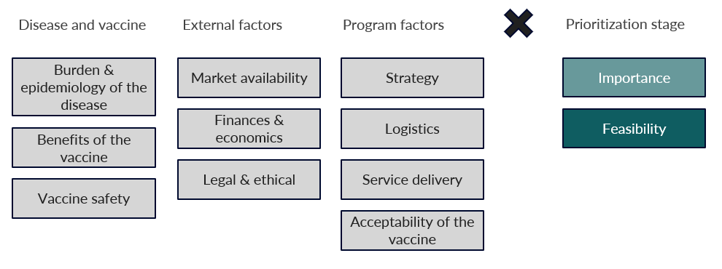

Both approaches are underpinned by MCDA, ensuring structured and transparent decision-making
Immunization decisions often involve trade-offs — MCDA helps weigh multiple factors transparently
Example: NVI-PST process
Prioritization funnel
Criteria categories (72 criteria)
Multi-Criteria Decision Analysis (MCDA) combines quantitative and qualitative evidence to support complex health decisions
It helps compare options across various criteria representing trade-offs: health impact, cost effectiveness, market dynamics, programmatic feasibility, etc.
MCDA relies on a simple approach
Define question
Select options & criteria
Score or rank
Aggregate results
Deliberate and decide
As a result, it improves transparency, consistency, and stakeholder engagement in immunization decision-making

Slide 21
These frameworks are guided by overarching principles: keeping the process simple, evidence-based, adaptable, and iterative
Evidence-responsiveness
Decisions on sequencing are often influenced by national and international agenda and can rely on opinions rather than facts
This framework relies on use of best available measurable evidence to ensure consistency of decision-making through time
Simple
Existing tools and processes either refer to overabundant criteria or to no criteria at all
This framework refers to a limited number of criteria for the NITAG to select the most relevant ones
The selected criteria should allow the NITAG to answer simple but crucial questions.
Comprehensive & adaptable
Decisions regarding vaccine introductions are often taken antigen by antigen and with different processes based on the nature of the decision
This framework is designed to be comprehensive, with a systematic portfolio lens and applicable to all countries
Country-owned & consensus-based
To allow for better appropriation by countries, the frameworks will be discussed and adapted by the national structures (NITAG, EPI)
Recommendations are formed based on votes and concertation of the NITAG and EPI, not individual decision
Iterative
Current decision-making on NVI sequencing is done on a reactive basis
This exercise can be conducted by the NITAGs on a recurring basis to ensure adaptation to evolving research and markets

Slide 22
Each process follows three phases—framework adaptation, option ranking, and documentation—to ensure consistency
PHASE 1: FRAMEWORK ADAPTATION
PHASE 2: EVIDENCE COLLECTION, ASSESSMENT, SEQUENCING
PHASE 3: RECOMMENDATIONS
Workshop
1
Workshop
2
Process design and stakeholder engagement
Data collection
Validation and documentation
Objectives:
Define the core-team (EPI & NITAG), workplan and timelines
Engage relevant stakeholders in the process
Adapt the framework to country context, by defining the scope of work (vaccines to be considered, optimization questions, time horizon)
Adapt the framework to country priorities by defining the criteria used when assessing options
Objectives:
Collect, clean and synthesize evidence to facilitate review by the NITAG
Review evidence and rank options on selected criteria individually
Rank options across all criteria
Assess level of feasibility of all options
Sequence implementation of options (new vaccine introductions, vaccine switches, etc.) based on feedback from EPI
Objectives:
Document decisions/recommendations
Share decisions/recommendations and disseminate
Ensure decisions are integrated in strategic-planning documents

Slide 23
Depending on context, countries will follow one of three configurations, impacting scope and timeline
PHASE 1: FRAMEWORK ADAPTATION
PHASE 2: EVIDENCE COLLECTION, ASSESSMENT, SEQUENCING
PHASE 3: RECOMMENDATIONS
Workshop
1
Workshop
2
Process design and stakeholder engagement
Data collection
Validation and documentation
Prioritization
only
1
Around 2 to 4 weeks
Workshop ~1day
Around 3 months (possibly less)
Workshop ~2 days
Maximum 2 months
Optimization
only
2
Around 2 to 4 weeks
Workshop ~half day
1 to 3 months
(depending on no of questions)
Workshop ~1 day
(depending on no of questions)
Maximum 1 month
Prioritization
& Optimization
Around 2 to 4 weeks
Workshop ~1 to 2 days
3 to 4 months
Workshop ~3 days
Maximum 2 months
3
External technical assistance may also accelerate the timelines

Slide 24
Agenda
Why: rationale and purpose
1
What: core concepts and benefits
2
When: triggers for action
3
How: principles and process
4
Configuration 1: focus on prioritization
5
Configuration 2: focus on optimization
6
Configuration 3: doing prioritization and optimization
7

Slide 25
The process flows from the selection of vaccines/criteria to consider to the production of evidence-based prioritization and sequencing recommendations
Phase 1: Framework Adaptation
Phase 2: Assessment, Prioritization and Sequencing
Phase 3: Recommendations
1 month
3 months
2 months
Workshop
1
(1 day)
Workshop
2
(2 days)
Endorsement by Ministry of Health and integration into national program
Process design and stakeholder engagement
Data collection
Validation and documentation
Objectives:
Develop workplan and timeline
Engage key stakeholders
Define list of vaccines and the timeframe to be considered
Select criteria for decision-making
Plan for data collection
Objectives:
Collect and assess available data
Translate evidence into prioritizations using vaccine ranking
Explore programmatic constraints
Develop sequencing recommendations
Objectives:
Document actionable recommendations
Ensure consensus and consistency
Develop final recommendation materials
Output:
Prioritized and weighted criteria for decision-making
Preselection of vaccines to consider for introduction
Workplan to collect and prepare data for assessment
Output:
Prioritized vaccine lists for introduction (high, medium and low priority)
Scenarii for sequencing based on known constraints
Output:
Finalized recommendation shared with EPI and Ministry of Health

Slide 26
Governance rests with the NITAG, supported by the EPI and partners to ensure broad ownership
Phase 1: Framework Adaptation
Phase 2: Assessment, Prioritization and Sequencing
Phase 3: Recommendations
Workshop
1
Workshop
2
Process design and stakeholder engagement
Data collection
Validation and documentation
NITAG
(lead)
Lead and facilitate workshop 1 (NITAG chair)
Vote on criteria, vaccines, time horizon
Decide on criteria, vaccines, time horizon
Support data collection (in working groups)
Review evidence and rank vaccine for each criteria
Define priority lists for selected vaccines
Propose scenarios for new vaccine introduction sequence
Formulate additional recommendations
Review and validate recommendations document
Present to stakeholders (MoH, ICC)
EPI
(support)
(If secretariat) Reviews methodology and NVI-PST docs
(If secretariat) Prepare online form and document for workshop 1
(If secretariat) Prepare short overview on proposed vaccines
Prepare data collection
Lead data collection (consolidate, clean, synthesize evidence)
(If secretariat) Prepare document for workshop 2
Share programmatic constraints
Provide feedback on proposed scenarios
Draft recommendations document
Liaise with key stakeholders
Translate recommendations in strategic-planning documents (NIS, etc.)

Slide 27


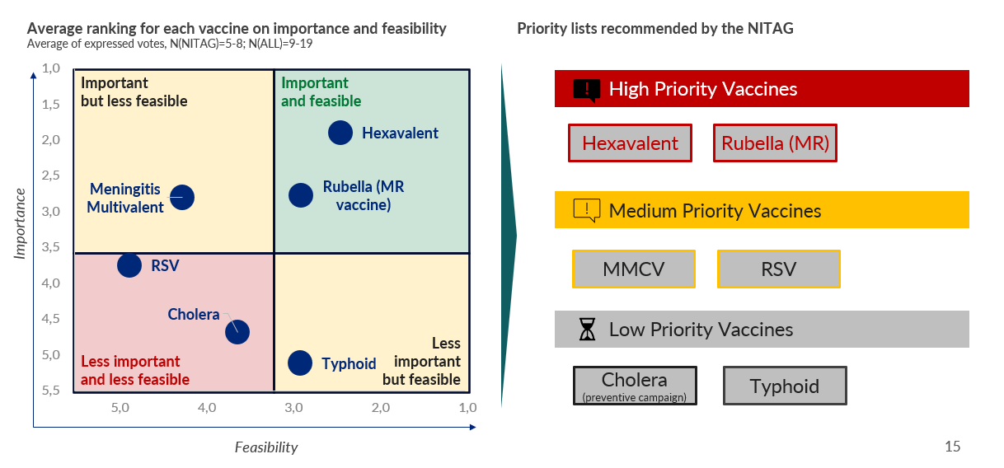
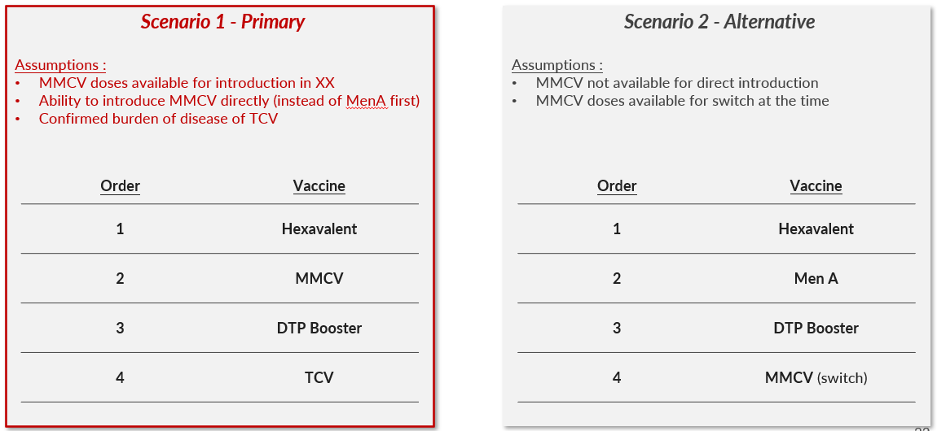
The outputs include evidence-based recommendations and introduction sequencing scenarios that guide vaccine adoption
Main outputs of the process
Evidence supporting decision
Importance and feasibility ranking for all preselected vaccines
Priority level (high, medium, low) for all preselected vaccines
Sequencing scenarios of new vaccines to be introduced to inform strategic documents¹
List of criteria selected
Evidence for each criteria X vaccine matrix element
Vaccine ranking voting results for each criteria, and overall computed option scores/rank
Example for the Mortality criteria (partial)
“Vaccines were ranked according to their relative importance with respect to mortality, namely the estimated number of deaths related to each disease in 2022 and the case fatality ratio, that is, mortality (number of deaths) divided by incidence (number of cases). Data from the 2022 MDO report (2) indicate a case fatality rate of 0.2% for measles (32 deaths), though this likely underestimates the true fatality rate, which is estimated to be around 1–2% in the region. For the hexavalent vaccine, only data for pertussis, diphtheria, and neonatal tetanus (TTN) were available from the same source (2), with an average case fatality rate of 4.1% (245 deaths).For HPV, the reported mortality corresponds to cervical cancer: 475 deaths in 2023 (5), representing a case fatality rate of 76.4%, but only 0.06% when modeled relative to the number of women infected with HPV. (…)
Examples
1. If the country decides to work on both optimization and prioritization, the proposed sequenced will also include potential optimizations

Slide 28

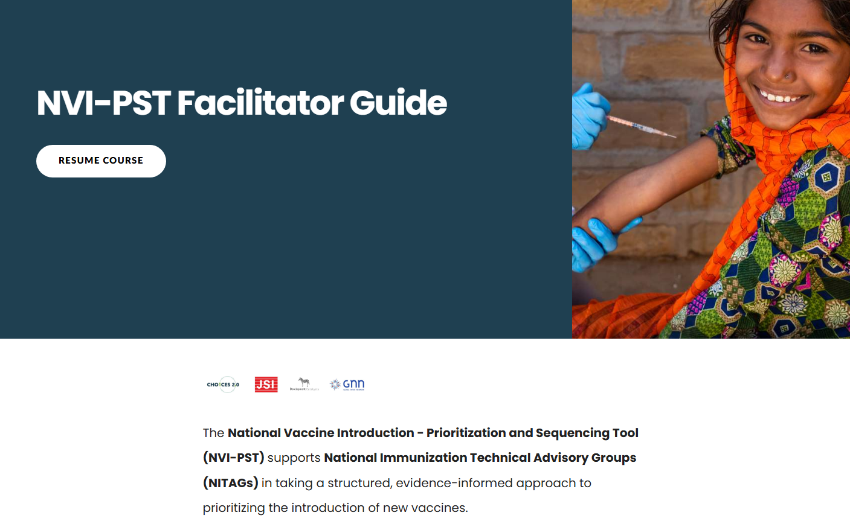


NVI-PST tools are available to support the process
One main eLearning module outlining the entire process, enriched with tips, references to the tools and lessons learned
12 ancillary tools facilitating the NITAG’s and secretariat’s work at each step of the process
0.1 Partner Terms of Reference
0.2 Stakeholder engagement slidedeck
0.3 Workplan template
1.1 Prioritized list of criteria and indicators
1.2 Criteria & Vaccines Questionnaire
1.3 Online session slidedeck
1.4 Workshop 1 slidedeck
1.5 Data collection planning matrix
1.6 Google form result analysis
2.1 Ranking Calculations model
2.2 Guide to collecting evidence & building content
2.2 Workshop 2 slidedeck
Phase 0
Phase 1
… also available on a ~35-page document
Phase 2

Slide 29






Examples—Ethiopia— illustrate how prioritization works in practice
Question: Which vaccines should be introduced in the Ethiopian routine immunization schedule over the next five years?
Context
Ethiopia faces growing demand for new vaccines amid constrained resources and declining donor support
Immunization is critical: EPI has expanded from 6 to 13 antigens since 1980
Limited domestic health financing and reliance on Gavi funding (~60% of immunization costs) require prioritization
A functional ENITAG supported by a strong EPI / secretariat able to provide evidence-based guidance to inform vaccine introduction and sequencing decisions
Process & criteria
Tool: ENITAG adapted the NVI-PST
Candidate vaccines: Hexavalent, MR (rubella), MMCV, RSV, TCV, OCV
8 importance criteria: incidence, prevalence, mortality/lethality, contribution to goals, effectiveness, duration of protection, serogroup coverage, availability of alternatives
5 feasibility criteria: individual risk, funding availability, market supply, cold chain adequacy, human resource impact
Data collection: Four thematic groups
Scoring & ranking: Participatory workshop with ENITAG and stakeholders; consensus-based decision-making for vaccine prioritization and sequencing
Results
Recommendations: Sequence introductions to avoid clashes with other NVIs (yellow fever, malaria, HepB birth dose, measles campaigns)
Top priorities: Hexavalent and MR vaccines—high importance and high feasibility for earliest introduction (2026–2027)
Medium priorities: MMCV and RSV—important but with programmatic or financial constraints
Low priorities: TCV and OCV—lower priority for routine immunization; OCV reserved for outbreak campaigns
Sources: Memirie ST, Teka T, Mekasha A, Alemayehu T, Kokobie MA, Tefera YL, Abebe W, Kaba M, Mohamed N, Guiod F, Senouci K. Prioritization of future new vaccines introduction: The experience of the Ethiopian National Immunization Technical Advisory Group. Vaccine. 2025 Nov 1;68:127932. doi: 10.1016/j.vaccine.2025.127932. Epub ahead of print. PMID: 41176965.

Slide 30
Agenda
Why: rationale and purpose
1
What: core concepts and benefits
2
When: triggers for action
3
How: principles and process
4
Configuration 1: focus on prioritization
5
Configuration 2: focus on optimization
6
Configuration 3: doing prioritization and optimization
7

Slide 31
Through portfolio assessment and criteria-based analysis, opportunities for optimization are identified
Phase 1: Framework Adaptation
Phase 2: Assessment, Optimization, Sequencing
Phase 3: Recommendations
2-4 weeks
1 month
1 month
Workshop
1
Workshop
2
Endorsement by Ministry of Health and integration into national program
Process design and stakeholder engagement
Data collection
Validation and documentation
Objectives:
Before workshop:
Based on the national EPI schedule, review all potential optimization questions
Confirm process, agree on steps and timeline, (including alignment with NIS development/update)
Engage key stakeholders and define R&Rs
Objectives:
Before workshop:
Collect, assess and synthesize available data
Objectives:
Document actionable recommendation(s)
Ensure consensus, consistency and compliance
Include selected options in NIS or other strategic planning document(s)
Develop actionable plan for switch implementation
During workshop:
Translate evidence into option ranking, for each optimization question
Explore programmatic constraints (including budget, market) to define the feasibility level of each optimization question
Develop sequencing recommendations
Develop recommendations for selected products/schedule/presentations
During workshop:
Define list of optimization questions and goals
Select criteria for decision-making for each optimization question and weighting scheme
Develop a workplan for data collection and synthesis
Output:
Selection of vaccines to optimize and corresponding questions (3 max)
Prioritized and weighted criteria for each question (10 max for each question)
Workplan for data collection
Output:
List of proposed optimization choices with ranked options
Sequencing scenarios for optimization choices incorporating programmatic and global market constraints
Output:
NITAG recommendation(s) for selected options
Updated NIS or other strategic planning document(s)
Plan for optimization implementation

Slide 32
Governance lies with the EPI and the NITAG, the latter providing technical oversight technical support from partners may be mobilised
Phase 1: Framework Adaptation
Phase 2: Assessment, Optimization, Sequencing
Phase 3: Recommendations
Workshop
1
(half day)
Workshop
2
(1-2 days)
Process design and stakeholder engagement
Data collection
Validation and documentation
Reviews methodology and process
Preselect a limited number of optimization questions based on current portfolio and programmatic objectives
Vote on optimization questions
Takes part in criteria and weighting discussions
Prepares data collection
Prepare online form and material for WS1
Prepare overview of proposed opti. questions
Lead data collection (consolidate, clean, synthesize evidence)
Share programmatic constraints
Provide feedback on proposed scenarios
Prepare material for workshop 2
Draft recommendations document
Liaise with key stakeholders
Translate recommendations in strategic-planning documents (NIS, etc.)
Present to stakeholders (MoH, ICC)
Prepare material for workshop 2
EPI
If secretariat
NITAG
Lead and facilitate workshop 1 (NITAG chair)
Vote on optimization questions
Takes part in criteria and weighting discussions
Decide on optimization questions and criteria
Support data collection (in working groups)
Review evidence and rank options for each optimization question
Define preferred option for each optimization question
Propose scenarios for optimization implementation sequence
Formulate additional recommendations
Review and validate recommendations document

Slide 33
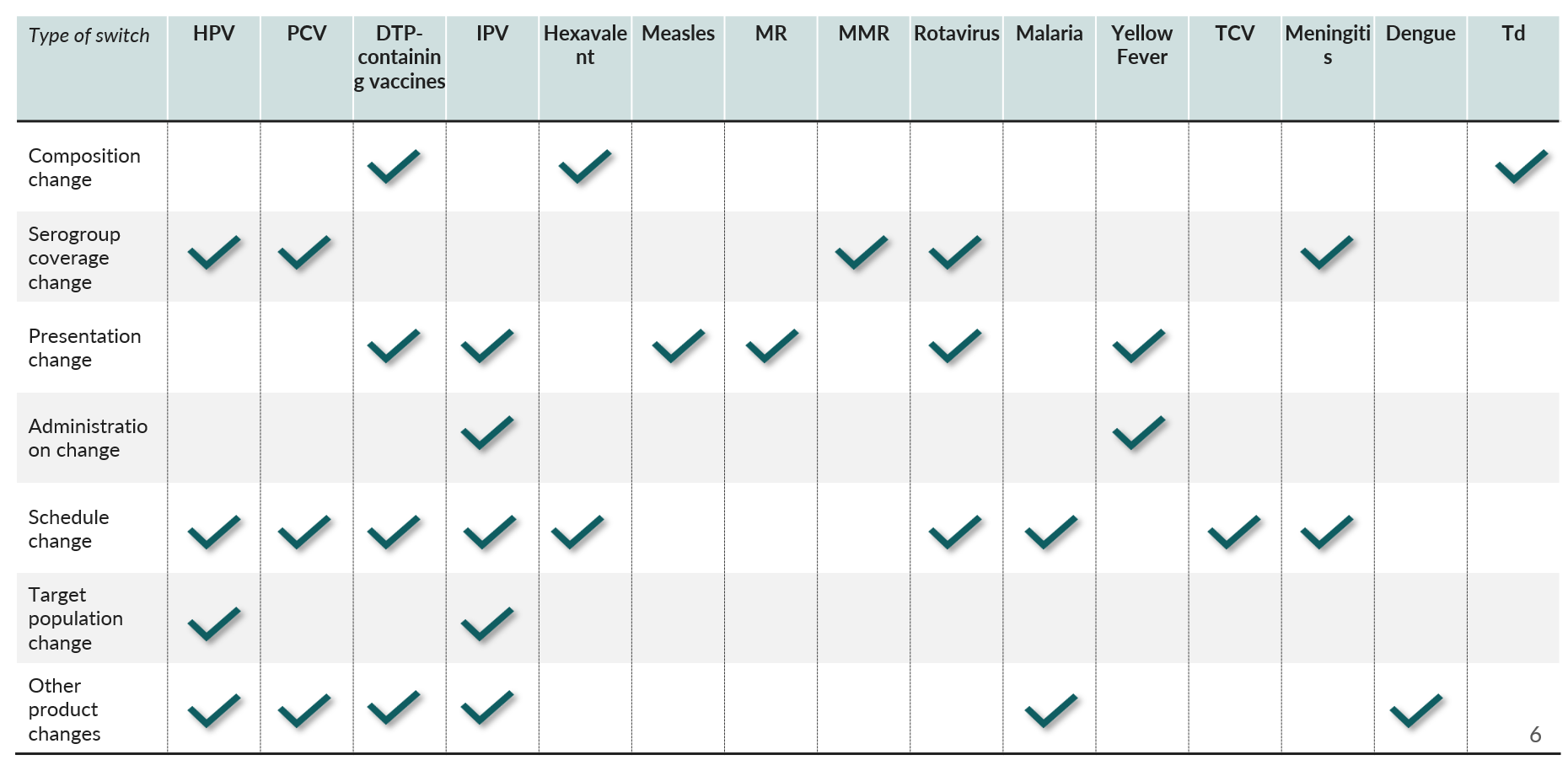
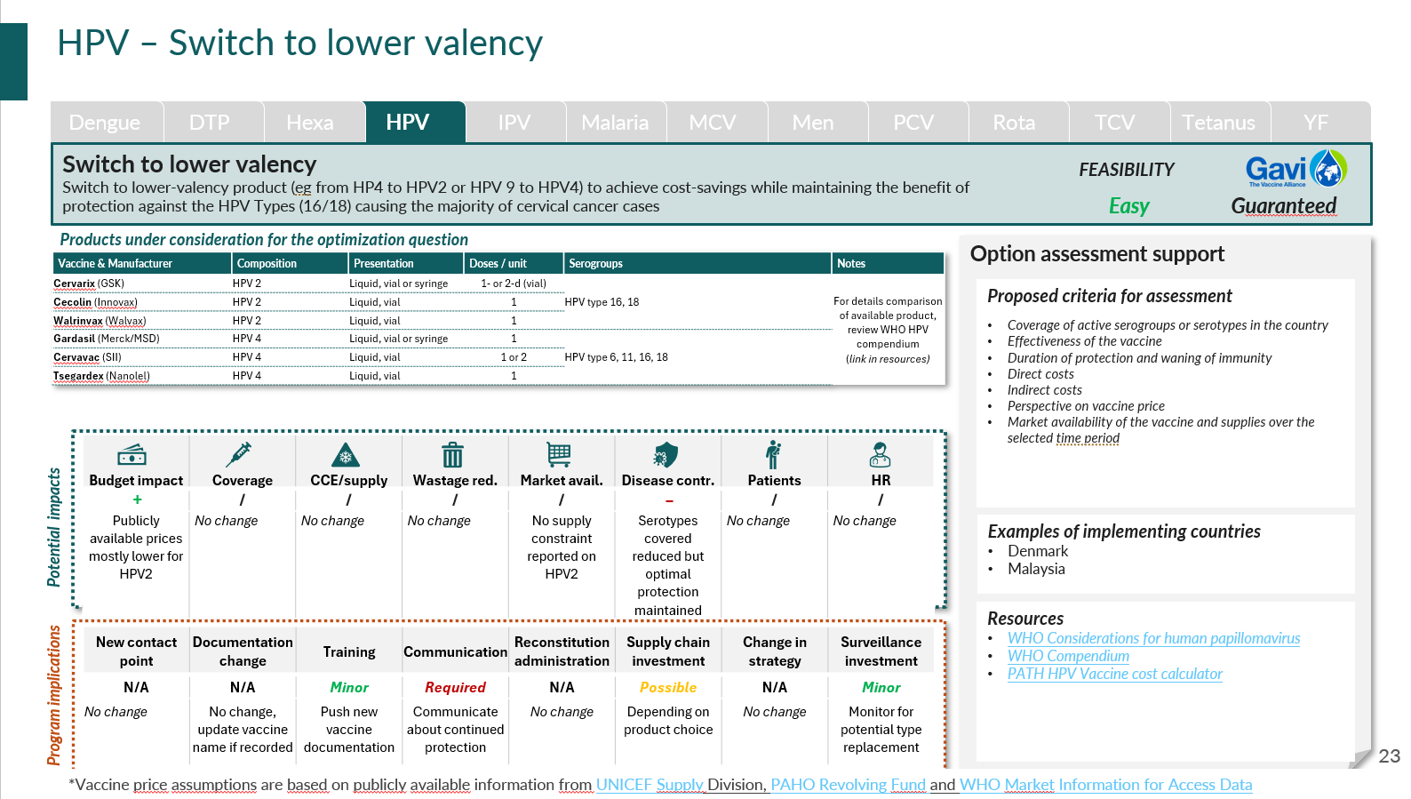
The process should begin with a comprehensive review of the existing immunization schedule
1
2
3
4
5
Start from current portfolio
Use the List of Optimization questions as benchmark
Filter for relevance
Select optimization questions
Select criteria
List all vaccines currently in use
Note formulations (valency, presentation, schedule, target group)
Perform fiscal / budget space analysis
Assess holistic budget constraints
Evaluate current global and relative value of vaccination programs
Go vaccine by vaccine
For each, check the list of possible optimization questions
Also review expected benefits and feasibility considerations for each question
For optimization questions, filter, before Workshop 1:
Which questions apply to your portfolio?
Which correspond to strategic priorities (Budget impact, coverage, etc.)?
Which are most feasible?
Filter to prepare a short (8-10 max) list of questions
Select a limited number of optimization questions
Propose the filtered list of questions to the joint NITAG + EPI audience
Present key / summarized aspects of each optimization question
(Best practice) Organize a vote on optimization questions to support discussions
Collectively select up to 3 questions for further assessment, together with criteria
For each optimization question, select ~10 criteria
Consult the list of criteria from the joint NVI-PST – Optimization guidance
Clarify objectives of the optimization
Select criteria as to align with stated objectives, potential impacts and program implications
(Best practice) Organize a vote on criteria to select for each question
Use the List of optimization questions
Use the optimization questions factsheets

Slide 34




Zoom on process – some questions need to be treated in specific orders
When addressing several optimization questions for the same vaccine, antigen, order matters
Optimization questions often have strong programmatic impact, meaning optimizations questions for different antigens need to be considered holistically
The generally suggested order is the following:
First address target group questions to ensure that health impact comes first
Then address serogroup questions to ensure selected vaccines correctly tackle the health problem
Then address schedule questions to optimize uptake and disease control
Then address presentation and administration questions to optimize delivery
Finally address product and composition questions, achieving programmatic and financial benefits under constraint
Optimization questions can impact the following aspects of the program as a whole, and should therefore trigger questions for the entire vaccine portfolio, including other optimization questions being discussed
Negative impact
Positive impact
Will my overall program cost remain within budget / funding ?
Am I overloading my cold chain and logistics capacity?
Will health workers be able to deliver the vaccine as intended? Will it jeopardize other programs?
Will it create additional burden on patients (e.g. too many injections)?
Can cost savings be reinvested within the immunization program to strengthen other areas?
How can the freed cold chain capacity be used most effectively?
Can the time saved per vaccination be leveraged to improve delivery of other vaccines or services?
Could other vaccines benefit from the reduced number of injections?
However, for certain vaccines, those decisions are intertwined
In some cases, product choices affect schedule (e.g. malaria vaccines), therefore the two questions should be addressed at the same time
Similarly, product choices are often strongly linked to serogroup coverage, in some cases they should therefore be treated together
Schedule revision can bring financial benefits or additional costs, meaning deciding on the product to ensure balanced cost impact can be relevant

Slide 35
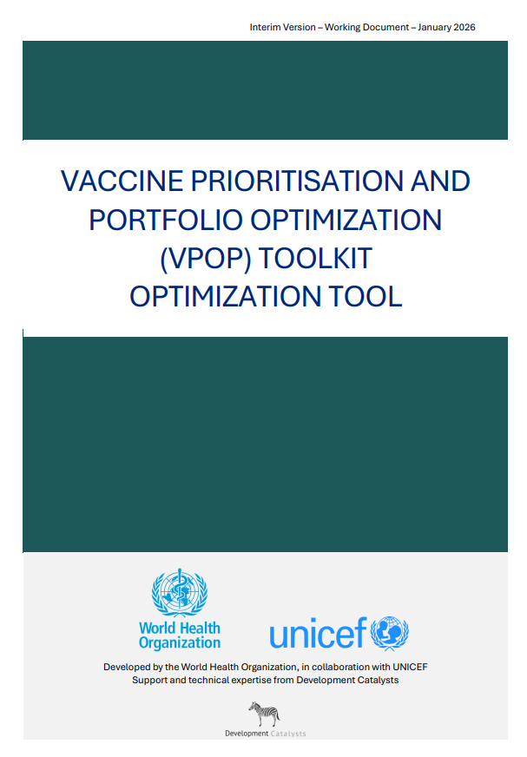
Tools are available to support structured evaluations
READ ME – Optimisation tool:
Guidance on process to optimize current portfolio of vaccines
6 ancillary tools facilitating the NITAG’s and secretariat’s work at each step of the process -6 additional in development
0.1 Country Concept Note
0.2 Stakeholder engagement slidedeck
0.3 Workplan template
1.1 Prioritized list of criteria and indicators
1.2 List of Optimization questions
1.3 Data collection planning matrix
1.3 Online session slidedeck
1.4 Workshop 1 slidedeck
1.5 Google form result analysis
2.1 Ranking Calculations model
2.2 Guide to collecting evidence & building content
2.2 Workshop 2 slidedeck
Phase 0
Phase 1
Phase 2
Documents in italic are in development and will be available in Q2 2026

Slide 36
The output should be a list of preferred options for each optimization question, backed by strong evidence for each option
Main outputs of the process
Evidence supporting decision
Consolidated list of optimization questions that were considered for each vaccine already in the portfolio
Prioritized ranking of options for each question
Feasibility assessment of potential switches/changes: distinguishing between high-impact, immediately implementable changes and those requiring further monitoring, resources, or evidence
Proposed sequence (and potential timing) of changes to be implemented to inform strategic documents¹
List of criteria selected for each optimization question (e.g. market availability, cost of each option), with their relative weight
Evidence for each criteria X option matrix element
When relevant, financial and budget impact analysis
Summarized statement for each option, highlighting benefits and requirement of each ranked option
Option ranking voting results for each criteria, and overall computed option scores/rank
Example of a summarized statement for Q1, Option1:
“Recent studies confirm that Pneumosil 10 (5-dose) achieves ~65% efficacy (95% CI: 55–75%) against invasive pneumococcal disease, comparable to PCV13 in similar settings. At ~USD 2 per dose, switching would lower the total vaccine program cost by nearly 40% compared to PCV13. The 5-dose vial format reduces cold chain volume by 30%, easing storage and transport bottlenecks. Observed wastage rates remain below 5% even in low-session sites. With proven immunogenicity across the 10 targeted serotypes (prevalent in [Country X]), Pneumosil-5 is a cost-saving, high-performance option for sustainable immunization.”
Q1: Change PCV product
Q2: Change RVV schedule
Preferred option #1
Preferred option #1
Pneumosil10, 5-dose
2 doses (1+1)
Examples
Preferred option #2
Preferred option #2
Prevenar 13, 4-dose
2 doses (2+0)
Preferred option #3
Pneumosil10, 1-dose
1. If the country decides to work on both optimization and prioritization, the proposed sequenced will also include potential new vaccine introductions

Slide 37
Examples such as PCV 13 to PCV 10 switch in South Africa highlight optimization in action
Question: Can the country switch to a lower-cost PCV 10 vaccine from PCV13?
Context
South Africa introduced PCV7 in 2009 and PCV13 in 2011 in a 2+1 schedule
National surveillance shows highest IPD burden in infants and persistent circulation of a limited number of dominant serotypes, covered by both PCV13 and PCV10 formulations
The country entered a period of severe fiscal constraint following COVID-19, and was seeking funding to introduce Tdap in pregnancy and rubella
National tender for PCV was ending – three year budgeting cycle with National Treasury - and a new tender being discussed, hence NAGI advice sought by MoH/EPI
Process & criteria
NAGI reviewed evidence data for PCV13 and PCV10
NAGI’s role was advisory on equivalence; the final selection was made by the Department of Health through the national tender process
Key criteria considered
Coverage of serotypes currently prevalent in South Africa
Effectiveness & immunogenicity (comparable protection between PCV10 & 13)
Safety and co-administration
Programmatic feasibility (schedule)
Affordability & opportunity cost
Results
NAGI concluded PCV10 and PCV13 were programmatically and clinically equivalent
South Africa officially switched from PCV13 to PCV10 (SII/Cipla) on 1 January 2024
Cost savings from the switch enabled introduction of Tdap in pregnancy and measles-rubella
The switch was framed as a procurement and optimization decision, not a withdrawal of pneumococcal disease control
Continued intensive surveillance allowed to monitor serotype replacement and disease trends.
Source: South Africa health knowledge hub (https://knowledgehub.health.gov.za/system/files/2023-11/KH%20webinar%20Session%201%20PCV%20-%20final%20%281%29.pdf)

Slide 38
Agenda
Why: rationale and purpose
1
What: core concepts and benefits
2
When: triggers for action
3
How: principles and process
4
Configuration 1: focus on prioritization
5
Configuration 2: focus on optimization
6
Configuration 3: doing prioritization and optimization
7

Slide 39
Optimization and prioritization can be carried jointly, provided careful planification
Phase 1: Framework Adaptation
Phase 2: Assessment, Prioritization, Optimization and Sequencing
Phase 3: Recommendations
1 month
3-4 months
2 months
Workshop
1
(1-2 days)
Workshop
2
(3 days)
Endorsement by Ministry of Health and integration into national program
Process design and stakeholder engagement
Data collection
Validation and documentation
Objectives:
Before workshop:
Review all potential optimization questions in light of the current national EPI schedule
Confirm process, agree on steps and timeline, and ensure consistency with NIS development/update
Engage key stakeholders and define R&Rs
During workshop:
Define list of optimization questions and goals to be discussed
Define list of vaccines / time horizon for prioritization
Select criteria for decision-making for prio and opti
Develop a workplan for data collection and synthesis
Objectives:
Before workshop:
Collect, assess and synthesize available data
During workshop:
Translate evidence into option ranking for each optimization question
Translate evidence into prioritization using vaccine ranking
Explore programmatic and market constraints
Develop sequencing recommendations for both NVI and optimization questions
Develop recommendations for selected products/schedule/presentations
Objectives:
Document actionable recommendation(s)
Ensure consensus, consistency and compliance
Include selected options in NIS or other strategic planning document(s)
Develop actionable plan for switch implementation
Output:
Prioritized and weighted criteria for decision-making
Selection of vaccines to optimize and corresponding questions
Preselection of vaccines to consider for introduction
Workplan to collect and prepare data for assessment
Output:
List of proposed optimization choices with ranked options
Sequencing scenarios for optimization choices incorporating programmatic constraints
Prioritized vaccine lists for introduction
Scenarii for sequencing based on known constraints
Output:
Finalized recommendation shared with EPI and Ministry of Health
Updated NIS or other strategic planning document(s)
Plan for optimization implementation

Slide 40
When undertaken together, careful coordination is required to keep process manageable and align sequencing
Phase 1: Framework Adaptation
Phase 2: Assessment, Prioritization, Optimization and Sequencing
Phase 3: Recommendations
Risk: Burden of evidence collection
Recommendation:
select fewer criteria (e.g. ~10 criteria for prioritization, max. 10 per optimization question)
Limit the number of vaccines (prioritization) and questions (optimization) to keep work manageable
Start with optimization, as the outcome can inform the ability to introduce new vaccines (e.g. from a cost perspective)
Sequencing should be done jointly for both new vaccine introductions and optimization changes to ensure programmatic limitations are considered holistically.
We strongly recommend to compute holistic budget impact to ensure financial feasibility and sustainability
Recommendations should be documented in a single document
Implementation planning documents and NIS should incorporate possible synergies between NVIs and optimizations (e.g. joint training)

Slide 41
Governance lies with the EPI and the NITAG
Phase 1: Framework Adaptation
Phase 2: Assessment, Prioritization, Optimization and Sequencing
Phase 3: Recommendations
Workshop
1
(1-2 days)
Workshop
2
(3 days)
Process design and stakeholder engagement
Data collection
Validation and documentation
EPI
(support)
Reviews methodology and process
Preselect a limited number of optimization questions based on current portfolio review
(If secretariat) Prepare online form and document for workshop 1
(If secretariat) Prepare short overview on proposed questions/options and vaccines
Prepare data collection
Lead data collection (consolidate, clean, synthesize evidence)
(If secretariat) Prepare document for workshop 2
Share programmatic constraints
Provide feedback on proposed scenarios
Draft recommendations document
Liaise with key stakeholders
Translate recommendations in strategic-planning documents (NIS, etc.)
Present to stakeholders (MoH, ICC)
NITAG
(lead)
Lead and facilitate workshop 1 (NITAG chair)
Vote on optimization questions and criteria (optimization) and criteria, vaccines, time horizon (prioritiziation)
Decide on optimization questions and criteria (optimization) and criteria, vaccines, time horizon (prioritization)
Support data collection (in working groups)
Review evidence and rank options for each optimization question / rank vaccine for each criteria (prioritization)
Define preferred option for each optimization question
Define priority lists for selected vaccines
Propose scenarios for optimization and NVI
Formulate additional recommendations
Review and validate recommendations document

