Slide 1
Enhancing Vietnam’s NITAG Capacity and Functionality in Response to Public Health Priorities
Mai-An T Nguyen¹, Thu-Anh Nguyen¹, Ketaki Sharma², Xuanchen Tao², Kristine Macartney²
¹The University of Sydney Vietnam Institute
² National Center for Immunisation Research and Surveillance
sydneyvietnaminstitute.org

Slide 2
System Context & Defining Moment
Vietnam’s immunization system is vast covering the entire country with:
4
63
10,000+
Regional EPI centers
(Ha Noi, Ho Chi Minh City, Central Highlands, Nha Trang)
Provincial EPI centers
(over 700 district-level units)
Commune health centers with immunisation sites
In such a multi-tiered and complex system, NITAG's recommendations can impact Vietnam’s population of nearly 100 millions.
However, by 2023, as the Ministry of Health (MOH) was preparing to introduce new vaccines such as HPV and Pneumococcal, NITAG’s capacity was facing significant challenges.

Slide 3
Identifying the Gaps
NMAT Assessment Results:
Further internal interviews highlighted:
Lack of a functional technical secretariat.
No operational funding.
Meetings were irregular, and data access was challenging.
NITAG
Maturity Criteria
40%
Key functions (e.g. decision-making, policy integration, and stakeholder recognition)
25%
NITAG’s experts have strong technical knowledge and an independent voice. What Vietnam needed was a model of timely and appropriate support.

Slide 4
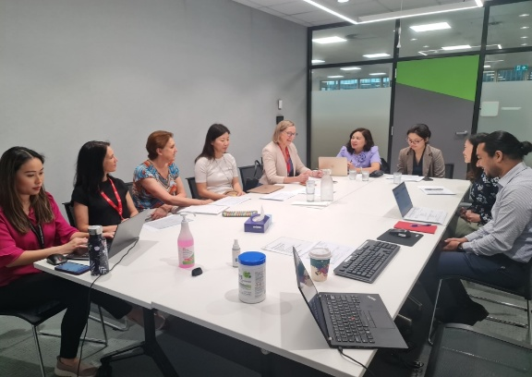
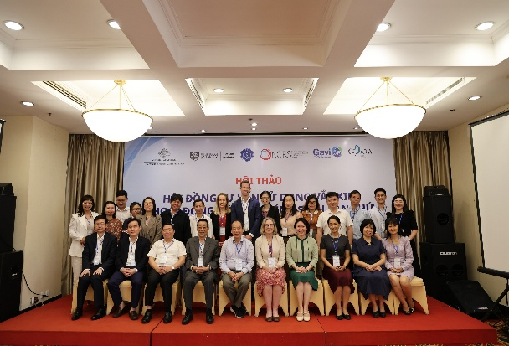
A Partnership Begins: From Intent to Action
Gavi Middle Income Country Strategy (MICS) Project
1. Scoping Visit by Prof. Kristine Macartney (NCIRS) to Vietnam in August 2023 aimed to initiate technical support for Vietnam’s NITAG. Key goals included:
Strengthening NITAG Functionality
Capacity Building
Support for Vaccine Introductions
Stakeholder Engagement
2. Vietnam NITAG Secretariat Visit to Australia in Nov-Dec 2023:
Enhancing processes and policy functions through shared experiences and practical approaches
Building capacity for evidence review, data analysis, and evidence-informed decision-making
Supporting communication between NITAG and the Ministry of Health
Assisting in the development of technical advice to guide new vaccine introductions
3. Three in-depth workshops focused on:
Evidence-based decision-making
Regional NITAG connections, such as ATAGI (Australia), and those in Canada and Singapore
Identifying research data gaps

Slide 5
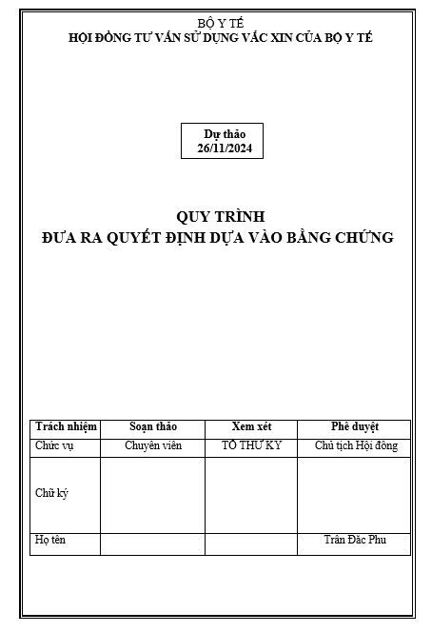
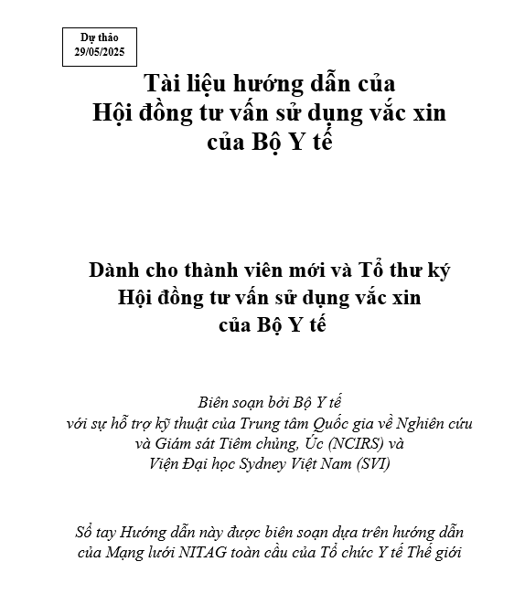
Building with Purpose: Tools That Last
Gavi Middle Income Country Strategy (MICS) Project
1. Standard Operating Procedures (SOPs):
Tailored to the structure of Vietnam NITAG
Provide clear processes, roles and workflows
Support consistent and transparent advisory practice
2. Evidence-to-Recommendation (EtR) Framework:
Aligned with WHO standards, adapted for Vietnam
Translates data into actionable policy options
Promotes structured, accountable decision-making
These tools institutionalise quality – enabling evidence to lead, and equity to follow.

Slide 6
The Right Partners, Creating Real Changes
Gavi Middle Income Country Strategy (MICS) Project
Key Achievements:
Regular NITAG meetings, SOPs developed, and evidence-based recommendations for HPV and pneumococcal vaccine
Introduced a transparent, consensus-drive process
Strengthened remote support and international collaboration
Connected the NITAG with other NITAGs and secretariats globally to exchange technical information and ways of working
Reconnected the NITAG with the Global NITAG Network
Collaborated on research to inform policy decisions
CIPE program linked policy to frontline practice through practical, evidence-based training

Slide 7
From Ideas to Impacts
Gavi Middle Income Country Strategy (MICS) Project
Vietnam NITAG’s has evolved from a fragmented structure to one with a functioning technical secretariat, standardized tools, and increasing recognition within the public health system.
Early signs of improvements:
Evidence-based recommendations on the introduction of HPV and pneumococcal vaccines
Adjustments to existing immunisation policies
These changes support stronger policies and better immunisation outcomes through a more responsive evidence-based system
More structured, evidence-aligned processes

Slide 8
Visit of the Vietnam Ministry of Health delegation to Australia (1)
Gavi Middle Income Country Strategy (MICS) Project
Timeline: 14 – 21 June 2025
Locations: Sydney & Canberra, Australia
Purpose: To understand how evidence translates into policy and public health outcomes through direct engagement with Australian partners
Government & Policy Partners
Academic & Research Leaders
Innovation & Strategic Platforms
Department of Health & Aged Care
NSW Health
ATAGI
NCIRS
The University of Sydney
NSW Investment
UNSW RNA Institute

Slide 9
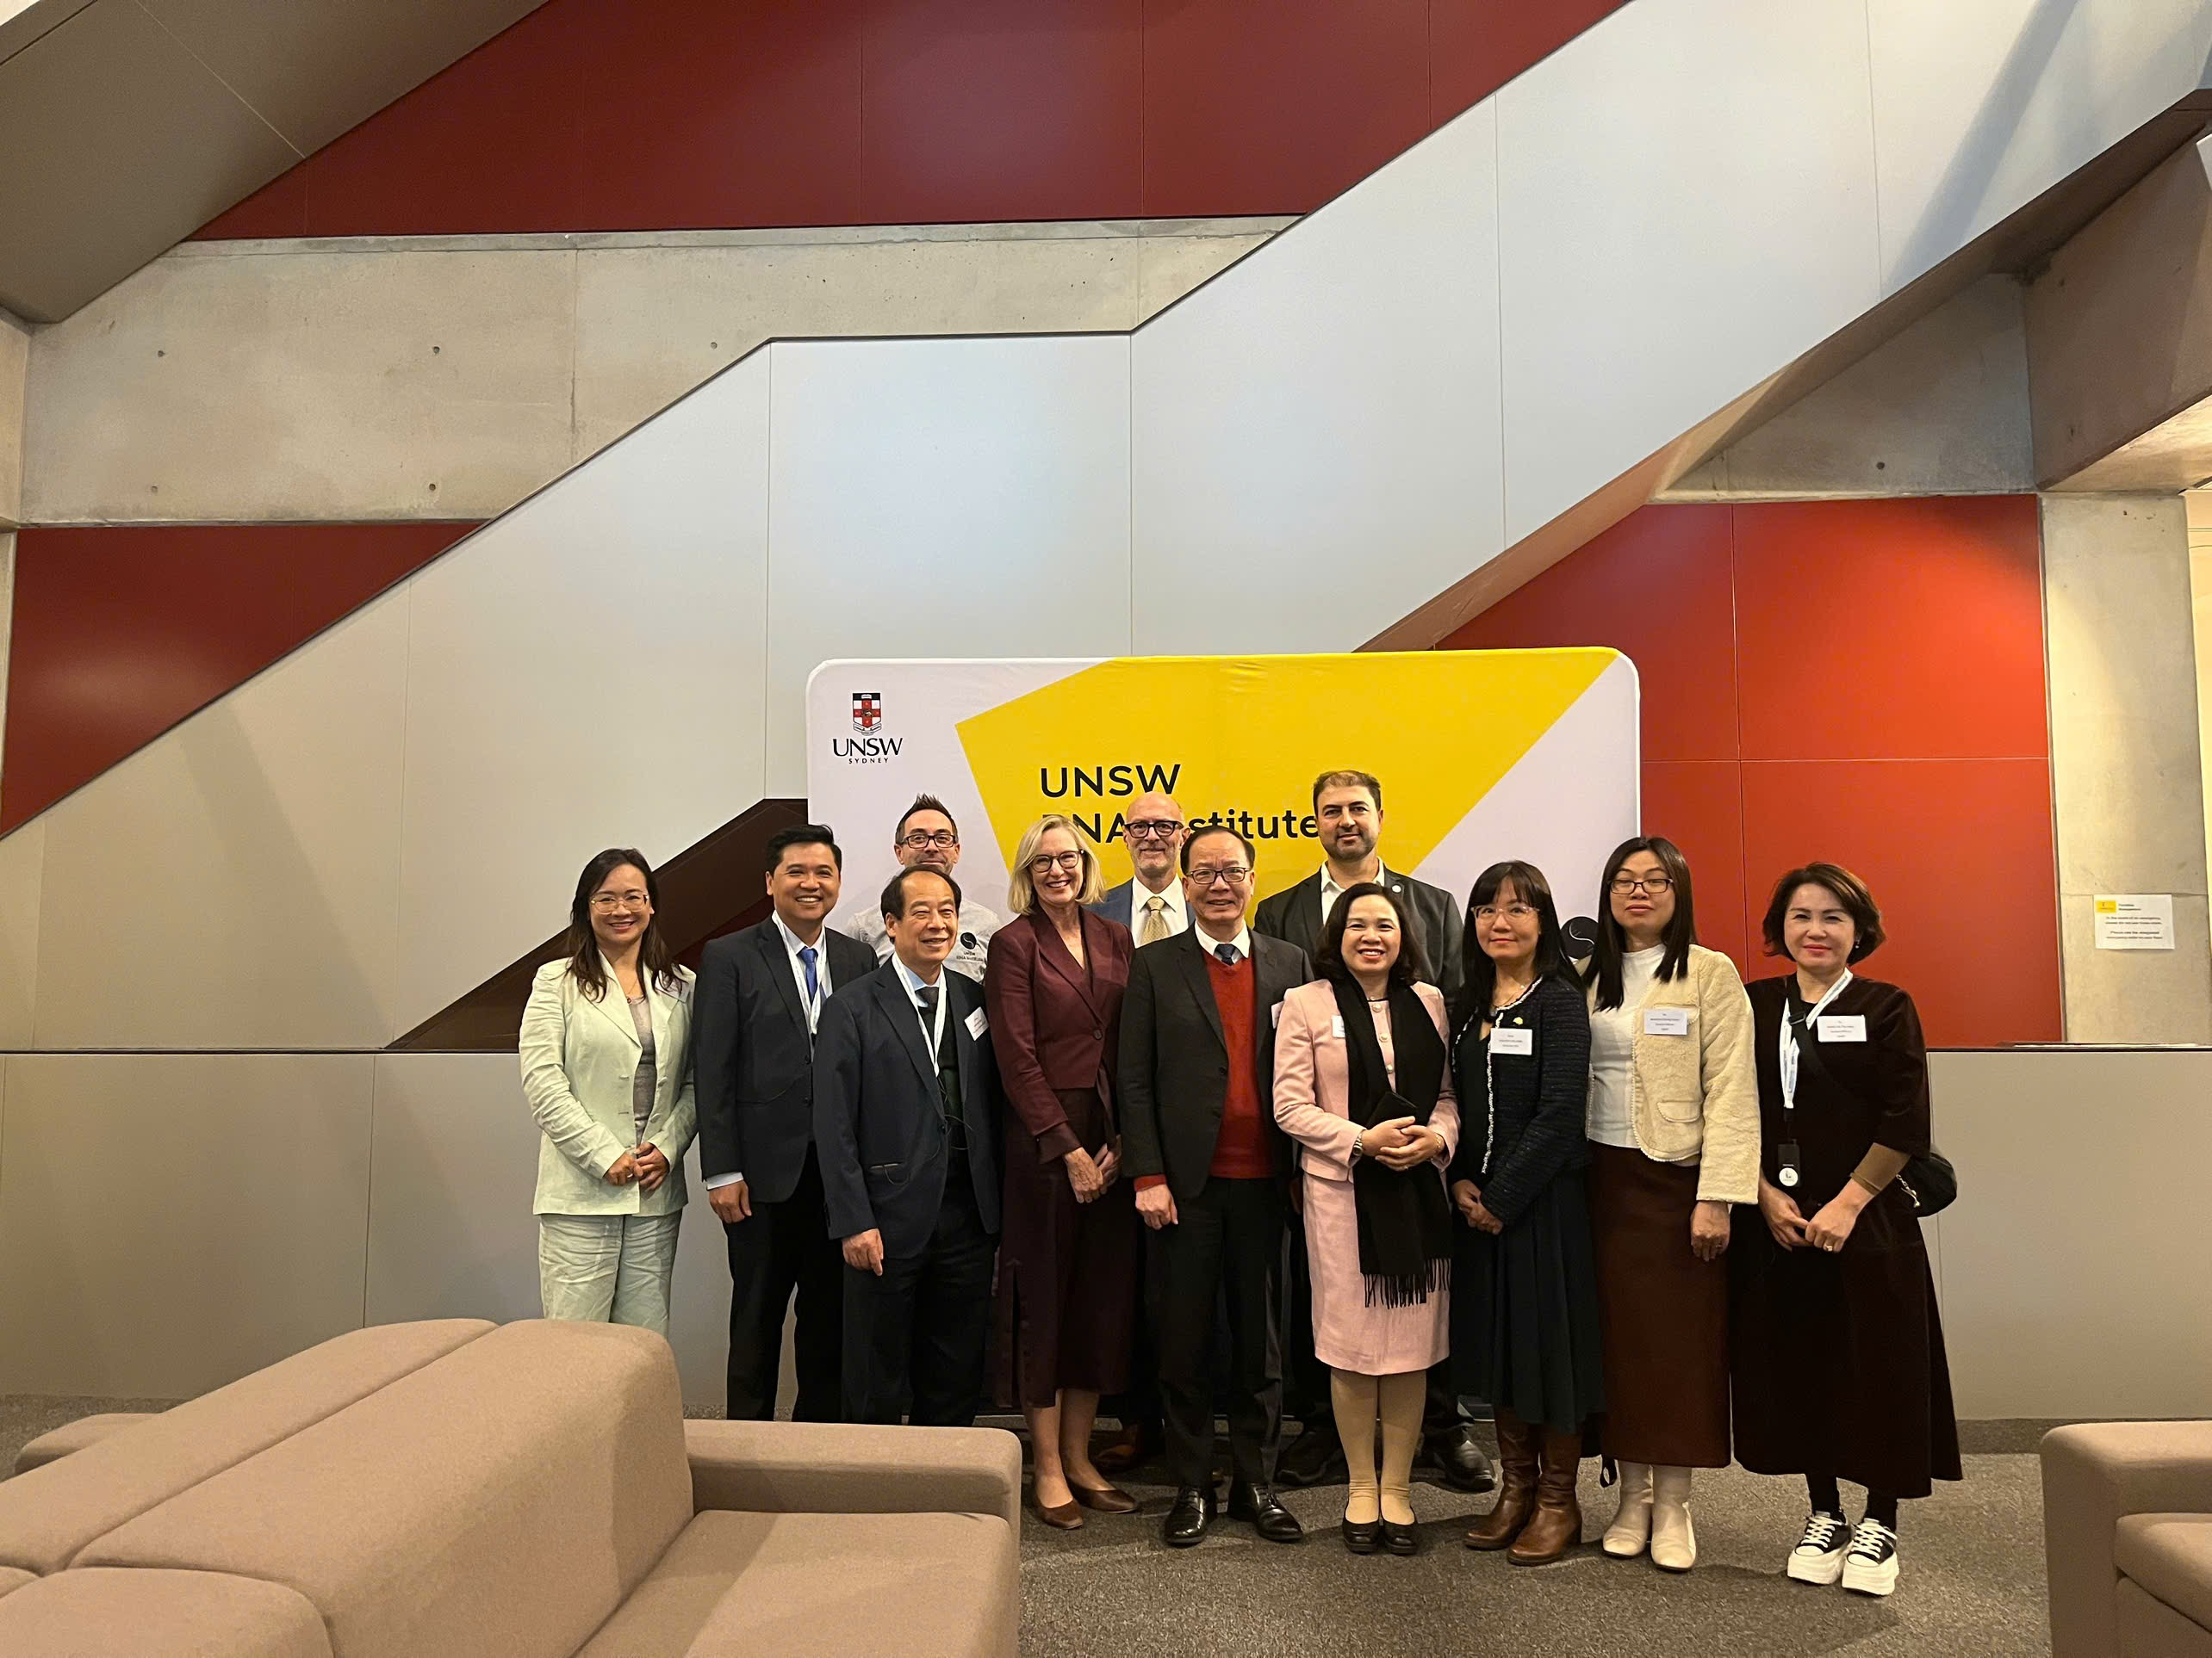
Visit of the Vietnam Ministry of Health delegation to Australia (2)
Gavi Middle Income Country Strategy (MICS) Project

Slide 10
Expanding the Collaboration
Gavi Middle Income Country Strategy (MICS) Project
The twinning model evolves into sustained, strategic partnership.
Key areas of future collaboration:
Joint Research | Co-designed Training | Regional Exchange | Data-driven Collaboration
Vaccine performance & safety Service delivery models Communication strategies | Focused on early-career public health professional | Among NITAGs across Asia-Pacific | With the National Institute of Hygiene and Epidemiology & the National Children’s Hospital Utilizing rich preventive and clinical datasets Exploring vaccine impact, system efficiency and access equity

Slide 11
Conclusion: A Model for Replication
Gavi Middle Income Country Strategy (MICS) Project
Right Timing
Right Community Service
Right Approach
Right Partners

Slide 12
Our team THANK YOU FOR LISTENING! Dr. Nguyen Thi Mai An Project Manager E: Nguyen.t.maian@sydneyvietnaminstitute.org sydneyvietnaminstitute.org
Notes:
Progress so far has been significant — but sustaining it will require more. Vietnam’s NITAG still faces challenges, especially as the government undertakes a broad and comprehensive wave of public sector reform, and the health system itself must adapt to meet the expectations of a changing context.
This is a timely moment to institutionalise progress, ensure continuity, and embed advisory structures that are agile, transparent, and responsive to society’s growing demands for quality, evidence-based care.
On behalf of our collaboration team, I thank the Global NITAG Network and WHO for creating this platform — Thank our team for your hardwork and great support, and thank you all for listening.

