Slide 1
New Vaccines Introduction Prioritization and Sequencing Tool (NVI-PST)
Collecting evidence and building content for workshop #2

Slide 2
Agenda
1
Introduction on evidence collection and content preparation
2
Example of summary slides

Slide 3
Data collection is a key step of the process – it enables the NITAG to later make evidence-based recommendations
A 5-step process
Prepare and finalize the data collection plan during workshop #1, assigning responsibilities and defining timelines
Collect evidence and data through various sources
Clean and prepare data to ensure consistency across vaccines and adequacy of data to the selected criteria
Prepare content, especially using visualization to facilitate comparison between vaccines
Review and share content ahead of workshop #2 so that everyone is on the same information level
Data collection is the most important part of the new vaccine introduction prioritization process
It provides a robust basis for comparison and recommendations by the NITAG

Slide 4
Building an adequate data collection plan is key – it involves defining the nature of data to collect and potential sources, the roles of each stakeholder and the timeline
Data
Roles
Timeline
Nature
Sources
NITAG members
Step 1. Data collection
Vaccine-specific data
Public scientific publications
Secretariat best suited for programmatic criteria
Step 2. Data preparation (e.g. calculations)
Disease-specific data
Reports from the MoH
Local partners can support the collection of national data (e.g. epidemiology)
Step 3. Content preparation (e.g. slides)
Criteria-specific data
Reports from international partners
International partners best suited for vaccine-level data (e.g. effectiveness, availability)
Step 4. Content review & sharing
(Sub-)National-level data
Direct requests to knowledgeable experts/officials
Donors can support collection of market and supply data (incl. Logistics)
International-level data
Disease observatories, surveillance, academic institutions
Observer members can provide insights on latest national/regional studies
Databases
What we recommend
Identifying nature and sources early in the process (at the end of workshop one) speeds up the process. Doing so in the presence of the entire NITAG also helps ensure access to latest available sources and to a wider network of experts.
Identification of public or partner databases can also facilitate the process by consolidating information across diseases or across criteria
What we recommend
Appoint a Data Collection Lead who will oversee the process. Then leverage any preexisting working groups (e.g. NITAG WG per vaccine). If there are none, create a NITAG working group for country-specific data for each criteria. Appoint someone from the EPI for programmatic criteria and partners (WHO, UNICEF, etc.) for international-level data
What we recommend
A minimum of 2 months, and an ideal period of 3 months provide enough time to reach out to the relevant stakeholders and gather the targeted evidence.
Ensure the data collection lead has regular check-ins (once a week) to track progress

Slide 5
The NVI-PST toolkit equips NITAGs with a template for data collection
1.5 NVI PST - Phase 1 - Data collection planning matrix
Extract

Slide 6
Data can be of various nature and be available at various levels – identifying the potential sources early helps speeding up the process
Type of evidence | Key stakeholders | Key sources
All | GNN | Global NITAG Network Resource Center SYSVAC registry Scientific publications on pivotal trials
Burden of disease, epidemiology | MoH directions (surveillance, VPD) Disease observatories or eradication initiatives (e.g. Takeontyphoid) WHO | DHIS2 or other national disease databases MoH annual disease reports WHO Country profiles (e.g. cervical cancer country profile)
Finances & economics | UNICEF | UNICEF NIS Material or here UNICEF NIS Costing tool
Market and supply | International partners (UNICEF, WHO, GAVI) | WHO MI4A UNICEF Market and Supply Updates GAVI Market shaping roadmaps
Vaccine specifications, safety profiles, etc. | WHO GAVI (Peer-reviewed) Studies databases Manufacturers | WHO List of prequalified vaccines GAVI Detailed Products NIH Studies Database Secondary: Manufacturers’ websites
Vaccine effectiveness, duration of protection, etc. | WHO SAGE (Peer-reviewed) Studies databases | WHO SAGE position papers and annexes (GRADE, ETR tables) NIH Studies Database
Service delivery | WHO | WHO recommendations for routine immunization
Logistics and cold chain | EPI Logistics section UNICEF | National Stock Management Tool (SMT) eLMIS
Acceptability and demand | EPI Demand generation section Demand generation partners National studies UNICEF | National Vaccination Coverage Surveys (VCS) UNICEF Knowledge, Attitude and Practices studies

Slide 7
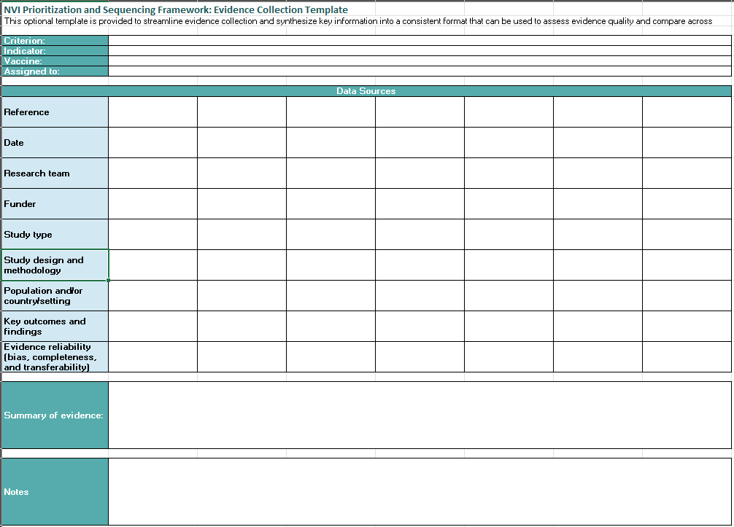
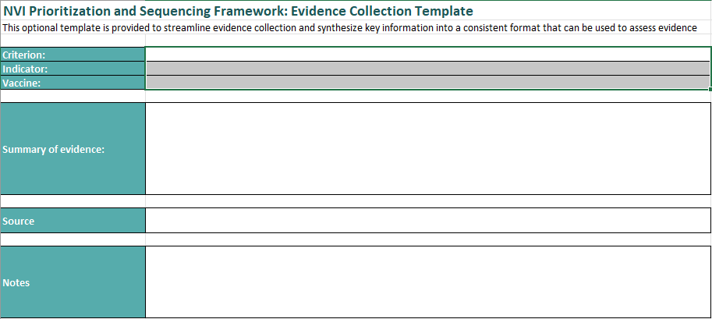
Data should be collected in a consistent and detailed way to ensure traceability and readability
1.5 NVI PST - Phase 1 - Data collection templates
Extracts
Long version
Short version (recommended)

Slide 8
Evidence quality can be considered when conducting NVI prioritization, although it does not have to be as structured/comprehensive as for EtR
Evidence quality should be considered, whether formally or informally (e.g. as a discussion during workshop)
The following can be used for assessing evidence quality, accuracy and reliability
Bias of the study or data
Are there any methodological limitations in the study design or execution that may have influenced the outcomes?
Are these clearly described and are mitigation measures explained?
More broadly, is the person evaluating the data able to discern the quality of the data?
As relevant evidence is identified, the quality and reliability of this evidence is assessed by those conducting data collection
For NVI-PST, evidence grading is not always necessary as it represents a strong additional workload. Shortcuts (such as identifying whether quality has been assessed by other organizations) can be useful
The WHO Development of WHO immunization policy and strategic guidance provides several tools to consider for assessing evidence quality.
Caveat: The optional evidence quality assessment conducted during the prioritization process should not replace the full evidence quality assessment conducted by NITAGs when considering and developing vaccine recommendations
Conflicts of interest
Are there any potential vested interest that the authors, publishers or funders may have?
Are any potential interests disclosed or acknowledged clearly? In that, case, these should recognized, acknowledged and discussed, while not necessarily leading to automatically downgrading these studies
Completeness
Is the study based on complete datasets (i.e., limited dropout or exclusion) or are there structural limitations that impact the results (i.e., in to lack of health care access or incomplete reporting)?
Do studies report similar and homogenous effects of the vaccines?
Are there concerns about underlying data quality?
Transferability
Is the evidence representative of the target population and/or country context?
Is the context in which the study was conducted relevant or comparable to the potential introducing country, or is there adequate information about the study population to allow for transferability to other settings?

Slide 9
NITAGs should also decide on the course of action in the case of missing / partial / inaccessible evidence
NITAGs can encounter the following issues regarding data…
… and should therefore define the course of action
Missing data
Remove criteria or vaccine from comparison
Incomplete data (e.g. for some vaccines/diseases only)
Model data
Inaccessible evidence
Use proxy data (e.g. regional)
Lack of clarity
Use qualitative source (expert opinion) or scale
Scattered data
Reduce criteria weight
Inconsistent data
Mandate complementary study
Incomparable data (extrapolation not possible)
Add caveat / disclaimer to content / visualization
Notes:
Examples of:
Missing data: shigella not monitored by the surveillance system
Incomplete data: disease knowledge and attitude study for some diseases only
Inaccessible evidence: experts / people with access to the evidence not responding
Lack of clarity: evidence data does not have a clear source, clear legend ;
Scattered data: information for one criteria comes from various sources depending on the disease
Inconsistent data: studies find different vaccine effectiveness levels depening on context
Incomparable data: cholera data from Bangladesh (endemic context)

Slide 10
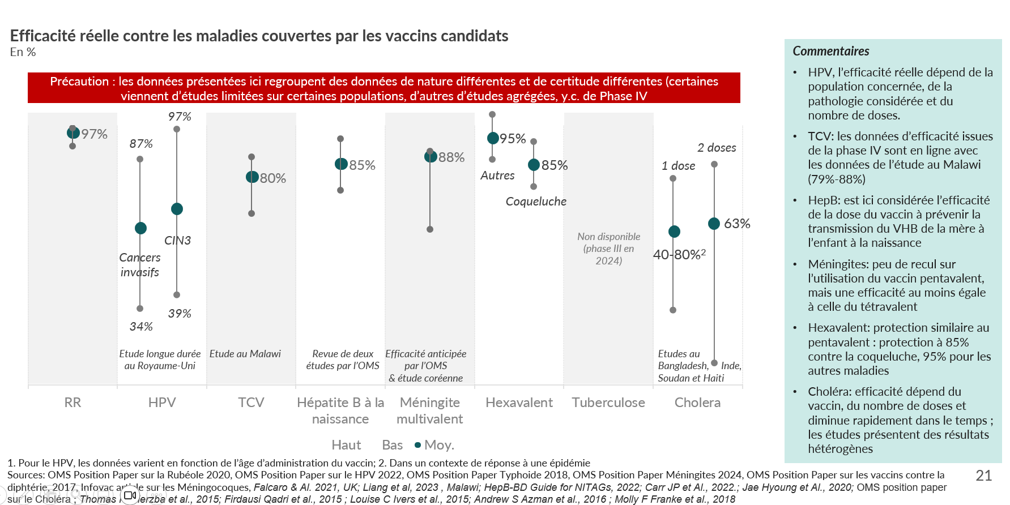
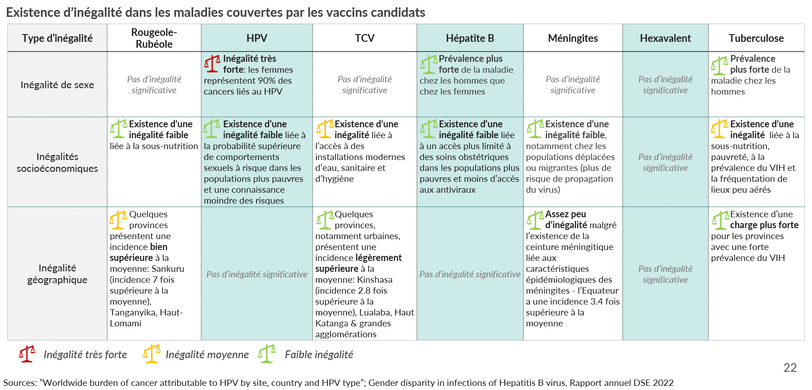
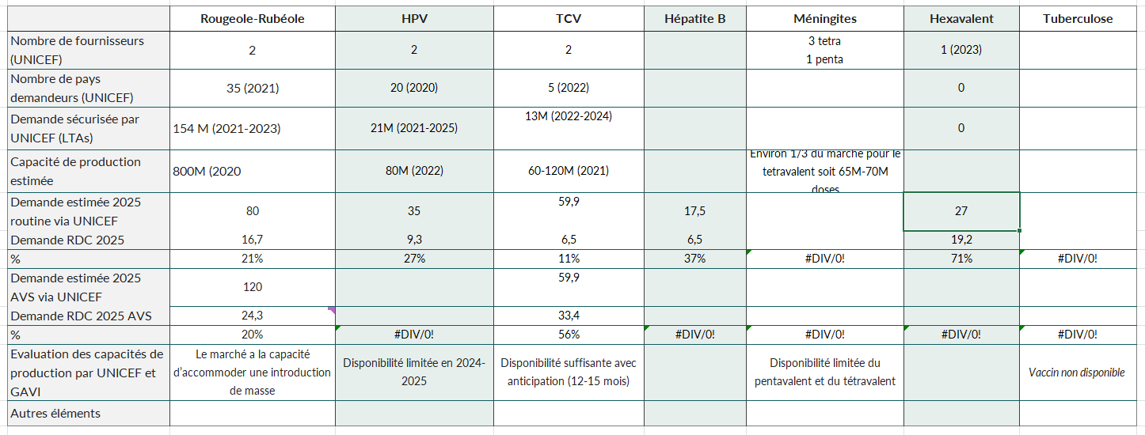
Finally, data and content preparation is a critical step that enables easy comparison between vaccines
Data needs to be cleaned and processed to ensure robustness and readability…
… and translated into visual content to facilitate efficient discussions during workshop 2
Ex: vaccine effectiveness
Ex: cold chain volume calculations
Ex: market weight calculations
Ex: disease inequity

Slide 11
Agenda
1
Introduction on evidence collection and content preparation
2
Example of summary slides
Note: the following slides provide format examples on how to summarize content for one criteria across several vaccines. Data has been anonymized. Do not reuse data contained in those slides as they may not be relevant to your context and/or up-to-date. Content can be in different languages due to the original language of the example.

Slide 12
Incidence: summary of evidence
1
Number of new cases for each disease covered by vaccine candidates
Nb cases, all age, 2021-2022
Comments
Disease 1: Disease 1a accounts for approximately 2-3% of the cumulative suspected
[Vaccine 1] cases and 21% of confirmed cases. Vaccine 2: Data for cervical cancer, 2020 and 2023.
Disease 3: Prevalence data available, no incidence data.
1 944 140
Data for Disease 2a
No data
1 380 955
Data for Disease 6a et Dis 6b not available
Sources: xxx

Slide 13
Prevalence: summary of evidence
2
Share of the population affected with each disease covered by vaccine candidates
%,
2019
2022
Not available / not relevant
Not available / not relevant
Not available / not relevant
Not available / not relevant
Sources: yyy

Slide 14
Mortality & lethality: summary of evidence
3
Mortality and case fatality rate of each disease covered by candidate vaccines in XXX
Case fatality rate, % & Nb de deaths (nb), most recent available data
Comments
Vaccine 1: The figure is 1.86% in 2023.
Vaccine 2: The reported mortality reflects the mortality associated with Disease 2. Mortality relative to the carrier population is approximately 0.03%.
Vaccine 3: Disease 3 has a fatality rate ranging from 1% (with antibiotic treatment) to 10% (without treatment). In XXX, it was 4.7% during the 2021 outbreak and approximately 6% for hospitalized individuals.
Nb deaths | 1875 | 5548¹ | 813 | 4460² | 549 | 245 | 4993¹
No data
71.0%
Only data for disease 6a, 6b and 6c is available
5-6%
0.03%
1. 2023; 2. 2019
Sources: aaa

Slide 15
Outbreak risk: summary of evidence
4
Outbreak potential of diseases covered by candidate vaccines
 | Vaccine 1 | Vaccine 2 | Vaccine 3 | Vaccine 4 | Vaccine 5 | Vaccine 6 | Vaccine 7
Outbreak risk | Yes | No | Yes | No | Yes | Yes | No
Health Districts with outbreak in 2023 | 221-225 |  | 178 HZ with high incidence (>100/100 000) |  | 5 | No data
Other elements |  |  | Two outbreak in 2021: XX & yy |  | 5 HZ with ongoing outbreak in 2021
Sources: yyy

Slide 16
Burden inequity: summary of evidence
5
Existence of various inequities linked to diseases covered by candidate vaccines
Type of inequality | Vaccine 1 | Vaccine 2 | Vaccine 3 | Vaccine 4 | Vaccine 5 | Vaccine 6 | Vaccine 7
Gender Inequity | No significant inequality | Very strong inequality: women represent 90% of cancers related to [Vaccine 2] | No significant inequality | Higher prevalence of the disease in men than in women | No significant inequality | No significant inequality | Higher prevalence of the disease in men
Socioeconomic Inequities | Existence of slight inequality related to undernutrition | Existence of slight inequality linked to a higher likelihood of risky sexual behaviors in poorer populations and lower awareness of risks | Existence of an inequality linked to access to modern water, sanitation, and hygiene facilities | Existence of slight inequality linked to more limited access to obstetric care in poorer populations and less access to antivirals | Existence of slight inequality, particularly among displaced or migrant populations (higher risk of virus spread) | No significant inequality | Existence of an inequality linked to undernutrition, poverty, HIV prevalence, and the use of poorly ventilated spaces
Geographic Inequity | Some provinces have an incidence far above the average: Sankuru (7 times the average incidence), Tanganyika, Haut-Lomami | No significant inequality | Some provinces, especially urban ones, have a slightly higher incidence than average: Kinshasa (2.8 times the average incidence), Lualaba, Haut Katanga, and major urban areas | No significant inequality | Few inequalities despite the meningitis belt's epidemiological characteristics; Equateur has an incidence 3.4 times higher than average | No significant inequality | Higher burden in provinces with a high prevalence of HIV
Strong inequity
Medium inequity
Weak inequity
Sources: aaa

Slide 17
Coverage of active serotypes: summary of evidence
6
 | Vaccine 1 | Vaccine 2 | Vaccine 3 | Vaccine 4 | Vaccine 5 | Vaccine 6 | Vaccine 7
Serogroups | Serogroup 1, Serogroup 2 | 100+ genotypes (13 with a high risk of cancer) In [Country]: 68/58/52/53/35/45/16/18/31/66 | Typhi, Typhimurium, Enteritidis |  | A/C/W/X/Y, in [Country], the most prevalent serogroups are W and C. | Polio 1/2/3
Coverage of serogroups | 100% | Bivalent: 16, 18 Quadrivalent: 6, 11, 16, 18 Nonavalent: 6, 11, 16, 18, 31, 33, 45, 52, 58 | <50% | 100% | 95% pour le Tetravalent 100% pour le Men5CV | 100% | 100%
Comments |  | Types 16 and 18 are responsible for 70% of cervical cancers globally, followed by type 45 (6%), type 31 (4%), and type 33 (4%). | Non-typhoidal strains are increasingly prevalent among children. |  | The main serotypes in [Country] are C and W; however, serogroup X is increasing in the region.
Sources: Rapport annuel DSE 2022, Prevalence and Distribution of Human Papillomavirus Genotypes Among Women in Kinshasa, [Country] (2019), Microbiological, clinical and molecular findings of non-typhoidal Salmonella bloodstream infections associated with malaria, Oriental Province (2016), [Country], Non-typhoidal Salmonella bloodstream infections in Kisantu, [Country]: Emergence of O5-negative Salmonella Typhimurium and extensive drug resistance (2020)

Slide 18
Effectiveness of the vaccine: summary of evidence
7
Effectiveness against diseases covered by candidate vaccines
In %
Comments
Vaccine 1: The actual effectiveness depends on the target population, the specific pathology considered, and the number of doses.
Vaccine 2: Effectiveness data from phase IV is consistent with the data from the study in Malawi (79%-88%).
Vaccine 3: Here, the effectiveness of the vaccine dose in preventing the transmission of Disease 3 from mother to child at birth is considered.
Vaccine 5: Limited data on the use of the pentavalent vaccine, but its effectiveness is at least equal to that of the tetravalent vaccine.
Vaccine 6: Offers similar protection to the pentavalent vaccine: 85% protection against whooping cough and 95% for other diseases.
Vaccine 8: Effectiveness depends on the vaccine, the number of doses, and declines rapidly over time; studies show heterogeneous results.
Caveat: The data presented here includes information of varying nature and certainty (some come from limited studies on specific populations, others from aggregated studies, including Phase IV).
97%
95%
Non disponible (phase III en 2024)
87%
2 doses
Other
85%
1 dose
Disease 6
Disease 2b
63%
Disease 2a
40-80%²
39%
34%
Long study in the UK
Study in Malawi
Review of two studies by WHO
Expected effectiveness by WHO & corean study
Studies in Bangladesh, India, Sudan and Haiti
1. For Disease 1, the data varies depending on the age at which the vaccine is administered. 2. In the context of responding to an epidemic.
Sources: WHO Position Paper on XXX.

Slide 19
Duration of protection: summary of evidence
8
Vulnerability period and duration of protection by candidate vaccines [Country]
Established duration of protection in years
Comments
[Vaccine 2]: Persistent seropositivity for at least 12 years with the bivalent vaccine, 6 years with the nonavalent vaccine.
[Vaccine 1]: Persistent seropositivity after 20 years.
[Vaccine 3]: Protection lasts for at least 5 years.
[Vaccine 4]: Limited data on the duration of protection. For the tetravalent vaccine, boosters are recommended every 3 to 5 years.
[Vaccine 5]: Limited data on the duration of protection, but boosters are recommended every 5 to 10 years.
Childhood (dis 1) & reproductive period (dis 2) | Period of active sexuality | Childhood (<5y) & adolescence (< 14y) | Birth/Childhood | Childhood & adolescence (< 19y) | Childhood (<5y) | Childhood (<5y) & young adults
Not available (phase III in 2024)
12
10
5
Sources: Note from the Public Health Division of Canada on meningococcal vaccinesWHO Position Paper on RubellaHBV-BD Guide for NITAGS 2022Post-hoc analysis of RCT on [Vaccine 2] vaccinesWHO Position Paper on [Vaccine 3]

Slide 20
Current availability of the vaccine: summary of evidence
9
Market information for each vaccine
Caution: The data presented are estimates made from modeled elements based on publicly available data.
 | Vaccine 1 | Vaccine 2 | Vaccine 3 | Vaccine 4 | Vaccine 5 | Vaccine 6 | Vaccine 7 | Vaccine 8
No of suppliers (UNICEF) | 2 | 2 | 2 | 2 (/4 PQ OMS) | 3 (Tetravalent) 1 (Pentavalent) not yet with UNICEF | 1 | 0 | 2
No of countries supply by UNICEF | 35 (2021) | 20 (2020) | 5 (2022) | Unknown | Unknown | 0 (2023) | 0 | 20 (2021)
Secured volumes through UNICEF (LTAs) | 154 M (2021-23) | 21M (2021-25) | 13M (2022-24) | ~15M | 1-2M? | 0M | 0M | 37M
Weight of XX’s demand on overall demand | ~4% | ~6% | ~3% | ~8% | Unknown | ~15% | Unknown | ~5%
Available supply for consumption | 800M (2020) | 80M (2022) | 60M-120M (2021) | Unknown | ~65M (2019) | Unknown | 0M | 35-40M
UNICEF/GAVI summarized assessment on availability | The market has the capacity to accommodate a mass introduction. | Limited availability in 2024-2025 | Sufficient availability with anticipation (12-15 months). | Availability is sufficient (greater than demand) | Very limited availability of the pentavalent and tetravalent. | Availability expected from Q2 2024 for Gavi | Not available | Limited availability, increasing demand, decreasing supply
Other elements | Simultaneous transition in [Country], ETH, and NIG represents a risk to availability. |  |  | One country is responsible for the majority of UNICEF purchases to date. |  |  |  | Demand is expected to increase significantly starting in 2024 (supported by GAVI).
Sources: Measles & Rubella Supply & Demand update 2022, [Vaccine 2] Supply & Demand update 2020, Typhoid Supply & Demand update 2022, WHO MI4A Global Market Study Typhoid, WHO MI4A Global Market Study [Vaccine 2], WHO MI4A Global Market Study Measles containing vaccines, Diphtheria-Tetanus-Pertussis-Vaccine-Containing Market sypply & demand 2023, Meningococcal Vaccines Supply & Demand update 2019, HepB Market & supply update, OCV Market & Supply Update by UNICEF, Gavi Alliance MS Roadmap for Oral Cholera Vaccines,

Slide 21
Availability of funding: summary of evidence
10
Available funding for each candidate vaccine
 |  | Vaccine 1 | Vaccine 2 | Vaccine 3 | Vaccine 4 | Vaccine 5 | Vaccine 6 | Vaccine 7
GAVI Eligibility |  | Under condition¹ Currently not fulfilled for routine, campaign, and ongoing survey. | Yes | Yes | Pending (principle agreement in 2018) | Pending (principle agreement in 2018) | Yes | Not available
Expected co-financing |  | 0.30$/dose | 0.20$/dose | 0.20$/dose | 0.20$/dose | 0.20$/dose | Same contribution as [Vaccine 8] (0.20$) | Not available
GAVI Subsidies | SIV |  |  |  | TBC | TBC | Booster | TBC
 | Ops | FU campaign | Multi-age coh. |  | TBC | TBC |  | TBC
 | Chang
Funding amount |  |  | 2.40$/girl or 100,000 USD 0.65$/person multi-age cohort | 0.80$/child or 100,000 USD |  |  | 0.25$/child or 30,000 USD 0.80$/child or 100,000 USD¹
1. At least 80% coverage for the first dose of VAR or 80% coverage during the last measles campaign.
Sources: GAVI Application Process Guidelines

Slide 22
Availability of cold chain equipment: summary of evidence
11
Additional required cold chain capacity for each candidate vaccine
M³, positive cold chain, 2024
Comments
The maximum available space at the central level is approximately 108m³ and between 5 and 30m³ at the regional depot levels.
[Vaccine 2]: The volume required for one dose is 15cm³, which explains the importance of the total volume; vaccination coverage for this calculation is set at 70%, and the values correspond to a single-age cohort.
[Vaccine 5]: The use of [Vaccine 5] helps free up space currently occupied by the VPI vaccine, but the OPV remains necessary – the introduction of a booster slightly reduces the positive effect.
[Vaccine 7] In the absence of data (vaccine currently unavailable), the impact is considered negligible.
Inconnu
Maximum available capacity
at the central level = 108 m³
Maximum available capacity
considering occupation = 57 m³
Volume required for the catch up campaign 9-14
Replacement w/o additional volume
Volume freed: 20m³ without booster and 16m³ with booster
Sources: SMT [Country], Logistics of the DI, Information on new vaccines, World Bank data on [Country]

Slide 23
Individual risk: summary of evidence
12
Individual risk
Caution: All the vaccines presented have been deemed safe by the WHO, and the side effect data are displayed here.
 | Vaccine 1 | Vaccine 2 | Vaccine 3 | Vaccine 4 | Vaccine 5 | Vaccine 6 | Vaccine 7 | Vaccine 8
Light AEFIs (incidence and nature) | <10% for children Localized pain and redness; mild fever, rash. | 49-69% according to the vaccines Headaches, dizziness, myalgia, arthralgia, and gastrointestinal symptoms. | 1-10% Fever, pain, and swelling. | <10% for children Localized pain, myalgia, or transient fever. | >10% Headaches, localized pain, diarrhea, myalgia. | >10% Localized pain, fever, vomiting. | No information | No significant occurrence (vs. placebo). Mild abdominal discomfort, pain, or diarrhea
Severe AEFIs (incidence and nature) | < 1/30 000 Thrombocytopenia | < 1/1000 Ex: appendicitis | / | 1.1 / 1 000 000 Anaphylactic reactions. | <1 / 100¹ Appendicitis, pneumonia, staphylococcal infection, dehydration, febrile and tonic seizures. | < 1/100,000 Anaphylactic reactions. | No information | /
Contra-indications | Pregnant women Individuals with a history of allergy to the components. | Individuals with a history of allergy to the components. | Individuals with a history of allergy to the components. | Individuals with a history of allergy to the components. | Individuals with a history of allergy to the components. | Individuals with a history of allergy to the components. | No information | Individuals with a history of allergy to the components.
Depending on the duration of observation post-administration.
Sources: WHO HepB Position Paper 2017, WHO Rubella Position Paper 2020, Vaccine package inserts (Menveo, MR), WHO Typhoid Position Paper 2018, WHO [Vaccine 2] Position Papyer 2022, WHO Meningitis position paper 2024, Menveo Safety profile,; Moreira ED et al. Safety profile of the 9-valent [Vaccine 2] vaccine: a combined analysis of 7 phase III clinical trials. Pediatrics.2016;138(2).; Infovac France fiche sur l’[Vaccine 5], Infanrix hexa fiche vaccin; Hexasiil safety profile

Slide 24
Availability of human and technical resources: summary of evidence
13
Level of human and technical requirement by vaccine
 | [Vaccine 1] | [Vaccine 2] | [Vaccine 3] | [Vaccine 4] | [Vaccine 5] | [Vaccine 6] | [Vaccine 7]
Training of new health workers beyond already trained health workers | No | Yes (ex: school health workers) | Yes | No | No | No | Unknown
Additional training for current health personnel | Minor | High (ex: teachers training) | Average | Average | Average (part of the personel has been trained on [Porduct 5b] | Minor | Unknown
Expected impact on health personnel workload | Null | Strong increase of workload Organization of dedicated sessions for young girls and at school, pairing with sexual health sensitization activities | Increase of routine workload and strong increase for campaigns Organization of catch-up campaigns for teenagers < 15 yo | Ligh increase of workload Addition of a vaccine to be administered at birth | Strong increase of workload Catch-up campaigns, potentially wide target | Decrease of workload Removing the need for IPV vaccination | Unknown
Sources: SMT [Pays], Logistique du PEV, information sur les nouveaux vaccins

Slide 25
Compatibility of dosing and schedule: summary of evidence
14
Compatibility of dosing and schedule
 | [Vaccine 1] | [Vaccine 2] | [Vaccine 3] | [Vaccine 4] | [Vaccine 5] | [Vaccine 6] | [Vaccine 7]
Target population already covered by immunization program | Yes | No | Yes & No | Yes | Yes & No | Yes | Vaccine not yet available
Number of additional contact points with target population | Zero | One (to three) | One | Zero | One or two based on selected target | Zero (to three¹) | Vaccine not yet available
Additional comments | Replace XXX | 1 to 2 doses pour young girls (9-14) et women (15-20) 2 doses for older women (21+) 2 to 3 doses pour immuno-depressed or HIV-positive |  | Administered at birth with BCG | One dose for vaccination after 2yo, two doses for vaccination of infants | Replace Pentavalent, addition of a series of boosters is recommended | Vaccine not yet available
1. En cas d’association de l’hexavalent avec l’ajout d’un booster, un à trois contacts supplémentaires attendus
Sources: SMT [Pays], Logistique du PEV, information sur les nouveaux vaccins

