Slide 1

Documenting NITAG work: Best Practices
These slides were developed with inputs from the GNN, the WHO regional offices and our partner the US-CDC
Updated August 2024
unsplash.com

Slide 2

Learning objectives
On completion of this training, you will be able to:
Explain the importance of NITAG documentation
Identify the different types of documentation
Assess the documentation process of your NITAG
Develop an action plan to improve or update your NITAG documentation
NITAG: Documentation Best Practices

Slide 3


Meeting minutes
WHO IS IT FOR?
  Internal use within NITAG
WHO DOCUMENTS IT?
  The secretariat prepares the minutes of the meeting
  Summary minutes must be reviewed, and endorsed by NITAGs within 60 days of the meeting
  The minutes must be archived by the secretariat in a dedicated folder (or on the website) along with the agenda of the meeting, the DOI, the recommendations to the MoH, the Confidentiality Agreements, Background Documents etc.
PURPOSE:
  Provide a tangible record of the meetings
  Document the deliberation process, and the decisions taken, with rationale
  Track next steps and action items

Slide 4
Meeting minutes
+
BENEFITS?
  Orient new NITAG members to the previous/ongoing areas of work
    helps reduce the training time involved and
    ensures stronger continuity and consistency for all members to efficiently perform
  In case of any discrepancy with the MoH where a specific decision is recommended by the NITAG but information on its determination is required by the MoH – the NITAGs can then refer back to the detailed minutes
    This assists in better collaboration with the MoH and
    Increased transparency and trust with the public

Slide 5

Checklist: What should minutes include?
✅ Date and time of the meeting
✅ Names of participants, chair, and members unable to attend, and whether quorum was met
✅ Acceptance/corrections to previous meeting minutes
✅ List of agenda items or topics
✅ Assessment of the Declaration of Interests
✅ Summary of discussion for each agenda item, not verbatim, using a standard format
✅ Actions taken or agreed to be taken
✅ Next meeting date and time
A standardized template for the minutes will ensure
all items are covered in each meeting

Slide 6

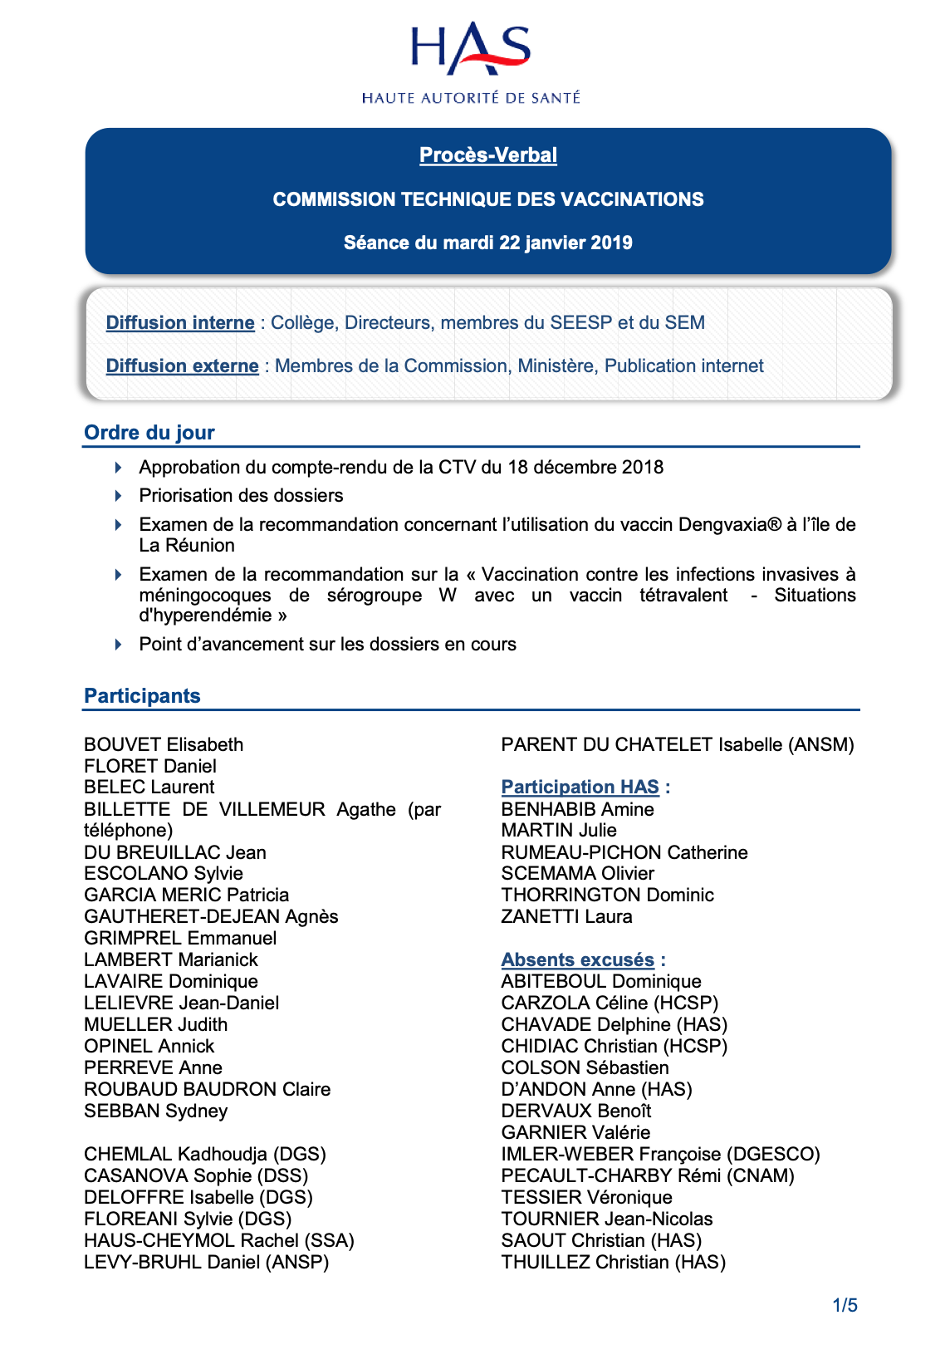
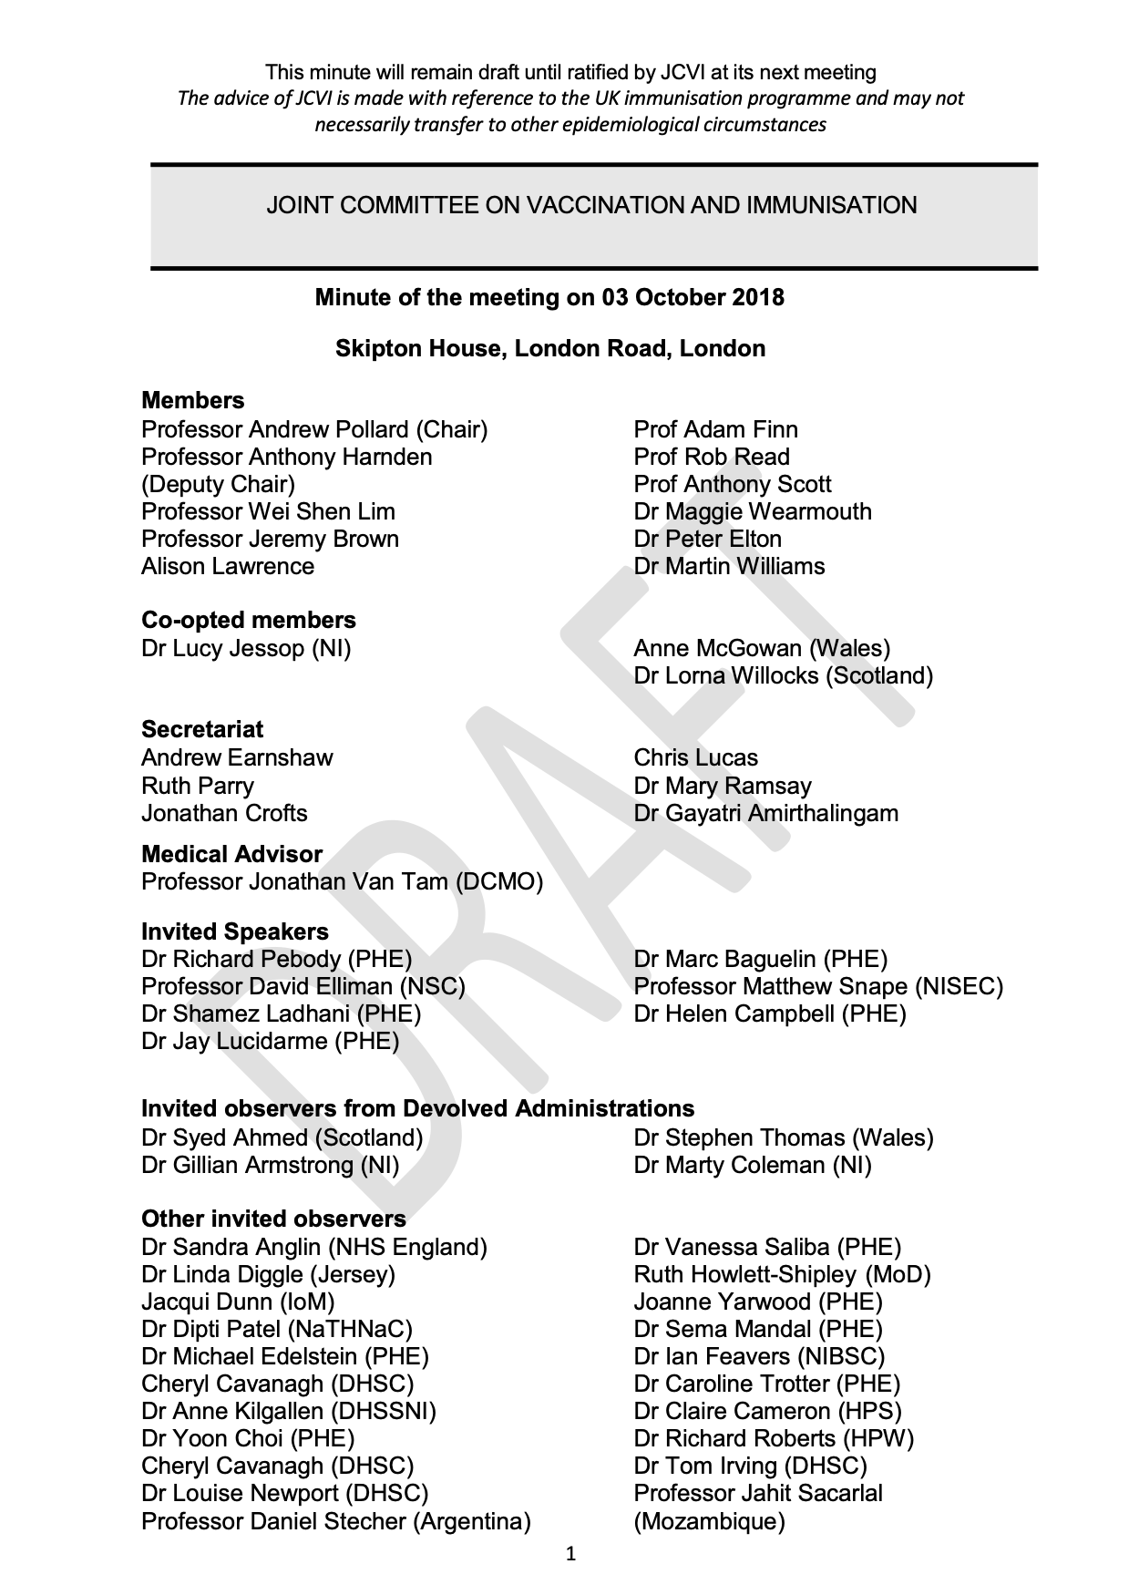


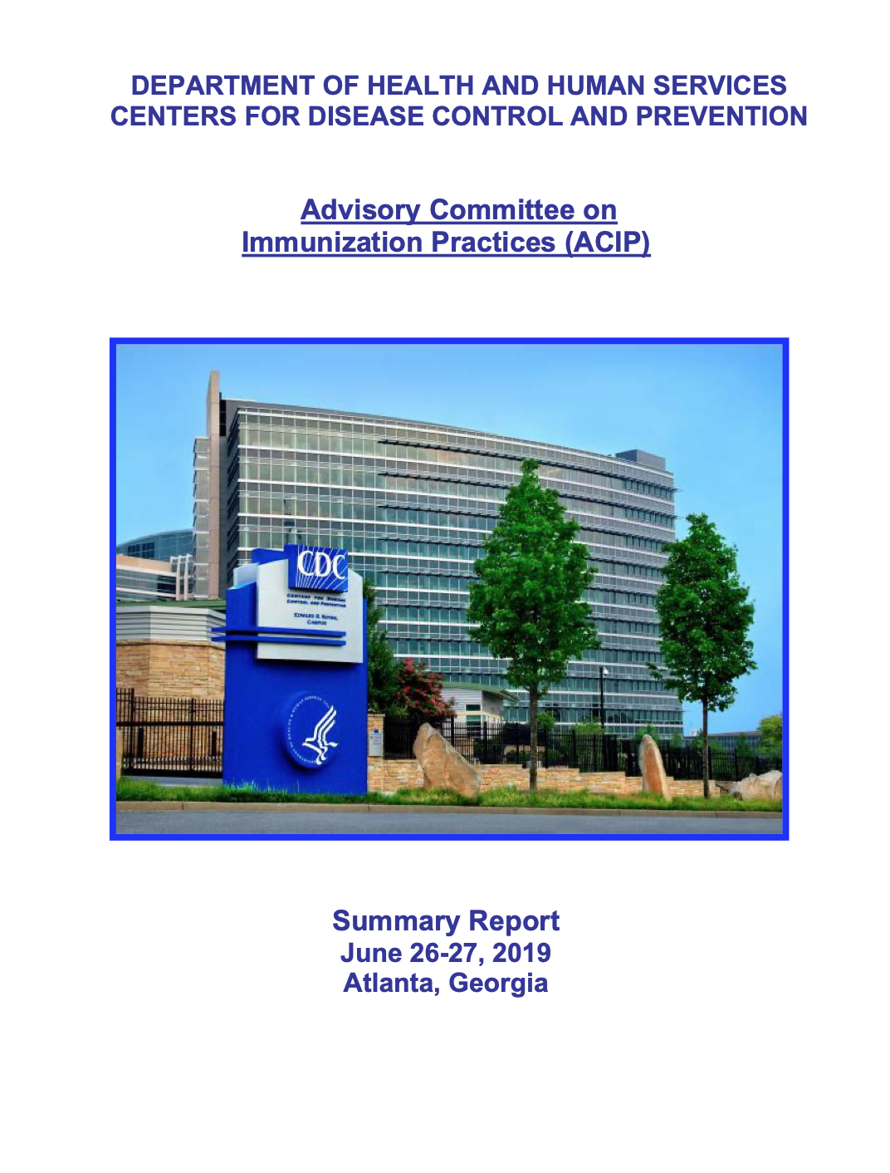
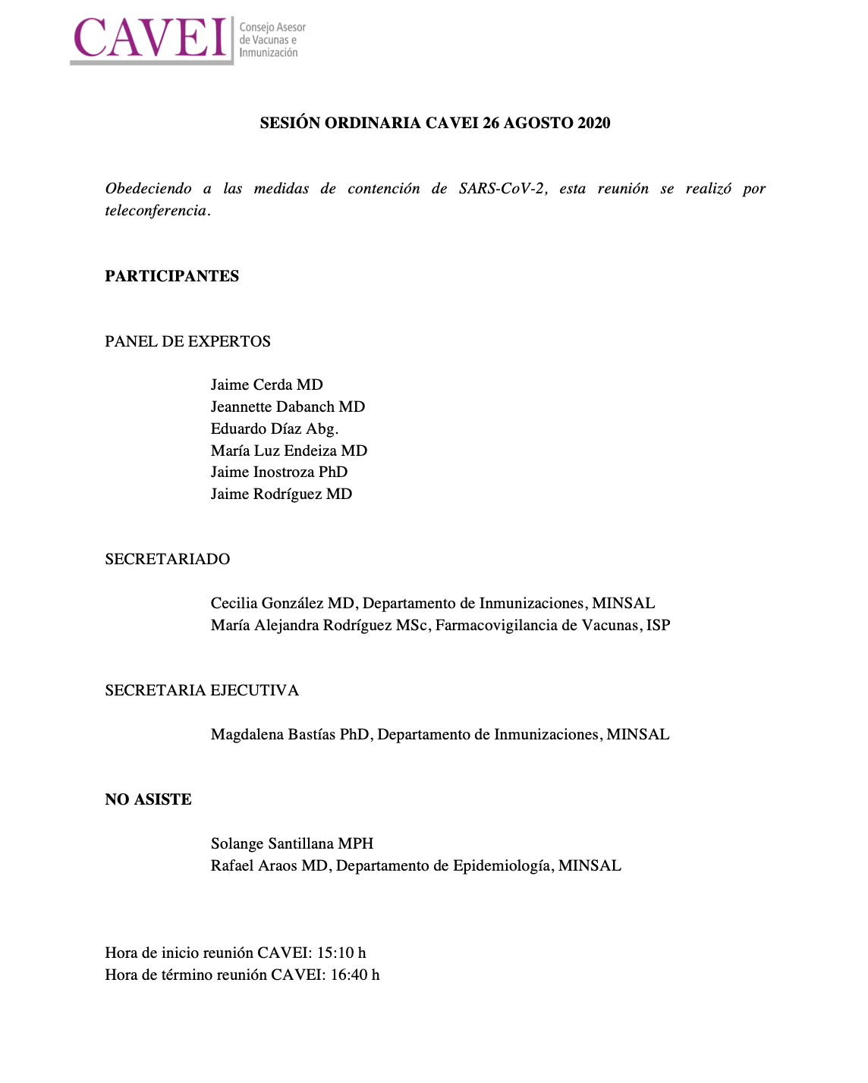


Example of minutes
CTV, France
JCVI, UK
ACIP, USA
CAVEI, Chile

Slide 7


Report of Recommendations to MoH
WHO IS IT FOR?
  MoH decision-makers
WHO DOCUMENTS IT?
  The secretariat drafts the recommendations based on NITAGs decisions and sends it to the MoH
  The MoH receives the recommendations and can decide whether to accept/implement them
  The recommendations must be archived by the secretariat in a dedicated folder or on the website along with the rest of the important NITAG meeting documents
  The recommendation sent to the MoH should ideally not exceed 2-4 pages but a more detailed report on how the decisions were formulated can be drafted and published on the website
PURPOSE:
  Provide a summary of the evidence supporting the recommendation, rationale for decision
  Support decision-making

Slide 8

Report of Recommendations to MoH
FORMAT
  Consistent, clear, logical flow, short (ideally less than 2-4 pages)
  Standard format
    Specify the MoH focal point and procedures of communications in the NITAG Charter or other documentation.
CONTEXT OF THE QUESTION
  What is the question?
  Who added the topic to the NITAG agenda?
      → Was it in the annual work plan, or suggested by the Ministry of Health or a NITAG member?
  Why was the topic added to the agenda?
      → Opportunity of introduction of a new vaccine, ongoing epidemic, new data on vaccine efficacy or disease burden?
?

Slide 9
Content of Recommendations to MoH
1
General information on the subject:
Brief description of the problem identified
2
Describe the evidence search process
3
Findings on the disease, health systems and context issues, systematic reviews or literature reviews which were taken into account in the recommendation framework
4
The implementation considerations
5
Discussion of the evidence
6
Proposed recommendation clearly formulated
Notes:
Evidence search process: to be transparent and accessible to policymakers and stakeholders (mostly unfamiliar with research language)

Slide 10
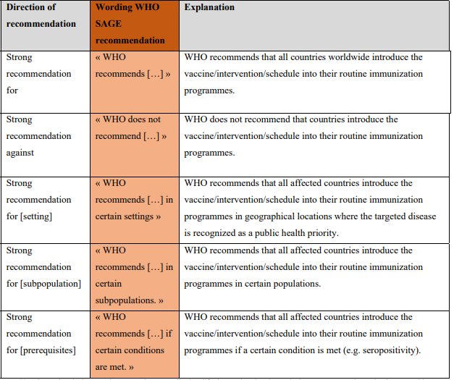
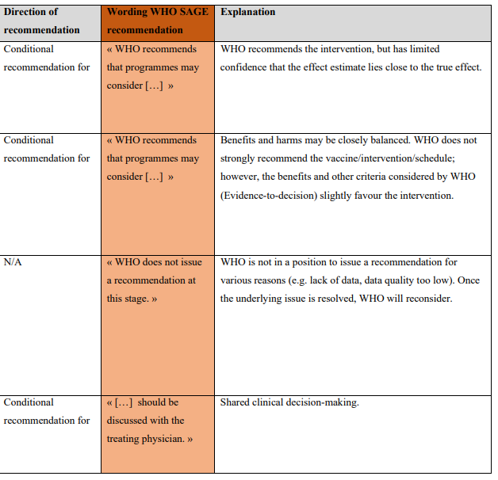

WHO standardized wording by scenario
Strong recommendation
Weak recommendation
Notes:
https://iris.who.int/bitstream/handle/10665/376622/9789240090729-eng.pdf?sequence=1

Slide 11
Checklist: Suggested sections for the MoH report
✅ Policy question
✅ Disease burden
✅ Vaccine efficacy and risks
✅ Economics
✅ Programmatic considerations
✅ Values
✅ Recommendation specifying vaccine, age groups, number of doses and schedule, if relevant

Slide 12
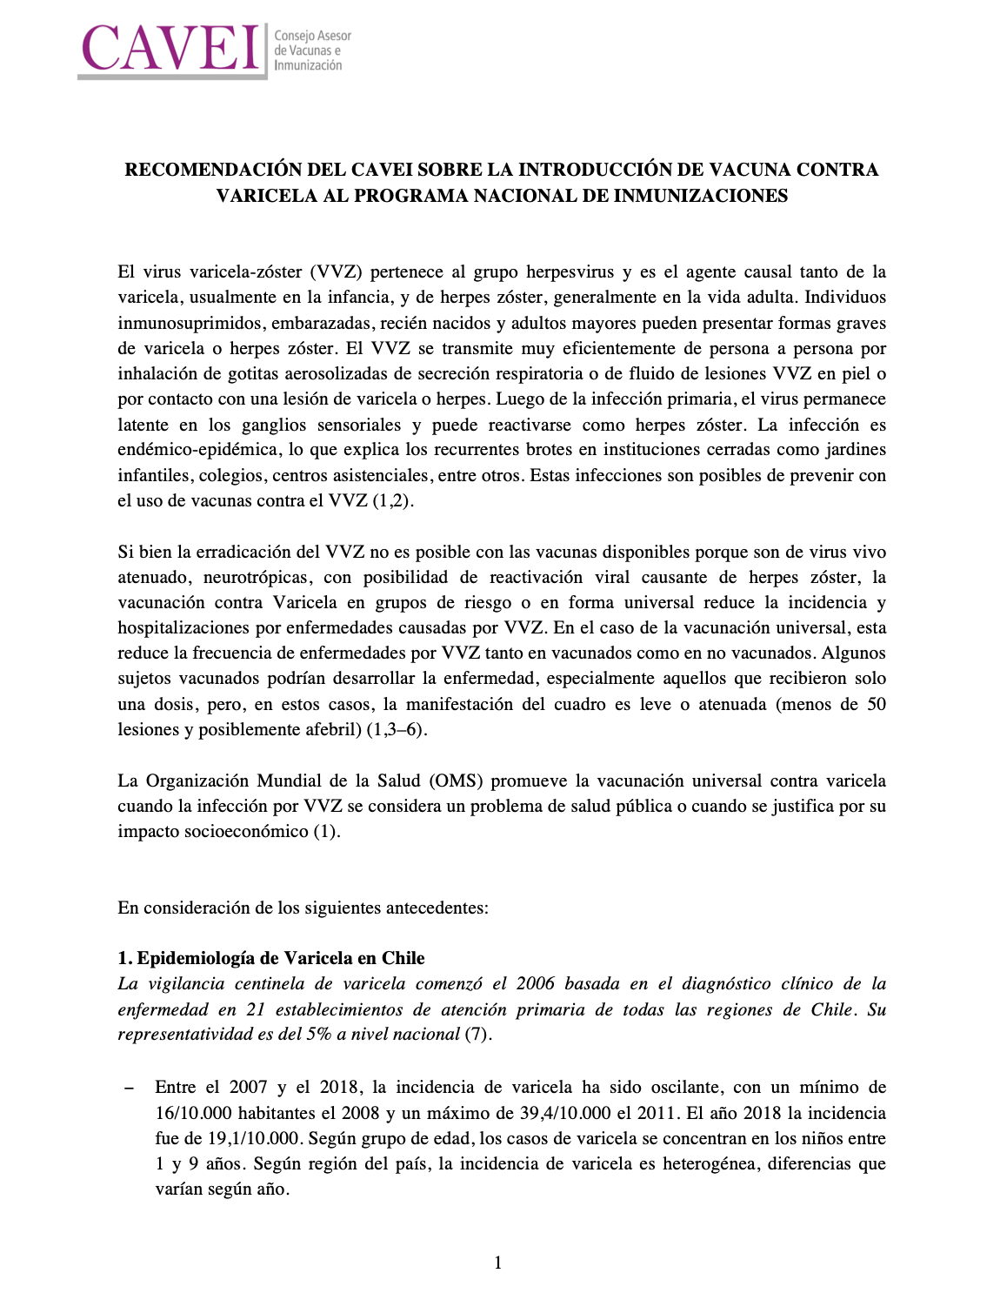

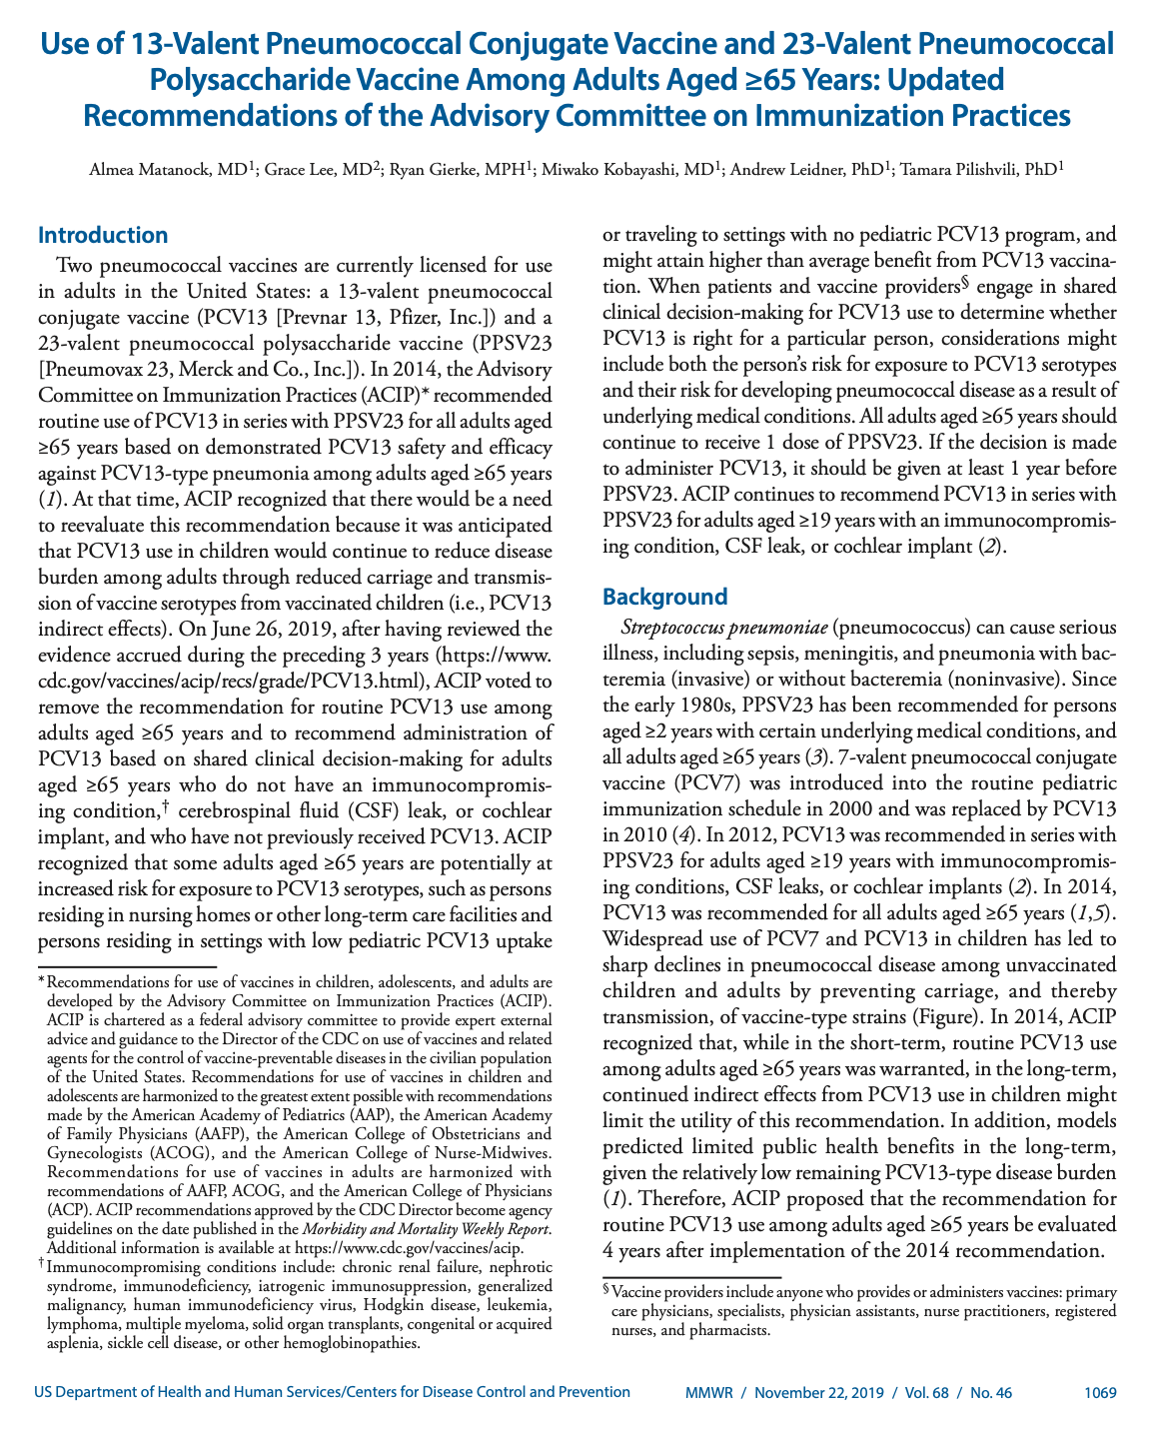
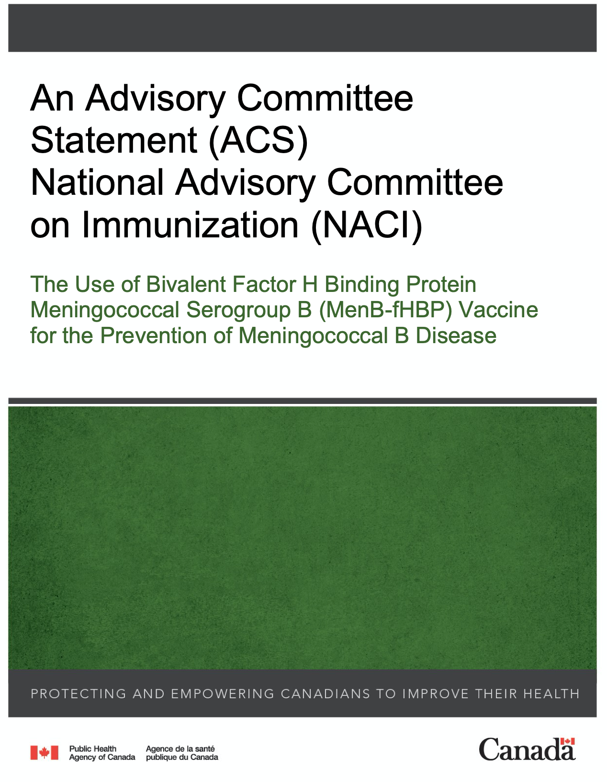

Example
Examples of more detailed report of recommendations that can be published:
Chile
USA
Canada
France

Slide 13


Check-in Activity
MoH has requested a recommendation on whether to introduce Rotavirus vaccine (RVV) in the routine schedule.
After the presentation of proposed recommendations by the WG, the NITAG voted and accepted one recommendation. The person who usually summarizes and writes the meeting minutes was not present. Another member (Mr. X) completed this task. The final 18-page minutes produced by Mr. X included detailed suggestions that the policy makers might consider and highlighted a few aspects that the MoH must avoid during the implementation process.
Mr. X then sent off the document to the MoH. Two weeks later he learned that the document had been inadvertently sent to the wrong official.
What are the main problems in this scenario?
What do you think can be done to prevent such a situation from happening again?
Notes:
Notes for discussion:
Part 1:
Length of the document – 18 pages contains too much detail for decision-making level at the MoH. The document should briefly and clearly lay out the recommendations and justification.
Content of the document – wordings (focus on ‘Do’s’ and not ‘Don’t’ / use strongly worded recommendation – not ‘suggestions’’. Avoid the phrasing of ’might’)
Lack of clear focal points and procedures to communicate recommendations to the MoH
Part 2:
1) Develop a standard format for communicating recommendations to the MoH.
2) Specify the MoH focal point and procedures of communications in the NITAG Charter or other documentation.
3) All NITAG members must review the meeting minutes and approve it

Slide 14
Websites: Dissemination to the general public
WHO IS IT FOR?
  General public
WHO SHOULD OVERSEE THE DOCUMENTATION FOR THE WEBSITE
  The secretariat must oversee and approve the documents to be uploaded on the website
WHERE SHOULD THE WEBSITE BE HOSTED?
  It should be hosted as a subsection under the website of the Secretariat
PURPOSE AND BENEFITS
  Advocacy and recognition for your NITAG
  Helps enhance credibility, transparency and trust
  Helps attract and recruit experts
+

Slide 15
Checklist: Potential items to include on the NITAG websites
✅ A short bio with the NITAG’s terms of reference
✅ List of the NITAG members and their background (helps show diversity in expertise)
✅ Declaration of interests (helps increase transparency)
✅ Current working groups
✅ Yearly workplan
✅ Meeting agenda and minutes if possible
✅ The NITAG’s recommendation reports (helps increase transparency)

Slide 16
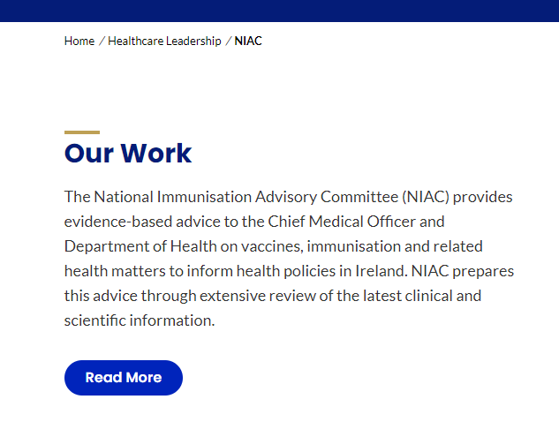
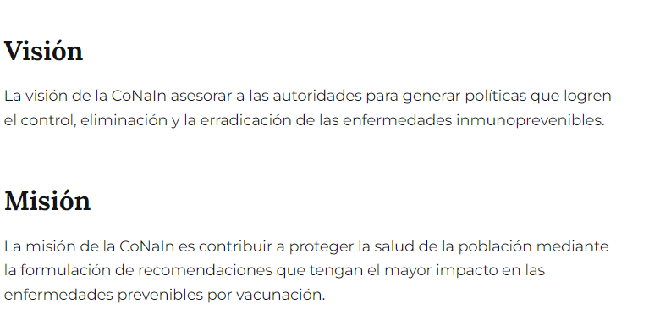
State the NITAG’s mission
  Good introduction for the layperson
  Ensure the user is on the right platform
  Clarify roles and responsibility
https://www.argentina.gob.ar/salud/inmunoprevenibles/comisiones-de-la-direccion-de-control-de-enfermedades-inmunoprevenibles
https://www.rcpi.ie/Healthcare-Leadership/NIAC

Slide 17
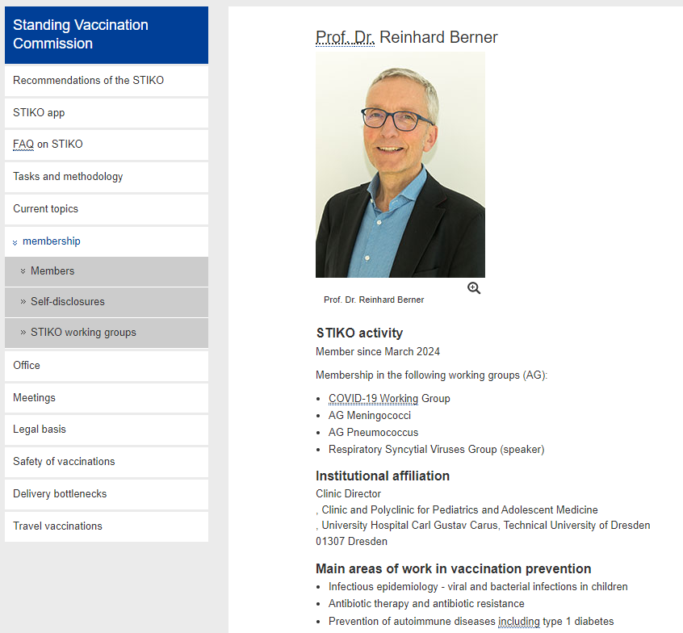
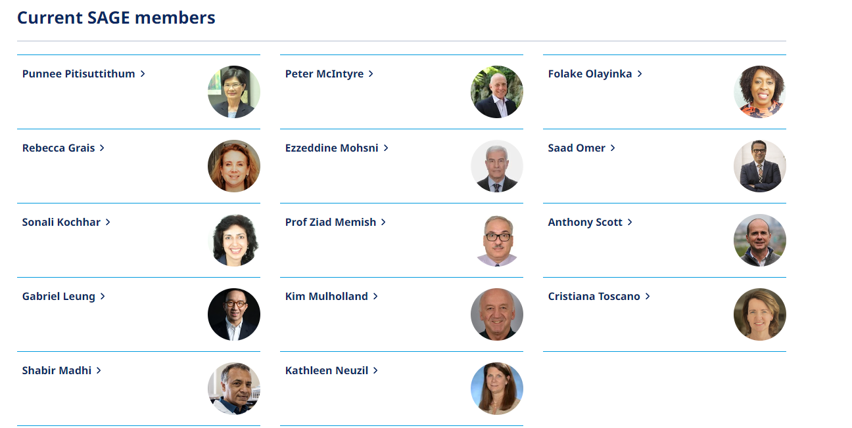
Introduce the members
  Make the work human
  Promote the behind the scene work
  Help recruit new members
  Increase transparency
https://www.rki.de/DE/Content/Kommissionen/STIKO/Mitgliedschaft/Mitglieder/mitglieder_node.html

Slide 18
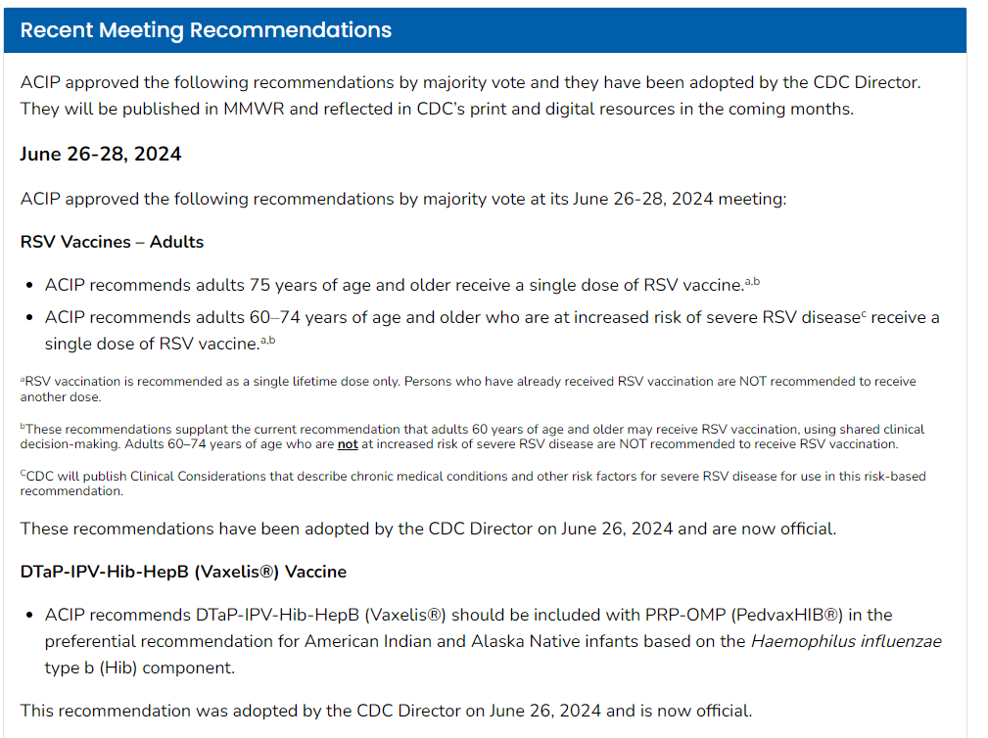
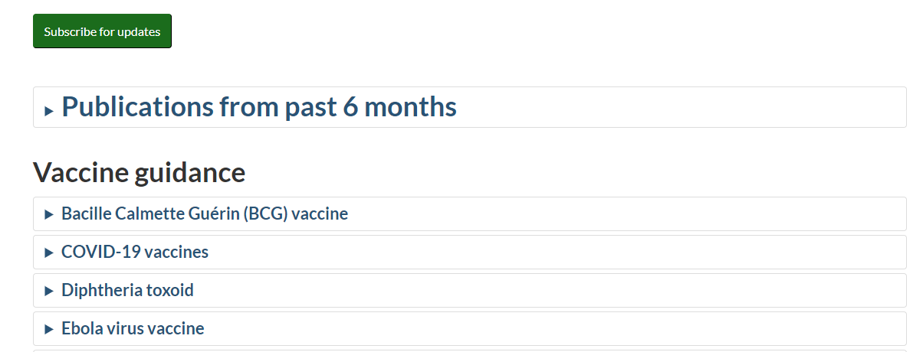
Highlighting the latest recommendations
  Show the NITAG is active
  Flag recent updates to recommendations (especially useful in case of pandemic response, new vaccines)
  Straightfoward: most users are coming back to the NITAG website to find recommendations
https://www.cdc.gov/vaccines/acip/recommendations.html

Slide 19

Publication of recommendations (Optional)
WHO IS IT FOR?
  Scientific community, researchers
WHO DOCUMENTS IT?
  Can be initiated by the Secretariat, Chair or the Work Group Lead
PURPOSE
  Provides technical details and rationale for decision
  Lends credibility to recommendations
BENEFITS
  Spreads awareness of ongoing updates in the field – e.g.: introduction of a new dose or significant change in vaccination dose to a specific population group, etc.
  Visibility and credibility for your NITAG
FORMAT
  Depends on journal
CONTENT
  What does the scientific community need to know?
    Vaccine, target population, age, doses, schedule, delivery strategy, AEFI surveillance
    Technical rationale
+

Slide 20
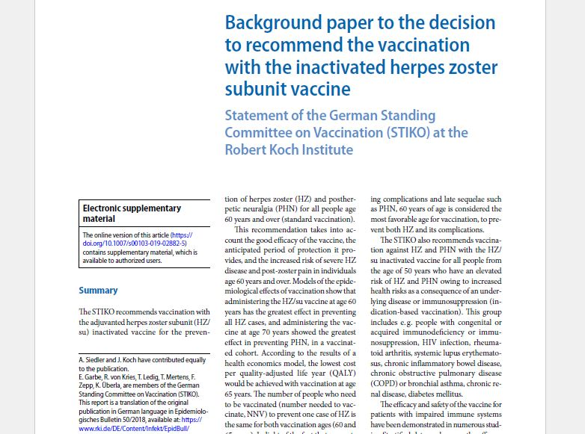
Example
⤵️
Background paper to the decision to recommend the vaccination with the inactivated herpes zoster subunit vaccine in Germany
https://link.springer.com/content/pdf/10.1007%2Fs00103-019-02882-5.pdf

Slide 21
Takeaway messages
Documentation is important
  Within 24 hours, most people forget an average of 70% of new information → immediate and clear documentation is key
  Documentation helps with visibility, credibility and smooth operations for all NITAGs
Standardize all your documentation templates to bring consistency and ensure smooth functioning
Assign a person responsible to record and archive all documents
Designate a focal point at your NITAG and at the MoH to ease the communication channel and collaboration
Record and archive all documents efficiently

Slide 22
Thank you for your attention!

