Slide 1
New vaccines Introduction Prioritization and Sequencing Framework
Introduction to the approach and methodology
Date of online session

Slide 2
Agenda
To be updated by country
Time | Activity | Responsible
15 minutes | Introductions and Objectives | TBD
30 minutes | Approach and methodology | TBD
45 minutes | Criteria | TBD
15 minutes | Workplan | TBD
15 minutes | Online questionnaire | TBD

Slide 3
Agenda
1
Introductions and Objectives
2
Approach and Methodology
3
Workplan
4
Prioritization Criteria
5
Online Questionnaire

Slide 4
Context: Countries are pushed to introduce more and more vaccines, potentially resulting in the entire EPI being overwhelmed and unable to deliver
Countries & NITAGs are facing increased pressure to introduce new vaccines and NVI recommendations are often siloed…
…resulting in the adoption of ambitious new vaccine introduction roadmaps built without an adequate process…
… which bears risks on the immunization programs
Political agenda
Example
Absence of financial sustainability
Vaccine | Disease | Year
RTS, S/AS 01 | Malaria | 2024
RR | Measles & Rubella | 2024
Rotarix | Rotavirus | 2024/2025
R21-Matrix-M | Malaria | 2024/2025
Gardasil | HPV | 2026
Shanchol/Euvichol | Cholera | 2026
HepB | Hepatitis B | 2027
TCV | Typhoid | 2028
Donors’ agenda
Inability for the program to deliver
Recommendations from experts
Competition for resources between vaccine programs
Public and media
pressure
Competition for resources with other health programmes
Regional & neighboring countries expectations
Lower acceptability & demand

Slide 5
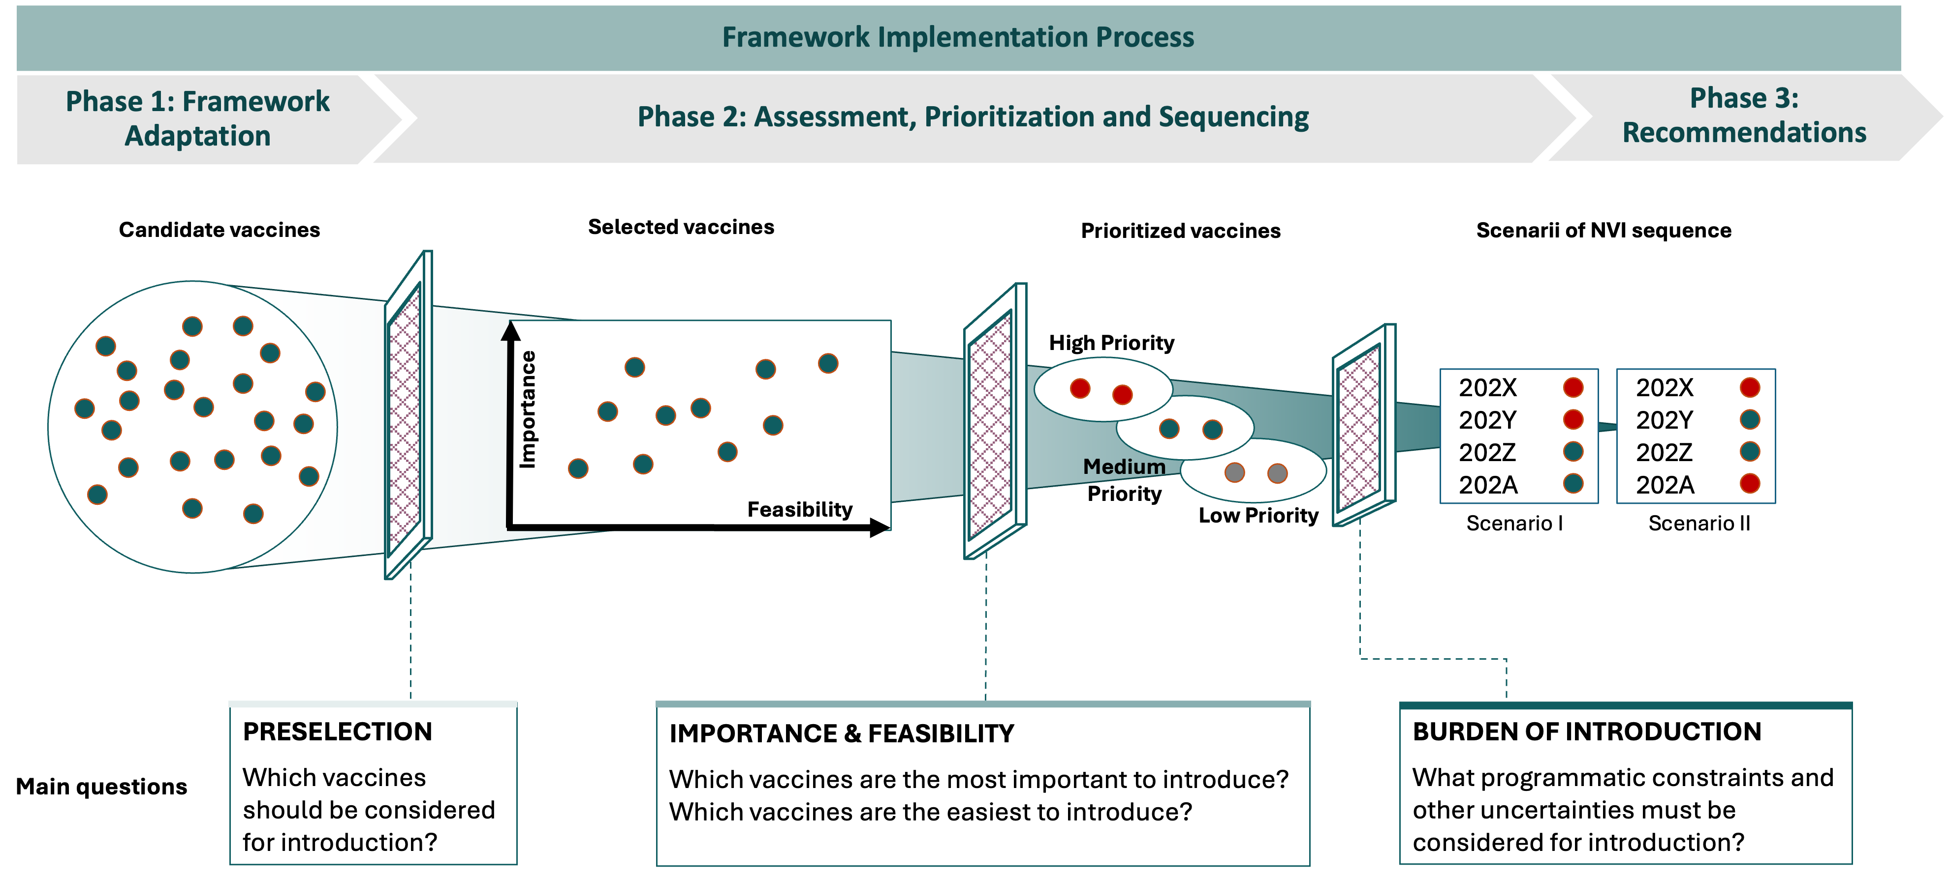
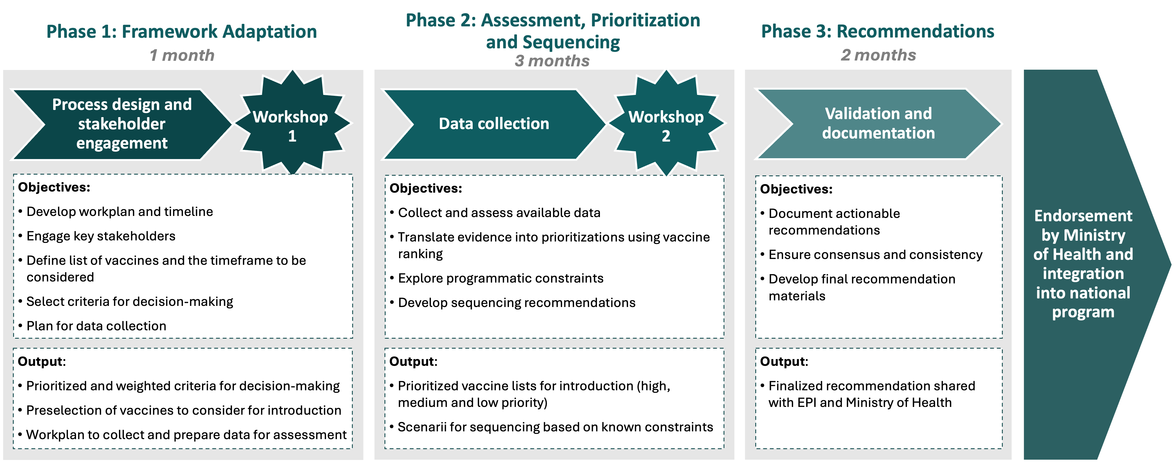
The NITAG will adapt and apply the NVI Prioritization Framework to prioritize new vaccine introductions and produce sequencing recommendations
The NVI Prioritization Framework is a proven NITAG-driven framework supporting the prioritization of new vaccine introductions. It leverages a simple, evidence-based and comprehensive approach to support the preparation of NVI sequencing scenarios based on a pre-hierarchized list of potential criteria. It was developed in alignment with existing tools (VIS, EtR) to ensure the consistency of the process
Today’s objectives
Review the NVI Prioritization Framework methodology
Discuss the expected process and timeline
Review the comprehensive criteria list
Distribute online questionnaire to inform critical decision points for adapting the framework

Slide 6
Agenda
1
Introductions and Objectives
2
Approach and Methodology
3
Workplan
4
Prioritization Criteria
5
Online Questionnaire

Slide 7
The NVI Prioritization Framework has been built to be evidence-based, simple yet comprehensive, iterative and to allow for tweaks based on countries own priorities
Evidence-based
Decisions on sequencing are often influenced by national and international agenda and rely on opinions rather than facts
This framework relies on measurable evidence to ensure consistency of decision-making through time
Simple
Existing tools and processes either refer to overabundant criteria or to no criteria at all
This framework refers to a limited number of criteria which will be selected by the NITAG
The selected criteria should allow the NITAG to answer simple but crucial questions.
Comprehensive
Decisions regarding vaccine introductions are often taken independently and with different processes based on the nature of the decision
This framework is designed to be comprehensive in terms of vaccines and type of country
Adaptative
To allow for better appropriation by countries, the prioritization framework will be discussed and adapted by the NITAG, which will be done mainly through the addition or removal of secondary criteria and the selection of candidate vaccines
Iterative
Current decision-making on NVI sequencing is done on a reactive basis, often to answer requests from technical partners or submit grant applications to donors
This exercise can be conducted by the NITAGs on a recurring basis to ensure adaptation to evolving research and markets
Sources: discussions with WHO/GAVI, Capaciti manual

Slide 8
The vaccine introduction prioritization funnel relies on a series of assessments and decisions based on a sub-set of pre-selected criteria
Framework Implementation Process
Phase 1: Framework Adaptation
Phase 2: Assessment, Prioritization and Sequencing
Phase 3: Recommendations
Candidate vaccines
Selected vaccines
Prioritized vaccines
Scenarii of NVI sequence
High Priority vaccines
202X
202Y
202Z
202A
202X
202Y
202Z
202A
Importance
Feasibility
Medium Priority vaccines
Scenario I
Scenario II
Main questions
PRESELECTION
Which vaccines should be considered for introduction?
IMPORTANCE & FEASIBILITY
Which vaccines are the most important to introduce? Which vaccines are the easiest to introduce?
BURDEN OF INTRODUCTION
What programmatic constraints and other uncertainties must be considered for introduction?

Slide 9
The NITAG will adapt and apply the NVI Prioritization Framework to produce evidence-based prioritization and sequencing recommendations to be disseminated to the authorities.
Phase 1: Framework Adaptation
Phase 2: Assessment, Prioritization and Sequencing
Phase 3: Recommendations
1 month
3 months
2 months
Workshop
1
Workshop
2
Endorsement by Ministry of Health and integration into national program
Process design and stakeholder engagement
Data collection
Validation and documentation
Objectives:
Develop workplan and timeline
Engage key stakeholders
Define list of vaccines and the timeframe to be considered
Select criteria for decision-making
Plan for data collection
Objectives:
Collect and assess available data
Translate evidence into prioritizations using vaccine ranking
Explore programmatic constraints
Develop sequencing recommendations
Objectives:
Document actionable recommendations
Ensure consensus and consistency
Develop final recommendation materials
Output:
Prioritized and weighted criteria for decision-making
Preselection of vaccines to consider for introduction
Workplan to collect and prepare data for assessment
Output:
Prioritized vaccine lists for introduction (high and medium priority)
Scenarii for sequencing based on known constraints
Output:
Finalized recommendation shared with EPI and Ministry of Health

Slide 10
Agenda
1
Introductions and Objectives
2
Approach and Methodology
3
Workplan
4
Prioritization Criteria
5
Online Questionnaire

Slide 11
NVI Prioritization Workplan
To be updated by country
 |  | Month |  |  |  | Month |  |  |  | Month |  |  |  | Month |  |  |  | Month |  |  |  | Month
Activities | Lead / Support | Week | Week | Week | Week | Week | Week | Week | Week | Week | Week | Week | Week | Week | Week | Week | Week | Week | Week | Week | Week | Week | Week | Week | Week | Week
Phases
Methodology
Review
Validation
Workshops
Date
ToR & Budgeting
Logistics
Agenda & invite
Documents
Facilitation
Data
Retrieval
Iterations
Analysis / presentation
Recommandations
Finalization
Review with EPI
ICC
NIS integration
Phase I
Phase II
Phase III
Workshop 1
Workshop 2
Online session (today)

Slide 12
Agenda
1
Introductions and Objectives
2
Approach and Methodology
3
Workplan
4
Prioritization Criteria
5
Online Questionnaire

Slide 13
An extensive literature review was carried out to create a comprehensive list of criteria
Title | Year | Author(s)
An analytical framework for immunization programs in Canada | 2004 | L.J. Erickson, P. De Wals, L. Farand
National decision-making on adopting new vaccines: a systematic review | 2011 | Burchett et al.
New vaccine adoption: qualitative study of national decision-making processes in seven low- and middle-income countries | 2012 | Burchett et al.
Ranking Vaccines: A Prioritization Framework: Phase I: Demonstration of Concept and a Software Blueprint | 2012 | Guruprasad Madhavan, Kinpritma Sangha, Charles Phelps, Dennis Fryback, Tracy Lieu, Rose Marie Martinez, and Lonnie King
SAGE Guidance for the development of evidence-based vaccination- related recommendations | 2017 | WHO
National decision-making for the introduction of new vaccines: A systematic review, 2010–2020 | 2021 | Morgane Donadel, Maria Susana Panero, Lynnette Ametewee, Abigail M. Shefer
Factors influencing the prioritization of vaccines by policymakers in low- and middle-income countries: a scoping review | 2022 | Guillaume et al.
The Use of Multicriteria Decision Analysis to Support Decision Making in Healthcare: An Updated Systematic Literature Review | 2023 | Pamela Gongora-Salazar, MSc, Stephen Rocks, MSc, Patrick Fahr, DPhil, Oliver Rivero-Arias, DPhil
CAPACITI Tool & Manual |  | WHO
Vaccine Investment Strategy (VIS) process |  | GAVI

Slide 14
These criteria relate to 10 topics and are categorized based on the prioritization stage
Disease and vaccine
External factors
Program factors
Prioritization stage
Burden & epidemiology of the disease
Market availability
Strategy
Importance
Finances & economics
Logistics
Feasibility
Benefits of the vaccine
Legal & ethical
Service delivery
Vaccine safety
Acceptability of the vaccine

Slide 15
71 criteria have been identified
Criterion | Category | Sud-category
Ethical, programmatic, reputational or social issues that may affect acceptability of the vaccine to the target population (e.g. reputation of the country producer, halal) | Acceptability of the vaccine | Perception of target population of the vaccine
Level of use in HICs, thought-leader or neighbouring countries (e.g. related to safety) | Acceptability of the vaccine | Perception of target population of the vaccine
Perception of the target population of the disease risk, severity, fear and demand for disease control | Acceptability of the vaccine | Perception of target population of the disease
Perception of the target population on the desirable and undesirable effects of the vaccine | Acceptability of the vaccine | Perception of target population of the vaccine
Acceptability of schedule (e.g. multiple injections, additional visits) | Acceptability of the vaccine | Perception of target population of the vaccine
Availability of resources for marketing and communication | Acceptability of the vaccine | Demand generation
Coverage of active serogroups or serotypes in the country | Benefits of the vaccine | Direct impact
Effectiveness of the vaccine including in different populations/age groups/cohorts | Benefits of the vaccine | Direct impact
Efficacy and immunogenicity of the vaccine in target population | Benefits of the vaccine | Direct impact
Duration of protection and waning of immunity | Benefits of the vaccine | Direct impact
Number needed to vaccinate to prevent a case | Benefits of the vaccine | Direct impact
Impact on resistance to antibiotics & antivirals | Benefits of the vaccine | Indirect impact
Herd immunity / protection | Benefits of the vaccine | Indirect impact
Effect of the vaccine on transmission | Benefits of the vaccine | Indirect impact
Cost of the disease to the health system | Burden & epidemiology | Economic impact
Direct & indirect costs to patient & families | Burden & epidemiology | Economic impact
Short- and long-term use of health care (e.g. treatments, hospitalization) | Burden & epidemiology | Economic impact
Productivity losses e.g. linked to work & school absenteeism linked to the disease | Burden & epidemiology | Economic impact
Burden inequity | Burden & epidemiology | Epidemiology
Incidence including in different sociodemographic and age groups | Burden & epidemiology | Epidemiology
Prevalence including in different sociodemographic and age groups | Burden & epidemiology | Epidemiology
Outbreak potential incl. past occurrence of outbreaks and potential for international spread, and epidemic and pandemic risk | Burden & epidemiology | Epidemiology
Hospitalization rate | Burden & epidemiology | Health impact
Mortality and lethality incl. in different sociodemographic and age groups | Burden & epidemiology | Health impact
Intensity of suffering/severity of disease symptoms | Burden & epidemiology | Social impact
Long-term complications of disease | Burden & epidemiology | Social impact
Disability-adjusted life years (DALYs) | Burden & epidemiology | Social impact
Loss of quality-adjusted life years (QALYs) | Burden & epidemiology | Social impact
Absence of satisfactory alternatives to prevent/treat the disease | Burden & epidemiology | Alternatives
Social and economic benefits including reduction in health care costs, improvement in life expectancy, in quality of life for individuals, families, caregivers and communities, productivity gains | Finances & economics | Benefits
Indirect benefits (i.e. reduced antimicrobial resistance, reduced emergency room overcrowding) | Finances & economics | Benefits
Direct costs (cost of vaccine, materials, vaccinators, delivery) | Finances & economics | Cost
Indirect costs (e.g. training of health-care workers, supply chain expenses) | Finances & economics | Cost
Perspective on vaccine price | Finances & economics | Cost
Availability and sustainability of funding to cover the total cost of the program (incl. GAVI eligibility) | Finances & economics | Cost
Criterion | Category | Sub-category
Net present cost benefit ratios (from health care and societal perspectives) of vaccine vs. alternative strategies (per life saved, case prevented, life year gained, quality-adjusted life year gained) | Finances & economics | Ratio
Absence of legal constraints concerning use of vaccine (i.e. departure from manufacturers’ recommendations/off license use of the vaccine, mandatory, recording, potential compensation for adverse events, incentives) | Legal & Ethical | Legal
Licensing by foreign NRA | Legal & Ethical | Legal
Prequalified by WHO | Legal & Ethical | Legal
Licensing by national RA | Legal & Ethical | Legal
Accessibility and equity of vaccination for the target population | Legal & Ethical | Ethical
Ethical, market and diplomatic issues that may affect acceptability of the vaccine to stakeholders | Legal & Ethical | Ethical
Compatibility of the presentation of the vaccines with the expected uses in the country (e.g. to population spread in the country) | Logistics | Product aspect
Ease of conservation (volume & cold chain requirements) | Logistics | Cold Chain
Shelf life of the vaccine | Logistics | Cold Chain
Availability of adequate cold chain equipment at all levels or ability to procure CCE required to store the vaccine | Logistics | Cold Chain
Readiness of the existing distribution channels in the country | Logistics | Distribution
Indicative wastage rate | Logistics | Wastage
Ability to maintain wastage at expected levels | Logistics | Wastage
Ability to manage waste | Logistics | Wastage
Adequacy of the labels to the local language | Logistics | Product aspect
Market availability of the vaccine and supplies over the selected time period | Market availability | Availability
Sustainability of the market availability of the vaccine and supplies in the longer term | Market availability | Availability
Ease of procurement of the vaccine | Market availability | Procurement
Safety issues related to the product being similar to an existing vaccines or drugs | Vaccine safety | Safety
Risk at population level (e.g. risk of displacement of average age of infection, potential impact of strain selection or emergence of non-vaccine serotypes) | Vaccine safety | Safety
Risk at individual level incl. Type, severity, consequences and frequency of AEFI, including reactogenicity profile & capacity to mitigate known adverse events | Vaccine safety | Safety
Contraindications and precautions for vaccination (e.g. requirement to check background especially factoring risk groups or risk factors) | Vaccine safety | Safety
Interference with other vaccines regarding immunity/protection | Vaccine safety | Safety
Ease of preparation, reconstitution & administration (open-vial policy, CTC) | Service delivery | Human Resources
Expected impact of the introduction on the human resources | Service delivery | Human Resources
Impact on existing immunization services or other health sectors - risk of overload | Service delivery | Human Resources
Availability of information systems to manage the vaccine supply chain and measure related performance metrics (i.e. coverage and vaccine utilization) | Service delivery | Systems
Interchangeability with alternative or future products/presentations | Strategy | Opportunities
Contribution to national/regional/global goals (e.g., eradication, control, elimination, reduction) | Strategy | Opportunities
Opportunity to pair introduction with other planned program (e.g. other vaccine introduction or switch with same target population) | Strategy | Opportunities
Existing recommendations / guidelines for use (e.g. SAGE, professional organizations) | Strategy | Opportunities
Accessibility of the target population (age, gender, special risk) | Strategy | Target
Ease of the considered immunization strategies - incl. geographic (stepwise or nationwide) and target populations (selective/stepwise or universal) | Strategy | Introduction
Administration strategy (single dose, routine primary series only, booster, campaigns) | Strategy | Administration
Feasibility of the program delivery strategy (physicians, CHW, nurses, pharmacists, school-based) | Strategy | Administration

Slide 16
Criteria have been pre-classified as essential, important or other to ensure simplicity and readability of the framework – but the NITAG will finalize these classifications as relevant to their context and priorities.
Criteria were pre-classified based on:
Criteria classifications
Important
Essential
Other
1
Relative importance of criteria
Is this criteria more important for decision-making than other criteria?
Is there potential for the data to singularly impact decision-making?
2
Expected availability of data
Is there a reasonable expectation that country-specific data is available that is current, representative and credible?
Is there regional or global data that exists and is made available?
If no published evidence is expected to be available, are there experts that can provide advice and considerations?
Essential criteria will have a higher weight and are globally relevant
Important criteria will have a lower weight and should be chosen based on country-specific relevancy and priorities
3
Ability to easily differentiate among vaccines
Will the data vary sufficiently to differentiate between vaccines, or are all vaccines expected to have similar results?
Other criteria will have the lowest weight and are chosen based on country-specific relevancy and priorities.
The pre-classification presented in the following slides is only a starting point for discussion. The NITAG will have the final say on the criteria selected, including a 4th consideration for selection: applicability to the country’s context.

Slide 17
Criteria review: Burden & epidemiology of the disease
Sub-category | Criteria | Group | Type | Source type
Epidemiology | Burden inequity (highest prevalence in poorer / at risk populations / gender inequity) | Importance | Qualitative | Primary / Modeled
Epidemiology | Incidence including in different sociodemographic and age groups | Importance | Quantitative | Primary
 | Prevalence including in different sociodemographic and age groups | Importance | Quantitative | Primary
Epidemiology | Outbreak potential incl. past occurrence of outbreaks and potential for international spread, and epidemic and pandemic risk | Importance | Quantitative | Primary
Health impact | Hospitalization rate | Importance | Quantitative | Primary
Health impact | Mortality and lethality including in different sociodemographic and age groups | Importance | Quantitative | Primary
Social impact | Intensity of suffering/severity of disease symptoms | Importance | Quantitative | Modeled
 | Long-term complications of disease | Importance | Quantitative | Primary
 | Disability-adjusted life years (DALYs) | Importance | Quantitative | Modeled
 | Loss of quality-adjusted life years (QALYs) | Importance | Quantitative | Modeled
Economic impact of the disease | Cost of the disease to the health system | Importance | Quantitative | Primary / Modeled
 | Direct & indirect costs to patient & families | Importance | Quantitative | Modeled
 | Short- and long-term use of health care | Importance | Quantitative | Primary / Modeled
 | Productivity losses | Importance | Quantitative | Modeled
Alternatives | Absence of satisfactory alternatives to prevent/treat the disease | Importance | Qualitative | Primary
Essential
Important

Slide 18
Criteria review: Benefits of the vaccine
Sub-category | Criteria | Group | Type | Source type
Direct impact | Coverage of active serogroups or serotypes in the country (for serogroup- or serotype-specific vaccines) | Importance | Quantitative | Primary / Modeled
Epidemiology | Effectiveness of the vaccine including in different populations/age groups/cohorts | Importance | Quantitative | Primary
Epidemiology | Efficacy and immunogenicity of the vaccine in target population | Importance | Quantitative | Primary
 | Duration of protection and waning of immunity | Importance | Quantitative | Primary
 | Number needed to vaccinate to prevent a case | Importance | Quantitative | Primary
Indirect impact | Impact on resistance to antibiotics & antivirals | Importance | Quantitative / Qualitative | Primary / Modeled
 | Herd immunity / protection | Importance | Quantitative | Primary
 | Effect of the vaccine on transmission | Importance | Quantitative | Primary
Essential
Important

Slide 19
Criteria review: Vaccine safety
Sub-category | Criteria | Group | Type | Source type
Safety | Safety issues related to the product being similar to an existing vaccines or drugs | Feasibility | Qualitative | Primary
Epidemiology | Risk at population level (e.g. risk of displacement of average age of infection, potential impact of strain selection or emergence of non-vaccine serotypes) | Feasibility | Qualitative | Modeled
 | Risk at individual level incl. Type, severity, consequences and frequency of AEFI, including reactogenicity profile & capacity to mitigate known adverse events | Feasibility | Quantitative | Primary
Impact indirect | Contraindications and precautions for vaccination (e.g. requirement to check background especially factoring risk groups or risk factors) | Feasibility | Qualitative | Primary
Health impact | Interference with other vaccines regarding immunity/protection | Feasibility | Qualitative | Primary
Essential
Important

Slide 20
Criteria review: Market availability
Sub-category | Criteria | Group | Type | Source type
Availability | Market availability of the vaccine and supplies over the selected time period | Feasibility | Quantitative | Primary
 | Sustainability of the market availability of the vaccine and supplies in the longer term | Feasibility | Quantitative | Primary
Procurement | Ease of procurement of the vaccine (e.g. ability to procure through UNICEF, procurement timeline, delivery speed) | Feasibility | Qualitative | Primary
Essential
Important

Slide 21
Criteria review: Finances and economics
Sub-category | Criteria | Group | Type | Source type
Benefits | Social and economic benefits including reduction in health care costs, improvement in life expectancy, in quality of life for individuals, families, caregivers and communities, productivity gains | Importance | Quantitative | Modeled
 | Indirect benefits (i.e. reduced antimicrobial resistance, reduced emergency room overcrowding) | Importance | Qualitative | Modeled
Cost | Direct costs (cost of vaccine, materials, vaccinators, delivery) | Feasibility | Quantitative | Modeled
 | Indirect costs (e.g. training of health-care workers, supply chain expenses) | Feasibility | Quantitative | Modeled
 | Perspective on vaccine price | Feasibility | Quantitative | Expert opinion
 | Availability and sustainability of funding to cover the total cost of the program (incl. GAVI eligibility) | Feasibility | Quantitative | Primary
Ratio | Net present cost benefit ratios (from health care and societal perspectives) of vaccine vs. alternative strategies (per life saved, case prevented, life year gained, quality-adjusted life year gained) | Importance | Quantitative | Modeled
Essential
Important

Slide 22
Criteria review: Legal and ethics
Sub-category | Criteria | Group | Type | Source type
Legal | Absence of legal constraints concerning use of vaccine (i.e. departure from manufacturers’ recommendations/off license use of the vaccine, mandatory, recording, potential compensation for adverse events, incentives) | Preselection | Yes/no | Primary
 | Licensing by foreign NRA | Preselection | Yes/no | Primary
Coût | Prequalified by WHO | Preselection | Yes/no | Primary
 | Licensing by national RA | Preselection | Yes/no | Primary
Ethical | Accessibility and equity of vaccination for the target population | Feasibiliy | Qualitative | Expert opinion
Ratio | Ethical, market and diplomatic issues that may affect acceptability of the vaccine to stakeholders | Preselection | Yes/no | Primary
Essential
Important

Slide 23
Criteria review: Strategy
Sub-category | Criteria | Group | Type | Source type
Opportunities | Interchangeability with alternative or future products/presentations | Feasibility | Qualitative | Primary
 | Contribution to national/regional/global goals (e.g., eradication, control, elimination, reduction) | Importance | Quantitative/ qualititative | Primary
 | Opportunity to pair introduction with other planned program (e.g. other vaccine introduction or switch with same target population) | Feasibility | Yes/no | Primary
 | Existing recommendations / guidelines for use (e.g. SAGE, professional organizations) | Importance | Yes/no | Primary
Target | Accessibility of the target population (age, gender, special risk) | Feasibility | Qualitative | Primary / Modeled
Introduction | Ease of the considered immunization strategies - incl. geographic (stepwise or nationwide) and target populations (selective/stepwise or universal) | Feasibility | Qualitative | Primary
Administration | Administration strategy (single dose, routine primary series only, booster, campaigns) | Feasibility | Qualitative | Primary
Health impact | Feasibility of the program delivery strategy (physicians, CHW, nurses, pharmacists, school-based) | Feasibility | Qualitative | Expert opinion
Essential
Important

Slide 24
Criteria review: Logistics
Sub-category | Criteria | Group | Type | Source type
Cold chain | Ease of conservation (volume & cold chain requirements) | Feasibility | Qualitative | Primary
 | Shelf life of the vaccine | Feasibility | Qualitative | Primary
 | Availability of adequate cold chain equipment at all levels or ability to procure CCE required to store the vaccine | Feasibility | Quantitative | Primary
Distribution | Readiness of the existing distribution channels in the country | Feasibliity | Qualitative | Modeled / expert opinion
Wastage | Indicative wastage rate | Feasibility | Quantitative | Primary
Disponibilité | Ability to maintain wastage at expected levels | Feasibility | Qualitative | Expert opinion
 | Ability to manage waste | Feasibility | Qualitative | Primary
Product aspect | Compatibility of the presentation of the vaccines with the expected uses in the country (e.g. to population spread in the country) | Feasibility | Qualitative | Primary
 | Adequacy of the labels to the local language | Feasibility | Yes/no | Primary
Essential
Important

Slide 25
Criteria review: Service delivery
Sub-category | Criteria | Group | Type | Source type
Human resources | Ease of preparation, reconstitution & administration (open-vial policy, CTC) | Feasibility | Qualitative | Modeled / expert opinion
Disponibilité | Expected impact of the introduction on the human resources (e.g. additional workload due to the schedule, complexity of the administration, flexibility of the schedule, level of training requirements for human resources) | Feasibility | Qualitative | Modeled / expert opinion
 | Impact on existing immunization services or other health sectors - risk of overload | Feasibility | Qualitative | Expert opinion
Systems | Availability of information systems to manage the vaccine supply chain and measure related performance metrics (i.e. coverage and vaccine utilization) | Feasibility | Yes/no | Primary
Essential
Important

Slide 26
Criteria review: Acceptability of the vaccine
Sub-category | Criteria | Group | Type | Source type
Perception of target population of the vaccine | Ethical, reputational or social issues that may affect acceptability of the vaccine to the target population (e.g. reputation of the country producer, halal) | Feasibility | Yes/no | Primary
 | Level of use in HICs, thought-leader or neighbouring countries (e.g. related to safety) | Feasibility | Quantitative | Primary / Modeled
 | Perception of the target population of the disease risk, severity, fear and demand for disease control | Importance | Qualitative | Expert opinion
 | Perception of the target population on the desirable and undesirable effects of the vaccine | Feasibility | Qualitative | Primary
 | Acceptability of schedule (e.g. multiple injections, additional visits) | Feasibility | Qualitative | Primary / Modeled
Demand generation | Availability of resources for marketing and communication | Feasibility | Qualitative | Primary
Essential
Important

Slide 27
DRAFT
Summary – Essential and Important criteria
IMPORTANCE: Which vaccines are the most important to introduce?
FEASIBILITY: Which vaccines are the easiest to introduce?
Burden & epidemiology of the disease
Market Availability
Cost of the disease to the health system
Market availability of the vaccine and supplies over the selected time period
Direct & indirect costs to patient & families
Sustainability of the market availability of the vaccine and supplies in the longer term
Burden inequity
Finances and Economics
Incidence
Direct costs
Prevalence
Availability and sustainability of funding
Outbreak potential
Acceptability of the vaccine
Hospitalization rate
Mortality and lethality
Ethical, reputational or social issues that may affect acceptability of the vaccine to the target population
Disability-adjusted life years (DALYs)
Absence of satisfactory alternatives to prevent/treat the disease
Acceptability of schedule
Benefits of the vaccine
Vaccine Safety
Effectiveness of the vaccine including in different populations/age groups/cohorts
Vaccine safety
Efficacy and immunogenicity of the vaccine in target population
Duration of protection and waning of immunity
Service Delivery
Herd immunity / protection
Ease of preparation, reconstitution & administration
Coverage of active serogroups or serotypes in the country
Expected impact of the introduction on the human resources
Acceptability of the vaccine
Impact on existing immunization services or other health sectors
Perception of the target population of the disease
Logistics
Availability of adequate cold chain equipment at all levels
Strategy
Readiness of the existing distribution channels in the country
Contribution to national/regional/global goals
Strategy
Essential criteria
Important criteria
Accessibility of the target population
Reminder: This pre-classification was completed at a global level and is only a starting point for discussion.
The NITAG will review, discuss and amend this list as appropriate for country context and needs.

Slide 28
Agenda
1
Introductions and Objectives
2
Approach and Methodology
3
Workplan
4
Prioritization Criteria
5
Online Questionnaire

Slide 29
An online questionnaire will be shared to gather feedback on adapting the framework to the country’s context, needs and priorities
To be updated by country with due date and any specific instructions
Timeframe
Criteria
Vaccines
Time period to be considered for this prioritization exercise
Selection of up to 8 essential criteria and 10 important criteria to be considered in the prioritization exercise.
Selection of 5-7 vaccine candidates to be considered for this prioritization exercise.
Please complete this questionnaire by INSERT DATE– this input is needed to prepare for the Framework Adaption Workshop
Expected time to complete: 10 to 15 minutes

Slide 30
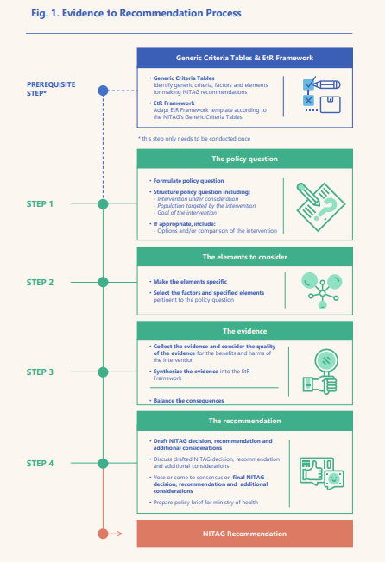
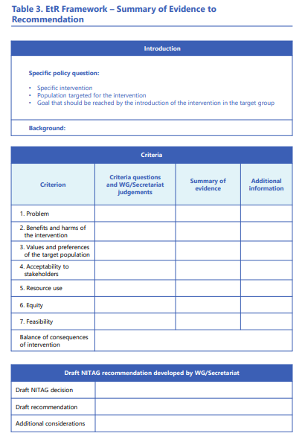
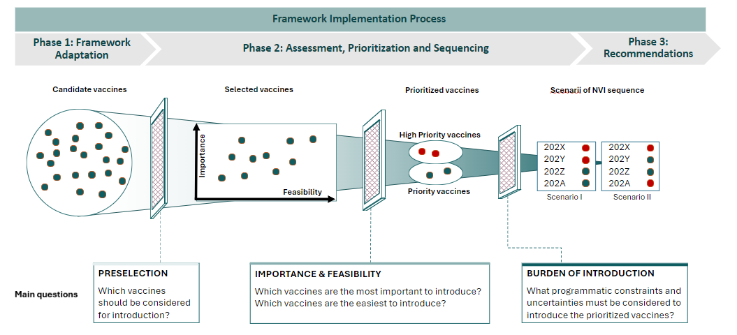
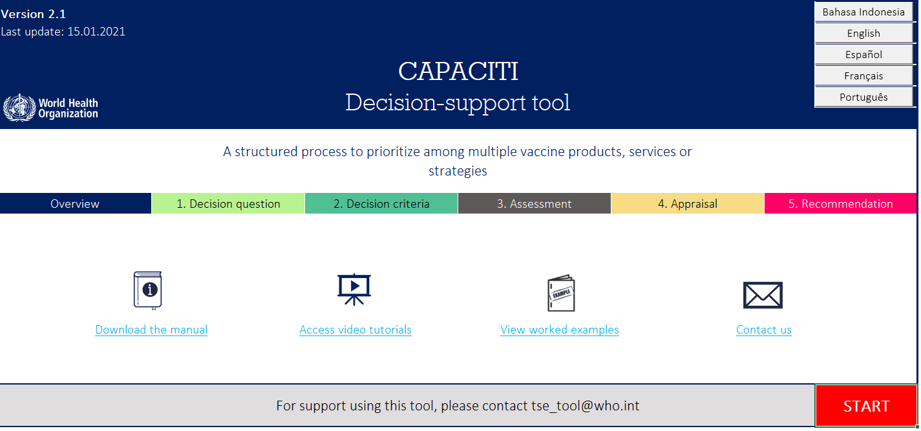
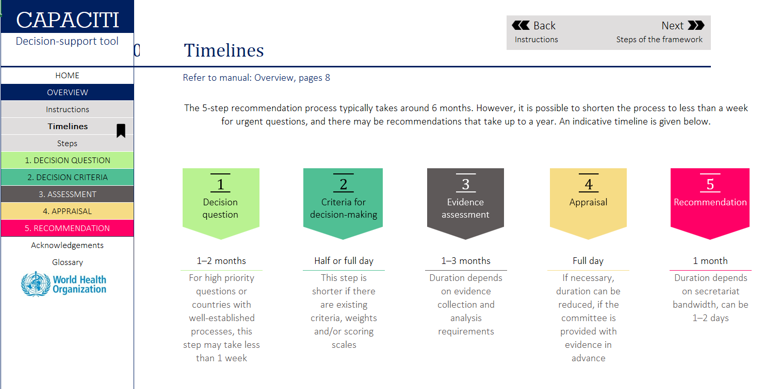
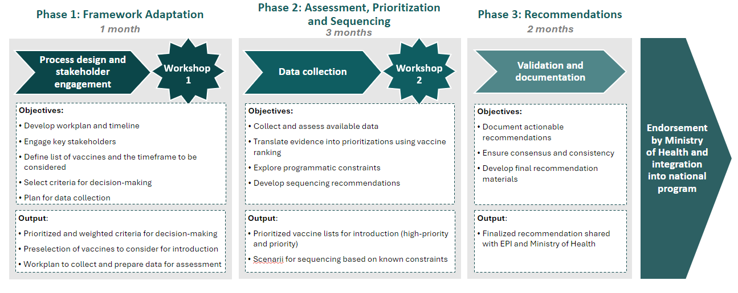
EtR is the sole tool suited for NITAG to make recommendations on whether and how vaccines should be introduced ; CAPACITI and NVI prioritization are complementary tools allowing NITAG to rank options and plan introductions over time
Unique process for recommendations on whether an intervention should be implemented
Complementary tools to compare and rank options, define sequence
Evidence to Recommendations
NVI Prioritization
WHO Capaciti
Evidence-to-Recommendations (EtR) is a framework that enables the adoption of recommendations regarding potential interventions by NITAGs. It is based on a list of criteria representing aspects that need to be incorporated when considering introduction of a new vaccine or intervention.
NVI prioritization is a proven NITAG-driven framework supporting the prioritization of new vaccine introductions. It leverages a simple, evidence-based and comprehensive approach to support the preparation of NVI sequencing scenarios based on a pre-hierarchized list of potential criteria.
CAPACITI is a comprehensive process tool that enables the comparison of interventions and selection of the best option thanks to a structured process excel tool that enables the grading of each option along predefined criteria.
Notes:
This slide can be included if stakeholders have questions regarding differences between available tools

Slide 31
Features of available NITAG tools for immunization recommendations
 | NVI Prioritization & Sequencing Framework | WHO Capaciti
Inception | Pilot-driven approach to answer short-term needs in pilot countries | BMGF-funded tool developed iteratively with 12 countries’ inputs
Examples of countries | DRC, Niger
Type of decision question | Which vaccines should be prioritized and when should they be introduced? | Should EPI introduce this vaccine or that vaccine next?
New intervention (yes / no)
Comparison between options
Sequencing of options
Mode of decision & recommendation | Supporting decision by highlighting “important” and “feasible” interventions based on rankings and constraints | Supporting decision by highlighting “best option” based on grading
Statement-based
Visualization-based
Grade-based decision support | Preference-based grading | Evidence-based grading
Type of support
Process and methodology
List of criteria
Grading tool | Vote-based tool | Excel grading tool
Other (describe) | Voting system, criteria hierarchization | Step-by-step guidelines, uncertainty modelling
Specific to immunization | Yes | No
Notes:
This slide can be included if stakeholders have questions regarding differences between available tools

