Slide 1
COVID VACCINE DELIVERY PARTNERSHIP
Considerations to inform country COVID-19 vaccination decision-making
Version 6 as of 31 January 2024

Slide 2
Purpose of this slide set
Content
This slide set summarizes WHO latest recommendations on COVID-19 vaccines and considerations for COVID-19 vaccination after the end of the Public Health Emergency of International Concern (PHEIC)
Targeted audience
WHO and UNICEF country officers, and partners
Objective
To help orient the Ministry of Health (MoH) and National Immunization Advisory Committee Group (NITAG) in their COVID-19 vaccination strategic decisions
The information contained in this slide set is current as of 31 January 2024. It has been developed based on WHO Interim guidance documents, technical documents, briefs, and webpages. This slide set will be periodically updated.

Slide 3
Content to support country COVID-19 vaccine decision-making
Information note to increase COVID-19 vaccine uptake
Regulatory considerations for the use of WHO EUL/PQ COVID-19 vaccines post PHEIC
Recap: Gavi COVID-19 vaccine programme for 2024-2025
Latest WHO SAGE COVID-19 vaccination roadmap
Latest WHO SAGE recommendations by COVID-19 vaccine (i.e. variant-containing vaccines, heterologous schedules, co-administration)
Key cold chain and storage attributes by COVID-19 vaccine
Updates on monitoring COVID-19 vaccination
COVID-19 vaccine effectiveness against Omicron
COVID-19 vaccine programmatic resources
Remaining scientific questions on COVID-19 vaccines

Slide 4
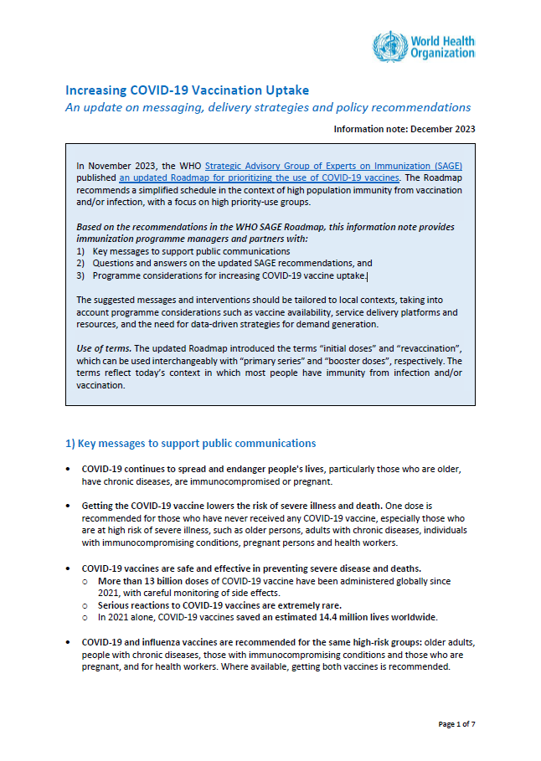
1. Increasing COVID-19 vaccination uptake (1/4)
An update on messaging, delivery strategies and policy recommendations to assist program managers and partners with:
Key messages to support public communications
Questions and answers on the updated SAGE recommendations, and
Programme considerations for increasing COVID-19 vaccine uptake.
Download here (English & French)
https://www.who.int/publications/m/item/increasing-covid-19-vaccination-uptake

Slide 5
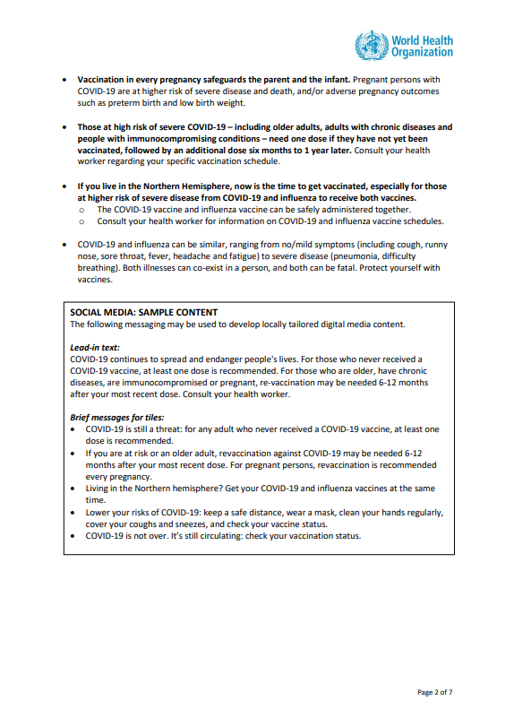
1. Increasing COVID-19 vaccination uptake (2/4)
Key messages to support public communications
Sample content: social media
https://www.who.int/publications/m/item/increasing-covid-19-vaccination-uptake

Slide 6
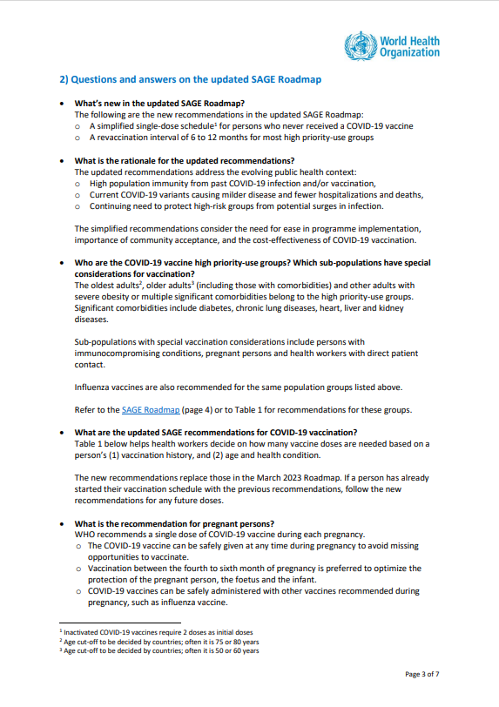
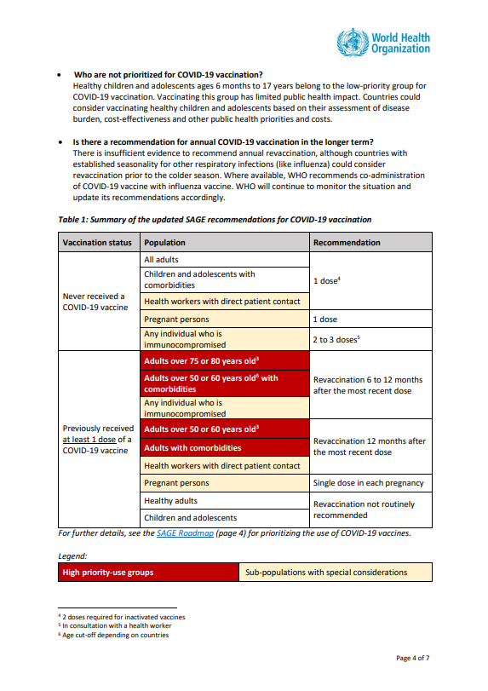
1. Increasing COVID-19 vaccination uptake (3/4)
Questions and answers on the updated WHO SAGE Roadmap
A simplified table on the updated recommendations
https://www.who.int/publications/m/item/increasing-covid-19-vaccination-uptake

Slide 7
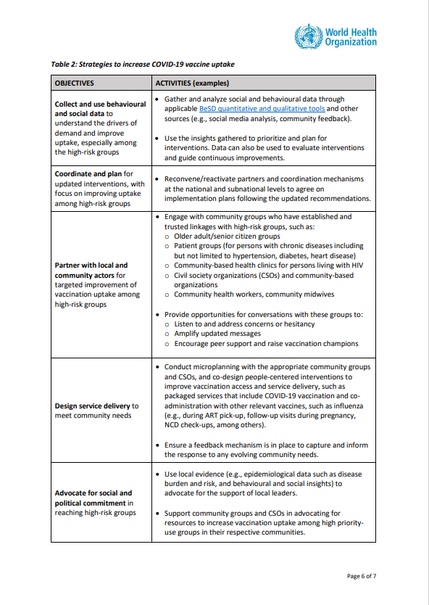
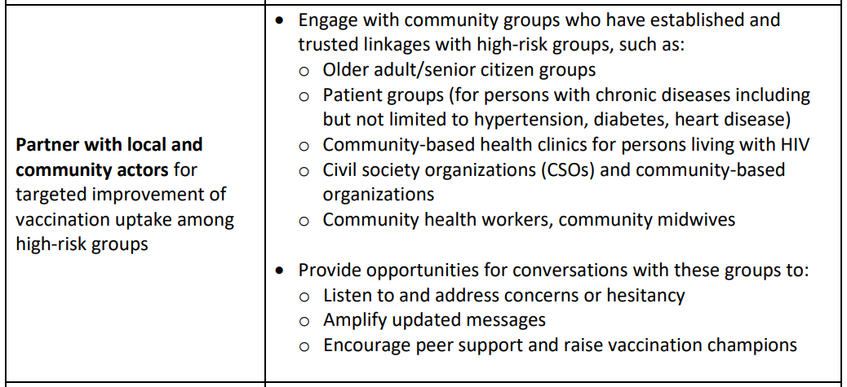
1. Increasing COVID-19 vaccination uptake (3/4)
Suggestions on leveraging platforms and partner collaborations to increase demand and uptake among high priority-use groups
Proposed objectives and activities to assist with local planning and resource mobilization
https://www.who.int/publications/m/item/increasing-covid-19-vaccination-uptake

Slide 8
2. Regulatory considerations for the use of WHO recommended COVID-19 vaccines post Public Health Emergency of International Concern (PHEIC)
With the lifting of the public health emergency of international concern (PHEIC), submissions to WHO for assessment under emergency use listing (EUL) are no longer accepted for COVID-19 vaccines.
Vaccine manufacturers may submit requests to WHO for prequalification (PQ), as long as the vaccine:
meets the criteria for PQ – see https://extranet.who.int/prequal/vaccines and https://extranet.who.int/prequal/vaccines/manufacturers for details, in summary:
is included in the vaccines prequalification priority list;
meets the mandatory characteristics for programmatic suitability;
has received marketing authorization from the national regulatory authority (NRA) of reference for the country in which the vaccine is manufactured;
and for which the NRA responsible for its regulatory oversight is a of maturity level 3 or higher for vaccine producing countries.
meets the recommendations for vaccine strains identified by the Technical Advisory Group on COVID-19 Vaccine Composition (TAG-CO-VAC) and the Strategic Advisory Group of Experts on Immunization (SAGE)
WHO EUL: https://extranet.who.int/prequal/vaccines/covid-19-vaccines-who-emergency-use-listing
WHO PQ: https://extranet.who.int/prequal/vaccines/welcome-vaccines-prequalification

Slide 9
3. Gavi COVID-19 vaccine programme for 2024-2025: objectives and scope (1/2)
Objective 1
Objective 2
Maximise health impact by continuing to support COVID-19 vaccine delivery for high priority use groups per the SAGE Roadmap
Continue to support health system strengthening and integration of COVID-19 vaccination into routine immunisation, primary healthcare, and other healthcare services
Scope: All AMC 91 countries are eligible for support (C19 vaccine doses & operational funding)
AMC 37 (former- and never-Gavi eligible countries which received COVAX support) are eligible for 50% procurement support for one year (either 2024 or 2025) – in line with Gavi’s Middle-Income-Countries Approach.
Gavi-eligible 54 (Gavi 54) countries are eligible for full vaccine procurement without co-financing obligations.
Approved COVID-19 Delivery Support (CDS) funds extended for use until the end of 2025
“The timeline was extended to enable countries to create sustainable integration of COVID-19 vaccine into routine immunization and PHC and reduce backsliding of other antigens due to acute focus on COVID-19 during the pandemic.”
COVID-19 Delivery Support (CDS) - Third Funding Window Guidelines (gavi.org) (update October 2023)

Slide 10
3. Allocation and delivery of Gavi C19 vaccine doses for 2024 (2/2)
Wave I
Wave II
Vaccine Application: Form for 2024 submitted via the COVAX Collaboration Portal
July
Oct
High Level Review Panel decision: Approval of countries who have submitted a C19 vaccine dose request during respective waves
Sep
Dec
Decision Letters: Gavi sends a Decision Letter to countries informing them of the HLRP approved volumes
Oct
Jan
Allocation: UNICEF/PAHO will lead the allocation process and dialogues directly with country to inform them of the product(s) being allocated. The latest available strain (XBB) will be available for allocations & delivery in accordance with SAGE recommendations
Nov
Feb
Q1 2024
Q2 2024
Delivery: Wave I first shipments from Q1 2024; Wave II first shipments from Q2 2024

Slide 11
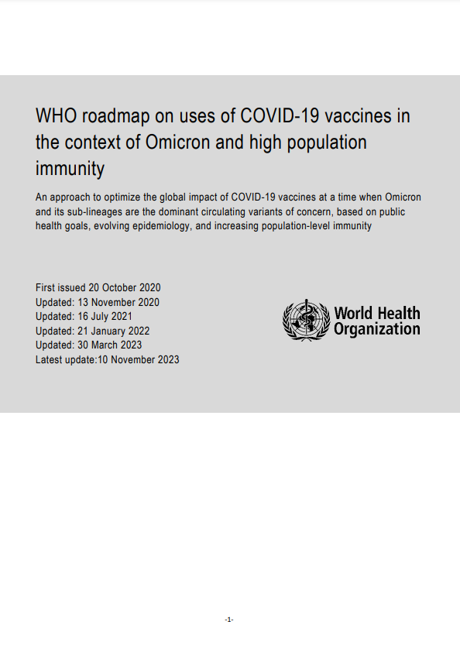
4. Latest WHO SAGE COVID-19 vaccination roadmap
Update: 10 November 2023
WHO Roadmap
An updated roadmap for COVID-19 vaccination that reflects the simplified schedule and updates recommendations on revaccination by risk groups.
A simplified single-dose regime for primary immunization for most COVID-19 vaccines which would improve acceptance and uptake and provide adequate protection at a time when most people have had at least one prior infection should be used.
HIGH priority-use groups and sub-populations with special considerations for COVID-19 vaccination are:
Older adults
Adults with comorbidities or severe obesity
Adults, adolescents and children with immunocompromising conditions
Pregnant adults and adolescents
Health workers
https://www.who.int/publications/i/item/WHO-2019-nCoV-Vaccines-SAGE-Prioritization-2023.1

Slide 12
Roadmap: WHO Interim Recommendations for the optimal use of COVID-19 vaccination (1/3)
Update: 10 November 2023
HIGH priority-use groups
Target population | Vaccination of persons who have never received a COVID-19 vaccine | Revaccination of persons who have received at least one dose of COVID-19 vaccine
Oldest adults^{i} Older adults with multiple comorbidities that put them at higher risk of severe COVID-19 | Single dose^{iii} | 6-12 months after previous dose
Older adults^{ii} Other adults^{iv} with severe obesity or a comorbidity that puts them at higher risk of severe COVID-19 | Single dose^{iii} | Approximately 12 months after previous dose
i Age cut-off to be decided by countries; often it is 75 or 80 years.
ii Age cut-off to be decided by countries: often it is 50 or 60 years.
iii In vaccine-naïve persons, for programmatic purposes, a single dose can be considered for primary vaccination given that the vast majority of the population will have been infected at least once. For inactivated COVID-19 vaccines, two doses are required for the primary vaccine series.
iv Age cut-off to be decided by countries: often it is 18 to 49 or 18 to 59 years.
v Regulatory approvals or WHO EUL for the age indication differ by vaccine product; refer to the product-specific vaccine recommendations.
https://www.who.int/publications/i/item/WHO-2019-nCoV-Vaccines-SAGE-Prioritization-2023.1

Slide 13
Roadmap: WHO Interim Recommendations for the optimal use of COVID-19 vaccination (2/3)
Update: 10 November 2023
Sub-populations with special considerations
Target population | Vaccination of persons who have never received a COVID-19 vaccine | Revaccination of persons who have received at least one dose of COVID-19 vaccine
Persons with moderate and severe immunocompromising conditions (adults, adolescents and children > 6 months) | Two or three doses in consultation with the health care provider | 6-12 months after previous dose; optimal time interval should be determined in consultation with the health care provider
Pregnant adults and pregnant adolescents^{viii} | Single dose in each pregnancy regardless of previous vaccination status; ideally during the second trimester or at any opportunity^{iii} | 6-12 months after previous dose; optimal time interval should be determined in consultation with the health care provider
Health and care workers with direct patient contact | Single dose^{iii} | Approximately 12 months after previous dose
iii In vaccine-naïve persons, for programmatic purposes, a single dose can be considered for primary vaccination given that the vast majority of the population will have been infected at least once.
viii Regulatory approvals or WHO EUL for the use in pregnancy may differ by vaccine product.
https://www.who.int/publications/i/item/WHO-2019-nCoV-Vaccines-SAGE-Prioritization-2023.1

Slide 14
Roadmap: WHO Interim Recommendations for the optimal use of COVID-19 vaccination (3/3)
Update: 10 November 2023
MEDIUM priority-use groups
Target population | Vaccination of persons who have never received a COVID-19 vaccine | Revaccination of persons who have received at least one dose of COVID-19 vaccine
Healthy adults^{iv} Children and adolescents aged 6 months to 17 years with severe obesity or a comorbidity that puts them at higher risk of severe COVID-19^{v} | Single dose^{iii} | Not routinely recommended^{vi}
LOW priority-use groups
Target population | Vaccination of persons who have never received a COVID-19 vaccine | Revaccination of persons who have received at least one dose of COVID-19 vaccine
Healthy children and adolescents aged 6 months to 17 years | If countries opt to vaccinate low priority-use groups^{vii}, they could consider single dose for ages 5 years and above; two doses for age 6 months to 4 years^{v} | Not routinely recommended^{vi}
iii In vaccine-naïve persons, for programmatic purposes, a single dose can be considered for primary vaccination given that the vast majority of the population will have been infected at least once. For inactivated COVID-19 vaccines, two doses are required for the primary vaccine series. iv Age cut-off to be decided by countries: often it is 18 to 49 or 18 to 59 years. v Regulatory approvals or WHO EUL for the age indication differ by vaccine product; refer to the product-specific vaccine recommendations. vi “Not routinely recommended” means that such vaccines are not recommended because of minimal public health impact and low cost-effectiveness in most settings. However, vaccination may be offered in individual country-specific circumstances where added benefit is expected to be more substantial. This interim recommendation acknowledges that some countries may elect to offer such doses in the routine programme based on population risks, disease epidemiology, or public health priorities. vii Benefit of vaccinating healthy children and adolescents is substantially lower compared to vaccinating older persons or as compared to other childhood vaccinations. Countries could consider vaccination based on disease burden, cost effectiveness, and other programmatic priorities.
https://www.who.int/publications/i/item/WHO-2019-nCoV-Vaccines-SAGE-Prioritization-2023.1

Slide 15
5. Latest WHO SAGE recommendations by COVID-19 vaccine platform
Latest WHO SAGE recommendations
WHO EUL/PQ Date*
Platform
Vaccine
Manufacturer
Messenger Ribonucleic Acid (mRNA) vaccines
COMIRNATY ®
31-Dec-20
WHO SAGE Interim Recommendation
19-Jul- 23
SPIKEVAX
30-Apr-21
Viral vector vaccines
WHO SAGE Interim Recommendation
15-Mar-22
COVISHIELDTM ¹
15-Feb-21
VAXZEVRIA® ¹
16-Apr-21
WHO SAGE Interim Recommendation
06-Jun-22
Ad26.COV2-S®
12-Mar-21
WHO SAGE Interim Recommendation
19-May-22
CONVIDECIA
19-May-22
Inactivated virus vaccines
BIBP®
07-May-21
WHO SAGE Interim Recommendation
31- Aug-23
CoronaVac
01-Jun-21
Protein subunit vaccines
COVOVAX® ²
17-Dec-21
NUVAXOVID™²
20-Dec-21
WHO SAGE Interim Recommendation
31-Aug-23
SKYCovione™³
16-Jun-23
BIMERVAX™³
09-Oct-23
CORBEVAX®
15-Jan-24
.1 Same vaccine products produced in different manufacturing sites or having different registered names can be used interchangeably
2. Same vaccine products produced in different manufacturing sites or having different registered names can be used interchangeably Due to the interchangeability, the rest of the presentation refers to these vaccine products as Novavax.
3. The WHO SAGE COVID-19 vaccine platform (protein subunit vaccines) recommendations apply to this product.
*Source: Summary Status of COVID-19 Vaccines within WHO EUL-PQ evaluation process - 25 January 2024 - WEB.pdf
More information at: COVID-19 Vaccines with WHO Emergency Use Listing | WHO - Prequalification of Medical Products (IVDs, Medicines, Vaccines and Immunization Devices, Vector Control)

Slide 16
5. Summary of WHO SAGE Interim recommendations by COVID-19 vaccine (1/2)
COMIRNATY (Pfizer BioNTech)
COMIRNATY (Pfizer BioNTech)
COVISHIELD (Serum Institute of India) VAXZEVRIA (AstraZeneca)
Ad26.COV 2-S (Janssen)
CONVIDECIA (CanSinoBIO)
Latest SAGE update
19-Jul-23
15-Mar-22
06-Jun-22
19-May-22
Vaccine Platform
mRNA
Viral vector
SPIKEVAX (Moderna)
Dosage/Schedule
Primary series: 1 dose (If countries opt to vaccinate low priority-use groups, two doses for age 6 months to 4 years with an interval at least 8 weeks)
Primary series: 1 dose
Primary series: 1 dose
Primary series: 1 dose
Add’l dose for ICPs (1-3ms)
Add’l dose for ICPs (1-3ms)
Add’l dose for ICPs (1-3ms)
Add’l dose for ICPs (1-3ms)
Booster/Revaccination
Revaccination: 6-12 months after previous dose for HIGH priority-use groups and Sub-populations with special considerations
)
Intended use
6 months and above
18 years and above
18 years and above
18 to 59 years of age
Use by pregnant women
Recommended
Recommended
Use when breastfeeding
Recommended
Recommended
Note: This table presents summarized key information up to 31 January 2024. For full details access the WHO SAGE Interim recommendations.
Add’l dose =Additional dose; ICPs = Immunocompromised persons; ms = months.
16

Slide 17
5. Summary of WHO SAGE Interim recommendations by COVID-19 vaccine (2/2)
BIBP(China National Biotech Group (CNBG)/Sinopharm)
CoronaVac (Sinovac Life Sciences)
COVOVAX (Serum Institute of India) NUVAXOVID (Novavax, Inc.)
SKYCovione
(SK Bioscience)
BIMERVAX
(HIPRA)
CORBEVAX (Biological E Limited)
Latest SAGE update
31-Aug-23
31- Aug-23
Vaccine Platform
Inactivated virus
Protein subunit
Dosage/Schedule
Primary series: 2 doses (interval 3-4 wks)
Primary series: 2 doses (interval 4 wks)
Primary series: 1 dose
Primary series: 1 dose*
Not applicable
Primary series: 1 dose*
Add’l dose for ICPs (1-3ms) and ≥60 years (3-6ms)
Add’l dose for ICPs and (1-3ms) and ≥60 years (3-6ms)
Add’l dose for ICPs (1-3ms)
Not applicable
Add’l dose for ICPs (1-3ms)
Booster/Revaccination
Revaccination: 6-12 months after previous dose for HIGH priority-use groups and Sub-populations with special considerations
Intended use
3 years and above
3 years and above
18 years and above
18 – 65 years
16 years and above
12 years and above (primary series) 18 years and above (booster)
Use by pregnant women
Recommended
Recommended
Recommended
Recommended
Recommended
Recommended**
Use when breastfeeding
Recommended
Recommended
Recommended
Recommended
Recommended
Recommended**
* In vaccine-naïve persons, for programmatic purposes, a single dose can be considered for primary vaccination given that the vast majority of the population will have been infected at least once.
** Limited data is available to date on use in pregnant women and when breastfeeding.
Note:. This table presents summarized key information up to 31 January 2024. For full details access the WHO SAGE Interim recommendations.
Add’l dose =Additional dose; ICPs = Immunocompromised persons; ms = months; wks = weeks.

Slide 18
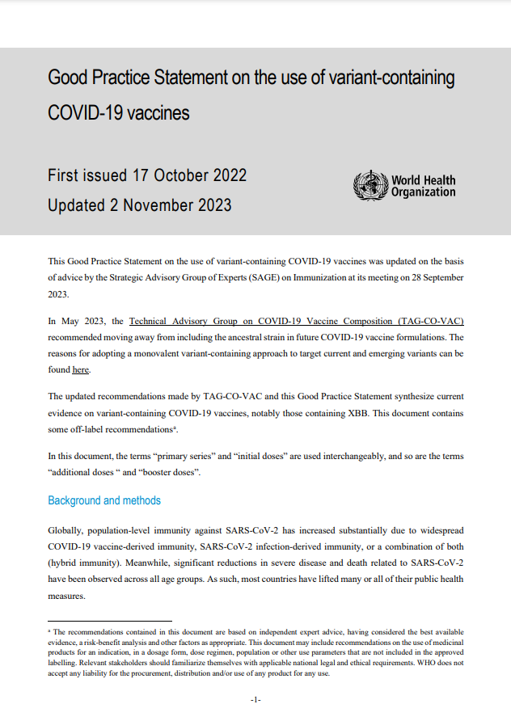
5. WHO SAGE good practice statement on the use of variant-containing COVID-19 vaccines (VCV)
2 November 2023
Monovalent XBB vaccines
In May 2023, global prevalence was dominated by Omicron and the Technical Advisory Group on COVID-19 Vaccine Composition (TAG-CO-VAC) recommended moving away from including the ancestral strain in future COVID-19 vaccine formulations to adopting monovalent-containing vaccines, notable those containing XBB
Available data suggest the monovalent Omicron XBB vaccines provide modestly enhanced protection compared to bivalent variant-containing vaccines and monovalent index virus vaccines
Many vaccine manufacturers have developed or are developing Omicron-only vaccine: Pfizer (mRNA), Moderna (mRNA); CanSino (adenovirus type 5 vector); Bharat (inactivated), Sinovac (inactivated), Sinopharm (inactivated); Novovax (protein-based)
Initial doses/Primary series: any of the WHO EUL COVID-19 vaccines can be used for the initial dose, including monovalent XBB vaccines
Booster/revaccination: any of the WHO EUL COVID-19 vaccines or authorized variant-containing vaccines can be used for the booster doses.
When monovalent XBB vaccines are not available, any available WHO EUL or prequalified bivalent variant-containing or monovalent index virus vaccines may be used to provide benefits against severe disease in high-risk groups.
https://www.who.int/publications-detail-redirect/WHO-2019-nCoV-Vaccines-SAGE-Variants-2022.1

Slide 19
5. WHO recommended schedules, including VCV
Variant-containing vaccines (VCVs) can now be considered for both the initial and booster doses
Heterologous schedules (“mix and match”): There is increasing evidence that subsequent doses/boosters using different COVID-19 vaccine platforms may provide superior immune response compared to homologous schedules (same vaccine)
Options for subsequent doses
(to complete primary series or booster doses/revaccination)
Initial dose
mRNA vaccine
(Pfizer, Moderna)
Viral vector vaccine
(AstraZeneca/SII, Janssen, CanSinoBIO)
mRNA/ viral vector / protein subunit vaccines can be considered, as heterologous or homologous schedule, to complete primary series and/or booster doses/revaccination. Inactivated vaccines may be only considered to complete primary series and/or booster doses/revaccination if they were administered as a first dose/primary series.
Protein subunit vaccine
(Novavax/SII, BEL, SK Bioscience)
Inactivated vaccine
(Sinopharm BBIP, Sinovac)
https://www.who.int/publications-detail-redirect/WHO-2019-nCoV-Vaccines-SAGE-Variants-2022.1
https://iris.who.int/bitstream/handle/10665/373987/WHO-2019-nCoV-Vaccines-SAGE-Prioritization-2023.2-eng.pdf?sequence=1

Slide 20
5. WHO SAGE recommendations on co-administration of COVID-19 vaccines (including VCV) with other vaccines
Adults and adolescents (≥9 y)
COVID-19 vaccines may be given concomitantly, or any time before or after, other vaccines including live-attenuated, inactivated, adjuvanted, or non-adjuvanted vaccines.
WHO recommends that countries consider co-administration of COVID-19 vaccines with seasonal influenza vaccines
Children
Evidence from co-administration studies is currently insufficient to make a recommendation for concomitant administration with COVID-19 vaccines
A minimum interval of 14 days between administration of COVID-19 vaccines and other vaccines is recommended. This recommendation may be updated when more data become available.
https://www.who.int/publications-detail-redirect/WHO-2019-nCoV-Vaccines-SAGE-Variants-2022.1

Slide 21
6. Summary of key cold chain and storage attributes by COVID-19 vaccine (1/3)
COMIRNATY ® VCV Original & Omicron BA.4-5 (Pfizer BioNTech)
COMIRNATY® Omicron XBB 1.5 (Pfizer BioNTech)
SPIKEVAX (Moderna)
Ready-to-use GREY CAP 12 years and older
Ready-to-use BLUE CAP 5-11 years old
With dilution ORANGE CAP 5-11 years old
With dilution MAROON CAP 6 months-4 years old
Ready-to-use GREY CAP 12 years and older
Ready-to-use BLUE CAP 5-11 years old
With dilution ORANGE CAP 5-11 years old
With dilution MAROON CAP 6 months – 4 years old
Platform
mRNA
Presentation/ number of doses
Vial/6 doses and single dose
Vial / 6 doses
Single dose
Vial/10 doses
Vial /10 doses
Vial / 6 doses
Single dose
Vial / 6 doses
Single dose
Vial / 10 doses
Vial / 10 doses
Vial / 10 doses
Diluent
No
Yes
No
Yes
No
Syringe
ADS 0.3 ml
ADS 0.2 mL
ADS 0.3 mL
ADS 0.2 mL
ADS 0.5 mL
Cold chain requirements
Ultra-cold chain: -90ºC to -60ºC Refrigerator: +2ºC to +8°C
Freezer: -25ºC to -15ºC Refrigerator: +2ºC to +8°C
Shelf-life
-90°C to -60°C: 24 m +2° to +8°C: 10 wks
-90°C to -60°C: 12 m +2° to +8°C: 10 wks
-90°C to -60°C: 24 m +2° to +8°C: 10 wks
-90°C to -60°C: 24 m +2° to +8°C: 10 wks
-90°C to -60°C: 18 m +2° to +8°C: 10 wks
-90°C to -60°C: 12 m +2° to +8°C: 10 wks
-90°C to -60°C: 18 m +2° to +8°C: 10 wks
-90°C to -60°C: 18 m +2° to +8°C: 10 wks
-25°C to -15°C: 9 m +2°C to +8°C: 1 m
Cold chain volume
MDV: range 1.54 to 2.57 cm³/dose) SDV: 15.5 cm³/dose
MDV: range 1.54 to 2.57 cm³/dose SDV: 15.5 cm³/dose
MDV: range 1.54 to 2.57 cm³/dose
1.6 cm3/dose
MDV: 1.8 cm³/doce SDV: 15.5 cm³/dose
MDV: 1.8 cm³/doce SDV: 15.5 cm³/dose
1.6 cm3/dose
1.6 cm3/dose
10-dose vial:4.3 cm³/dose
Handling of opened multidose-vials
Discard opened vials 6 hours after first puncture or at end of immunization session, whichever comes first
Vaccine vial monitor (VVM)
None
Note: This table presents summarized key information as of 31 January 2024. For additional information and full details access the WHO COVID-19 vaccine explainers.. m = months, wks=weeks.

Slide 22
6. Summary of key cold chain and storage attributes by COVID-19 vaccine (2/3)
COVISHIELD ® (Serum Institute of India) VAXZEVRIA ® (AstraZeneca)
Ad26.COV 2-S ® (Janssen)
CONVIDECIA ® (CanSinoBIO)
Inactivated SARS-CoV-2 vaccine® (BIBP/Sinopharm)
CORONAVAC® (Sinovac Life Sciences)
Platform
Viral Vector
Inactivated virus
Presentation/ number of doses
COVISHIELD: Vial / 2 or 10 doses VAXZEVRIA: vial/ 8 or 10 doses
Vial / 5 doses
Vial / 1 or 3 doses
Single-dose pre-filled AD syringes and 1, 2 or 5 dose vials
Single-dose in pre-filled non-AD syringes and 1 or 2 dose vials
Diluent
No
Syringe
ADS 0.5 mL
Cold chain requirements
Refrigerator: +2°C to +8°C
Freezer: -25ºC to -15º C Refrigerator: +2°C to +8°C
Refrigerator: +2°C to +8°C
Shelf-life
+2°C to +8°C: 9 m
-25ºC to -15°C: 24 m +2°C to +8°C: 11 m
+2°C to +8°C: 12 m
+2°C to +8°C: 24 m
+2°C to +8°C: 24 m
Cold chain volume
COVISHIELD: range 2.11 to 7.03 cm³/dose)
VAXZEVRIA: range from 2.90 to 5.03 cm³/dose
3.82 cm³/dose
Single dose: 16.30 cm³/dose
3-dose vial: 5.43 cm³/dose
Depending on product/vial size (range 4.2 to 124.9 cm³/dose)
Depending on product/vial size (range 8.15 to 41.65 cm³/dose)
Handling of opened multidose-vials
Discard opened vials 6 hours after first puncture or at end of immunization session, whichever comes first
Vaccine vial monitor (VVM)
None
Type 7
None
Note: This table presents summarized key information as of 31 January 2024. For additional information and full details access the WHO COVID-19 vaccine explainers..
m = months.

Slide 23
6. Summary of key cold chain and storage attributes by COVID-19 vaccine (3/3)
COVOVAX TM (Serum Institute of India) NUVAXOVID TM (Novavax, Inc.)
NUVAXOVID TM XBB.1.5
(Novavax, Inc.)
SKYCovione TM (GBP510)
(SK Bioscience)
BIMERVAX®
(HIPRA)
Corbevax®
(Biological E. Limited)
Platform
Protein subunit
Presentation/ number of doses
Covovax: Vial / 1 or 10 doses
Nuvaxoid: 5-10 doses
Vial/ 5 and 10 doses
Vial/single dose
Single dose
Vial/ 10 or 20 doses, Single dose
Diluent
No
To be mixed with adjuvant
No
No, shake well before use
Syringe
ADS 0.5 mL
Cold chain requirements
Refrigerator: +2°C to +8°C
Shelf-life
Covovax: +2°C to +8°C: 9 m
Nuvaxovid: +2°C to +8°C 12 m
+2°C to +8°C: 12 m
+2°C to +8°C: 12 m
+2°C to +8°C: 15 m
+2°C to +8°C: 24 m
Cold chain volume
Depending on product/vial size (range 2.05 to 15.82 cm³/dose)
2.05 cm3 /dose
Vaccine: 3.0 cm³/dose
Adjuvant: range 1.15 to 1.37 cm³/dose
Depending on product/carton size (range 22.21 to 88.87 cm³/dose)
Depending on product/carton size (range 14.7 to 2.9 cm³/dose)
Handling of opened multidose-vials
Discard opened vials 6 hours after first puncture or at end of immunization session, whichever comes first
Vaccine vial monitor (VVM)
None
Type 14
Note: This table presents summarized key information as of 31 January 2024. For additional information and full details access the WHO COVID-19 vaccine explainers..
m = months.
23

Slide 24
7. Upcoming changes to global-level COVID-19 vaccination monitoring (1/4)
WHO has revised global-level COVID-19 vaccination-related reporting requirements from Member States, considering 1) high vaccination coverage in most Member States, 2) ongoing routinization of COVID-19 vaccination programs, and 3) the recent update of the WHO SAGE Roadmap for prioritizing uses of COVID-19 vaccines.
The revision affects both the indicators requested and the frequency of their requested reporting.
From end of Sept. 2023, Member States are requested to report indicators on a quarterly basis, instead of monthly, through the end of Sept. 2024.
Some indicators are not needed as frequently and will already be integrated into the 2024 annual Joint Reporting Form (JRF) questionnaire.
From end of Sept. 2024, all indicators will be collected annually and integrated into the 2025 annual JRF questionnaire.
Updated indicators align with current policy and programmatic recommendations; they will enter into effect from 01 January 2024.
These upcoming changes have been communicated in greater detail to Member States by letter from their corresponding WHO Regional Office.
Timeline of upcoming monitoring changes
01 October 2023:
COVID-19 vaccination data collection shifted to quarterly reporting cadence
01 January 2024:
Revised indicators enter into effect
Some indicators not needed frequently will be integrated into the 2024 annual JRF questionnaire
01 October 2024:
All remaining COVID-19 vaccination data collection shifted to an annual reporting cadence

Slide 25
7. Updated global-level COVID-19 vaccination monitoring indicators, from 01 Jan 2024 (2/4)
Topic area | Summary of indicators included | Frequency | Notes
Products in-use | Vaccine products introduced and currently in use | Quarterly
Policy & scheduling | Populations recommended for vaccination and re-vaccination, interval for re-vaccination | Quarterly | Simplification of SAGE roadmap to align with country familiarity, taking into consideration influenza terminology, where relevant
Uptake | Uptake in total pop., disaggregated by risk group (HCW, older adults, adults with chronic conditions, pregnant adults / adolescents) and gender | Quarterly | Risk groups aligned with reporting risk groups for influenza, where relevant 2024 shift from ‘cumulative coverage’ to ‘annual uptake’
Safety | Serious AEFIs following COVID-19 vaccination | Quarterly
Integration | Co-delivery of COVID-19 vaccination with other health services | Quarterly
Procurement & pricing | Total doses received by product, procurement mechanism, price per dose, etc. | Annual | Direct integration with existing eJRF procurement table (MI4A)
Stock & wastage | Stock on hand, across levels Monthly consumption Closed vial wastage | Annual | Thrive360 will be used for more frequent (monthly) data; specific to Gavi countries
Immunization information systems | Future plans for COVID-specific information systems | Annual | Once-off exercise
Shifted to annual collection

Slide 26
7. Updated global-level COVID-19 vaccination monitoring process & timeline, for 2024 (3/4)
Data will continue to be collected via the system put in place by a Member States’ corresponding WHO Regional Office:
For Member States in AMR/PAHO, EMR, EUR, and SEAR, this will be through the electronic Joint Reporting Form (eJRF) COVID-19 module.
For Member States in AFR and WPR, this will be through region-specific systems for COVID-19 vaccination data collection.
Reporting dates are listed in the adjacent table for Member States in regions using the eJRF COVID-19 module; other Member States should contact their WHO Regional Office for specific dates.
Key reporting dates for Member States in regions using the eJRF COVID-19 module
Data for: | Will be collected from: | By way of:
Products in-use, scheduling, uptake, safety, and integration data
Quarter 4 2023 (October – December) | 15 January – 14 February 2024 | eJRF COVID-19 module
Quarter 1 2024 (January – March) | 15 April – 14 May 2024 | eJRF COVID-19 module
Quarter 2 2024 (April – June) | 15 July – 14 August 2024 | eJRF COVID-19 module
Quarter 3 2024 (July – September) | 15 October – 14 November 2024 | eJRF COVID-19 module
Procurement, supply & wastage, and immunization information system data
2023 | 06 March – 30 April 2024 | eJRF annual questionnaire

Slide 27
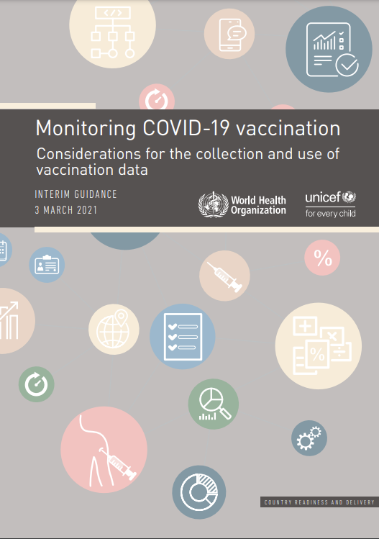
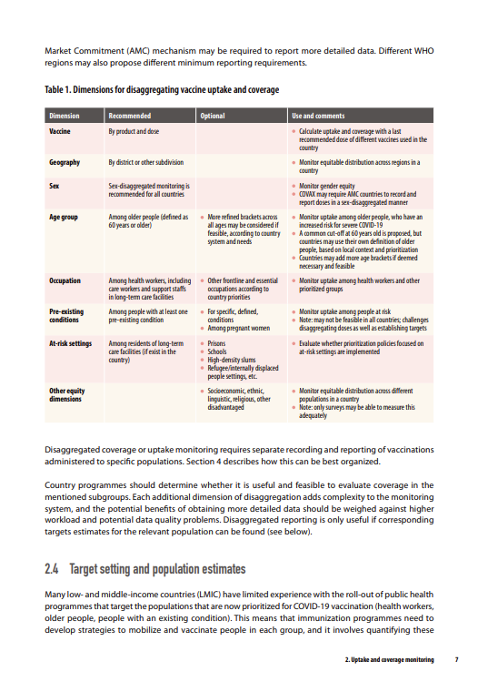
7. An update to COVID-19 vaccination monitoring guidance is underway (4/4)
WHO is working with partners to update the “Monitoring COVID-19 vaccination: Considerations for the collection and use of vaccination data” document.
The updated document will feature revised recommendations for country-level monitoring of COVID-19 vaccine programs, in line with the revised global-level reporting requirements.
The document will be made available on the WHO website and will be shared with Member States via WHO Regional Offices.

Slide 28
8. Overview of Vaccine Effectiveness (VE) studies against Omicron (1/2)
DATA AS OF NOVEMBER 28, 2023
Ongoing questions
249 total studies against Omicron
153 primary series studies and 213 booster studies
19 vaccines studied
Ancestral monovalent vaccines: Janssen, Cansino, AstraZeneca, Gamaleya, Beijing CNBG, Wuhan CNBG, Bharat, Sinovac, Medigen, Novovax, Moderna, Pfizer
Variant adapted vaccines: Pfizer BA.1, Moderna BA.1, Pfizer BA.4/5, Moderna BA.4/5, Pfizer XBB.1.5, Moderna XBB.1.5, Sanofi beta vaccine
1
VE of the XBB.1.5 monovalent vaccine – a new variant-containing vaccine?
2
VE of the time since a last and most recent revaccination?
3
VE of hybrid vs vaccine-induced vs infection induced immunity?
4
VE against Omicron subvariants and new variants?

Slide 29
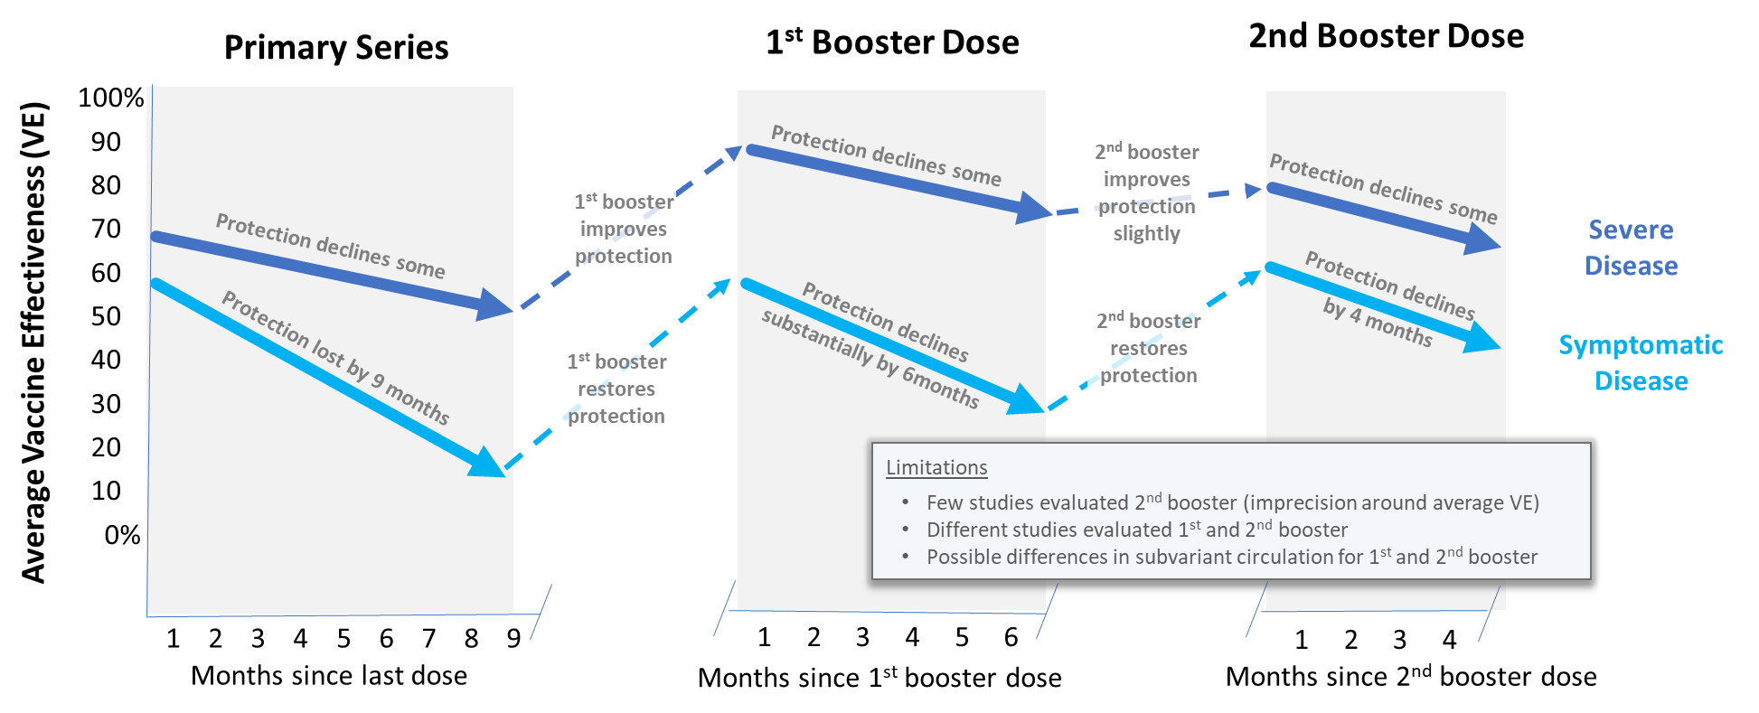
8. Boosters perform well against Omicron for severe disease (2/2)
Symptomatic disease
Primary series VE lower against Omicron than pre-Omicron but significant waning
1st booster VE restored after primary series but significant waning
2nd booster VE likely restored after 1st booster, but significant waning
Severe disease
Primary series VE lower against Omicron than pre-Omicron, with minimal waning
1st booster restores protection above primary series, with minimal waning
2nd booster likely restored after 1st booster with minimal waning
Average vaccine effectiveness ¹
Time since last dose seems more important than the vaccine platform but still few studies across non-mRNA platforms
1. Based on 81 studies in 20 countries
2. Approximation based on results for Pfizer-BioNTech vaccine from Duration of effectiveness of vaccines against SARS-CoV-2 infection and COVID-19 disease by Feikin D et al. (https://doi.org/10.1016/S0140-6736(22)00152-0), in which all studies were carried out before the omicron variant began circulating.
Source: Update of systematic review and meta-regression by Higdon M et al https://linkinghub.elsevier.com/retrieve/pii/S1473309922004091

Slide 30
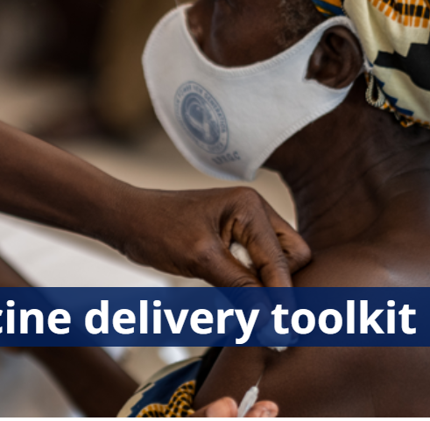
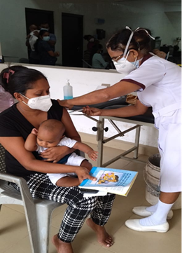
9. COVID-19 vaccine programmatic resources
COVID-19 vaccine delivery toolkit (Microplanning; Integration of COVID-19 vaccination into PHC; Regulatory; Supply, logistics & waste management; Vaccine safety; Generating acceptance & demand for COVID-19 vaccines; Data and monitoring; Evaluation…)
https://www.who.int/tools/covid-19-vaccine-introduction-toolkit#vaccine%20specific%20resources
Global Compendium of country knowledge on COVID-19 vaccination (country experiences and best practices by programmatic category)
Global compendium of country knowledge on COVID-19 vaccination
Vaccine Emergency Use Listing and Prequalification
https://extranet.who.int/prequal/vaccines/covid-19-vaccines-who-emergency-use-listing
https://extranet.who.int/prequal/vaccines/welcome-vaccines-prequalification

Slide 31
10. There remains unresolved scientific questions on COVID-19 vaccines, considering population immunity, variants, and more...
What we know
What remains unknown
Hybrid (infection- and vaccine-induced) immunity is better than either alone
In low coverage settings, older adults tend to have lower seroprevalence than other groups
Groups at risk for severe outcomes (esp. 60+) have had excess mortality, even in less affected geographies; communications and targeted infrastructure important to increase vaccination uptake
Variant-containing vaccines (VCVs) have been authorized
What is the vaccine effectiveness considering high population immunity?
What will be the need and timing for further booster doses/revaccination in the longer-term?
Can seroprevalence be used, and how, to modify the vaccine schedules in populations with high seroprevalence?
What is the evidence on duration of protection by the vaccine and protection against Post COVID-19 condition (Long COVID)?
Will new vaccines offer a better protection against infection and transmission?
How will vaccines/immunization perform against future variants?
https://iris.who.int/bitstream/handle/10665/373987/WHO-2019-nCoV-Vaccines-SAGE-Prioritization-2023.2-eng.pdf?sequence=1
31

