Slide 1
NITAGs Composition and modes of functioning
These slides were developed with inputs from the GNN, the WHO regional offices and our partner the US-CDC
Endorsed by the GNN and revised in 2023
unsplash.com

Slide 2
Module overview
Purpose of a NITAG
Composition of a NITAG
Functioning of NITAGs
Additional resources/Takeaways
1
2
3
4

Slide 3
Learning objectives
On completion of this training, you will be able to:
Describe the purpose of a NITAG
Review the strengths and weaknesses of your NITAG composition
Assess the functioning of your NITAG
Develop strategies to improve or update your internal procedures

Slide 4
What are some key words you associate with your NITAG?

Slide 5
What is a NITAG?
A body of national experts that provide technical and scientific guidance to the government (the MoH and/or the EPI) on immunization policy, norms, and practices.
An independent scientific advisory group.
MoH officials/NIP specialists should not be core members. Rather should serve as ex-officio members.
Notes:
NITAG is not completely independent from govt because it is established by the MoH, members selected by MoH, MoH has input into agenda.
As an independent scientific advisory group, the NITAG should not include the MoH officials and the NIP specialists as core members. They should serve as ex-officio.

Slide 6
Objective and Scope of NITAG Functions
ADVISORY
INDEPENDENT
EVIDENCE-BASED
Final decision made by national authorities
NITAG not in charge of the implementation and no interests
NITAG members advise based on the best available evidence and identify need for additional data or research
NITAGs may issue recommendations on any topic concerning vaccines and vaccination in general
Notes:
Optimal immunization policies and strategies
Monitoring immunization program impact
Collection of data and information

Slide 7
NITAG Composition

Slide 8
NITAG Composition
Ex-officio
MEMBERSHIP
Core
Ex-officio (Government agencies)
Liaison (Other stakeholders)
TECHNICAL SUPPORT
Secretariat
NITAG Chair
Liaison
Core
Secretariat
Notes:
Code and group the pre and post test forms using random alphabets. Distribute the pre-test form to all participants. Each participant has to keep note of the alphabet code on their form to ensure they receive the same alphabet code form for the later post test.

Slide 9
Core NITAG members
10-15 CORE MEMBERS RECOMMENDED
Credible experts who Function in their own capacity
Must not be a MoH or immunization program employee
Core
The NITAG should seek a gender-balanced composition
Notes:
Re 10-15: Critical mass for decision-making
Allows committee to continue functioning if all members are not present (quorum should be defined in advance)
Assists in manageable discussion and decision-making
Minimizes budget to bring members together
Odd number may be useful for tie-breaking
Terms should be staggered (all members should not rotate off committee at the same time)
To avoid expertise redundancy – members must each represent diverse areas of expertise

Slide 10
NITAG Chair
Criteria to consider:
May be appointed through an external process or selected from among the core members
Must be a senior, credible expert respected by the core members
Should be an effective leader and efficient moderator
Should not have any direct or indirect supervisory relationship with the MoH/NIP
Must run the meetings according to SOPs
NITAG Chair
Core
Notes:
Re 10-15: Critical mass for decision-making
Allows committee to continue functioning if all members are not present (quorum should be defined in advance)
Assists in manageable discussion and decision-making
Minimizes budget to bring members together
Odd number may be useful for tie-breaking
Terms should be staggered (all members should not rotate off committee at the same time)
To avoid expertise redundancy – members must each represent diverse areas of expertise

Slide 11
Core NITAG members
Terms:
SELECTION OF MEMBERS
ROTATION OF MEMBERS
TERMINATION
VOTING OR CONSENSUS
Should be nominated and appointed by senior government officials through a well-defined transparent process.
Limited duration of service for the core members (5-6 years) with staggering
In case of limited number of experts at the national level, they may choose to reappoint core members after absence from the group for a specified number of years (e.g. 2 years).
Written SOPs must specify who has the authority to initiate the process.
Possible reasons for termination include: not attending a specified number of consecutive meetings, conflicts of interest, breach of confidentiality etc.
Only core members have the power to vote on NITAG’s discussions

Slide 12
The NITAG Secretariat
A technical agency appointed by the MoH to provide scientific support
Requires substantial immunization-related expertise and experience
→ CRITICAL ROLE
Secretariat

Slide 13
Ex officio members
Eligibility:
Members “by virtue of their office”
Officials in key positions in government agencies that relate to immunization, i.e.,
MoH officials (heads of departments, specialists)
Vaccine licensing bodies,
Vaccine control laboratory,
Immunization program
Other ministries for planning, education, finance
Ex-officio

Slide 14
Ex officio members
Terms:
Membership ends when member ceases to hold the office
Non-voting
Number is not so important, but should be limited to those government agencies with a role in immunization
Ex-officio

Slide 15
Liaison members
Eligibility:
Representatives of professional, scientific, and civil organizations and societies with a role in immunization
Representatives of key technical partners (WHO, UNICEF)
Terms:
Liaison
Membership ends when member ceases to hold the office
Non-voting
Number is not so important, but should be limited to those stakeholders with a role in immunization

Slide 16
The stakeholders
Government
Professional
Academic
Industry
General public
Notes:
Stakeholders are involved in the decisions, processes, and/or outcomes of the immunization program.
Role of stakeholders at meetings:
Participate in preparatory discussions
Do NOT vote on final recommendations
May actively participate as
Ex-officio members
Liaison members
Special invitees to meetings

Slide 17
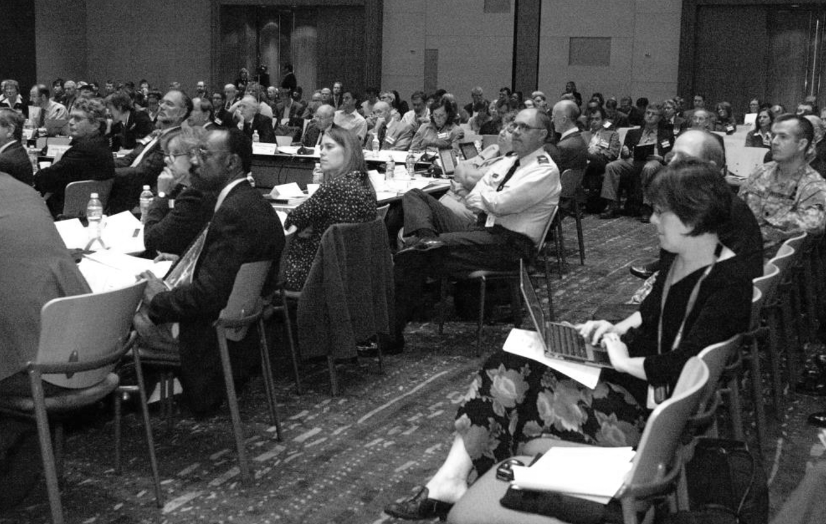
ACIP (US NITAG) meeting
1
2
3
4
ACIP members
(inner table)
1
2
General public
Ex-officio members
(outer table)
3
Liaison members and press
4
Notes:
Stakeholders are involved in the decisions, processes, and/or outcomes of the immunization program.
Role of stakeholders at meetings:
Participate in preparatory discussions
Do NOT vote on final recommendations
May actively participate as
Ex-officio members
Liaison members
Special invitees to meetings

Slide 18
Review your NITAG composition

Slide 19
NITAG Functioning

Slide 20
NITAG SoPs
DOCUMENT DESCRIBING ROLES AND RESPONSIBILITIES, AUTHORITY, AND MAIN STAKEHOLDERS:
Authority
Objective and scope
Duties
Agency to whom committee reports
Support
Meeting frequency and duration, closed vs. open
Committee termination (if Charter is not renewed)
Membership (core, ex-officio, liaison) - including requirements, term duration
Subcommittees and Working Groups
Recordkeeping
Let us look at a few of these aspects in more detail

Slide 21
Meeting Frequency and Format
MEETING FREQUENCY
At least once a year, with flexibility for additional meetings as needed.
OPEN VS CLOSED MEETINGS
Countries may select option appropriate for them. Open meetings increase transparency and may improve public acceptance but may make the process less efficient.
VOTING RIGHTS
Only core members have the power to vote. Members of the secretariat, ex-officio members, liaison members, and invited experts can contribute to discussions but cannot vote.

Slide 22
NITAG Process
Before meeting
During meeting
After meeting
Agenda defined by Chair based on MoH needs
Secretariat gathers technical documents related to the agenda topics to help with discussions and recommendations
Work groups meet, discuss and prepare draft recommendations for committee to consider
Secretariat sends agenda and technical materials to NITAG members at least 2 weeks prior to the meeting
NITAG members request clarification in advance of meeting
Secretariat prepares minutes of meeting (recipients should be outlined in guidance document). Summary minutes must be reviewed, and endorsed by NITAGs within 60 days of the meeting
Secretariat prepares draft recommendations for MOH, based on NITAG decisions
MOH receives recommendations, decides whether to accept/implement
Chair solicits agenda topics for next meeting
Work groups regroup, discuss, make plans regarding unresolved and ongoing issues
Members declare interests, recuse themselves from issues with conflict and sign confidentiality agreements
Work group presentations
Discussion, deliberation, request for additional information
Vote or consensus on recommendations to MOH

Slide 23
Agenda setting
CHAIR SHOULD TAKE THE LEAD
AGENDA SHOULD INCLUDE:
Topics based on MoH needs
Speakers, to provide background information
Reports from working group(s)
Clearly articulated questions for the NITAG to address, e.g.,
→ “Should rotavirus vaccine be introduced?”
→ “Should the age for measles vaccination be changed?”

Slide 24
NITAG Working Groups
Composition:
Include NITAG and secretariat members and invited experts
Work Group chair should be a NITAG member
Roles:
May be permanent (e.g., “adult immunization”) or ad hoc (e.g., “pandemic influenza”)
Meet throughout the year (in person and by teleconference)
Study specific questions and conduct rigorous, in-depth reviews of vaccine-related data
Draft recommendation options for NITAG to consider
Present the evidence and the proposed recommendation during NITAG meeting
To learn more about NITAGs Work Groups - their purpose and functions, click here

Slide 25
NITAG recommendations
RECOMMENDATIONS ARE ISSUED BY THE NITAG TO THE MOH, WHO DECIDES WHETHER TO ACCEPT AND IMPLEMENT THEM
PROCESS
Consensus OR vote OR both
Secretariat prepares draft recommendations for MoH, based on NITAG decisions
BASIS FOR RECOMMENDATIONS
Disease burden and epidemiology
Vaccine efficacy, effectiveness, safety
Societal impact and public health
Cost effectiveness, affordability
Approaches taken in other countries

Slide 26
Activity time: SWOT Analysis
Which aspects are you doing well?
Which aspects might need improvement?
STRENGTHS
WEAKNESSES
OPPORTUNITIES
THREATS
What opportunities can you use to help reach your goals?
What obstacles are you facing in reaching your desired goals?
Notes:
Divide the participants into the same groups as earlier. Get participants to individually reflect on each of the points in the activity 2A – 2 and based on their notes, to then discuss it with their groups and present a SWOT analysis of their group (activity 3A - 1). End the activity by getting the participants to reflect and use the gaps identified, to make necessary changes to their charter (activity 3A – 2). Total activity time = 40 mins.

Slide 27
Indicators monitored annualy by WHO
Legal or administrative basis
1
Formal terms of reference
Added in 2021
2
One recommendation issued
Disclosure of interests
3
Recommendation adopted
by the MoH
5 areas of expertise
4
* These indicators are the minimum set of indicators to monitor progress at the global level.
* More in-depth performance evaluation tools for review of NITAGs process, functionality and output are available
One meeting a year
5
Agenda circulated one week
before meeting
6
Notes:
A functional NITAG has been defined as one that meets all of the six following process indicators agreed upon in 2010 by WHO and its partners

Slide 28
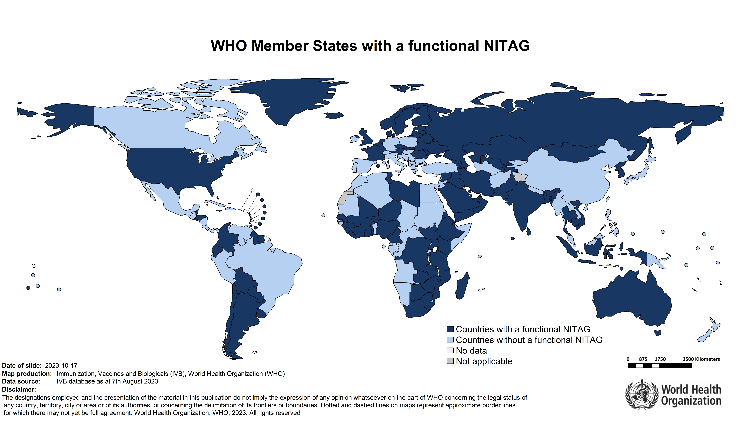
Does your NITAG meet the 6 indicators?
Data from the JRF 2022
Notes:
A functional NITAG has been defined as one that meets all of the six following process indicators agreed upon in 2010 by WHO and its partners

Slide 29
The global NITAG Network
The goal
The activities
Membership
Share information, experiences and best practices
Ensure materials and guidance developed are relevant
Inform WHO and partners the needs and priorities
Face-to-face meeting
Webinars
Monthly update
Review of guidelines, tools and trainings
Members are countries
All NITAGs can join
Express interest to the GNN secretariat or regional office
Designate two focal points
A
B
C
D
Notes:
A functional NITAG has been defined as one that meets all of the six following process indicators agreed upon in 2010 by WHO and its partners

Slide 30
Conclusion and Takeaways
NITAGs are an independent, scientific, advisory group
NITAG’s composition includes:
core members (credible experts from diverse areas of expertise)
ex-officio members (government agencies) and
liaison members (other stakeholders).
Technical support is offered by the Secretariat
The NITAG functions and processes must be formalized
NITAGs must aim to meet all 6 indicators of a well-functioning NITAG
Notes:
Encourage participants to share their takeaways and to ask any further queries they might have

Slide 31
Additional training resources: Hyperlinks
Training modules to help establish a NITAG
This resource page provides access to training modules, case studies and helpful reference documents such as :
Operational guide for NITAGs
Guidance paper
Declaration of Interest form
Confidentiality agreement form

Slide 32
Thank you for your attention!
This version has been reviewed by Pooja Pradeep, Instructional Designer

