Slide 1
Documenting NITAG work: Best Practices
These slides were developed with inputs from the GNN, the WHO regional offices and our partner the US-CDC
Endorsed by the GNN and updated in May 2023
unsplash.com

Slide 2
Before we start
Note the alphabet code assigned on the pre-training form. Ensure you take a form with the same alphabet code for the later post-test.
All forms are anonymous. The letter code is only to ensure uniformity.
The forms are a short quiz and will not be graded. The evaluations will be used only to help us enhance our training packages.
🙂
All the best!
NITAG: Documentation Best Practices
Notes:
Code and group the pre and post test forms using random alphabets. Distribute the pre-test form to all participants. Each participant has to keep note of the alphabet code on their form to ensure they receive the same alphabet code form for the later post test.

Slide 3
Learning objectives
On completion of this training, you will be able to:
Explain the importance of NITAG documentation
Identify the different types of documentation
Assess the documentation process of your NITAG
Develop an action plan to improve or update your NITAG documentation
NITAG: Documentation Best Practices

Slide 4
Group activity (15 minutes)
A new member Mr. Thomas has joined your NITAG and today is his first day at your NITAG’s meeting.
Group 1 is tasked to orient and familiarize him to your NITAG’s core work areas.
Group 2 responds to Mr. Thomas’ comment regarding the previous organization that he was part of who considered documentation to be tedious and felt it wasn’t a very valuable task to put time into.
Notes:
Divide the participants into 2 groups. The first group discusses and presents the orientation task and the other group discusses and presents ways to respond to Mr. Thomas’s notion about documentation. Each group gets 15 minutes to discuss and 5 minutes to present.

Slide 5
Group one
A new member Mr. Thomas has joined your NITAG and today is his first day at your NITAG’s meeting. You have been tasked to orient and familiarize him to your NITAG’s core work areas.
1
ORIENTING THOMAS to the different ways your NITAG documents their work:
What are the different format/mediums by which the work is currently documented and archived at your NITAG?
What serves as good reference documents to orient Thomas to all the previous and ongoing NITAG work areas?
Where can he find these documents? Showcase these as a flowchart.
Notes:
Divide the participants into 2 groups. The first group discusses and presents the orientation task and the other group discusses and presents ways to respond to Mr. Thomas’s notion about documentation. Each group gets 15 minutes to discuss and 5 minutes to present.

Slide 6
Group two
A new member Mr. Thomas has joined your NITAG and today is his first day at your NITAG’s meeting. You have been tasked to orient and familiarize him to your NITAG’s core work areas.
2
AFTER THE ORIENTATION Mr. Thomas mentions the previous organization that he was part of, considered documentation to be tedious and felt it wasn’t a very valuable task to put time into. How would you respond to him? Would you support or challenge his notion about documentation? You can base your responses on the below:
Has there been any added value to your NITAGs visibility / advocacy / operational functioning because of your documentations?
Are there any implications your NITAG has faced or foresee by not documenting the work efficiently?
Notes:
Divide the participants into 2 groups. The first group discusses and presents the orientation task and the other group discusses and presents ways to respond to Mr. Thomas’s notion about documentation. Each group gets 15 minutes to discuss and 5 minutes to present.

Slide 7
Meeting minutes
WHO IS IT FOR?
Internal use within NITAG
WHO DOCUMENTS IT?
The secretariat prepares the minutes of the meeting
Summary minutes must be reviewed, and endorsed by NITAGs within 60 days of the meeting
The minutes must be archived by the secretariat in a dedicated folder (or on the website) along with the agenda of the meeting, the DOI, the recommendations to the MoH, the Confidentiality Agreements, Background Documents etc.
PURPOSE:
Provide a tangible record of the meetings
Document the deliberation process, and the decisions taken, with rationale
Track next steps and action items

Slide 8
Meeting minutes
+
BENEFITS?
Orient new NITAG members to the previous/ongoing areas of work
helps reduce the training time involved and
ensures stronger continuity and consistency for all members to efficiently perform
In case of any discrepancy with the MoH where a specific decision is recommended by the NITAG but information on its determination is required by the MoH – the NITAGs can then refer back to the detailed minutes
This assists in better collaboration with the MoH and
Increased transparency and trust with the public

Slide 9
Checklist: What should minutes include?
✅ Date and time of the meeting
✅ Names of participants, chair, and members unable to attend, and whether quorum was met
✅ Acceptance/corrections to previous meeting minutes
✅ List of agenda items or topics
✅ Assessment of the Declaration of Interests
✅ Summary of discussion for each agenda item, not verbatim, using a standard format
✅ Actions taken or agreed to be taken
✅ Next meeting date and time
A standardized template for the minutes will ensure
all items are covered in each meeting

Slide 10
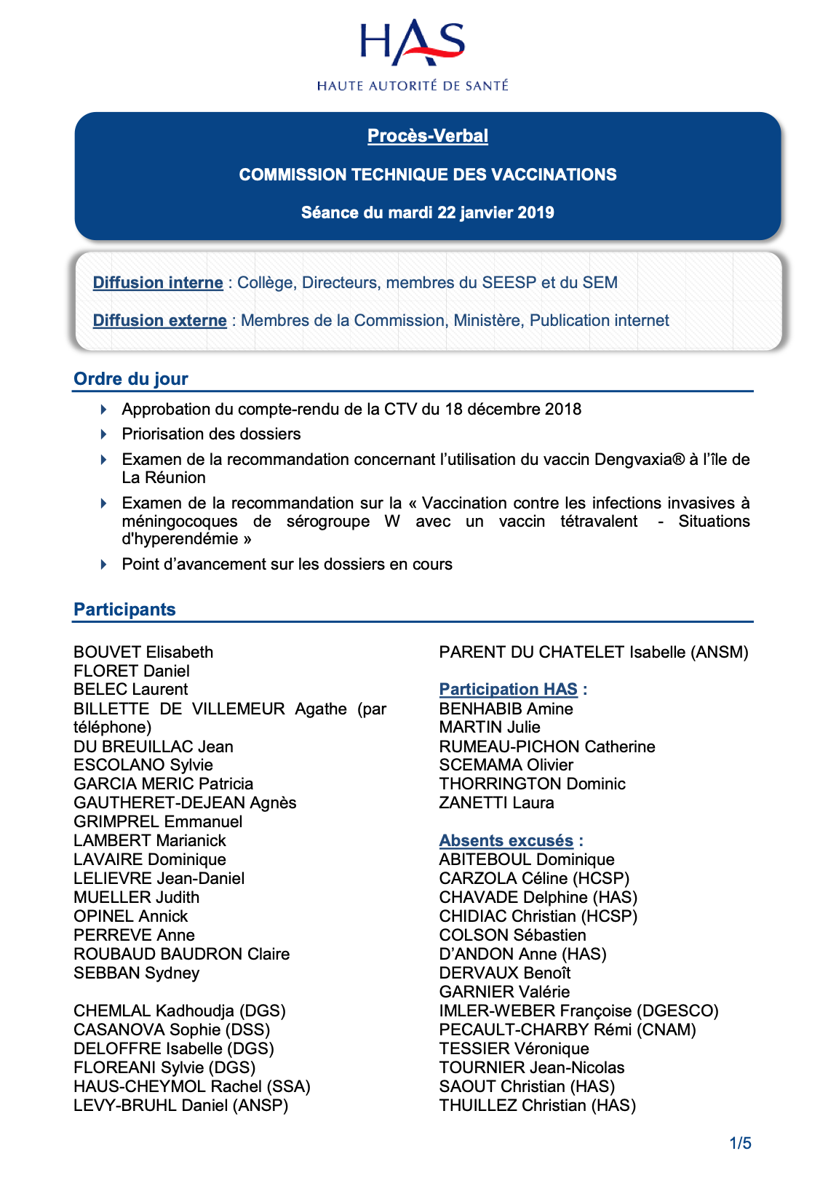
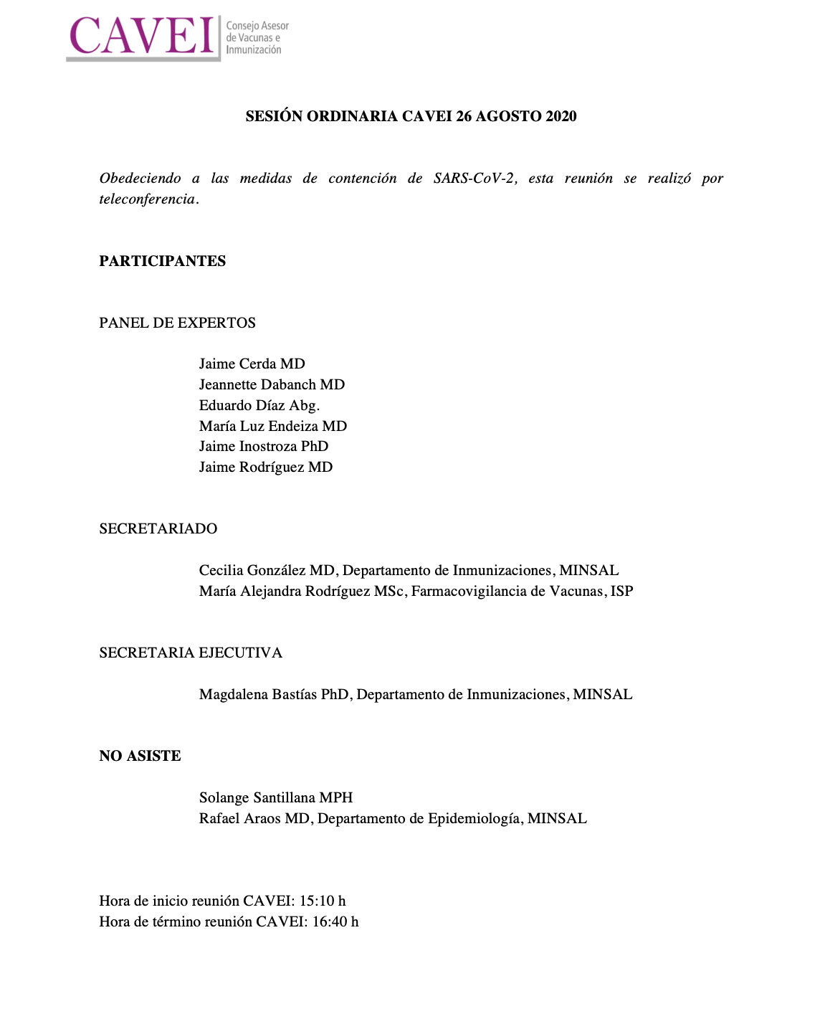
Example of minutes
CTV, France
JCVI, UK
ACIP, USA
CAVEI, Chile

Slide 11
Report of Recommendations to MoH
WHO IS IT FOR?
MoH decision-makers
WHO DOCUMENTS IT?
The secretariat drafts the recommendations based on NITAGs decisions and sends it to the MoH
The MoH receives the recommendations and can decide whether to accept/implement them
The recommendations must be archived by the secretariat in a dedicated folder or on the website along with the rest of the important NITAG meeting documents
The recommendation sent to the MoH should ideally not exceed 2-4 pages but a more detailed report on how the decisions were formulated can be drafted and published on the website
PURPOSE:
Provide a summary of the evidence supporting the recommendation, rationale for decision
Support decision-making

Slide 12
Report of Recommendations to MoH
FORMAT
Consistent, clear, logical flow, short (ideally less than 2-4 pages)
Standard format
Specify the MoH focal point and procedures of communications in the NITAG Charter or other documentation.
CONTEXT OF THE QUESTION
What is the question?
Who added the topic to the NITAG agenda?
→ Was it in the annual work plan, or suggested by the Ministry of Health or a NITAG member?
Why was the topic added to the agenda?
→ Opportunity of introduction of a new vaccine, ongoing epidemic, new data on vaccine efficacy or disease burden?
?

Slide 13
Content of Recommendations to MoH (2)
1
General information on the subject:
Brief description of the problem identified
2
Describe the evidence search process
3
Findings on the disease, health systems and context issues, systematic reviews or literature reviews which were taken into account in the recommendation framework
4
The implementation considerations
5
Discussion of the evidence
6
Proposed recommendation clearly formulated
Notes:
Evidence search process: to be transparent and accessible to policymakers and stakeholders (mostly unfamiliar with research language)

Slide 14
Wordings of the report: Best practice
DO’s
DON’T
IS RECOMMENDED
IS NOT RECOMMENDED
POLICY-MAKERS SHOULD
SHOULD NOT
WE SUGGEST
POLICY-MAKERS MIGHT
The language used to convey recommendations should be
unambiguous and only strong recommendations must be provided.
Notes:
https://www.who.int/immunization/sage/Guidelines_development_recommendations.pdf?ua=1

Slide 15
Checklist: Suggested sections for the MoH report
✅ Policy question
✅ Disease burden
✅ Vaccine efficacy and risks
✅ Economics
✅ Programmatic considerations
✅ Values
✅ Recommendation specifying vaccine, age groups, number of doses and schedule, if relevant

Slide 16
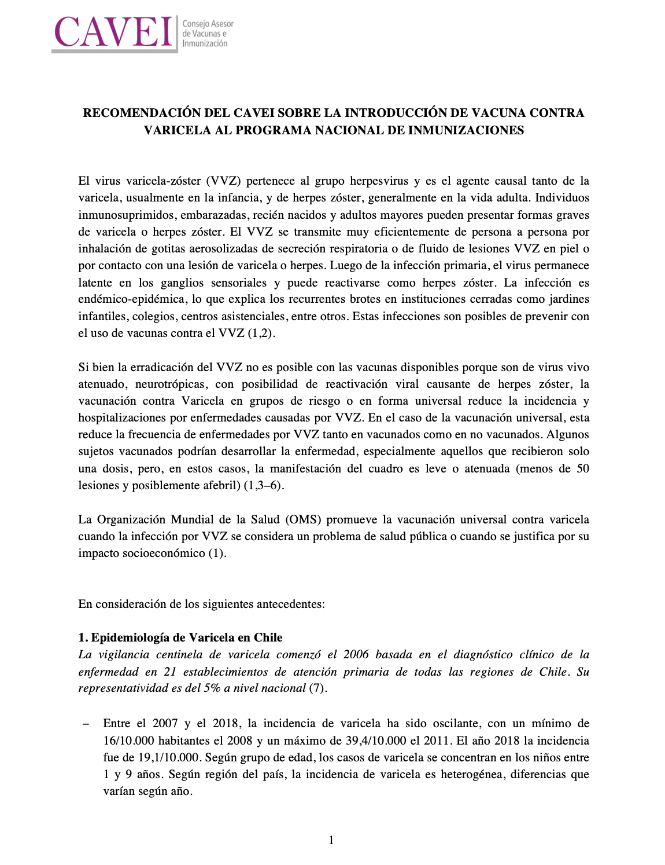
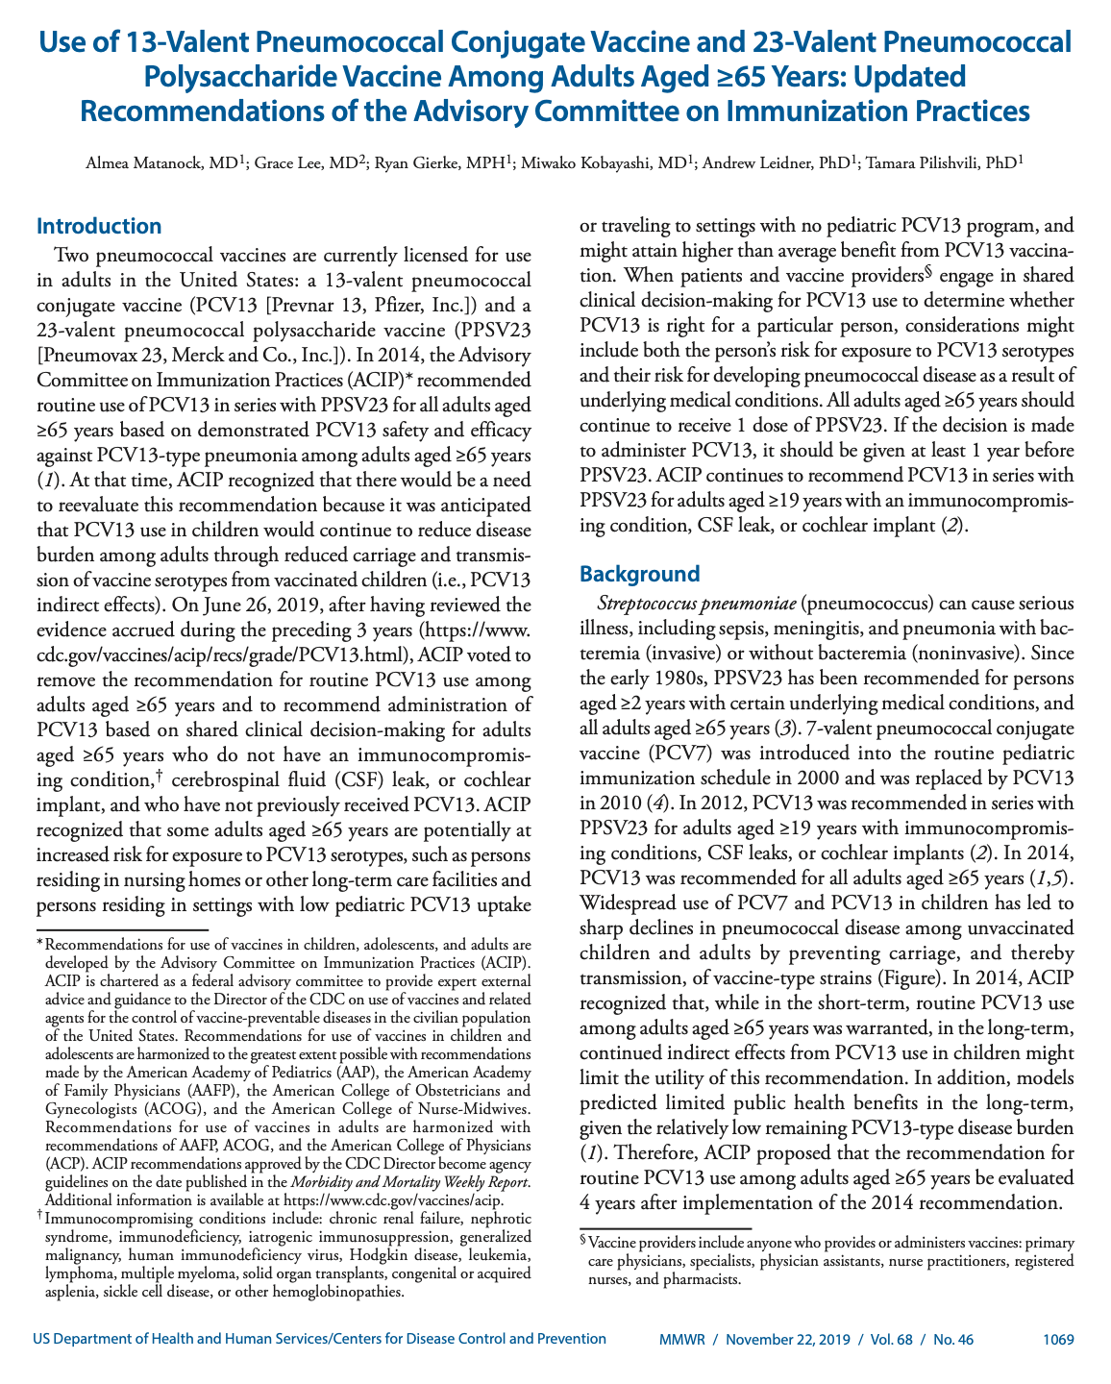
Example
Examples of more detailed report of recommendations that can be published:
Chile
USA
Canada
France

Slide 17
Check-in Activity
MoH has requested a recommendation on whether to introduce Rotavirus vaccine (RVV) in the routine schedule.
After the presentation of proposed recommendations by the WG, the NITAG voted and accepted one recommendation. The person who usually summarizes and writes the meeting minutes was not present. Another member (Mr. X) completed this task. The final 18-page minutes produced by Mr. X included detailed suggestions that the policy makers might consider and highlighted a few aspects that the MoH must avoid during the implementation process.
Mr. X then sent off the document to the MoH. Two weeks later he learned that the document had been inadvertently sent to the wrong official.
What are the main problems in this scenario?
What do you think can be done to prevent such a situation from happening again?
Notes:
Notes for discussion:
Part 1:
Length of the document – 18 pages contains too much detail for decision-making level at the MoH. The document should briefly and clearly lay out the recommendations and justification.
Content of the document – wordings (focus on ‘Do’s’ and not ‘Don’t’ / use strongly worded recommendation – not ‘suggestions’’. Avoid the phrasing of ’might’)
Lack of clear focal points and procedures to communicate recommendations to the MoH
Part 2:
1) Develop a standard format for communicating recommendations to the MoH.
2) Specify the MoH focal point and procedures of communications in the NITAG Charter or other documentation.
3) All NITAG members must review the meeting minutes and approve it

Slide 18
Websites: Dissemination to the general public
WHO IS IT FOR?
General public
WHO SHOULD OVERSEE THE DOCUMENTATION FOR THE WEBSITE
The secretariat must oversee and approve the documents to be uploaded on the website
WHERE SHOULD THE WEBSITE BE HOSTED?
It should be hosted as a subsection under the website of the Secretariat
PURPOSE AND BENEFITS
Advocacy and recognition for your NITAG
Helps enhance credibility, transparency and trust
Helps attract and recruit experts
+

Slide 19
Checklist: Potential items to include on the NITAG websites
✅ A short bio with the NITAG’s terms of reference
✅ List of the NITAG members and their background (helps show diversity in expertise)
✅ Declaration of interests (helps increase transparency)
✅ Current working groups
✅ Yearly workplan
✅ Meeting agenda and minutes if possible
✅ The NITAG’s recommendation reports (helps increase transparency)

Slide 20
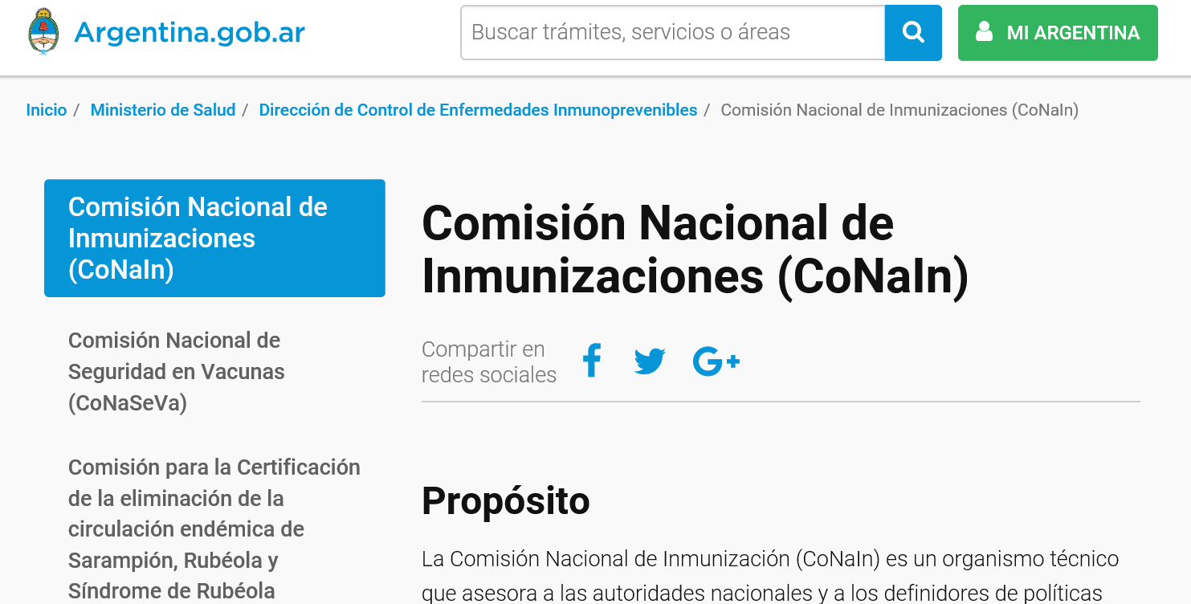
Example of NITAG websites

Slide 21
Publication of recommendations (Optional)
WHO IS IT FOR?
Scientific community, researchers
WHO DOCUMENTS IT?
Can be initiated by the Secretariat, Chair or the Work Group Lead
PURPOSE
Provides technical details and rationale for decision
Lends credibility to recommendations
BENEFITS
Spreads awareness of ongoing updates in the field – e.g.: introduction of a new dose or significant change in vaccination dose to a specific population group, etc.
Visibility and credibility for your NITAG
FORMAT
Depends on journal
CONTENT
What does the scientific community need to know?
Vaccine, target population, age, doses, schedule, delivery strategy, AEFI surveillance
Technical rationale
+

Slide 22
Example
⤵️
Background paper to the decision to recommend the vaccination with the inactivated herpes zoster subunit vaccine in Germany
https://link.springer.com/content/pdf/10.1007%2Fs00103-019-02882-5.pdf

Slide 23
Takeaway messages
Documentation is important
Within 24 hours, most people forget an average of 70% of new information → immediate and clear documentation is key
Documentation helps with visibility, credibility and smooth operations for all NITAGs
Standardize all your documentation templates to bring consistency and ensure smooth functioning
Assign a person responsible to record and archive all documents
Designate a focal point at your NITAG and at the MoH to ease the communication channel and collaboration
Record and archive all documents efficiently

Slide 24
Action plan
Refer to your takeaway sheet and formulate an action plan with the checklists provided.
Medium | Tasks to achieve | Resources available and/or needed to achieve the task | Who will record and archive this document? Where will it be archived? | Remarks or Notes
Meeting minutes | Follow the checklist and make a note of what needs to be worked on Create a standardized template for all minutes Ensure minutes are reviewed, and endorsed by NITAGs within 60 days of the meeting
Reports to the MoH | Clear, logical flow and ideally less than 2-4 pages (1,500 words) Develop a standard format for communicating recommendations to the MoH. Specify the MoH focal point and procedures of communications in the NITAG Charter. Follow the checklist and make a note of what needs to be worked on
Your NITAG Website | Follow the checklist and make a note of what needs to be worked on
Notes:
Ask the participants to refer to the takeaway sheet and fill out their individual action plans. Open the floor for any queries/discussions.

Slide 25
Before we end
Please take a post-training form with the same alphabet code as your earlier pre-training form.
All forms are anonymous. The letter code is only to ensure uniformity.
The forms are a short quiz and will not be graded. The evaluations will be used only to help us enhance our training packages.
All the best!
🙂
NITAG Conflict of Interest – Prevention and Management
Notes:
Each participant must take the post-training form corresponding to the same alphabet code of their earlier pre-training form.

Slide 26
Thank you for your attention!

