Slide 1
Prevention and Management of Conflict of Interest in NITAGs
These slides were developed with inputs from the GNN, the WHO regional offices and our partner the US-CDC
Endorsed by the GNN in September 2020
unsplash.com

Slide 2
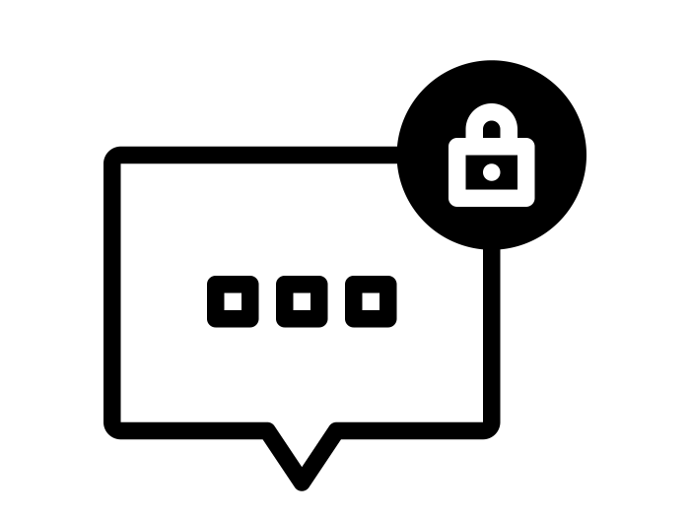
Before we start
Note the alphabet code assigned on the pre-test. Ensure you take a form with the same alphabet code for the later post-test.
All forms are anonymous. The letter code is only to ensure uniformity.
The forms are a short quiz and will not be graded. The evaluations will be used only to help us enhance our training packages.
🙂
All the best!
Notes:
Code and group the pre and post test forms using random alphabets. Distribute the pre-test form to all participants. Each participant has to keep note of the alphabet code on their form to ensure they receive the same alphabet code form for the later post test.

Slide 3
Learning objectives
On completion of this training, you will be able to:
Describe what constitutes a Conflict of Interest at the NITAG level
Identify the difference between an Interest vs Conflict of Interest in the context of a NITAG
Outline different ways to prevent Conflict of Interests
Summarize the key points involved in developing a CoI Prevention and Management Policy
Analyze different NITAG scenarios to identify potential CoI and develop best practices

Slide 4
Interests
Exercise
We all have interests (personal, family, work etc.).
Can you list a few interests that play an important role in your life?
NITAG Conflict of Interest – Prevention and Management
Notes:
Interests are manifested as actions one takes to accomplish their goals and commitments in their social roles.

Slide 5
Competing Interests
Do all interests automatically turn into a Conflict of Interest?
No. All Interests do not automatically turn into a Conflict of Interest.
→ Sometimes our interests are in conflict; often not.
Conflict of Interests are situations that are highly context-specific.
Assessing if an interest is in conflict cannot be made by oneself.
NITAG Conflict of Interest – Prevention and Management

Slide 6
What is a Conflict of Interest (CoI) for NITAGs ?
A CoI is a situation where multiple and competing interests of a person play out at the same time, having the potential of compromising their objective decision-making process.
In the context of NITAG, any member whose interest may affect, or may reasonably be perceived to affect, the member's objectivity and independence represents a potential Conflict of Interest.
NITAG Conflict of Interest – Prevention and Management

Slide 7
Interests that may exert an influence
NITAG Conflict of Interest – Prevention and Management

Slide 8
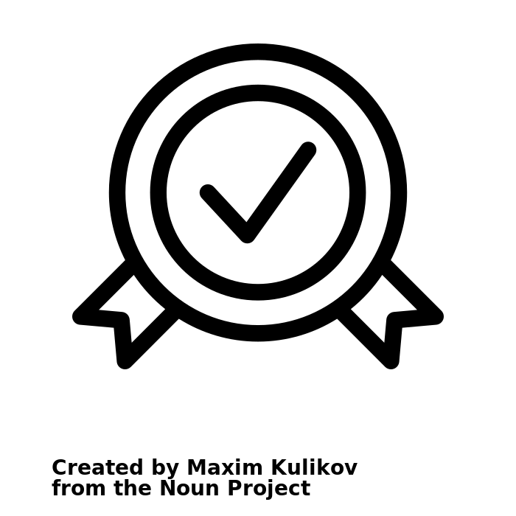
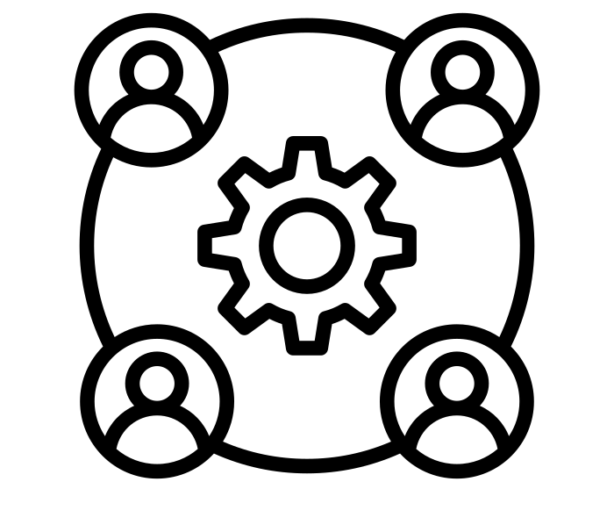
Types of interest
Do all interests automatically turn into a Conflict of Interest?
A financial interest involves material advantage such as a financial benefit, with or without direct money transfer
A personal interest involves an advantage benefiting the member personally
A non personal interest involves an advantage benefiting the organization in which the member works
A non-financial interest involves a non-material advantage
Consultancy, employment, gifts, support to attend a conference
Grant, fellowship for a post in the department
Shareholdings, intellectual Property rights (e.g. patent)
Personal beliefs or affiliation to an organization with some official position → intellectual bias
Personal network
Career advancement and honors
Directly
Indirectly: through one or more close family members
NITAG Conflict of Interest – Prevention and Management

Slide 9
Other features of an interest to be considered
SIGIFIANCE
SPECIFIC vs NON SPECIFIC
ADVANTAGE, NON-DISADVANTAGE, DISADVANTAGE
CONSIDERATION RELATIVE TO TIME
E.g. financially significant or insignificant (varies with context)
Depending whether it is directly related to a topic under discussion or not
An advantage/benefit for the member (or a third party – an individual or an organization the member is linked to)
A prevention of a disadvantage (for the member or a third party)
A disadvantage for a third party, in a context of competition
+/-
NITAG Conflict of Interest – Prevention and Management

Slide 10
Interests can exist in relation with?
Private/Public vaccine manufacturers
Private donors, including not-for-profit organizations
Technical agencies and public health institutes
Public donor agencies and international financial institutions
Governments
Academia and research institutes
Professional associations
NITAG Conflict of Interest – Prevention and Management

Slide 11
Interest vs Conflict of Interest?
Example of an interest leading to a CoI:
If a member works as a consultant on the rotavirus vaccine for vaccine manufacturer X – and if they had to discuss and vote about the introduction of a rotavirus vaccine in the NIP:
It would be a CoI as they may be influenced by the work performed or by the “marketing message” delivered by the manufacturer.
They may also have personal interests related to the marketing of this vaccine (e.g. being offered a position or invitations to international conferences).
Such a consultancy may alter their impartiality.
NITAG Conflict of Interest – Prevention and Management

Slide 12
Interest vs Conflict of Interest?
Example of an interest not leading to a CoI:
However, for another topic on the NITAG agenda which is not related to rotavirus vaccine nor the vaccine manufacturer X, it is unlikely that this interest would influence the member during the discussion.
NITAG Conflict of Interest – Prevention and Management
Notes:
These illustrations highlight why all interests do not necessarily lead to a CoI and how they are context-specific in nature

Slide 13
Management and prevention of conflicts of interest
NITAG Conflict of Interest – Prevention and Management

Slide 14
Guidelines to help NITAGs in developing, implementing and improving their own policy
Available in English only
Can be downloaded from the NITAG Resource Page
NITAG Conflict of Interest – Prevention and Management
Notes:
Mention that the presentation is based on these guidelines and that this is available on their key drive as well as online

Slide 15
Exercise
Take a few minutes and reflect on what strategies can help prevent Conflict of Interests and enhance trust in your NITAG.
Get innovative with your ideas and share your reflections.
Formulate a checklist based on all the suggestions.
NITAG Conflict of Interest – Prevention and Management
Notes:
Using a flipchart, the facilitator can note down all the points the participants share. Encourage the participants to share the reasoning behind their suggestions and encourage everyone to participate. Note down the points in the form of a checklist. Keep this checklist handy as the notes curated here, will be used later for slide 28.

Slide 16
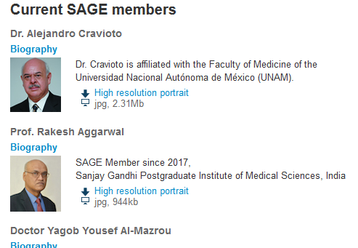
Different ways to prevent CoI and keep the trust!
Use of a systematic process for issuing evidence-based recommendations including evidence to decision framework.
Disclosure of a short CV and affiliation.
Policy to prevent and manage conflicts of interest.
Declaration of interests with careful review.
Encourage members to regularly and proactively declare their interests.
Foster a culture of transparency, objectivity and trust.
NITAG Conflict of Interest – Prevention and Management

Slide 17
Purpose of a policy to prevent and manage CoI
Prevent situations in which NITAG members, secretariat & WG members perform their work on the NITAG while having conflicting interests – both:
Actual influence of any interest or perception of a possible CoI
Contribute to maintain/enhance transparency of the recommendation-making process.
Maintain the trust and credibility.
So critical that it is one of the six basic indicators set out by WHO to assess functionality of a NITAG.
NITAG Conflict of Interest – Prevention and Management

Slide 18
Who is protected by the CoI prevention and management policy?
The NITAG member, who could otherwise be suspected, rightly or wrongly, of having been influenced by outside interests during the recommendation-making process.
The NITAG, which could otherwise appear as not legitimate, independent and science-based.
The MoH and National Immunization Programme whose decisions could otherwise lack credibility (could fuel vaccine hesitancy).
NITAG Conflict of Interest – Prevention and Management

Slide 19
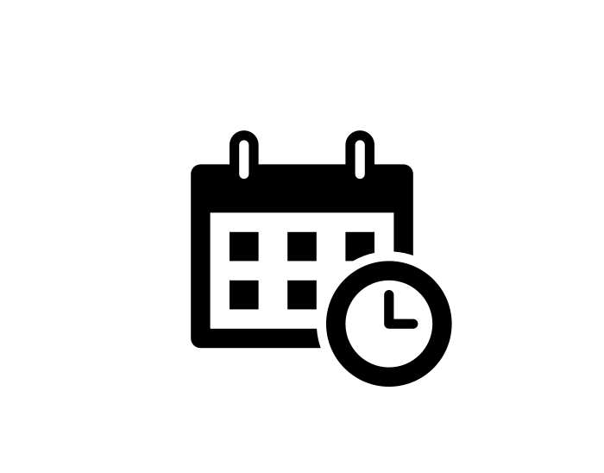
Policy process – Step one
DECLARE INTERESTS
1
WHO?
NITAG Secretariat, core members including NITAG Chair and working group members i.e. those involved in the decision making and review of evidence.
WHEN?
When being appointed
Annually or before each meeting
Proactively, if there is a meaningful
Change
→ NITAGs can declare their interests, using the Declaration of Interest form available here
NITAG Conflict of Interest – Prevention and Management

Slide 20
Policy process – Step two
RECORD AND DISCLOSE
2
WHO?
The NITAG Secretariat.
HOW?
Recorded in a consistent format and made available for audit.
The more transparent the better: ideally, declarations of interests are publicly disclosed (summarized) in the meeting minutes/on the website of the NITAG.
Disclosure does not eliminate the CoI but mitigates its impact.
NITAG Conflict of Interest – Prevention and Management

Slide 21
Policy process – Step three
ASSESS
3
WHO?
The NITAG Secretariat and Chair with support of legal department if necessary.
WHEN?
Before each NITAG meeting, considering each topic to be discussed.
HOW?
By considering the following elements:
Amount of benefit and its significance
Personal versus non personal nature
Directness with regard to topic under discussion
Frequency/nature of the relationship
When the interest started/took place or will start or end
Assessment remains in part subjective and can be conducted on a case-by-case basis with specific criteria
NITAG Conflict of Interest – Prevention and Management

Slide 22
Policy process – Step four
INFORM & IMPLEMENT
4
WHO?
The NITAG Secretariat and Chair inform the NITAG member.
WHAT ARE THE POTENTIAL OUTCOMES?
Participation in the discussion AND in the decision-making
Participation in the discussion (possibly only answering questions) BUT NOT in the voting
Exclusion from both the discussion AND the voting.
Decisions should be documented and recorded.
NITAG Conflict of Interest – Prevention and Management

Slide 23
The WHO balancing test
The answer is not always black & white:
Nature, type and magnitude of the interest – and therefore the degree to which the interest may be reasonably expected to influence the expert's judgment
VERSUS
Adequacy of the measures/options available to protect the independence and integrity of the decision-making process
NITAG Conflict of Interest – Prevention and Management

Slide 24
Developing a CoI prevention and management policy
The policy of each NITAG should take the national setting into account:
Existing legislation regarding CoI-management
Standards of practice and cultural aspects regarding disclosure of interests
It must be a step-by-step process involving:
Clarification of the scope of CoIs to be prevented
Definition of the CoI-prevention process
Development of the tools to implement CoI-prevention policy
Involvement of NITAG members during the process to develop the policy is key
NITAG Conflict of Interest – Prevention and Management
Notes:
Institutional landscape (e.g. presence / role of organizations and their potential relationships with NITAG participants)

Slide 25
EXERCISE
If you are to help set up a CoI prevention and management policy for your NITAG – Can you list a few points you would take into account?
NITAG Conflict of Interest – Prevention and Management

Slide 26
Points to consider for developing a CoI prevention and management policy
Declaration process
Frequency of declaration/update
Level of details
Assessment process and rules
Categorization of interests?
Criteria to assess?
Stringency of the rules – thresholds?
Disclosure policy
Extent to which the declarations of interests are made public
Outcomes of decisions
NITAG Conflict of Interest – Prevention and Management

Slide 27
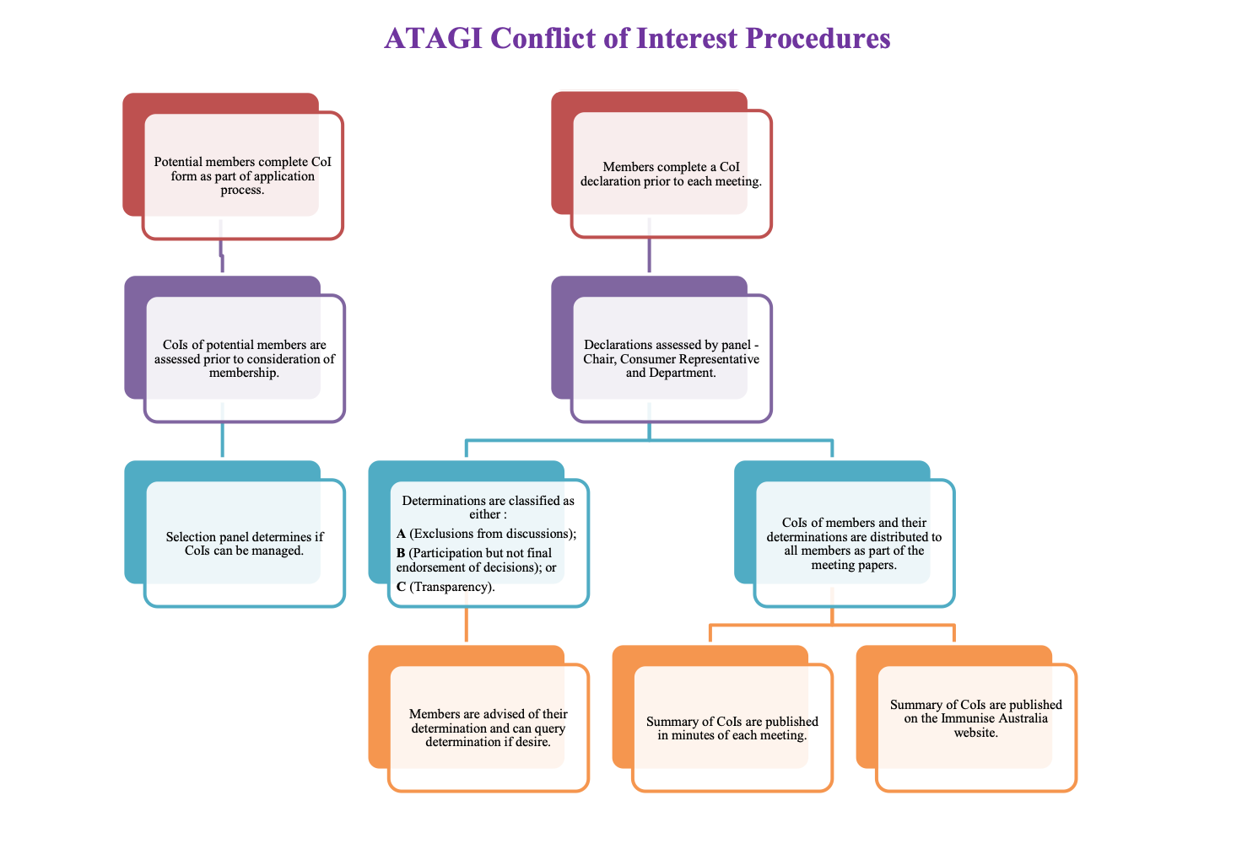
Examples of country-level NITAG CoI policy
Australia
France
USA (Pg.14)
NITAG Conflict of Interest – Prevention and Management

Slide 28
EXERCISE
What are some of the challenges you have experienced/foresee in the successful implementation of a CoI prevention and management policy at your NITAG?
NITAG Conflict of Interest – Prevention and Management
Notes:
Facilitate this as a group discussion. Link this activity with Slide 15 activity on “Different ways to prevent CoI and keep the trust!” – share the strategies the group came up with previously to see if those could be used to combat these current challenges – brainstorm other ways to combat these challenges to ensure successful CoI prevention and management.

Slide 29
Major pitfalls/challenges
Policy only on paper versus implemented
Nothing done with DoIs
Often seen as a pain - Need to educate and inform members
Lack of updating of DoI
Insufficient reporting – (pre-determination by expert of what to report). Better to report more!
Not enough specificity/details in the completed DoIs
NITAG Conflict of Interest – Prevention and Management
Notes:
Discuss possible strategies/solutions for these – in case they haven’t already been discussed in the previous slide.

Slide 30
Is this worrisome?
DISCLOSURE
☐ I have no potential conflict of interest to report
☒ I have the following potential conflict(s) of interest to report
Type of affiliation/financial interest:
Receipt of grants/research supports:
Receipt of honoraria or consultation fees:
Name of commercial company
GlaxoSmithKline, Pfizer
Curevac, Merck Vaccines
NITAG Conflict of Interest – Prevention and Management

Slide 31
Is this worrisome?
DISCLOSURE
☐ I have no potential conflict of interest to report
☒ I have the following potential conflict(s) of interest to report
Type of affiliation/financial interest:
Receipt of grants/research supports:
Receipt of honoraria or consultation fees:
Name of commercial company
GlaxoSmithKline, Pfizer
Curevac, Merck Vaccines (DSMB)
(Both research grants to my institution)
NITAG Conflict of Interest – Prevention and Management

Slide 32
Activity time: Analyse – Identify – Develop!
CASE STUDIES
NITAG Conflict of Interest – Prevention and Management
Notes:
Facilitate this as a group discussion. Link this activity with Slide 15 activity on “Different ways to prevent CoI and keep the trust!” – share the strategies the group came up with previously to see if those could be used to combat these current challenges – brainstorm other ways to combat these challenges to ensure successful CoI prevention and management.

Slide 33
Activity time: Analyse – Identify – Develop!
John Smith works only part-time (50%) for a private vaccine manufacturing company. Can he be a NITAG member?
Louise Dupont is a NITAG member. Her spouse regularly conducts consultancies for one of the companies manufacturing PCV. Revision of PCV schedule is on the next NITAG meeting agenda. What should she do?
Kalyar Win has received two grants - one to examine PCV side effects in the elderly funded by a company and one to look at factors that influence acceptance of HPV vaccine by school girls from the National Research Council. What should she do?
Samuel Daye is a member of the secretariat and ex officio to the NITAG. His son has just started as the marketing director for a local vaccine manufacturing company that makes a pentavalent vaccine for infants. What should he do?
NITAG Conflict of Interest – Prevention and Management
Notes:
Divide the participants into groups where each group gets 1 case to analyze and identity potential conflict of interests and develop recommendations on how best to manage the case.
Clarify that those who work for manufacturing companies actually work in the office of the branch of the manufacturer located in their country, not in the headquarters of the manufacturer.

Slide 34
CASE STUDY 1
John Smith works only part-time (50%) for a private vaccine manufacturing company.
Is there a conflict of interest?
Should he be a NITAG member?
NITAG Conflict of Interest – Prevention and Management
Notes:
Ask the first group to present at this stage. Follow it up with the recommended best practices on the next slide. Follow the same structure for all the rest of the cases.

Slide 35
CASE STUDY 1
John Smith works only part-time (50%) for a private vaccine manufacturing company.
Is there a conflict of interest? Yes; Financial, Personal, Direct, Current
Should he be a NITAG member? No, even if company is not producing vaccines specific to the discussion.
Why ?
1) There would be a perception that he cannot give an independent opinion because of his personal direct interest
2) The NITAG will be perceived as being under the influence of a pharma company
Consider adding to the ToRs a policy that “No member, his/her spouse, or a member of his/her immediate family can be directly employed by a vaccine manufacturer or its parent company"
NITAG Conflict of Interest – Prevention and Management
Notes:
Ask the first group to present at this stage. Follow it up with the recommended best practices on the next slide. Follow the same structure for all the rest of the cases.

Slide 36
CASE STUDY 2
Louise Dupont is a NITAG member. Her spouse regularly conducts consultancies for one of the companies manufacturing PCV. Revision of PCV schedule is on the next NITAG meeting agenda.
What should she do? She should flag this interest to the NITAG Secretariat and Chair
Is there a conflict of interest? Yes; Financial, Personal, Indirect, Specific, Significant, Current
If so, how should it be managed/how could the Secretariat manage the COI? Exclude the member from PCV discussions and vote (or only from vote)
NITAG Conflict of Interest – Prevention and Management
Notes:
She should flag this interest to the secretariat and the chair.
The assessment of risk would probably be the following: Ongoing relationship, indirect personal financial interest, specific to the topic, significant.
The secretariat should decide: Exclude the member from the PCV discussion and vote (or only vote but probably not ideal)

Slide 37
CASE STUDY 2
Louise Dupont is a NITAG member. Her spouse regularly conducts consultancies for one of the companies manufacturing PCV. Revision of PCV schedule is on the next NITAG meeting agenda.
What should she do? She should flag this interest to the NITAG Secretariat and Chair
Is there a conflict of interest? Yes; Financial, Personal, Indirect, Specific, Significant, Current
If so, how should it be managed/how could the Secretariat manage the COI? Exclude the member from PCV discussions and vote (or only from vote)
NITAG Conflict of Interest – Prevention and Management
Notes:
She should flag this interest to the secretariat and the chair.
The assessment of risk would probably be the following: Ongoing relationship, indirect personal financial interest, specific to the topic, significant.
The secretariat should decide: Exclude the member from the PCV discussion and vote (or only vote but probably not ideal)

Slide 38
CASE STUDY 3
Kalyar Win has received two grants, 1) to examine PCV side effects in the elderly, funded by a company and 2) to look at factors that influence acceptance of HPV vaccine by school girls, funded by the National Research Council.
What should she do?
Is there a conflict of interest?
If so, how could the Secretariat manage the COI?
NITAG Conflict of Interest – Prevention and Management

Slide 39
CASE STUDY 3
Kalyar Win has received two grants, 1) to examine PCV side effects in the elderly, funded by a company and 2) to look at factors that influence acceptance of HPV vaccine by school girls, funded by the National Research Council.
What should she do? She should flag this interest to the NITAG Secretariat and Chair
Is there a conflict of interest?
Re: PCV - More information is needed to determine the type of interest and the relationship of the member to the company beyond the grant
Re: HPV - More information is needed to determine the type of interest, but it poses less of a problem since it is publicly funded
If so, how could the Secretariat manage the COI?
Re: PCV - Exclude the member from PCV discussions and vote (or only from vote)
Re: HPV - Exclude the member from HPV voteclude the member from PCV discussions and vote (or only from vote)
NITAG Conflict of Interest – Prevention and Management

Slide 40
CASE STUDY 4
Samuel Daye is a member of the secretariat and ex officio to the NITAG. His son has just started as the marketing director for a local vaccine manufacturing company that makes a pentavalent vaccine for infants
What should he do? He should flag this interest to the NITAG Secretariat and Chairhe should flag this interest to the NITAG Secretariat and Chair
Is there a conflict of interest? Financial, personal, indirect, specific to vaccines, significant, current Financial, Personal, Indirect, Specific, Significant, Current
If so, how could the Secretariat manage the COI? Exclude from discussion related to the change in pentavalent use of schedule mber from PCV discussions and vote (or only from vote)
NITAG Conflict of Interest – Prevention and Management

Slide 41
CASE STUDY 4
Samuel Daye is a member of the secretariat and ex officio to the NITAG. His son has just started as the marketing director for a local vaccine manufacturing company that makes a pentavalent vaccine for infants
What should he do? He should flag this interest to the NITAG Secretariat and Chairhe should flag this interest to the NITAG Secretariat and Chair
Is there a conflict of interest? Financial, personal, indirect, specific to vaccines, significant, current Financial, Personal, Indirect, Specific, Significant, Current
If so, how could the Secretariat manage the COI? Exclude from discussion related to the change in pentavalent use of schedule mber from PCV discussions and vote (or only from vote)
NITAG Conflict of Interest – Prevention and Management

Slide 42
Take away messages
Perception of a possible CoI can be harmful for the NITAG reputation and credibility.
A CoI prevention and management policy is critical but not the only tool to avoid CoIs.
The more stringent the better – local context to be considered and appropriate balance to be found.
A CoI management policy is also about transparency to maintain/increase trust.
Issue of CoI can be sensitive, and sometimes misunderstood. Developing a policy requires involving the NITAG members.
Conflict of interests are not only about dealing with industry.
Use the guidelines and please share experience with peers within the network.
NITAG Conflict of Interest – Prevention and Management
Notes:
Ask the participants to share their key takeaway messages as well.

Slide 43
Before we end:
Please take a post-training form with the same alphabet code as your earlier pre-training form.
All forms are anonymous. The letter code is only to ensure uniformity.
The tests are a short quiz and will not be graded. The evaluations will be used only to help us enhance our training packages.
All the best!
🙂
NITAG Conflict of Interest – Prevention and Management
Notes:
Each participant must take the post-training form corresponding to the same alphabet code of their earlier pre-training form.

Slide 44
Thank you for your attention!
This version has been reviewed by Pooja Pradeep, Instructional Designer

