Slide 1
NITAG secretariat checklist
Louise Henaff, Technical officer
NITAG training
2022

Slide 2
Agenda
Drafting Internal Procedures.
Developing a Work Plan and Establishing an Annual Budget.
Work Groups.
Collect evidence / Gather technical documents related to agenda topics.
Documenting NITAG work.
Enhancing the NITAG into the policy process.
Evaluation tasks

Slide 3
Overall objectives
This slide deck provides an easy structure to the Secretariat work routine and provide a one-stop access to all key resources that can assist with efficient functioning.
The checklist below has been divided into “core” and “desirable” tasks to also clarify recommended and essential tasks as well as assist with tips and suggestions on desirable tasks that could assist NITAG secretariats with the NITAG functioning.
It provides links, guidance and resources that can help facilitate the functioning of your Secretariat, enhance the capacity of your NITAG and serve in the quality improvement process of your NITAG towards meeting the global assessment criteria.

Slide 4
Drafting internal procedures (CORE)
Standard operating procedures
SOP VS TOR
A NITAG SOP is an important document that formally outlines the authority and scope of the NITAG. It documents the NITAG’s mandate, purpose, scope of action of the NITAG-related activities as well as the membership terms of reference, funding, and functioning aspects.
Having a clear and well-defined SOP provides clarity and helps as a reference and guide for all members (especially new-comers) to follow.
SOP is a terminology used for documentation that provides an in-depth overview encompassing all operating procedures and aspects of the committee. Terms of Reference (TOR) specifies and defines the boundaries for specific projects (for instance: TOR for your NITAG Work Groups).
The following NITAG SOP and NITAG TOR can help clarify this distinction:
NITAG Bahrain SOP
NITAG ATAGI COVID – 19 Work Group TOR
Notes:
As secretariats, a core function is to develop, maintain and monitor relevant internal rules and procedures applicable to the NITAG for its operations

Slide 5
Drafting internal procedures (CORE)
Interest Prevention and Management Policy
Confidentiality Agreement Form
As a Secretariat, you can help prevent and manage interests in your NITAG by:
Developing and implementing a NITAG interest management policy which all NITAG members adhere to.
The written policy must define the types of conflicts applicable to all NITAG members (core members, liaison members, ex-officio members, working group members, ad hoc experts).
It must comprehensively describe a process for declaring, assessing, and managing interests in the NITAG. More details and guidance for this process can be found here
A Declaration of Interest form that can be adapted to your NITAG can be found here. As a secretariat, it is recommended to keep records of all declarations.
To protect confidential information produced by a NITAG, it is necessary to have a Confidentially Agreement Form.
All members must sign this form and follow this procedure on joining and/or also sign annually.
A template for a Confidentially Agreement Form can be accessed here

Slide 6
Developing a workplan and annual budget (desirable)
NITAG Work Plan
Annual Budget:
The annual work plan defines the NITAG work based on the National Immunization Programme (NIP) needs.
The work plan represents a collaborative effort of the NITAG chair, secretariat, and core members. The work plan should be validated by all NITAG core members.
The key elements to consider while developing your NITAG work plan are:
Defining the different areas of work for a set time period.
Identifying the activities intended for each area of work.
An estimated timeline for task completion.
Estimated budget requirements.
NITAG workplan country example : NITAG Canada: 2019-20 Workplan
The NITAG should develop an annual budget that covers all activities of the NITAG specified in the work plan and which specifies the sources of funding.
A senior level MOH staff must receive this annual budget and a budget line for NITAG activities should appear in the overall MOH budget.
Notes:
Establishing a work plan helps identify priority issues to be addressed by the committee during a specific period like a trimester, semester, or year. This provides clarity that can assist in organization and planning of the NITAG meetings and working needs. A work plan shall not, however, prevent a NITAG from responding timely to crisis or requests from the Ministry of Health that were not originally part of the working plan.

Slide 7
Coordinating work groups (desirable)
Functioning
References:
The need, work tasks and charge for a WG is to be discussed and agreed by the NITAG.
The WG should have succinct TORs with specific objectives and clear deliverables.
A NITAG core member must chair the WG.
The duration of WG may vary (permanent or time bound).
As Secretariats, it is important to include in the agenda regular updates from the WG to let the NITAG know about progress, even before the WG is ready to propose recommendation options for discussion / vote.
SAGE existing and previous working groups
Work Group Terms of Reference example: ATAGI’s (NITAG Australia) COVID – 19 Work Group TOR available here
ACIP (NITAG USA) Work Group purpose, composition, rules of engagement and roles and responsibilities here.
Notes:
The purpose of a Work Group (WG) is to support a NITAG in providing technical assistance on a particular policy question, especially in situations where the policy question requires very detailed consideration and substantial input from subject matter experts. WG might also be a regular working strategy within some NITAGs in order to make the production of material and recommendations more efficient. WG comprise 1-2 (or more) core NITAG members along with additional subject matter experts as required. WG can help increase the effectiveness of NITAG deliberations along with the Secretariat’s support for drafting of the recommendations.

Slide 8
Collect evidence / Gather technical documents related to agenda topics (CORE)
Background document
Key technical documents and data to consider
The secretariat or a technical WG should develop a background document, using a consistent format including:
Introduction to present the policy question.
Methods to describe how evidence was searched for, reviewed, and synthesized.
Results to present the findings per key outcome.
Discussion to synthesize the findings and consider the limitations.
Recommendation options including logical rationale.
References and the recommendation framework.
The NITAG members must receive these background documents at least 2 weeks prior to the meeting, to review them.
Access local and/or regional data
Familiarize yourselves with WHO position papers
Obtain input from relevant governmental agencies (National immunization programme, National regulatory agency, etc.), via direct consultation or invitation as ex-officio members
For recommendations from other NITAGs, check the NITAG Resource Center
The SYSVAC registry, a systematic review database, contains reviews on vaccine efficacy, effectiveness, safety, coverage that have been critically appraised using AMSTAR 2 (A MeaSurement Tool to Assess systematic Reviews 2) and if freely accessible here
Notes:
Once the agenda for a NITAG meeting is defined, the Secretariat (if established so by the SOP) must gather technical documents related to the agenda topics to help the Work Groups or the NITAG members with their consideration / deliberations towards the recommendations.

Slide 9
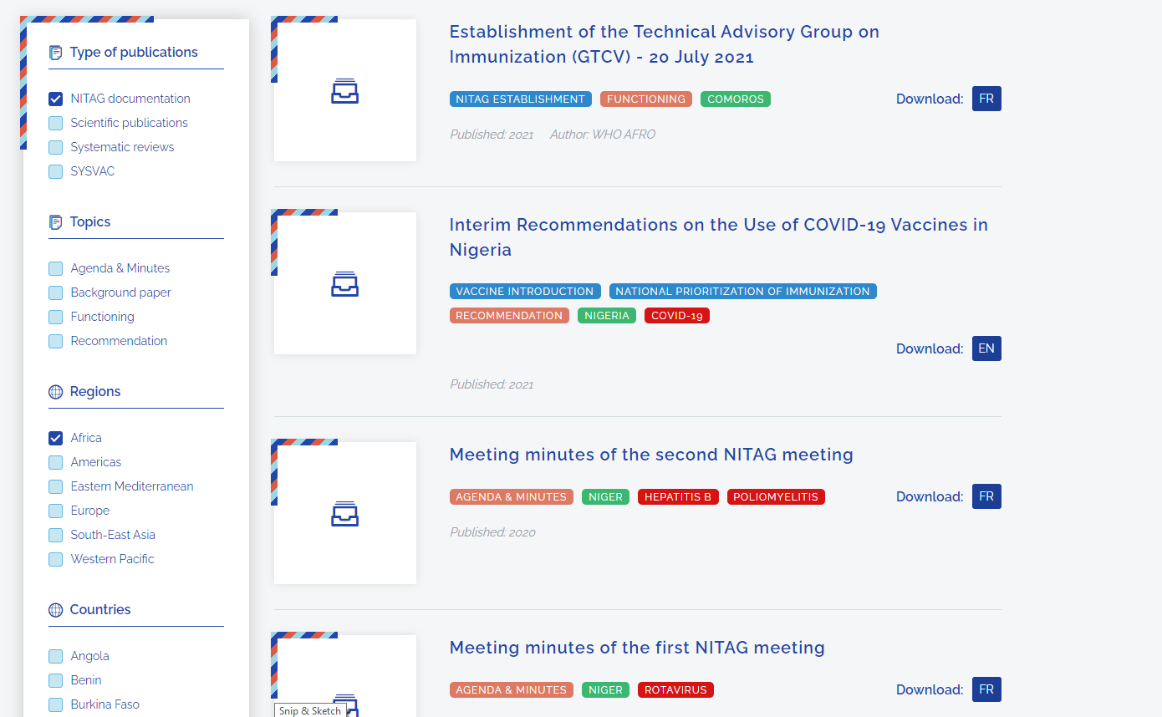
Documenting NITAG work (CORE)
Background document
Website or NRC
All materials fully documenting the recommendation making process must be archived by the secretariat in a dedicated folder and, ideally, on the website, including
the agenda of the meeting,
the Declaration of Interests,
the recommendations to the MoH,
the Confidentiality Agreements,
Background Documents etc.
The existing archived NITAG documentation should imply guaranteed access to it, either upon request or by an open-source online repository.
The NITAG can request a dedicated page on the website of the institution hosting the secretariat.
If there is no website but the publication of NITAG documentation is allowed, the NITAG can use the WHO website (NRC) to promote its recommendations.
Notes:
It is the NITAG’s secretariat’s role to draft and archive all NITAG documentation (mainly the meeting background documentation and minutes and the drafting of the MoH recommendations) and optionally – overseeing the NITAG website (if available) and publishing scientific journal articles (if desired) .
Thorough and clear documentation provides a tangible and transparent record for future use and clarification needs. This also promotes public and key stakeholders trust in the NITAG’s decision making process.
Documentation also provides an added advantage of orienting new NITAG members to ongoing/previous work and ensures stronger consistency for all members to efficiently perform.

Slide 10
Enhancing the NITAG into the policy process (desirable)
National visibility
The Global NITAG community
The NITAG must be well-recognized by key national immunization stakeholders and the scientific community.
The NITAG recommendations should be accessible by the scientific and professional organizations and immunization stakeholders.
The general population must also be aware of the NITAG’s role.
To enhance such visibility, NITAGs can collaborate with relevant partners based on interest and should network with the key stakeholders in the national, regional, and global immunization landscape.
Networking and learning from other NITAG experiences and peers can also help in sharing experiences, best practices, and enhancement of overall functioning.
The Global NITAG Network (GNN) is a platform to promote such connections. All NITAGs can join the network free of charge, by registering here.
Notes:
The purpose of a Work Group (WG) is to support a NITAG in providing technical assistance on a particular policy question, especially in situations where the policy question requires very detailed consideration and substantial input from subject matter experts. WG might also be a regular working strategy within some NITAGs in order to make the production of material and recommendations more efficient. WG comprise 1-2 (or more) core NITAG members along with additional subject matter experts as required. WG can help increase the effectiveness of NITAG deliberations along with the Secretariat’s support for drafting of the recommendations.

Slide 11
Evaluation tasks (desirable)
Global Indicators
Evaluation tools
Eight process indicators help with global level monitoring of NITAG functioning (eJRF) and that are publicly available through the dashboard :
A legislative or administrative mandate (Ministerial decree).
Formal written terms of reference.
At least five different areas of expertise represented among core members.
At least one meeting per year.
Circulation of the agenda and background documents at least one week prior to meetings.
Mandatory disclosure of any conflict of interest.
Issuance of 1+ recommendations by the NITAG in a year.
Adoption of one or more of the NITAG’s recommendations by the Ministry of Health.
The simplified evaluation tool, accessible here.
The comprehensive evaluation tool evaluates NITAGs in their mission of informing immunisation policy-making, using a performance definition that considers three dimensions:
Functionality: Do the NITAG’s structure and operations foster the timely generation of recommendations?
Quality: Has the NITAG developed formalised and implemented appropriate processes to ensure quality recommendations?
Integration: Is the NITAG fully integrated into the decision-making system?.
Notes:
Evaluations are crucial for the identification of functioning gaps, assessment of strengths, and evaluation of room for improvements within a NITAG. A NITAG may choose to run an evaluation at any stage of its development, even soon after its establishment, so it can plan and document processes that will improve the capacity of the NITAG. A NITAG may also decide to conduct an evaluation annually or set a time period for regular NITAG assessment. In this way, the assessment could serve as part of a quality improvement process.
The need and periodicity of a NITAG evaluation is to be discussed and agreed by the NITAG. The Secretariat can lead, co-lead or support the NITAG assessment accordingly.

Slide 12
Thank you

