Slide 1


National Immunization Technical Advisory Groups (NITAGs):
Composition and modes of functioning
These slides were developed with inputs from the GNN, the WHO regional offices and our partner the US-CDC.
Endorsed by the GNN in September 2020.
Immunization, Vaccines and Biologicals

Slide 2
Ice breaker
Find the commonality!
Notes:
Divide the participants into groups of 3/4 – each group has to take a few minutes trying to find one thing they all have in common – it could be related to their likes, dislikes etc. – the statements can’t be too general, obvious or broad – encourage the participants to find as specific details as possible – encourage the participants to get creative, engage and connect! Each group then comes forward and shares their commonality with the rest of the group.

Slide 3
Pre-test
Note the alphabet code assigned on the pre-test. Ensure you take a form with the same alphabet code for the later post-test.
All forms are anonymous. The letter code is only to ensure uniformity.
The tests are a short quiz and will not be graded. The evaluations will be used only to help us enhance our training packages.
All the best! ☺
Notes:
Code and group the pre and post test forms using random alphabets. Distribute the pre-test form to all participants. Each participant has to keep note of the alphabet code on their form to ensure they receive the same alphabet code form for the later post test.

Slide 4
Module overview
Purpose of a NITAG
Terms of reference for NITAGs
Composition of a NITAG
Role of stakeholders at NITAGs
Functioning of NITAGs
Additional resources/Takeaways

Slide 5
Learning objectives
On completion of this training, you will be able to:
Describe the purpose of a NITAG
Review the strengths and weaknesses of your NITAG composition
Assess the functioning of your NITAG
Develop strategies to improve or update your NITAG charter and other relevant internal procedures and
Identify additional resources to assist with the functioning of your NITAG

Slide 6
What are some key words you associate with your NITAG?
Notes:
Ask participants what are some key words they associate with their NITAG – how best would they describe their NITAG? Write down the responses on a flipchart (or via WordCloud if done virtually). At the end of the training, the word sheet can be relooked, and participants can share if all the words truly capture the essence of NITAGs or post the training session, if they now wish to add any additional responses as a wrap up to the training session.

Slide 7
What is a NITAG?
A body of national experts that provide technical and scientific guidance to the government (the MoH and/or the EPI) on immunization policy, norms, and practices.
An independent scientific advisory group.
    MoH officials/NIP specialists should not be core members. Rather should serve as ex-officio members.
Notes:
NITAG is not completely independent from govt because it is established by the MoH, members selected by MoH, MoH has input into agenda.
As an independent scientific advisory group, the NITAG should not include the MoH officials and the NIP specialists as core members. They should serve as ex-officio.

Slide 8
What should a NITAG do?
Conduct the best possible review of scientific evidence
Bring credibility through expertise, minimize pressure from outside interest groups, and eliminate real or apparent personal conflicts of interest
Provide timely, evidence-based recommendations on vaccine policy

Slide 9
NITAG’s terms of reference
Advise the MoH on:
    Optimal immunization policies and strategies
    Monitoring immunization program impact
    Collection of data and information
Identify need for additional data or research for evidence-based decision and policy-making

Slide 10
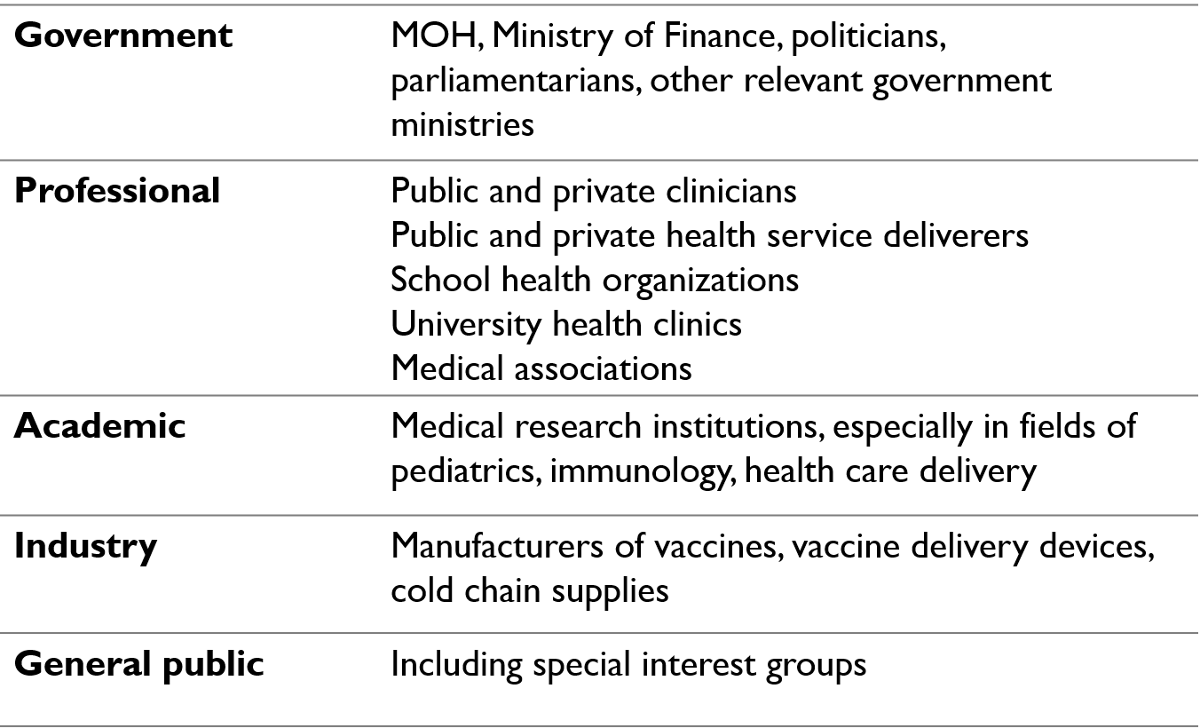



Who are the stakeholders?
Notes:
Mention involvement with NITAG will be described later in the presentation (see slide 20 and 21)

Slide 11
NITAG Composition

Slide 12
NITAG Composition
Membership
  Core
  Ex-officio (Government agencies)
  Liaison (Other stakeholders)
Technical support
  Secretariat
Ex-officio
NITAG
Chair
Liaison
Core
Secretariat

Slide 13
Core NITAG members
Eligibility:
  Senior, credible experts
  Function in their own capacity
  Must not have any direct or indirect supervisory relationship within the immunization programme
  Must not be a MoH or immunization programme employee
  Must not represent interest groups or other stakeholders
  Must declare interests
  Should represent broad range of disciplines
  Should balance gender, geography, special populations
Core

Slide 14
Core NITAG members
Suggested expertise:
Clinical physician (pediatrician, adult physician, geriatrician)
Epidemiologist
Infectious disease expert
Microbiologist
Public health expert
Immunologist, vaccinologist
Health economist
  Clinical trials expert
  Research or academic clinicians
  Health systems and immunization program
  Health systems and health delivery expert
  Logistics/cold chain expert
  Health information systems or surveillance expert
Core

Slide 15
Core NITAG members
Composition:
10-15 core members recommended
  Critical mass for decision-making
  Allows committee to continue functioning if all members are not present (quorum should be defined in advance)
  Assists in manageable discussion and decision-making
  Minimizes budget to bring members together
  Odd number may be useful for tie-breaking
  Terms should be staggered (all members should not rotate off committee at the same time)
  To avoid expertise redundancy – members must each represent diverse areas of expertise
Core

Slide 16
NITAG Chair
Criteria to consider:
  May be appointed through an external process or selected from among the core members
  Must be a senior, credible expert respected by the core members
  Should be an effective leader and efficient moderator able to guide the NITAG’s deliberations
  Should not have any direct or indirect supervisory relationship
  with the MoH/NIP
  Must run the meetings according to SOPs
NITAG
Chair
Core

Slide 17
Core NITAG members
Terms:
Selection of Members
    Should be nominated and appointed by senior government officials through a well-defined transparent process.
Rotation of members
    Limited duration of service for the core members (5-6 years) with staggering to provide continuity and ensure the terms of all members do not expire at the same time.
    In case of limited number of experts at the national level, they may choose to reappoint core members after absence from the group for a specified number of years (e.g. 2 years).
Termination
    Written SOPs must specify who has the authority to initiate the process.
    Possible reasons for termination include: not attending a specified number of consecutive meetings, conflicts of interest, breach of confidentiality etc.
  Voting
    Only core members have the power to vote on NITAG’s discussions.

Slide 18
Ex-officio members
Eligibility
  Members “by virtue of their office”
  Officials in key positions in government agencies that relate to immunization, i.e.,
    MoH officials (heads of departments, specialists)
    Vaccine licensing bodies,
    Vaccine control laboratory,
    Immunization program
    Other ministries for planning, education, finance
Terms
  Membership ends when member ceases to hold the office
  Non-voting
  Number of ex-officio members is not so important, but should be limited to those government agencies with a role in immunization
Ex- officio

Slide 19
Liaison members
Eligibility
  Representatives of professional, scientific, and civil organizations and societies with a role in immunization
  Representatives of key technical partners (WHO, UNICEF)
Terms
  Membership ends when member ceases to hold the office
  Non-voting
  Number of liaison members not so important, but should be limited to those stakeholders with a role in immunization
Liaison

Slide 20
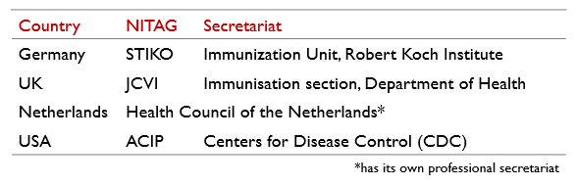
The NITAG Secretariat
A technical agency appointed by the MoH to provide scientific support
Requires substantial immunization-related expertise and experience
Examples:
Secretariat

Slide 21
Duties of the Secretariat
Gather technical documents related to agenda topics to help the NITAG & Work Groups with their discussions
Coordinate and participate in Work Groups
Send agenda and background documents to NITAG members at least 2 weeks prior to the meeting
Prepare minutes of the meeting and draft recommendations for MoH, based on NITAG decisions
Archive all relevant documents of the meeting such as agenda, background documents, minutes, declaration of interests, confidentiality agreements, recommendation reports sent to the MoH etc. to help monitor/keep track as needed
Secretariat

Slide 22
NITAG Stakeholders
Stakeholders are involved in the decisions, processes, and/or outcomes of the immunization program.
Role of stakeholders at meetings:
    Participate in preparatory discussions
    Do NOT vote on final recommendations
    May actively participate as
      Ex-officio members
      Liaison members
      Special invitees to meetings

Slide 23
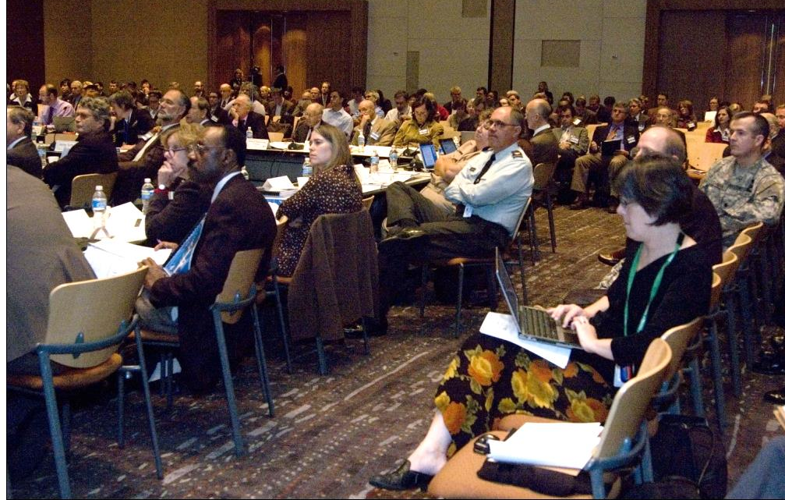
ACIP (US NITAG) meeting
ACIP members (inner table)
General public
Liaison members and press
Ex-officio members (outer table)

Slide 24
Activity time!
Review your NITAG composition
Notes:
Divide the participants into groups of 3/4. Each participant must fill in their individual notes for activity 2A-1 and then share their experiences and reflections with their group. Each group later presents which aspects were common, what features were different, and what are their recommended areas for improvement. Ask the participants to keep their notes handy as it will be useful for the next activity.
(Activity time = 15 mins for discussions + 5 mins to present)

Slide 25

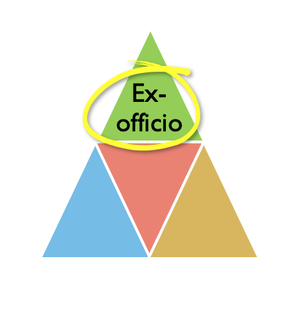
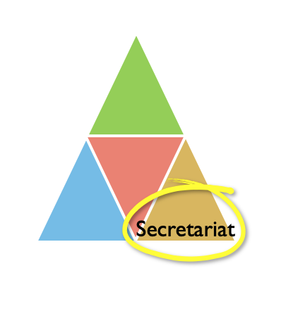
NITAG composition examples
ATAGI (Australia)
Core Members:
16 (Including Chair and Deputy Chair)
Ex-officio representatives from:
  NCIRS (National Centre for Immunisation Research and Surveillance)
  The Communicable Diseases Network Australia (CDNA)
  Immunisation and Communicable Diseases Branch, Australian Government Department of Health
  Pharmacovigilance and Special Access Branch, Therapeutic Goods Administration
  Pharmaceutical Benefits Advisory Committee (PBAC) or its sub-committees
  National Immunisation Committee
Secretariat:
The immunisation policy section, Australian Government Department of Health

Slide 26
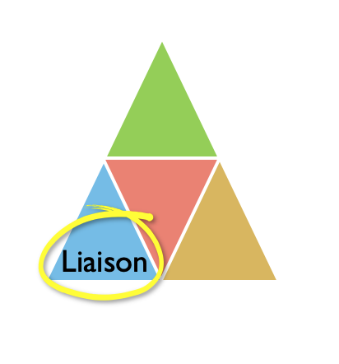
NITAG composition examples
CCVS (Senegal)
Core Members:
15 (Including Chair and Vice Chair)
Secretariat:
Director of Prevention
Ex-officio representatives:
Ministry of Health
Ministry of Economy and Finance
Ministry in charge of the Budget
Ministry of the Interior
Ministry of the Armed Forces
Ministry of National Education
Ministry of Communication, Telecommunications and the Digital Economy
Ministry responsible for Regional Planning and Local Authorities and
A representative of the Technical and Financial Partners
Liaison:
WHO, UNICEF, PATH, USAID, OOAS, AMP

Slide 27
NITAG composition examples
CAVEI (Chile)
Core Members:
7 – 12 (Including the Chair)
Secretariat:
Ministry of Health
Ex-officio representatives:
MoH Immunization and Epidemiology departments and
National Regulatory Authority, Institute of Public Health (IPH)
Liaison:
Invitations associated with specific topics/discussions

Slide 28
NITAG Functioning

Slide 29
NITAG Charter
Statement describing roles and responsibilities, authority, and main stakeholders:
  Authority
  Objective and scope
  Duties
  Agency to whom committee reports
  Support
  Meeting frequency and duration, closed vs. open
  Committee termination (if Charter is not renewed)
  Membership (core, ex-officio, liaison) - including requirements, term duration
  Subcommittees and Working Groups
  Recordkeeping
Let us look at a few of these aspects in more detail
Notes:
Discuss the charter in more detail along with the activities – on slide 41

Slide 30
Objective and Scope of NITAG Functions
Advisory
final decision made by national authorities
NITAG not in charge of the implementation
NITAG members advise in their individual capacity, based on evidence
Independent
Evidence-based
NITAGs may issue recommendations on any topic concerning vaccines and vaccination in general

Slide 31
Meeting Frequency and Format
Meeting frequency
    At least once a year, with flexibility for additional meetings as needed.
Open vs Closed meetings
    Countries may select option appropriate for them. Open meetings increase transparency and may improve public acceptance but may make the process less efficient.
Voting rights
    Only core members have the power to vote. Members of the secretariat, ex-officio members, liaison members, and invited experts can contribute to discussions but cannot vote.

Slide 32
NITAG Process
Before meeting
During meeting
After meeting
Secretariat prepares minutes of meeting (recipients should be outlined in guidance document). Summary minutes must be reviewed, and endorsed by NITAGs within 60 days of the meeting
Secretariat prepares draft recommendations for MOH, based on NITAG decisions
MOH receives recommendations, decides whether to accept/implement
Chair solicits agenda topics for next meeting
Work groups regroup, discuss, make plans regarding unresolved and ongoing issues
Agenda defined by Chair based on MoH needs
Secretariat gathers technical documents related to the agenda topics to help with discussions and recommendations
Work groups meet, discuss and prepare draft recommendations for committee to consider
Secretariat sends agenda and technical materials to NITAG members at least 2 weeks prior to the meeting
NITAG members request clarification in advance of meeting
Members declare interests, recuse themselves from issues with conflict and sign confidentiality agreements
Work group presentations
Discussion, deliberation, request for additional information
Vote or consensus on recommendations to MOH

Slide 33
Agenda setting
Chair should take the lead
Agenda should include:
    Topics based on MoH needs
    Speakers, to provide background information
    Reports from working group(s)
    Clearly articulated questions for the NITAG to address, e.g.,
      “Should rotavirus vaccine be introduced?”
      “Should the age for measles vaccination be changed?”

Slide 34
NITAG Working Groups
Composition:
Groups of technical experts selected by secretariat to gather, analyze, and prepare information to address specific questions, for presentation at NITAG meetings
Include NITAG and secretariat members and invited experts
Work Group chair should be a NITAG member
Roles:
Meet throughout the year (in person and by teleconference) to study specific questions and conduct rigorous, in-depth reviews of vaccine-related data
  Epidemiology
  Vaccine efficacy, effectiveness, safety
  Feasibility of implementation
  Economic aspects
Draft recommendation options for NITAG to consider
Maintain written record of each work group meeting for internal use
May be permanent (e.g., “adult immunization”) or ad hoc (e.g., “pandemic influenza”)
To learn more about NITAGs Work Groups - their purpose and functions, click here

Slide 35

Declaration of Interests
What is an interest?
Manifest as actions one takes to accomplish goals in their social roles
Can be personal, financial, non-financial etc.
Do all interests automatically turn into a Conflict of Interest?
No. All Interests do not automatically turn into a Conflict of Interest.
Conflict of Interests are situations that are highly context-specific.
Notes:
Alternative to the next 3 slides, feel free to insert/show the CoI animated video accessible here: https://www.nitag-resource.org/media-center/declaration-interests

Slide 36
What is a Conflict of Interest (CoI)?
A CoI is a situation where multiple and competing interests of a person play out at the same time, having the potential of compromising their objective decision-making process.
In the context of NITAG, any member whose interest may affect, or may reasonably be perceived to affect, the member's objectivity and independence represents a potential Conflict of Interest.
Because NITAG recommendations can affect vaccine sales, members must be independent of industry influence.
Declaring of interests are so critical that it is one of the six basic indicators set out by WHO to assess the functionality of a NITAG.

Slide 37
Interest vs Conflict of interests
When does an interest lead (or not lead) to a CoI?
If for instance, a NITAG member works as a consultant on the rotavirus vaccine for vaccine manufacturer X, such a consultancy may alter the member’s impartiality and they would be in a situation of CoI if they had to discuss and vote about the introduction of a rotavirus vaccine in the National Immunization Programme.
However, for another topic on the NITAG agenda which is neither related to rotavirus vaccine nor the vaccine manufacturer X, it is then unlikely that this interest would influence the member during the discussion.
What interests should NITAGs declare? Who determines if an interest is a CoI?
Members must fully declare all relevant interests without predetermining whether or not they constitute a CoI.
Once declared, assessing whether an interest constitutes a CoI is the role of the NITAG Chair and the Secretariat.

Slide 38
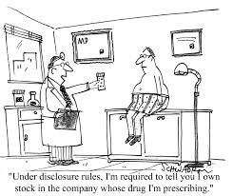
Declaration of interests
Who must declare?
NITAG secretariat, core members including the NITAG Chair and the working group members (i.e those involved in the decision making and review of evidence)
When must you declare?
When being appointed
Annually, or before each meeting
Proactively, if there is a meaningful change
  Members may be excused from part or all of a meeting
  Members abstain from voting on topic of conflict
To learn more about NITAGs Conflict of Interest training module, click here

Slide 39
NITAG recommendations
Recommendations are issued by the NITAG to the MoH, who decides whether to accept and implement them
Process
  Consensus OR vote OR both
  Guidance document should clearly specify process
  Secretariat prepares draft recommendations for MoH, based on NITAG decisions
Basis for recommendations
  Disease burden and epidemiology
  Vaccine efficacy, effectiveness, safety
  Societal impact and public health
  Approaches taken in other countries
  Cost effectiveness, affordability
Notes:
Mention the EtR framework – insert relevant links to the training / job aids once available

Slide 40
NITAG communication and documentation
NITAG communication and documentation process should be formalized in charter based on the following criteria:
How will minutes and recommendations be communicated?
What format will be used?
To whom in MoH should minutes and recommendations be submitted?
How soon after the meeting should they be submitted?
Will they be public or private?
To learn more about NITAGs training module on best practices for documenting NITAG work
click here

Slide 41
Activity time: SWOT Analysis
Strengths
Weaknesses
Threats
Opportunities
Which aspects are you doing well?
Which aspects might need improvement?
What opportunities can you use to help reach your goals?
What obstacles are you facing in reaching your desired goals?
Notes:
Divide the participants into the same groups as earlier. Get participants to individually reflect on each of the points in the activity 2A – 2 and based on their notes, to then discuss it with their groups and present a SWOT analysis of their group (activity 3A - 1). End the activity by getting the participants to reflect and use the gaps identified, to make necessary changes to their charter (activity 3A – 2). Total activity time = 40 mins.

Slide 42
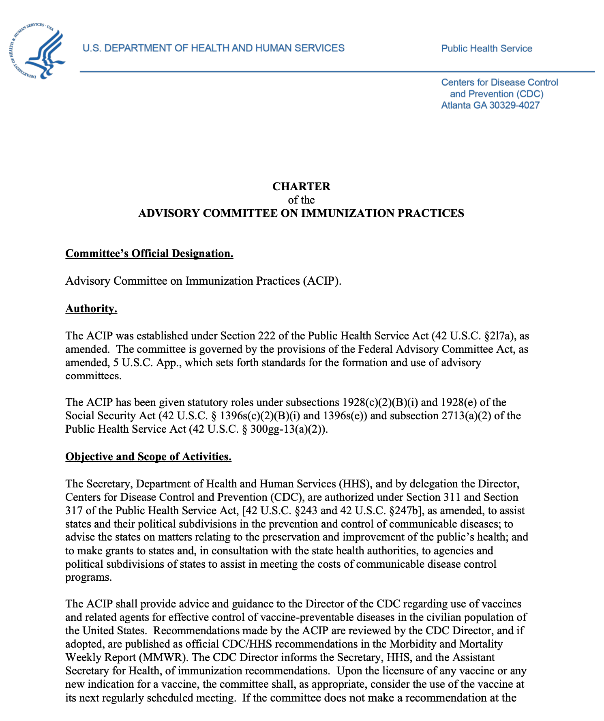
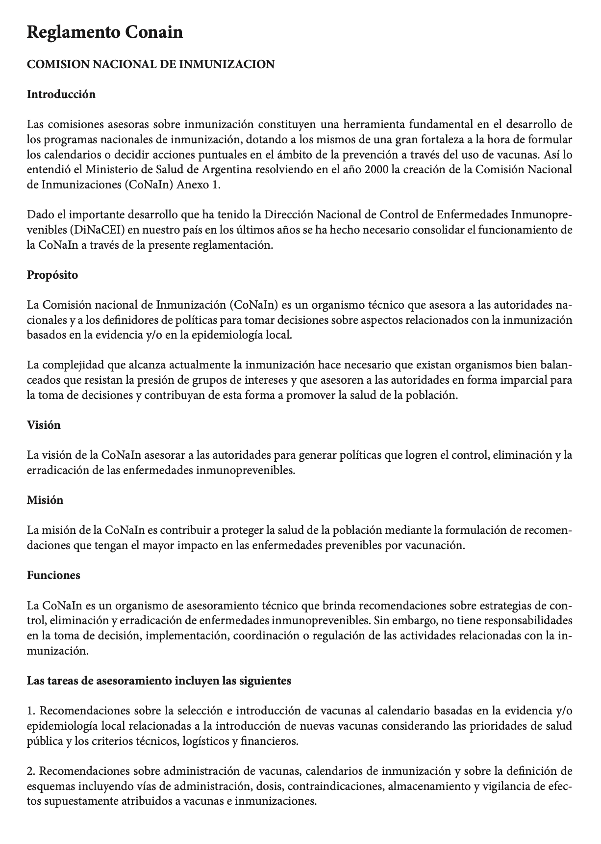

Examples of a NITAG Charter
ACIP
(USA)
CoNaIn (Argentina)
CTV (France)

Slide 43
6 indicators of a well functioning NITAG
A legislative mandate (Ministerial decree).
Formal written terms of reference.
At least five different areas of expertise represented among core members.
At least one meeting per year.
Circulation of the agenda and background documents at least one week prior to meetings.
Mandatory disclosure of any conflict of interest.
*These six indicators do not guarantee the functionality of the NITAG but are the minimum set of indicators that helps with monitoring of progress at the global level.
*More in-depth performance evaluation tools for review of NITAGs process, functionality and output are available online at the NITAG Resource Center.

Slide 44
Does your NITAG meet the 6 indicators?

Slide 45
The Global NITAG Network
The Global NITAG Network (GNN) is a platform to help promote connections between the different NITAGs and share information, experiences and best practices.
All NITAGs can join the network free of charge.
The GNN meets once a year and organizes virtual webinars.
Monthly update on recent recommendations are sent to all GNN members
To know more about the mission, the trainings being offered and the registration process click here

Slide 46
Conclusion and Takeaways
NITAGs are an independent, scientific, advisory group
NITAG’s composition includes:
  core members (credible experts from diverse areas of expertise)
  ex-officio members (government agencies) and
  liaison members (other stakeholders).
  Technical support is offered to the NITAG by the Secretariat.
The NITAG functions and processes must be formalized in the charter
NITAGs must aim to meet all 6 indicators of a well-functioning NITAG
Notes:
Encourage participants to share their takeaways and to ask any further queries they might have

Slide 47
Additional training resources: Hyperlinks
Training modules to help establish a NITAG This resource page provides access to training modules, case studies and helpful reference documents such as:
  Operational guide for NITAGs
  Guidance paper
  Declaration of Interest form
  Confidentiality agreement form

Slide 48
Post-Test
Please take a post-test form with the same alphabet code as your earlier pre-test form
All forms are anonymous. The letter code is only to ensure uniformity.
The tests are a short quiz and will not be graded. The evaluations will be used only to help us enhance our training packages.
All the best! ☺

Slide 49
Thank you for your attention!
This version has been reviewed by Pooja Pradeep, Instructional Designer.

