Slide 1
Session 4 Developing NITAG recommendations: Work group and NITAG background documents

Slide 2
From policy question to recommendation
Step 1
Formulate policy question
Focus policy question
Step 2
Define criteria for decision-making
Rank criteria
Step 3
Gather, analyze evidence
Step 4
Discuss recommendation
Decide on recommendation
Assess quality of evidence
Synthesize evidence
Prepare background documents
Who does?
Secretariat or Work Group
Notes:
You’ll recall that in the last session, we mentioned that Step 3 may be conducted by a Work Group. We will now talk about the purpose of a Work Group and how to establish one.

Slide 3
Work Group (WG): purpose
Provide technical assistance to NITAG on a particular policy question
Involve relevant subject matter experts and key stakeholders for input
Technical
Programmatic
Other
Expected outcome
Increase effectiveness of NITAG deliberations
Notes:
The purpose of a Work Group to support a NITAG is first to provide technical assistance on a particular policy question.
A work group enables the involvement of relevant subject matter experts and stakeholders. Their input on technical matters ensures that the process of gathering and assessing evidence is comprehensive. And their input on programmatic and other matters helps ensure that the drafted recommendations are feasible and acceptable to the stakeholders.
Based on these inputs, a work group will usually increase the effectiveness of NITAG deliberations

Slide 4
Work Group (WG): other considerations
Consider establishing WG if:
Policy question requires very detailed consideration
Substantial input from subject matter experts is needed
The need and charge for a WG is discussed and agreed by Chair and Secretariat in consultation with NIP
Duration of WG may vary
Permanent, or
Time limited
Planning around WG
The decision to establish WG should be indicated in the NITAG work plan
Allow sufficient time to collect and analyse evidence
Plan agendas for regular updates from WG to NITAG
Notes:
How does the NITAG determine if a WG is needed? Generally, a WG is recommended to help the NITAG in these situations:
--if the policy question requires very detailed consideration, and/or
--if substantial input from subject matter experts.
Who makes the decision to establish a WG? The Chair and the Secretariat should discuss the need and then consult with the NIP.
The expected duration of the WG can vary:
--For some issues, a WG might be permanent. A permanent WG would be helpful for an issue that would be considered on a recurring basis, for example ‘adult immunizations’ or ‘childhood and adolescent immunizations’. Some countries have a permanent WG for influenza.
--For other policy questions, a time-limited WG would be appropriate. For example, the policy question of whether to recommend HPV vaccine.
It’s important to plan for a WG by including the needs in the NITAG work plan.
--This includes allowing enough time for the WG to collect and analyze the evidence.
--the Agendas should include regular updates from the WG to let the NITAG know about progress, even before the WG is ready to propose recommendation options for a vote. This allows the NITAG members to be informed about the evidence being gathered.

Slide 5
Work Group: best practices
Element | Best practices
Terms of reference | Goals, objectives, roles, responsibilities
Members and roles | At least 1 core NITAG member (1 serves as WG chair); at least 1 person who provides secretariat support Subject matter experts (serve in their individual capacity, not a representative of their institution) Stakeholders relevant to policy question 10 or fewer members
Member qualifications | Expertise, experience relevant to work group Provide current Curriculum Vitae Complete Declaration of Interest (with verbal updates)
Endorsement | NITAG Chair and Head of Secretariat endorse Terms of Reference and member selection
Notes:
This shows best practices for WGs
Terms of reference are important to clearly specify the WGs goals, objectives and responsibilities. This could be drafted by the secretariat and the NITAG chair.
For members and roles,
Typically one core NITAG member serves as the WG chair (there may be more core NITAG members on the WG).
Subject matter experts should be selected to serve in their own capacity as an expert, not to represent their institution. Subject matter experts should also include those in program and vaccine safety.
Stakeholders who are relevant to the policy question can provide much needed input on programmatic issues.
The size of the WG is important—it should be larger enough to provide relevant expertise and input, and some redundancy, but not too large. Recommended size is 10 or fewer.
Members should have expertise and experience relevant to the WG’s goals and objectives, they should provide a current CV, and should complete a declaration of interest. If the member’s interests change, any changes should be stated verbally during the meeting and in writing.
And finally, the WG terms of reference and composition should be endorsed by the NITAG Chair and Secretariat.

Slide 6
Work Group (WG) relationship with NITAG and MOH
WG should NOT communicate directly with MOH
WG works under coordination of the Secretariat
WG gathers and organizes information for NITAG deliberation and reports to NITAG
WG is not empowered to speak on behalf of NITAG
MOH
NITAG
WG 1
e.g., HPV
WG 2
e.g., HepB
WG 3
e.g., Flu
Secretariat
Notes:
A WG does not communicate directly with the MOH, that is with the designated official in the MOH to whom the NITAG reports.
A WG works under the coordination of the Secretariat—again, while the Secretariat is part of the MOH, when we talk about the WG’s relationship with the MOH, we are referring to the designated official to whom the NITAG reports.

Slide 7
Work group (WG) responsibilities vis a vis Secretariat
Ministry of Health
Secretariat
NITAG
Secretariat
-Coordinates WGs
-Recruits members
-Disbands WG when
appropriate
Work Group
(NITAG member,
SMEs,
Stakeholders)
WG
-Reports to NITAG
-Provides update on evidence
-Drafts recommendation options
Notes:
This illustrates the responsibilities of the Secretariat and the Work groups
The secretariat is responsible for recruiting members, …

Slide 8
Work Group scope of work
Review the issue for discussion (broad policy question and PICO)
Develop a work plan and time lines
Technical work
Collect, review, analyse
Assess quality of evidence
Synthesize evidence (Evidence to Recommendation Table)
Prepare background documents for NITAG
Drafts recommendation options
Communications
Maintain close communications with Secretariat
Give regular updates of work to NITAG

Slide 9
Management of conflict of interests
Members report conflict of interests relevant to WG topic:
When members are selected
Proactively inform WG chair on any change in relevant interests
NITAG members or representative of Secretariat with conflict of interests should not participate in WG
Consultants with conflict of interests may participate if bring specific essential expertise:
in judgement of Chair and Head of Secretariat
conflict of interests should be declared and recorded
person should not participate in drafting policy recommendations/options

Slide 10
Work Group (WG) terms of reference
Details on WG structure, function, management
Duration: time frame (temporary, permanent)
Composition
expertise needed, relevant stakeholders
Technical issue and Deliverables
Examples:
Review and summarize evidence on X vaccine with respect to the recommendations framework questions
Propose recommendations to NITAG on introduction of X vaccine
Provide NITAG with summaries and analyses to support its decision and recommendation process
Provides NITAG with background documents
Declaration of interest, confidentiality agreement
Notes:
Terms of reference for a WG help ensure the members know what is expected of them.

Slide 11
Work group: Examples from 3 NITAGs
Work group element | JCVI¹ | STIKO² | ACIP³
Members from NITAG | Yes | 2-4 | 2
Members from secretariat | Yes | 1-2 | 1
Members as invited consultants | External experts | External experts | Subject matter expert, FDA, stakeholders
Participation of Vaccine manufacturers | Yes, with restrictions | No | Not a member, May present data
Declaration of interest | Yes | Yes | Yes
Confidentiality agreement | Yes | No | Yes
¹ Joint Committee on Vaccination and Immunisation, United Kingdom
² Standing Committee on Vaccination, Germany
³ Advisory Committee on Immunization Practices, United States
Notes:
Examples of the structure, function, and management of WG from 3 NITAGs.

Slide 12
Overview of roles, responsibilities, and interactions between NITAG and Workgroup
NITAG (Chair)
Work Group
NITAG (Chair)
NITAG Secretariat
Frames policy question
Decides need for Work group
Appoint WG Chair and members
Develops WG TORs (for NITAG Chair approval)
Compiles evidence based on predetermined criteria
At each NITAG meeting, updates NITAG on progress
Develops background document and proposed recommendations
Presents summary of evidence and proposed recommendations to NITAG
Studies background document, proposed recommendations before meeting
Engages in discussion and deliberation
Decides on proposed recommendation

Slide 13
Background documents
WG should provide background documents to the NITAG
Background documents can include:
Review of activities of WG to date (including TORs, past activities and recommendations, next steps, current members)
Summary of presentations made to NITAG both for information and for voting
Relevant publications
Evidence to recommendation framework, if applicable
Briefing document, depending on the audience

Slide 14
Briefing document
Distributed prior to full NITAG meeting
Provides succinct description of upcoming agenda items
2-3 pages for each topic area (e.g., HPV vaccine, HPV disease, , etc) related to a policy question
Can provide pertinent information for:
Other NITAG members
Non-voting participants (MoH, partners)
Observers

Slide 15
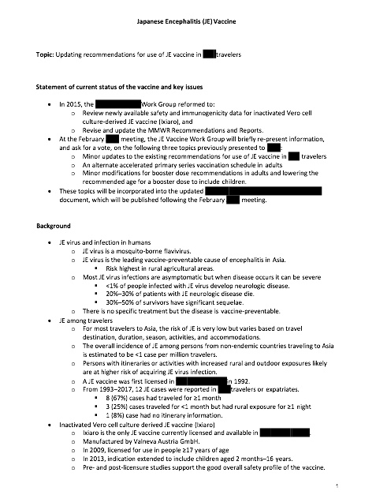
Example: briefing document topic area (pg 1)
Topic
Statement of current status of the vaccine and key issues
Background

Slide 16
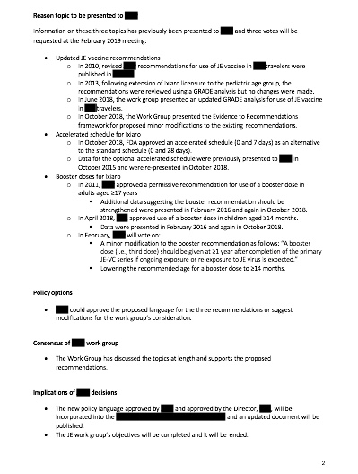
Example: briefing document topic area (pg 2)
Reason topic presented to NITAG
Policy options
Consensus of NITAG work group
Implications of NITAG decision

Slide 17
Work group: Sample topics for WG to present to NITAG
Issue considered | Currently available local data | Present to NITAG on evidence collected
Disease burden | Hospitalized lab-confirmed cases | WHO estimates Data from neighboring Country X
Vaccine efficacy and safety data | None | Review GRADE tables from WHO or SAGE Review country or regional data
Economics | Vaccine cost | Conduct assessment of cost
Programmatic | Recent cold chain inventory WHO coverage estimates | Review MOH statistics
Values, preferences of target population | None | Review data from Country X, which recently introduced the vaccine
Notes:
Let’s look at some of the topics that a WG might present to the NITAG.

Slide 18
Work group: example of HPV vaccine WG presentations in 2005 to the ACIP (U.S. NITAG)
Agenda item and presentations | Purpose, Action | Presider/Presenting
10 February 2005
HPV Work Group Update | Information | Dr. X (Merck) Dr. Y (GSK) Dr. Z (HPV work group)
30 June 2005
HPV Work group overview and presentations HPV natural history of disease Cervical cancer epidemiology, Pap screening and burden of disease HPV vaccine cost-effectiveness | Information | Dr. Z (HPV work group) Dr. Q (Subject matter expert) Dr. Q (Subject matter expert) Dr. R (external consultant)
27 October 2005
HPV vaccine | Information Discussion | Dr. Z (HPV work group)
NB. GRADE was not being used at the time of these deliberations.
Notes:
Many NITAGs start a work group before the vaccines are licensed so that the NITAG has reviewed the evidence and is ready to make a recommendation as soon as the vaccine is licensed.
This shows the process of the ACIP work group on HPV in gathering evidence and updating the ACIP. Note that the purpose of these three meetings was for information and discussion, not for a vote.

Slide 19
Work group: example of HPV vaccine WG presentations in 2006 to the ACIP (U.S. NITAG)
Agenda item | Purpose, Action | Presider/Presenting
21 February 2006
Introduction Overview HPV HPV Epidemiology in the U.S. Brief review of cervical cancer in the U.S. GSK bivalent HPV vaccine clinical trial data Merck quadrivalent HPV vaccine clinical trial data Cost effectiveness of HPV vaccine Mathematical modeling of HPV vaccine Behavioral issues related to use of HPV vaccine Recommendation options | Information, discussion | Dr. B, Chair HPV work group Dr. Q (Subject matter expert) Dr. Q (Subject matter expert) Dr. Q (Subject matter expert) Dr. Y (GSK) Dr. X (Merck) Dr. R (external consultant) Dr. Z (HPV work group)
29 June 2006
Quadrivalent HPV vaccine trials Discussion Plans for post-licensure monitoring Plans for post-licensure safety studies Discussion Review of cost-effectiveness analyses Discussion Public comment Proposed recommendations for quadrivalent HPV vaccine | Information Information Information Information Vote | Dr. X (Merck) Dr. X (Merck) Dr. Q (Subject matter expert) Dr. R (external consultant) Dr. B, Chair HPV work group

Slide 20
Overview of roles, responsibilities, and interactions between NITAG and Workgroup
NITAG (Chair)
Work Group
NITAG (Chair)
NITAG Secretariat
Frames policy question
Decides need for Work group
Appoint WG Chair and members
Develops WG TORs (for NITAG Chair approval)
Compiles evidence based on predetermined criteria
At each NITAG meeting, updates NITAG on progress
Develops background document and proposed recommendations
Presents summary of evidence and proposed recommendations to NITAG
Studies background document, proposed recommendations before meeting
Engages in discussion and deliberation
Decides on proposed recommendation
Notes:
To summarize,…

Slide 21
Exercise G—Establishing a work group
See participant and facilitator versions
Provide template slides for feedback to the plenary

