Slide 1
Session 3 From Policy Question to Recommendation

Slide 2
From policy question to recommendation
Step 1
Formulate policy question
Focus policy question
Step 2
Specify evidence to be collected
Rank outcomes
Step 3
Gather, analyze evidence
Step 4
Discuss recommendation
Decide on recommendation
Assess quality of evidence
Synthesize evidence
Prepare background documents
Notes:
How does the NITAG go from a policy question to developing a recommendation?
Facilitator should walk participants through the slide as follows:
This graphic shows the steps in the process. In the course of this workshop, we will go into detail for each of these steps. And you will participate in group exercises in which you will conduct some of these steps.
For now, let’s look at this briefly:
The 1st step is the Formulating and focusing the policy question. This is a prerequisite for starting the process.
The 2nd step involves specifying evidence to be collected. And then ranking the outcomes to prioritize data collection.
The 3rd step includes gathering evidence—we will discuss various options.
Where relevant, you will assess the quality of that evidence.
Then the NITAG will synthesize the evidence to draft a recommendation. We will use a tool for this step.
The final step is for the NITAG to discuss the recommendation and when ready to make a decision on it.
In this session, we will cover steps 1, 2 and 3.
Any questions?

Slide 3
Formulate broad policy question
Should routine rotavirus vaccination of infants be recommended in Germany?
Should PCV13 be administered routinely to all adults?
Should rubella vaccine be recommended for children in routine immunization programme?
Who does?
NITAG, MoH or both
Notes:
The broad policy question is just that—broad. This is often how the MOH words its request to the NITAG. Later, the NITAG will focus the question, but at the beginning it is non-specific.
Comment about the fact that when we talk about the MOH in this presentation, we are referring to the high level official within the MOH with which the NITAG chair or Secretariat interacts. We are not referring to the Secretariat, even though the Secretariat is part of the MOH. This is because the Secretariat’s role is to provide support to the NITAG, not to represent the MOH.
These are some examples. Read each question.
Who is responsible for formulating the broad question?
Click--Sometimes the NITAG may formulate the policy question, for example, when knowledge of pending licensure of a new vaccine is known to NITAG members. In this case, the NITAG chair or Secretariat may bring the question to the MOH for consideration.
Sometimes, the question is jointly developed by the NITAG and MOH based on regular communication or discussions.

Slide 4
Broad policy question
Every policy decision comes with desirable and undesirable effects or outcomes
Desirable outcomes
lower mortality
reduced hospital stay
reduced duration of disease
reduced resource expenditure
Undesirable outcomes
adverse reactions
costs of treatment for adverse events
costs of implementation
strain replacement
Notes:
Every decision to implement an intervention comes with desirable and undesirable effects.
Click--Desirable outcomes or benefits of a vaccine introduction may be lower mortality, reduced hospital stay, reduced duration of disease, reduced resource expenditure.
What other desirable outcomes may there be? Reduced morbidity, reduced duration of disease…
Click--On the other hand, Undesirable outcomes or harms of the intervention may include adverse reactions, costs of treatment for adverse events, …
When developing a recommendation, the NITAG should consider both the benefits and the harms and make a judgement about the balance between the two.
Click—
Are the benefits large? Are the harms small? Do the benefits outweigh the harms?

Slide 5
Specific policy question: The PICO method
Purpose of PICO Question:
Clarifies the question—assists in initial assessment of relevance.
Guides reviewer how to search for evidence on the effects of the intervention, check whether studies are eligible, conduct analysis.
What is it?:
P = Target Population for vaccination (e.g., age range, medical conditions)
I = Vaccine Intervention (e.g., product, doses, schedule)
C = Comparison (e.g., placebo, no vaccination, control, standard care, existing vaccine, other prevention options)
O = Outcomes of vaccination (e.g., anticipated benefits or harms)
Notes:
Once you have the broad policy question, the NITAG needs to narrow or specify the question. The specific policy question can be developed using the PICO method. This is just one of many ways to organize your thought process. The purpose of the PICO question is to clarify the question and to facilitate the search for evidence on benefits and harms of the proposed intervention or vaccine.
The PICO question specifies the population for the intervention, the intervention, the comparison (or what the intervention will be compared with), and the outcome of the intervention.
There will often be more than one PICO question for each policy question.
In the next few slides, we will review some broad and specific policy questions.

Slide 6
Draft specific policy question
Example 1:
Broad policy question: Should routine rotavirus vaccination of infants be recommended in Germany?
“PICO” Question: Should rotavirus vaccine be recommended, over no vaccination, to be administered to infants (<6 months of age) to reduce the number of RV infections requiring hospital admission in children < 5 years of age in Germany?
Population: Children at age <6 months in Europe or other industrialized countries
Intervention: RV vaccine licensed in Germany
Comparison: No vaccination/placebo
Outcome: RV-gastroenteritis, severe RV-gastroenteritis, RV-death, RV-hospitalization, nosocomial RV-gastroenteritis, severe gastroenteritis (any pathogen), intussusception, Kawasaki, reactogenicity
Notes:
In this example, the broad policy question is—Should routine rotavirus vaccination of infants be recommended in Germany?
Which parts of the PICO question are specified?
Does it include Population and Intervention? What are they?
Does it include Comparison and Outcome.
Let’s look at the PICO question (read aloud PICO question). How did the PICO question further specify the population?
What is the comparison?
What is the outcome? Are there other potential outcomes of use of rotavirus vaccine?
How would using this PICO question focus the search for evidence? It would prompt the NITAG to gather evidence on studies that include these outcomes
Below for reference only
Rotavirus
Position paper (January 2013) Original English and French versions pdf, 950kb
References pdf, 319kb
Grading of scientific evidence (Tables 1-4: RV1 and RV5 protection in young children) pdf, 215kb
Grading of scientific evidence (Table 5: 3rd dose of RV1; Table 6: partial vaccination) pdf, 141kb
Grading of scientific evidence (Table 7: Safety of 1st dose at different ages) pdf, 74kb
Summary of WHO position paper on rotavirus vaccines pdf, 73kb
Presentation: Summary of key points - WHO position paper on rotavirus vaccines pdf, 79kb

Slide 7
Draft specific policy question
Example 2:
Broad policy question: Should PCV13 be administered routinely to all adults aged ≥65 years?
“PICO” Question: Should single dose of PCV13 be recommended over a dose of 23-valent polysaccharide vaccine, to be administered to all adults aged ≥65 years to reduce burden of pneumococcal diseases?
Population: Adults aged ≥65 years
Intervention: Single dose of PCV13
Comparison: A dose of 23-valent polysaccharide vaccine (PPSV23)
Outcome: Invasive pneumococcal disease, Pneumococcal community-acquired pneumonia, hospitalizations due to pneumococcal disease, serious adverse events (SAE), deaths and systemic adverse events
Notes:
In this example, the broad policy question is about pneumococcal conjugate vaccine 13—Should PCV13 be administered routinely to all adults aged ≥65 years?
Which parts of the PICO question are specified?
Does it include Population and Intervention? What are they?
Does it include Comparison and Outcome.
Let’s look at the PICO question (read aloud PICO question). How did the PICO question further specify the population?
What is the comparison?
What is the outcome? Are there other potential outcomes of use of the JE vaccine? How would using this PICO question focus the search for evidence? It would prompt the NITAG to gather evidence on studies that include these outcomes
Below for reference only
Pneumococcus
Position paper on pneumococcal vaccines (April 2012) pdf, 855kb
Summary of WHO position paper on pneumococcal vaccines pdf, 90kb
Presentation: Summary of key points - WHO position paper on pneumococcal vaccines pdf, 78kb
References for WHO position paper on pneumococcal vaccines (2012) pdf, 352kb
Grading of scientific evidence for position paper on Pneumococcus pdf, 596kb
This version updates and replaces the previous position paper published in January 2007.
Position paper on 23-valent pneumococcal polysaccharide vaccine (October 2008) pdf, 315kb
GRADE tables (grading of quality of scientific evidence)
Additional summaries of information
Core list of references with summaries for October 2008 paper pdf, 255kb
Extended list of references for October 2008 paper pdf, 316kb

Slide 8
Draft specific policy question
Example 3a:
Broad policy question: Should rubella vaccine be recommended for children in routine immunization programme?
“PICO” Question: In immunocompetent children, what is the scientific evidence that two doses of rubella-containing vaccine compared to no vaccine induce protection against rubella disease?
Population: Immunocompetent children
Intervention: 2 doses of licensed rubella (-containing) vaccine(s)
Comparison: No vaccination
Outcome: Rubella disease (or antibody response)
Notes:
often, there will be several PICO questions to break down the outcomes.
Focus here is on rubella disease outcomes

Slide 9
Draft specific policy question
Example 3b:
Broad policy question: Should rubella vaccine be recommended for children in routine immunization programme?
“PICO” Question: In immunocompetent children, what is the scientific evidence that two doses of rubella-containing vaccine compared to no vaccine reduce the overall incidence of congenital rubella syndrome in country x?
Population: Immunocompetent children
Intervention: 2 doses of licensed rubella (-containing) vaccine(s)
Comparison: No vaccination
Outcome: Congential rubella syndrome
Notes:
often, there will be several PICO questions to break down the outcomes.
Focus here is on CRS

Slide 10
Draft specific policy question
Example 3c:
Broad policy question: Should rubella vaccine be recommended for children in routine immunization programme?
“PICO” Question: In immunocompetent children, what is the risk of serious adverse events following any dose of rubella-containing vaccine?
Population: Immunocompetent children
Intervention: Any dose of licensed rubella (-containing) vaccine(s)
Comparison: No vaccination/placebo
Outcome: Serious adverse events related to immunization
Notes:
often, there will be several PICO questions to break down the outcomes.
Focus here is on adverse events

Slide 11
Group exercise C—Drafting PICO question
Break out groups by country.
Each group is given two broad policy questions and completes the following:
for each policy question, draft at least 1 PICO question with four PICO components
report back to plenary using template slides provided
The group is also invited to use their latest policy question as another example and develop a PICO question and the four PICO components.
Notes:
Now we will complete a group exercise

Slide 12
Template for Group Exercise C
Broad policy question: Should rubella vaccine be recommended for children in routine immunization programme?
PICO Question:
Population:
Intervention:
Comparator:
Outcome:
Notes:
Resources for reference only
Rubella
Position paper (July 2011) Original English and French versions pdf, 414kb
References pdf, 431kb
Grading of scientific evidence (protection) pdf, 136kb
Grading of scientific evidence (duration) pdf, 114kb
Grading of scientific evidence (safety) pdf, 159kb
Summary of WHO position paper on rubella pdf, 76kb
Presentation: Summary of key points - WHO position paper on rubella pdf, 88kb

Slide 13
Template for Group Exercise C
Broad policy question: Should HPV vaccine be recommended for use in female adolescents?
PICO Question:
Population:
Intervention:
Comparator:
Outcome:
Notes:
Each work group should be given the 2 templates in electronic format.

Slide 14
Evidence to Recommendation:
Defining issues
Ranking outcomes

Slide 15
From policy question to recommendation
Step 1
Formulate policy question
Focus policy question
Step 2
Specify evidence to be collected
Step 3
Gather, analyze evidence
Step 4
Discuss recommendation
Decide on recommendation
Assess quality of evidence
Synthesize evidence
Prepare background documents
Rank outcomes
Who does?
NITAG &
Secretariat
Notes:
Next, we will focus on step 2 that specifies the evidence to be collected.
Each NITAG must specify what evidence it will collect to guide in making a recommendation.
In this session, we will present generic elements that SAGE uses and by the end of the session, you will have specified the evidence that you will gather.
Click--This is done by the NITAG and the Secretariat

Slide 16
Generic issues for decision-making
Disease or Public health problem
Resource use
Health policy and programmatic issues
Vaccine and immunization characteristics
Notes:
The issues for decision-making includes evidence that generally fall into one of these 4 areas, Disease or Public health problem ; Vaccine and immunization characteristic; Resource use; and Health policy and programmatic issues.
Over the course of the next section, we will fill the boxes below each title with elements that fall under each of issues.

Slide 17
Generic table: Disease or Public Health Problem
Issue | Element | Specific data
1. Disease or Public health problem | 1.1 Burden of disease
 | 1.2 Clinical characteristics of the disease
 | 1.3 Use and Costs of Health Care
 | 1.4 Alternative preventive and control measures
 | 1.5 Regional and international considerations
Notes:
This is a generic table for evidence on the Disease or the Public Health Problem. In the second column, you see 5 elements of this issue.
To understand the extent of the public health problem, the NITAG should look at evidence on these elements:
burden of disease,
clinical characteristics,
implications on the use of health care,
whether there are alternative preventive and control measures, and
taking into considerations regional and international aspects.
In the next few slides, we will talk about specific data that would be relevant to explain the elements of this issue.
Please note that these are generic topics that could be modified to fit your situation.

Slide 18
Generic table: Disease or Public Health Problem
Issue | Element | Specific data
1. Disease or Public health problem | 1.1 Burden of disease | Incidence of morbidity & mortality; age-specific morbidity and mortality, risk groups, serotype distribution, disease occurrence over time, changes in epidemiology over time
 | 1.2 Clinical characteristics of the disease
 | 1.3 Use and Costs of Health Care
 | 1.4 Alternative preventive and control measures
 | 1.5 Regional and international considerations
Notes:
To understand the burden of disease, we need to look at data that relates to the topics in the 2nd column. For example, what does the evidence say about the Incidence of morbidity & mortality, about Age specific morbidity and mortality, Risk groups, Serotype distribution, Epidemic potential, Changes in epidemiology over time?
Ideally the data should come from in-country. If, however, this is not available, then you could use data from a similar country.

Slide 19
Generic table: Disease or Public Health Problem
Issue | Element | Specific data
1. Disease or Public health problem | 1.1 Burden of disease | Incidence of morbidity & mortality; age-specific morbidity and mortality, risk groups, serotype distribution, disease occurrence over time, changes in epidemiology over time
 | 1.2 Clinical characteristics of the disease | Signs and symptoms of disease, severe forms, long term complications of disease, medical management of disease
 | 1.3 Use and Costs of Health Care
 | 1.4 Alternative preventive and control measures
 | 1.5 Regional and international considerations
Notes:
The next element in understanding disease burden is the clinical characteristics of the disease.
And to understand the clinical characteristics, the NITAG should look at evidence on the topics shown here—what are the Signs/symptoms of disease, are there Severe forms?
For example, a disease with severe forms and long term complications would present a larger PH problem than a disease without them.

Slide 20
Generic table: Disease or Public Health Problem
Issue | Element | Specific data
1. Disease or Public health problem | 1.1 Burden of disease | Incidence of morbidity & mortality; age-specific morbidity and mortality, risk groups, serotype distribution, disease occurrence over time, changes in epidemiology over time
 | 1.2 Clinical characteristics of the disease | Signs and symptoms of disease, severe forms, long term complications of disease, medical management of disease
 | 1.3 Use and Costs of Health Care | Primary/secondary/tertiary care implications, short- and long-term use of healthcare (e.g. treatments, hospitalisation)
 | 1.4 Alternative preventive and control measures
 | 1.5 Regional and international considerations
Notes:
The next element is the use and costs of health care.
What might be expected implications on health care use of primary, secondary, or tertiary care for patients with the disease?
For example, if a person doesn’t get vaccinated, they could get the disease and get a complication that requires long term nursing care (paralysis, etc.). The NITAG should consider the implications of this on the health care system.

Slide 21
Generic table: Disease or Public Health Problem
Issue | Element | Specific data
1. Disease or Public health problem | 1.1 Burden of disease | Incidence of morbidity & mortality; age-specific morbidity and mortality, risk groups, serotype distribution, disease occurrence over time, changes in epidemiology over time
 | 1.2 Clinical characteristics of the disease | Signs and symptoms of disease, severe forms, long term complications of disease, medical management of disease
 | 1.3 Use and Costs of Health Care | Primary/secondary/tertiary care implications, short- and long-term use of healthcare (e.g. treatments, hospitalisation)
 | 1.4 Alternative preventive and control measures | Alternative preventive and control measures (e.g. health education, hygiene) and their effectiveness, costs, and practicality
 | 1.5 Regional and international considerations
Notes:
The next element is whether there are alternative preventive and control measures.
For this element, NITAG would look at evidence on the effectiveness of any alternative preventive or control measures, e.g., health education, hygiene, vector control, screening. What are their costs and practicality?
For example, a disease for which there are no alternative preventive and control measures would present a larger PH problem than a disease that could be easily and practically prevented or control. Or if those measures were very expensive or not practical to implement.

Slide 22
Generic table: Disease or Public Health Problem
Issue | Element | Specific data
1. Disease or Public health problem | 1.1 Burden of disease | Incidence of morbidity & mortality; age-specific morbidity and mortality, risk groups, serotype distribution, disease occurrence over time, changes in epidemiology over time
 | 1.2 Clinical characteristics of the disease | Signs and symptoms of disease, severe forms, long term complications of disease, medical management of disease
 | 1.3 Use and Costs of Health Care | Primary/secondary/tertiary care implications, short- and long-term use of healthcare (e.g. treatments, hospitalisation)
 | 1.4 Alternative preventive and control measures | Alternative preventive and control measures (e.g. health education, hygiene) and their effectiveness, costs, and practicality
 | 1.5 Regional and international considerations | Existence of regional and global recommendations
 |  | Disease potential for international spread and pandemic risk
Notes:
The last element concerns regional or international considerations.
This would include whether there are regional or global recommendations for or against using a vaccine to prevent the disease. Also whether the disease has the potential for international spread and to cause a pandemic.
A disease that has the potential to spread internationally poses a larger PH problem than one that does not have this potential. In addition, the existence of regional or global recommendations for vaccines that prevent this disease would strengthen the case for recommending the use of the vaccine.
Please note that these are generic topics that could be modified to fit your situation. In a later exercise, you will adapt the criteria to your country.

Slide 23
Generic issues for decision-making
Disease or Public health problem
Burden of disease
Resource use
Health policy and programmatic issues
Vaccine and immunization characteristics
Clinical characteristic
Use and costs of health care
Alternative preventive and control measures
Regional and international considerations
Notes:
We have now discussed the major elements of evidence for the disease or the public health problem.
Now we will move to the Vaccine and immunization characteristics.

Slide 24
Generic table: Vaccine and immunization characteristics
Issue | Element | Specific data
2. Vaccine and immunization characteristics | 2.1 Vaccine characteristics
 | 2.2 Safety
 | 2.3 Efficacy and effectiveness
 | 2.4 Vaccine Indirect Effects
Notes:
This table shows the four elements for the Vaccine and immunization characteristics:
Vaccine characteristics
Safety
Efficacy and effectiveness
Vaccine indirect effects
Now we will discuss specific data needed for each element.

Slide 25
Generic table: Vaccine and immunization characteristics
Issue | Element | Specific data
2. Vaccine and immunization characteristics | 2.1 Vaccine characteristics | Vaccine presentation, formulation, dosage and route of administration
 |  | Administration schedule and possibility of co-administration with other vaccines and drugs
 |  | Flexibility of vaccination schedule
 |  | Cold chain and logistic requirements
 | 2.2 Safety
 | 2.3 Efficacy and effectiveness
 | 2.4 Vaccine Indirect Effects
Notes:
Let’s look at the first element, vaccine characteristics. The NITAG would consider evidence that relates to the topics shown in the last column. Please note that these are generic topics that could be modified to fit your situation.
For example
What is the presentation of the vaccine being considered? Its formulation, dosage and route of administration?
What impact might the new vaccine have on the safety and efficacy or other vaccines— would the vaccine interact with another vaccine already received in the routine schedule?
What are the Cold chain and logistics requirements

Slide 26
Generic table: Vaccine and immunization characteristics
Issue | Element | Specific data
2. Vaccine and immunization characteristics | 2.1 Vaccine characteristics | Vaccine presentation, formulation, dosage and route of administration
 |  | Administration schedule and possibility of co-administration with other vaccines and drugs
 |  | Flexibility of vaccination schedule
 |  | Cold chain and logistic requirements
 | 2.2 Safety | Type, consequences and frequency of short and long-term adverse events following vaccination
 |  | Risk groups or risk factors for adverse events
 |  | Contraindications or precautions
 | 2.3 Efficacy and effectiveness
 | 2.4 Vaccine Indirect Effects
Notes:
For safety, the NITAG would consider evidence on the topics shown here in the last column.
Are there known adverse events following vaccination? If so, what kind, and with what frequency? Are they short term or long-term? What about any consequences of the adverse events?
Are there any risk groups or risk factors for adverse events?
Are there any Contraindications or precautions for vaccination?

Slide 27
Generic table: Vaccine and immunization characteristics
Issue | Element | Specific data
2. Vaccine and immunization characteristics | 2.1 Vaccine characteristics | Vaccine presentation, formulation, dosage and route of administration
 |  | Administration schedule and possibility of co-administration with other vaccines and drugs
 |  | Flexibility of vaccination schedule
 |  | Cold chain and logistic requirements
 | 2.2 Safety | Type, consequences and frequency of short and long-term adverse events following vaccination
 |  | Risk groups or risk factors for adverse events
 |  | Contraindications or precautions
 | 2.3 Efficacy and effectiveness | Types specific protection afforded
 |  | Critical determinants of the immune response associated with protection
 |  | Duration of protection and waning of immunity in general and risk groups
 |  | Interference regarding protection or immunity with other vaccines
 | 2.4 Vaccine Indirect Effects
Notes:
For efficacy and effectiveness, the NITAG would consider evidence on these topics:
What type of specific protection does the vaccine afford? This really translates into: WHAT IS THE EFFECTIVENESS OF THE VACCINE?
What are the Crucial determinants of the immune response associated with protection?
What is the Duration of protection? Is there waning of immunity in general and risk groups?
Is there any Interference in protection or immunity with other vaccines?
Note: Efficacy =results under ideal conditions; Effectiveness=beneficial effects under real world conditions

Slide 28
Generic table: Vaccine and immunization characteristics
Issue | Element | Specific data
2. Vaccine and immunization characteristics | 2.1 Vaccine characteristics | Vaccine presentation, formulation, dosage and route of administration
 |  | Administration schedule and possibility of co-administration with other vaccines and drugs
 |  | Flexibility of vaccination schedule
 |  | Cold chain and logistic requirements
 | 2.2 Safety | Type, consequences and frequency of short and long-term adverse events following vaccination
 |  | Risk groups or risk factors for adverse events
 |  | Contraindications or precautions
 | 2.3 Efficacy and effectiveness | Types specific protection afforded
 |  | Critical determinants of the immune response associated with protection
 |  | Duration of protection and waning of immunity in general and risk groups
 |  | Interference regarding protection or immunity with other vaccines
 | 2.4 Vaccine Indirect Effects | Herd immunity/protection
 |  | Potential negative population impact of emergence of non-vaccine serotypes
Notes:
And finally, for Indirect effects for the vaccine;
What is the herd immunity and how protective is it?
Are there potentially negative impact associated with the emergence of non-vaccine serotypes?

Slide 29
Generic issues for decision-making
Disease or Public health problem
Burden of disease
Resource use
Health policy and programmatic issues
Vaccine and immunization characteristics
Vaccine characteristics
Clinical characteristic
Use and costs of health care
Alternative preventive and control measures
Regional and international considerations
Safety
Efficacy and effectiveness
Vaccine indirect effects
Notes:
We have now discussed the major elements of evidence for the vaccine and immunization characteristics
Now we will move to Resource use.

Slide 30
Generic table: Resource use
Issue | Element | Specific data
3. Resource use | 3.1 Vaccine related costs and resource use
 | 3.2 Vaccine availability
 | 3.3 Vaccine affordability
 | 3.4 Economic impact of intervention on immunization program as well as health sector
Notes:
Now we will look at the elements for Resource use that would be needed for the intervention.
These elements include
--vaccine related costs…

Slide 31
Generic table: Resource use
Issue | Element | Specific data
3. Resource use | 3.1 Vaccine related costs and resource use | Direct and indirect costs to administer the vaccine as they compare to other prevention or control measures; cost using different strategies
 | 3.2 Vaccine availability
 | 3.3 Vaccine affordability
 | 3.4 Economic impact of intervention on immunization program as well as health sector
Notes:
The first element is vaccine related costs and resource use.
Here the NITAG would want to have data on the costs to administer the vaccine compared to other measures—also the cost of administering the vaccine using different strategies. For example, school based distribution versus clinic based.

Slide 32
Generic table: Resource use
Issue | Element | Specific data
3. Resource use | 3.1 Vaccine related costs and resource use | Direct and indirect costs to administer the vaccine as they compare to other prevention or control measures; cost using different strategies
 | 3.2 Vaccine availability | Availability of vaccine and long-term supply
 |  | Available suppliers and competition dynamic in the market
 | 3.3 Vaccine affordability
 | 3.4 Economic impact of intervention on immunization program as well as health sector
Notes:
For the second element of vaccine availability, you would want to refer to data on
--The availability (i.e. is the vaccine available to purchase or is there a global shortage?). What about the availability of vaccine in the public and private sector.
--Who are the suppliers of the vaccine and is there competition in the market that might affect availability of the vaccine?
Remember these are generic and could be modified to fit your situation.

Slide 33
Generic table: Resource use
Issue | Element | Specific data
3. Resource use | 3.1 Vaccine related costs and resource use | Direct and indirect costs to administer the vaccine as they compare to other prevention or control measures; cost using different strategies
 | 3.2 Vaccine availability | Availability of vaccine and long-term supply
 |  | Available suppliers and competition dynamic in the market
 | 3.3 Vaccine affordability | Availability of fiscal space to effectively implement and sustain the recommendation in the programme
 |  | Prevailing prices for the vaccine in the market and price estimations for the local community
 | 3.4 Economic impact of intervention on immunization program as well as health sector
Notes:
For vaccine affordability, you would want to know:
Is there fiscal space—or room in the budget—to implement and sustain the recommendation?
What are the prevailing prices for the vaccine (for the government to purchase it) and the estimated price for the local community or the target population to buy the vaccine.
For reference only: Definition of fiscal space: room in the budget. https://www.who.int/health_financing/topics/fiscal-space/why-it-matter/en/

Slide 34
Generic table: Resource use
Issue | Element | Specific data
3. Resource use | 3.1 Vaccine related costs and resource use | Direct and indirect costs to administer the vaccine as they compare to other prevention or control measures; cost using different strategies
 | 3.2 Vaccine availability | Availability of vaccine and long-term supply
 |  | Available suppliers and competition dynamic in the market
 | 3.3 Vaccine affordability | Availability of fiscal space to effectively implement and sustain the recommendation in the programme
 |  | Prevailing prices for the vaccine in the market and price estimations for the local community
 | 3.4 Economic impact of intervention on immunization program as well as health sector | Health Gain
 |  | Reduction in healthcare costs
 |  | Cost-effectiveness ratio of vaccination program
Notes:
And finally, the last element is the economic impact of the intervention on the immunization program and the health sector.
This is very important and would include data on :
What is the health gain from the intervention?
Would the intervention result in health care costs?
And what is the cost-effectiveness ratio of the vaccination program?
Remember these are generic and could be modified to fit your situation.

Slide 35
Generic issues for decision-making
Disease or Public health problem
Burden of disease
Resource use
Vaccine related costs and resource use
Health policy and programmatic issues
Vaccine and immunization characteristics
Vaccine characteristics
Clinical characteristic
Use and costs of health care
Alternative preventive and control measures
Regional and international considerations
Safety
Efficacy and effectiveness
Vaccine indirect effects
Vaccine availability
Vaccine affordability
Economic impact of intervention on NIP as well as health sector
Notes:
We have now discussed the major elements of evidence for Economic and operational considerations.
Now we will move to Health policy and programmatic issues.

Slide 36
Generic table: Health policy and programmatic issues
Issue | Element | Specific data
4. Health policy and programmatic issues | 4.1 Interaction with other existing intervention and control strategies
 | 4.2 Feasibility
 | 4.3 Vaccine registration and regulations
 | 4.4 Impact on Resources
 | 4.5 Ability to evaluate
 | 4.6 Acceptability
 | 4.7 Equity
 | 4.8 Social Considerations
Notes:
This is the last table, and it concerns Health policy and programmatic issues which include Values, preferences, equity, acceptability, feasibility
There are 8 elements and we will go through these two at a time..

Slide 37
Generic table: Health policy and programmatic issues
Issue | Element | Specific data
4. Health policy and programmatic issues | 4.1 Interaction with other existing intervention and control strategies | Impacts of program on efficacy and safety of other vaccines and health care interventions
 | 4.2 Feasibility | Accessibility of target population
Notes:
For the first element on the interaction of the new vaccine with other existing interventions and control strategies, you would want to consider data on the potential impacts of the new vaccine on the efficacy and safety of other vaccines.
For feasibility, we’d ask—
What is the accessibility of the target population? How easy is it to reach them? What does the evidence say about how well the target population is reached by the existing vaccine program?

Slide 38
Generic table: Health policy and programmatic issues
Issue | Element | Specific data
4. Health policy and programmatic issues | 4.1 Interaction with other existing intervention and control strategies | Impacts of program on efficacy and safety of other vaccines and health care interventions
 | 4.2 Feasibility | Accessibility of target population
 | 4.3 Vaccine registration and regulations | NRA* requirements to register available vaccines for use in target population and/or use in a different schedule as originally recommended
 | 4.4 Impact on Resources | Availability of human, technical, and financial resources for distribution (including cold chain sustainability)
* National Regulatory Authority
Notes:
Let’s discuss. Vaccine registration and regulations.
In many situations, the NRA consideration come before the NITAG consideration. The NITAG may not review if the product cannot be legally sold in the country.
What are NRA requirements for the licensing of the vaccine? For example, for what schedule was it licensed?
For impact on resources—the NITAG would want to consider what human, technical and financial resources are currently available for distributing the new vaccine? This includes cold chain availability and sustainability. Would additional training be needed for health workers? If so, what are the programmatic implications of this need?
This is especially relevant for HPV vaccine. Is there already a platform, for example school-based program? If not, what are the implications on the cost of implementation? Also, How would health workers be impacted by this new vaccine?

Slide 39
Generic table: Health policy and programmatic issues
Issue | Element | Specific data
4. Health policy and programmatic issues | 4.1 Interaction with other existing intervention and control strategies | Impacts of program on efficacy and safety of other vaccines and health care interventions
 | 4.2 Feasibility | Accessibility of target population
 | 4.3 Vaccine registration and regulations | NRA* requirements to register available vaccines for use in target population and/or use in a different schedule as originally recommended
 | 4.4 Impact on Resources | Availability of human, technical, and financial resources for distribution (including cold chain sustainability)
 | 4.5 Ability to evaluate | Availability of information systems to manage the vaccine supply chain measure related performance metrics, i.e. coverage and vaccine utilization
 |  | Existence and reliability of surveillance systems
 | 4.6 Acceptability | Perception of the public, medical community, and stakeholders about disease and vaccine
 | 4.7 Equity
 | 4.8 Social Considerations
* National Regulatory Authority
Notes:
For the next two elements,
Ability to evaluate
Does EPI have information systems that could for example monitor the supply chain (follow vaccine distribution), measure the coverage of the new vaccine, and monitor disease surveillance?
For acceptability, is there any information about perceptions of the public, medical community, and stakeholders about the disease and the vaccine? For HPV, does the public have preconceived notions about the vaccine or the disease?

Slide 40
Generic table: Health policy and programmatic issues
Issue | Element | Specific data
4. Health policy and programmatic issues | 4.1 Interaction with other existing intervention and control strategies | Impacts of program on efficacy and safety of other vaccines and health care interventions
 | 4.2 Feasibility | Accessibility of target population
 | 4.3 Vaccine registration and regulations | NRA* requirements to register available vaccines for use in target population and/or use in a different schedule as originally recommended
 | 4.4 Impact on Resources | Availability of human, technical, and financial resources for distribution (including cold chain sustainability)
 | 4.5 Ability to evaluate | Availability of information systems to manage the vaccine supply chain measure related performance metrics, i.e. coverage and vaccine utilization
 |  | Existence and reliability of surveillance systems
 | 4.6 Acceptability | Perception of the public, stakeholders, and medical community about disease and vaccine
 | 4.7 Equity | Universality, accessibility and gratuity of services for all the inhabitants in the country, including vulnerable, hard to reach and immigrant populations
 | 4.8 Social Considerations | Non-health related effects of vaccination, ethical considerations, legal implications. Stigma around the disease or around vaccination.
* National Regulatory Authority
Notes:
For equity, the NITAG would want to look at information on how well the vaccine could be accessible with gratuitous services for all, including hard to reach and vulnerable populations.
And finally,
For social considerations, is there information about any non-health related effects of vaccination or ethical considerations, legal implications, or stigma around the disease or vaccination.
Prompts: Are there any religious beliefs that would preclude acceptance of the vaccine? Would the population accept a mandatory vaccine?
Prompts: “I’m sure you can all think of an example of stigma in your country,” or to spark discussion, “Can anyone here give an example of stigma around a vaccine in your country?” If a participant brings up the example of HPV vaccine and promiscuity, the facilitator could say, “That is a good example, even though scientific studies have shown that is not true, nevertheless some community members may have that concern and it is helpful to know about these types of concerns when designing a vaccine program.
Another example: In the US, Hep B is recommended for adults for people with certain high risk behaviors (injection drug use, etc). Due to the stigma, people don't want to identify as having this condition and therefore are at risk but not vaccinated.

Slide 41
Generic issues for decision-making
Disease or Public health problem
Burden of disease
Resource use
Vaccine related costs and resource use
Health policy and programmatic issues
Interactions with existing interventions and control strategies
Vaccine and immunization characteristics
Vaccine characteristics
Clinical characteristic
Use and costs of health care
Alternative preventive and control measures
Regional and international considerations
Safety
Efficacy and effectiveness
Vaccine indirect effects
Vaccine availability
Vaccine affordability
Economic impact of intervention on NIP as well as health sector
Feasibility
Vaccine registration and regulations
Impact on resources
Ability to evaluate
Acceptability
Equity
Social considerations
Notes:
We have now discussed the elements for all 4 tables of criteria for decision-making.
Again, these are recommended criteria. Your NITAG may adapt these issues to your local context. In an exercise coming up, you will have an opportunity to do that.
But before we go on, are there any questions?
But first, let’s consider that there are many issues, it may not be feasible to gather information on all of these topics. To manage the process of gathering evidence, it’s very useful to prioritize. We will discuss this in the next section.

Slide 42
From policy question to recommendation
Step 1
Formulate policy question
Focus policy question
Step 2
Specify evidence to be collected
Step 3
Gather, analyze evidence
Step 4
Discuss recommendation
Decide on recommendation
Assess quality of evidence
Synthesize evidence
Prepare background documents
Rank outcomes
Who does?
NITAG &
Secretariat
Notes:
Next, we will focus on the part of step 2.
To manage the data collection, it is useful to rank the outcomes.
Click--This is done by the NITAG and the Secretariat

Slide 43
Rank importance of specific data
Critical for decision-making
Important, but not critical for decision-making
Why rank?
Ranking will guide data collection—gather only on critical and important outcomes
Knowing the relative importance of evidence helps when balancing outcomes to make a recommendation
Note that relative importance may vary
across populations
across patient groups within the same population
Notes:
We rank the importance by deciding which outcomes are:
critical for decision-making,
Important but not critical for decision-making, and
Not important for decision making
The relative importance may vary across populations, so you will do this ranking in your country groups.
Ranking can be useful because for example, you would not wait 6 months to gather information on an element that is not critical.

Slide 44
While ranking outcomes…
Broad policy question: Should HPV vaccine be recommended for use in female adolescents?
“PICO” Question: “Should two doses of any HPV vaccine given 6-12 months apart be recommended routinely for 9 through 14 year old girls?”
Population: 9-14 year-old girls
Intervention: 2 doses HPV vaccination
Comparison: no vaccination
Outcome: Immunogenicity (seroconversion/Geometric Mean Titers/ avidity); HPV infections; Anogenital warts/condyloma; Cervical precancer; Cervical cancer; Oropharyngeal cancer; Anal cancer; Vaginal/vulvar cancer
Notes:
We are going to start going through the tables and think about ranking. As we do this, Let’s keep this PICO question in mind.
Participants should have this in hard copy in a binder for reference.
Outcomes: Immunogenicity (seroconversion/Geometric Mean Titers/ avidity); HPV infections; Anogenital warts/condyloma; Cervical precancer; Cervical cancer; Oropharyngeal cancer; Anal cancer; Vaginal/vulvar cancer

Slide 45
Ranking: Disease or Public Health Problem Critical, important for decision-making
Element | Specific data | Ranking
1.1 Burden of disease | Incidence of morbidity & mortality; age-specific morbidity and mortality, risk groups, serotype distribution, disease occurrence over time, changes in epidemiology over time
1.2 Clinical characteristics of the disease | Signs and symptoms of disease, severe forms, long term complications of disease, medical management of disease
1.3 Use and Costs of Health Care | Primary/secondary/tertiary care implications, short- and long-term use of healthcare (e.g. treatments, hospitalisation)
1.4 Alternative preventive and control measures | Alternative preventive and control measures (e.g. health education, hygiene) and their effectiveness, costs, and practicality
1.5 Regional and international considerations | Existence of regional and global recommendations
 | Disease potential for international spread and pandemic risk
Notes:
For the public health problem, please look at the second column.
Consider the PICO question we just looked at –” Should two doses of any HPV vaccine given 6-12 months apart be recommended routinely for 9 through 14 year old girls?”
For which outcomes do you think would be critical to gather evidence? Why?
For which do you think would be important but not critical? Why?
Go through the slide and give some examples of things that would be considered critical, important, not important.

Slide 46
Ranking: Vaccine and immunization characteristics Critical, important for decision-making
Element | Specific data | Ranking
2.1 Vaccine characteristics | Vaccine presentation, formulation, dosage and route of administration
 | Administration schedule and possibility of co-administration with other vaccines and drugs
 | Flexibility of vaccination schedule
 | Cold chain and logistic requirements
2.2 Safety | Type, consequences and frequency of short and long-term adverse events following vaccination
 | Risk groups or risk factors for adverse events
 | Contraindications or precautions
2.3 Efficacy and effectiveness | Types specific protection afforded
 | Critical determinants of the immune response associated with protection
 | Duration of protection and waning of immunity in general and risk groups
 | Interference regarding protection or immunity with other vaccines
2.4 Vaccine Indirect Effects | Herd immunity/protection
 | Potential negative population impact of emergence of non-vaccine serotypes
Notes:
Let’s do the same For benefits and harms of the vaccine—consider the relative importance of the outcomes in the second column.
Again, let’s think in terms of the PICO question we just looked at --–” Should two doses of any HPV vaccine given 6-12 months apart be recommended routinely for 9 through 14 year old girls?”
For which outcomes do you think would be critical to gather evidence? Why?
For which do you think would be important but not critical? Why?
Note: For type specific protection afforded, it may be that some outcomes are critical and some important. For example, CRITICAL= prevention of cervical precancers and cancers, oropharyngeal cancer, anal cancer, vaginal/vulvar cancer, and penile cancers; IMPORTANT=HPV infections and anogenital warts/condyloma
Go through the slide and give some examples of things that would be considered critical, important, not important.

Slide 47
Ranking: Resource use Critical, important for decision-making
Element | Specific data | Ranking
3.1 Vaccine related costs and resource use | Direct and indirect costs to administer the vaccine as they compare to other prevention or control measures; cost using different strategies
3.2 Vaccine availability | Availability of vaccine and long-term supply
 | Available suppliers and competition dynamic in the market
3.3 Vaccine affordability | Availability of fiscal space to effectively implement and sustain the recommendation in the programme
 | Prevailing prices for the vaccine in the market and price estimations for the local community
 | Availability of vaccine and long-term supply in public and private sector, including collaborations with insurance sector
3.4 Economic impact of intervention on immunization program as well as health sector | Health Gain
 | Reduction in healthcare costs
 | Cost-effectiveness ratio of vaccination program
Notes:
.
For which outcomes do you think would be critical to gather evidence? Why?
For which do you think would be important but not critical? Why?

Slide 48
Ranking: Health policy and programmatic issues Critical, important for decision-making
Element | Specific data | Ranking
4.1 Interaction with existing intervention and control strategies | Impacts of program on efficacy and safety of other vaccines and health care interventions
4.2 Feasibility | Accessibility of target population
4.3 Vaccine registration and regulations | NRA* requirements to register available vaccines for use in target population and/or use in a different schedule as originally recommended
4.4 Impact on Resources | Availability of human, technical, and financial resources for distribution (including cold chain sustainability)
4.5 Ability to evaluate | Availability of information systems to manage the vaccine supply chain measure related performance metrics, i.e. coverage and vaccine utilization
 | Existence and reliability of surveillance systems
4.6 Acceptability | Perception of the public, medical community, and stakeholders about disease and vaccine
4.7 Equity | Universality, accessibility and gratuity of services for all the inhabitants in the country, including vulnerable, hard to reach and immigrant populations
4.8 Social Considerations | Non-health related effects of vaccination, ethical considerations, legal implications . Stigma around the disease or around vaccination.
* National Regulatory Authority
Notes:
Go through the slide and give some examples of things that would be considered critical, important, not important.

Slide 49
Group exercise D—Adapting and ranking outcomes
Break out groups by country
Each group
Receives electronic versions of 4 Generic Tables and a Policy Question
Adapts specific data to the PICO question
Ranks specific data to prioritize data collection
Each group reports back on ranking by presenting the marked-up table
Be prepared to justify the ranking of each outcome
Notes:
During group work, facilitators should prompt groups to talk about data sources if there is time. This will be discussed in the plenary feedback.

Slide 50
Group exercise D—Adapting and ranking outcomes (continued)
Consider this policy question:
Broad policy question: Should HPV vaccine be recommended for use in female adolescents?
“PICO” Question: “Should two doses of any HPV vaccine given 6-12 months apart be recommended routinely for 9 through 14 year old girls?”
Population: 9-14 year old girls
Intervention: 2 doses HPV vaccination
Comparison: no vaccination
Outcome: Immunogenicity (seroconversion/Geometric Mean Titers/ avidity); HPV infections; Anogenital warts/condyloma; Cervical precancer; Cervical cancer; Oropharyngeal cancer; Anal cancer; Vaginal/vulvar cancer
Notes:
Continue ranking using the same PICO question.

Slide 51
Gathering evidence

Slide 52
From policy question to recommendation
Step 1
Formulate policy question
Focus policy question
Step 2
Specify evidence to be collected
Step 3
Gather, analyze evidence
Step 4
Discuss recommendation
Decide on recommendation
Assess quality of evidence
Synthesize evidence
Prepare background documents
Rank outcomes
Who does?
Secretariat or Work Group
Notes:
Now, we will focus on the step 3 that involves gathering, analyzing evidence.
Click--This is done by the Secretariat or a Work Group

Slide 53
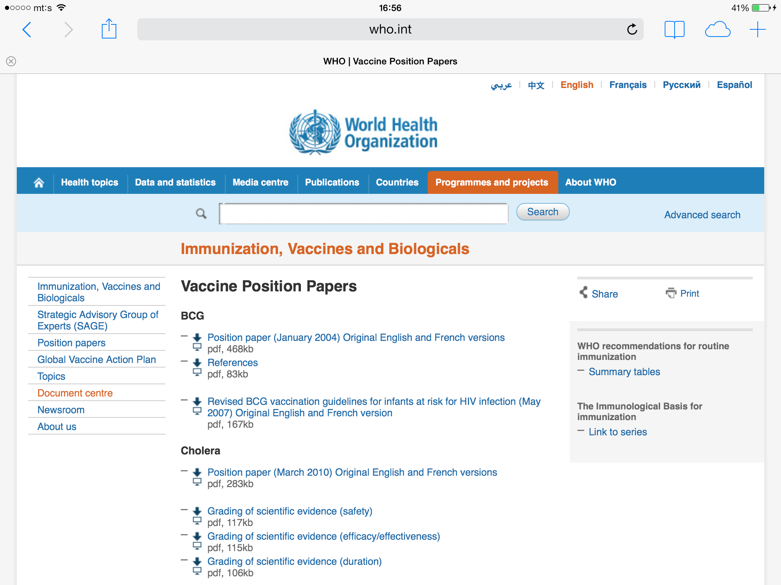
Gathering evidence WHO Position Papers
http://www.who.int/immunization/documents/positionpapers/en/
Seek evidence relating to all outcomes that are considered critical and important for decision-making.
Notes:
A good way to start your evidence gathering is to review the WHO position papers on the vaccine you are considering.

Slide 54
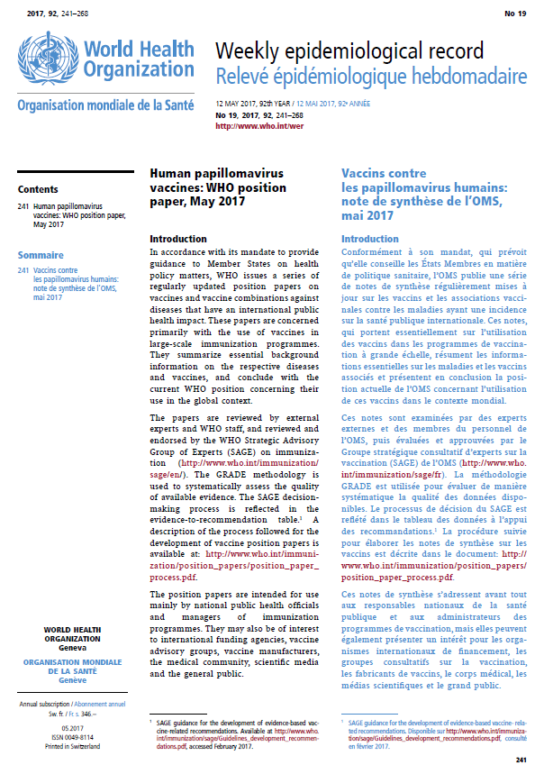
Gathering evidence WHO Position Paper on HPV vaccine http://apps.who.int/iris/bitstream/10665/255353/1/WER9219.pdf?ua=1
Notes:
Here is the WHO position paper on HPV vaccine published in May 2017.

Slide 55
Gathering evidence
Gather evidence on what?
Gather evidence only on outcomes deemed critical or important to decision-making
How to gather evidence?
Observational data or Literature review (not systematic)
Systematic review
Disease or public
health problem
Vaccine and immunization characteristics
Health policy and programmatic issues
Resource use
Observational data, or
Literature review of primary data
Rapid review
Systematic review
Notes:
In this section, we will discuss gathering of evidence on outcomes deemed critical or important to decision-making.
What are the methods for gathering evidence?
Observational data and a literature review or a rapid review
Systematic review
This next part shows you which type of evidence should be gathered for which criteria.
Observational data or literature review is appropriate for the first three criteria shown here.
Systematic review should be used for vaccine safety, vaccine efficacy and effectiveness, and duration of protection.
Keep in mind, that you can don’t have to do your own systematic reviews. You can use data and reviews that have been done by other countries.
The next few slides will discuss issues on non-systematic methods of evidence gathering.

Slide 56
Gathering data Literature review of primary data
Seek evidence relating to all outcomes that are considered critical and important for decision-making.
A literature review discusses published information in a particular subject area, and usually within a certain time period.
Should include
Summary: a recap of the important information of the source
Synthesis: a re-organization, or a reshuffling, of the information in the summary. It may
Present a new interpretation of old material or combine new with old interpretations, Or
Trace the progression of the field, including major debates, and
May evaluate the sources and comment on the most pertinent or relevant.
Notes:
Data can be summarized through a literature review of primary data.
Read thru slide
This can be time consuming. If the Secretariat or the Work Group can obtain the help of a librarian, it would be helpful, especially in defining search criteria. Some NITAGs have engaged with graduate students or those within academia to conduct literature reviews. It is also a good idea to do a consistency check on a subset of the titles and abstracts.

Slide 57
Gathering evidence on disease burden
Optimal
National surveillance data
National disease burden studies
Country-specific epidemiologic data
WHO country estimates of rotavirus, Hib, pneumococcal disease, meningitis, cervical cancer, HPV disease
Regional estimates
Proxy data from countries with similar demographic/socioeconomic conditions
Useful
Some uncertainty
Mathematical models
Interpretation requires understanding built-in assumptions
Notes:
Special considerations for disease burden—talk about it in more depth.
Evidence on disease burden. Optimal sources include national data on disease surveillance and epidemiology.
Useful sources to supplement national evidence include WHO country estimates of burden of disease. Regional estimates and data from countries with similar demographics and socioeconomic conditions could also be useful.
Many countries also use mathematical models, but interpretation must take into consideration the built-in assumptions of models.

Slide 58
Gathering evidence on disease burden Limitations of surveillance data to estimate disease burden
Poor access to health care
Lack of laboratory capacity to define etiology of diseases and causes of death
Incomplete reporting of diseases and deaths through passive surveillance
Lack of or incomplete cancer registries
Notes:
Although national surveillance is a good source of evidence on disease burden, there are limitations.
Let’s consider these situations in the context of HPV.
If there is poor access to health care, how would surveillance data be affected? Prompt input… Would lead to underestimation of the burden of disease.
If there is lack of lab capacity to define the etiology of disease and causes of death, how would surveillance data be affected? Prompt input… Would lead to underestimation of the burden of disease.
Another limitation is the long length of time between initial infection and development of reportable disease.
Continue as above with last bullets

Slide 59
Gathering evidence on disease burden Streptococcus pneumoniae; Surveillance for Laboratory Confirmed Disease only Provides Part of the Picture
Percent detected by culture
Laboratory-confirmed IPD
Non-lab confirmed IPD
Otitis media
Sinusitis
Non-bacteremic
pneumonia
Chris Van Beneden, MD, MPH
Centers for Disease Control and Prevention
Notes:
This illustrates the situation for Streptococcus pneumoniae. There are laboratory tests, but --Click 1 --only a proportion of the cases are actually tested.
Click 2—Laboratory-confirm invasive pneumococcal disease is only the tip of the iceberg.
Click 3—The vast majority of cases are non-lab confirmed IPD.
Knowing this, how would you interpret surveillance data on disease caused by Strep pneumo?
Prompt input… You should realize that surveillance data typically underestimates the burden of disease.
For HPV, the situation is a little different because surveillance for HPV pre-cancer precursors is not routine, which makes it even harder to define disease burden.

Slide 60
Gathering evidence on disease burden WHO country specific estimates (http://www.who.int/immunization/diseases/en/)
Hib and pneumococcal diseases:
http://www.who.int/immunization/monitoring_surveillance/burden/estimates/Pneumo_hib_2000/en/index1.html
Rotavirus diarrhoeas: http://www.who.int/immunization/monitoring_surveillance/burden/estimates/rotavirus/en/
Notes:
A useful source of evidence on disease burden are WHO country-specific estimates of disease burden of vaccine preventable disease. These are excellent sources of evidence that NITAGs can use to supplement local sources. These are updated regularly and can be found at the websites shown here.

Slide 61
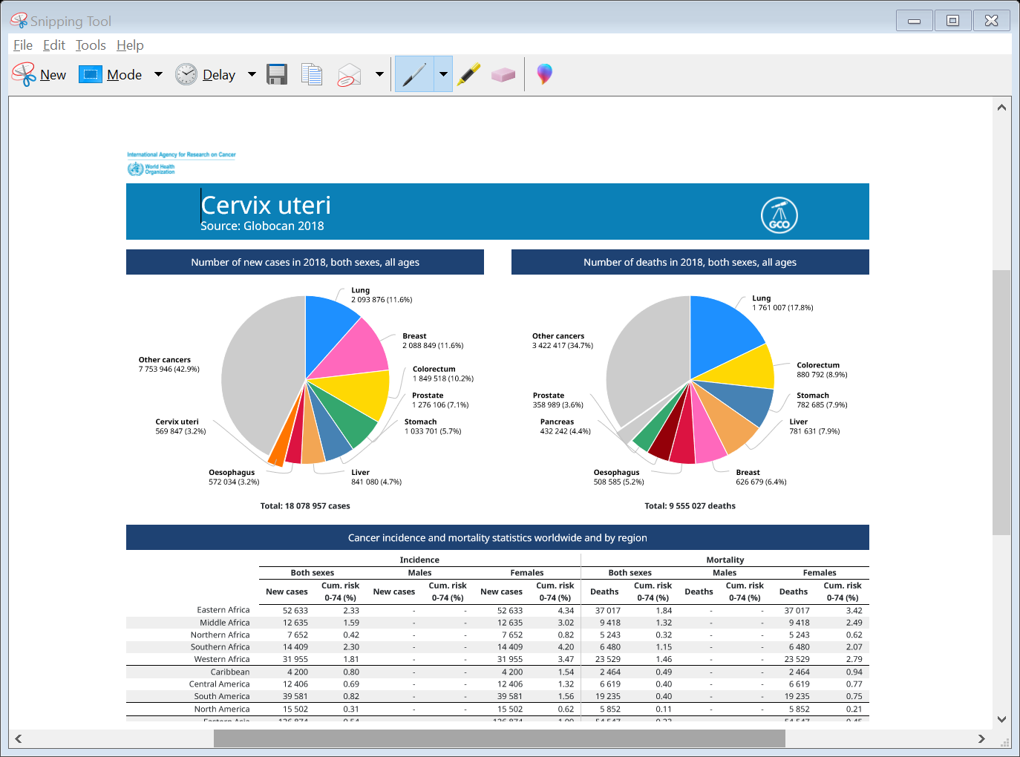
Gathering evidence on disease burden Other sources of estimates for HPV
HPV related disease: www.hpvcentre.net
Cervical cancer (Globocan 2018)
http://globocan.iarc.fr/Pages/fact_sheets_cancer.aspx
Notes:
For HPV, here are 2 sources of disease burden data.
The HPV Information Centre provides data on burden of HPV-related cancers: cervix, anus, vulva, vagina, penis, oral cavity, and pharynx. You can access it using the link in this slide.
Globocan publishes incidence and mortality rates of cervical cancer by country.

Slide 62
https://www.who.int/alliance-hpsr/resources/publications/rapid-review-guide/en/
Notes:
In the literature there is no standard definition for what is in a rapid review. This is a guide to rapid reviews created by WHO.
The important points to remember when doing any sort of search that is going to be used to generate policy, be as transparent as possible by providing detailed methods within your report (could be in an Appendix).

Slide 63
Interactive discussion — Data sources
Facilitator will engage the participants in suggesting data sources for elements that were ranked critical for the following tables:
Public Health Problem
Resource use
Health policy and programmatic issues
Notes:
Go around room and ask each country to contribute source of data – where would they find burden data in their country …. Etc.
Ask each country as a group where they would find data, so as not to put anyone on the spot.

Slide 64
Data sources on: Disease or Public Health Problem
Element | Specific data | Data sources
1.1 Burden of disease | Incidence of morbidity & mortality; age-specific morbidity and mortality, risk groups, serotype distribution, disease occurrence over time, changes in epidemiology over time
1.2 Clinical characteristics of the disease | Signs and symptoms of disease, severe forms, long term complications of disease, medical management of disease
1.3 Use and Costs of Health Care | Primary/secondary/tertiary care implications, short- and long-term use of healthcare (e.g. treatments, hospitalisation)
1.4 Alternative preventive and control measures | Alternative preventive and control measures (e.g. health education, hygiene) and their effectiveness, costs, and practicality
1.5 Regional and international considerations | Existence of regional and global recommendations
 | Disease potential for international spread and pandemic risk

Slide 65
Data sources on: Vaccine and immunization characteristics
Element | Specific data | Data sources
2.1 Vaccine characteristics | Vaccine presentation, formulation, dosage and route of administration
 | Administration schedule and possibility of co-administration with other vaccines and drugs
 | Flexibility of vaccination schedule
 | Cold chain and logistic requirements
2.2 Safety | Type, consequences and frequency of short and long-term adverse events following vaccination
 | Risk groups or risk factors for adverse events
 | Contraindications or precautions
2.3 Efficacy and effectiveness | Types specific protection afforded
 | Critical determinants of the immune response associated with protection
 | Duration of protection and waning of immunity in general and risk groups
 | Interference regarding protection or immunity with other vaccines
2.4 Vaccine Indirect Effects | Herd immunity/protection
 | Potential negative population impact of emergence of non-vaccine serotypes

Slide 66
Data sources on: Resource use
Element | Specific data | Data sources
3.1 Vaccine related costs and resource use | Direct and indirect costs to administer the vaccine as they compare to other prevention or control measures; cost using different strategies
3.2 Vaccine availability | Availability of vaccine and long-term supply
 | Available suppliers and competition dynamic in the market
3.3 Vaccine affordability | Availability of fiscal space to effectively implement and sustain the recommendation in the programme
 | Prevailing prices for the vaccine in the market and price estimations for the local community
 | Availability of vaccine and long-term supply in public and private sector, including collaborations with insurance sector
3.4 Economic impact of intervention on immunization program as well as health sector | Health Gain
 | Reduction in healthcare costs
 | Cost-effectiveness ratio of vaccination program

Slide 67
Data sources on: Health policy and programmatic issues
Element | Specific data | Data sources
4.1 Interaction with existing intervention and control strategies | Impacts of program on efficacy and safety of other vaccines and health care interventions
4.2 Feasibility | Accessibility of target population
4.3 Vaccine registration and regulations | NRA* requirements to register available vaccines for use in target population and/or use in a different schedule as originally recommended
4.4 Impact on Resources | Availability of human, technical, and financial resources for distribution (including cold chain sustainability)
4.5 Ability to evaluate | Availability of information systems to manage the vaccine supply chain measure related performance metrics, i.e. coverage and vaccine utilization
 | Existence and reliability of surveillance systems
4.6 Acceptability | Perception of the public and medical community about disease and vaccine
4.7 Equity | Universality, accessibility and gratuity of services for all the inhabitants in the country, including vulnerable, hard to reach and immigrant populations
4.8 Social Considerations | Non-health related effects of vaccination, ethical considerations, legal implications. Stigma around the disease or around vaccination.
* National Regulatory Authority

Slide 68
Systematic reviews and assessing quality of evidence

Slide 69
Gathering evidence
Gather evidence on what?
Gather evidence only on outcomes deemed critical or important to decision-making
How to gather evidence?
Observational data or Literature review (not systematic)
Systematic review
Disease or public
health problem
Vaccine and immunization characteristics
Health policy and programmatic issues
Resource use
Observational data, or
Literature review of primary data
Rapid review
Systematic review
Notes:
In this section, we will focus on how to conduct a systematic review, what steps are needed and also how to access reviews done by others. Please note that we cannot in the time we have together become experts in doing systematic reviews.
Systematic review should be used for evidence on vaccine safety, vaccine efficacy and effectiveness, and duration of protection.
Keep in mind, that you can use data and reviews that have been done by other countries. These can be found on the GNN website.

Slide 70
Gathering evidence Systematic review
Use Systematic methods to identify the evidence
documentation of the search strategy used to identify all relevant published and unpublished studies and
documentation of the eligibility criteria for the selection of studies
The Cochrane handbook provides guidance on searching for studies, including grey literature and unpublished studies (Chapter 6, Section 6.2, available at http://handbook.cochrane.org/)
Only necessary for vaccine safety, vaccine efficacy and effectiveness, and duration of protection
Notes:
Systematic methods involves documentation of the search strategy to identify all relevant studies, either published or unpublished. And documentation of the eligibility criteria for the selection of the studies.
You can obtain guidance on this process in the Cochrane handbook.
Remember, systematic methods are only necessary for vaccine safety, vaccine efficacy and effectiveness, and duration of protection.

Slide 71
Gathering evidence Steps in Conducting a Systematic Review
1. Formulate Research Question:
A well-formulated research question in PICO format
2. Develop Review Protocol:
Define inclusion/exclusion criteria
List study characteristics, quality, effects
3. Conduct Literature Search:
Develop search terms. (Typically, a broader search is done first and then refined.)
4. Select Studies per Protocol:
Usually at least two researchers should screen titles and abstracts based on inclusion and exclusion criteria stated in the protocol. Selected full text articles should be obtained for second stage screening by at least two reviewers.
5. Appraise Studies per Protocol
Selected full text articles should be appraised for methodological quality by at least two reviewers.
6. Summarize the Evidence.
Use statistical methods (meta-analysis) to combine effects
Assess or grade quality of body of evidence
7. Interpret Results
Consider limitations (including biases), strength of evidence, applicability, economic implications and implications for future research.
Notes:
Conducting a Systematic Review is labor and time intensive, consisting of these steps.
If your country has the resources and skills to do a systematic review, your NITAG may consider doing so.
If you choose not to conduct your own systematic review, there are other sources.
Depending on the audience (stage of development and technical capacity of the NITAG), the presenter can just touch on these steps or go into more detail (give sub-bullets).

Slide 72
Gathering evidence Use Systematic reviews conducted by others
WHO:
Vaccine position papers (available in English and Russian) and background documents
http://www.who.int/immunization/documents/positionpapers/ru/
SAGE recommendations and background documents for relevant SAGE meetings
http://www.who.int/immunization/policy/sage/en/
https://www.who.int/immunization/sage/Guidelines_development_recommendations.pdf?ua=1
Global Advisory Committee on Vaccine Safety statements and background documents
http://www.who.int/vaccine_safety/committee/topics/en/
NITAG Resource Center:
http://www.nitag-resource.org/
Cochrane library:
http://www.cochranelibrary.com/
London School of Hygiene and Tropical Medicine Database of Systematic Literature Reviews to Support Vaccine Policy (SYSVAC):
http://immunisation.hpru.nihr.ac.uk/sysvac
Notes:
Besides WHO, there may be other groups that have conducted systematic reviews.
It is important to read these reviews critically, to ensure their question is similar enough to yours and to review the methods used. A tool that can be used for a quality assessment is AMSTAR. This has a checklist of 16 elements that will help assess the methods used.

Slide 73
Rapid Reviews vs Systematic Reviews
 | Rapid Review | Systematic Review
Timelines | <6weeks | Longer (depending on scope)
Scope | More limited databases searched | Comprehensive (6 databases)
Methods | Pre defined inclusion/exclusion criteria | Pre defined inclusion/exclusion criteria
 | Pre defined search strategy | Pre defined search strategy
 | Pre defined data abstraction form | Pre defined data abstraction form
Synthesis | Synthesis less robust | Synthesis based on total evidence base
 | Descriptive summary/categorization of data | Qualitative summary, meta analysis possible
 | Step can be conducted by 1 reviewer | Each step conducted by 2 independent reviewers
What can we say? | Caution exercised with interpretation | Evidence based
Resources needed | Less | More
Notes:
This table provides a comparison of the similarities and differences between rapid reviews and systematic reviews.

Slide 74
Evidence Review Options Scenario
MoH has asked that your NITAG review the evidence on the use of PCV10 vs PCV13 for your routine childhood program
Options:
Review WHO materials from SAGE
If PICO is the same as or similar to yours – use it
Update or modify Systematic Review done by WHO
If within the secretariat there isn’t available resources – consider academic institutions that may have expertise and time to do an update
Go to NITAG Resource Center
Has another NITAG asked the same/similar question?
Could this be used/updated?
Rapid Literature Review
Twinning relationships can provide guidance/input on best approach
Notes:
Facilitator should emphasize that especially in countries that have limited capacity, the NITAG should use WHO materials (already conducted systematic reviews) so as not to reinvent the wheel.

Slide 75
From policy question to recommendation
Step 1
Formulate policy question
Focus policy question
Step 2
Specify evidence to be collected
Step 3
Gather, analyze evidence
Step 4
Discuss recommendation
Decide on recommendation
Assess quality of evidence
Synthesize evidence
Prepare background documents
Rank outcomes
Who does?
Secretariat or Work Group
Notes:
Let’s now move to the next part of step 3, Assessing the quality of evidence.
The part applies only to evidence on for vaccine safety, vaccine efficacy and effectiveness, and duration of protection*
The purpose of this section is to review why GRADE is used, and how GRADE scores are generated

Slide 76
Evaluating the Quality of Evidence
In the context of making recommendations:
The quality of evidence quantifies the confidence that the estimates of an effect are adequate to support a particular decision or recommendation.
A common process of evaluation is GRADE^{1,2}
EVALUATION OF QUALITY OF EVIDENCE IS NEEDED ONLY FOR OUTCOMES on vaccine safety, vaccine efficacy and effectiveness, and duration of protection³
¹ GRADE stands for Grading of Recommendation Assessment, Development and Evaluation
² ww.GradeWorking-Group.org
³ SAGE Guidance for the development of evidence-based vaccination-related recommendations, Version 8, 31 January 2017
Notes:
Why do we recommend evaluating the quality of evidence?
In the context of making recommendations, the quality of evidence reflects the extent of confidence you have in the body of evidence.
How confident are you that what the evidence shows supports the recommendation?
A common way to evaluate quality is GRADE, an acronym that stands for Grading of Recommendation Assessment, Development and Evaluation
The use of GRADE is needed only for outcomes for vaccine safety, vaccine efficacy and effectiveness, and duration of protection.
*Source—Guidance for the development of evidence-based vaccination-related recommendations, Version 8, 31 January 2017

Slide 77
Hierarchy of evidence
Meta
analysis
Notes:
Review slide
Point out difference between filtered and unfiltered information.
Click--Meta analysis would be considered the highest quality of evidence.

Slide 78
Study design and susceptibility to bias
STUDY DESIGN
Randomized Controlled Trials
Cohort Studies and Case Control Studies
Case Reports and Case Series, Non-systematic observations
Expert Opinion
BIAS
Least
Most
Notes:
The study design that was used in the published evidence affects the susceptibility of bias.
For example,
An RCT is the design with the least susceptibility to bias
Cohort and Case Control Studies are a little more susceptible to bias.
Case report, case series, and non-systematic observations, such as surveillance data, are more susceptible to bias.
And expert opinion is the most susceptible to bias.

Slide 79
GRADE—Step 1
Two step method based on:
Methods (study design) used for the data collection
Characteristics of data collection that affect bias
Step 1—Assess quality based on the study design:
Randomized Controlled Trials ⊕⊕⊕⊕/A/High 4
Cohort Studies, Case Control Studies ⊕⊕⊕/B/Moderate 3
Case Reports, Series, Observations ⊕⊕/C/Low 2
Expert opinion ⊕/D/Very low 1
*www.GradeWorking-Group.org
Notes:
GRADE is a two step method.
The first step is to assess quality based on the study design.
Because RCTs have the least bias, they are considered High quality.
Cohort and Case Control Studies are considered Moderate quality.
Observational studies are considered Low quality.
And Expert opinion is considered Very Low quality.
This is the starting evidence quality.

Slide 80
GRADE—Step 2
Step 2 – Adjust the evidence type based on likelihood of bias
5 factors that can lower quality
limitations in design and execution (risk of bias criteria)
Inconsistency (or heterogeneity)
Indirectness (PICO and applicability)
Imprecision (number of events and confidence intervals)
Publication bias
3 factors can increase quality
large magnitude of effect
all plausible residual confounding may be working to reduce the demonstrated effect or increase the effect if no effect was observed
dose-response gradient
*www.GradeWorking-Group.org
Notes:
While this section will provide an overview of GRADE, we will not have time to go through specifics. There are specific courses (usually 1-3 days) to learn this. Important to us as NITAG members and secretariat is understanding how GRADE scores are generated.
GRADE is a two step method.
The first step is to assign an Evidence Type of 1-4 based on the study design.
Because RCTs have the least bias, they are considered High quality or Evidence Type 1
Cohort and Case Control Studies are considered Moderate quality or Evidence Type 2
Observational studies are considered Low quality or Evidence Type 3
And Expert opinion is considered Very Low quality or Evidence Type 4
This is the starting evidence quality.

Slide 81
Assessing quality of individual studies vs body of evidence
Each study type receives a final evidence rating/score
An individual score is assigned to each outcome by combining individual studies
A single GRADE score is assigned for the quality of the evidence of each of the outcomes

Slide 82
Synthesizing evidence using Evidence to recommendation framework

Slide 83
SAGE evidence profile: Yellow Fever vaccine booster dose in immunocompetent individuals Population: Immunocompetent individuals Intervention: Primary yellow fever vaccination Comparison: No primary vaccination Outcome: Duration of immunity
Is there evidence that a booster dose of yellow fever vaccine is required to maintain protection in immunocompetent individuals?
 |  |  | Rating | Adjustment to rating
Quality Assessment | No. of studies/starting rating |  | 10/observational 1 | 2
 | Factors decreasing confidence | Limitation in study design | None serious2 | 0
 |  | Inconsistency | None serious | 0
 |  | Indirectness | None serious3 | 0
 |  | Imprecision | None Serious | 0
 |  | Publication bias | None serious | 0
 | Factors increasing confidence | Large effect | Not applicable | 0
 |  | Dose-response | Not applicable | 0
 |  | Antagonistic bias and confounding | Not applicable | 0
 | Final numerical rating of quality of evidence |  |  | 2
Summary of Findings | Statement on quality of evidence |  |  | Our confidence in the estimate of the effect on the outcome is limited.
 | Conclusion |  |  | Over 540 million doses of yellow fever vaccine have been used (1) with only 12 cases of secondary vaccine failure reported (2-6)4. Healthy persons rarely fail to develop neutralizing antibodies after vaccination (7). Neutralizing antibody titres can be found in most vaccines more than 10 years after vaccination (8-19). Immunity might also be cell- mediated (13;15). In endemic settings, high primary vaccination coverage (60-80%) prevents outbreaks. (20). In immunocompetent persons there is no demonstrated need for a booster dose every ten years.
Notes:
Here is a SAGE profile for evidence on whether a booster dose of YF vaccine is required in immunocompetent individuals to ensure long-term protection.
Remember – the rating of quality of evidence (also referred to as the evidence profiles) are only to be used for vaccine effectiveness and safety (referred to as Harms and Benefits on the SAGE ETR). The grading of quality of evidence is NOT used for any other part of the data collection/literature reviews.
SAGE found 10 observational studies related to this question.
The starting rating is shown in the first row of the quality assessment.
Then SAGE considered each of the factors decreasing confidence and subtracted points for each serious limitations. Read through.
Then SAGE considered each of the factors increasing confidence, and added a point for each factor that was applicable. The final rating of quality was 2.
In the lower section of the table, SAGE makes a statement on the quality of evidence—read it aloud.
And then makes a conclusion—read it aloud.
Questions?
Below for reference only
Source: https://www.who.int/immunization/position_papers/yellow_fever_duration_of_protection_immunocompetent.pdf?ua=1
Footnotes:
¹ 6 observational studies reported 74.5-100% neutralizing antibody (NTAb) ≥10years after vaccination. One small study reported 65% (n=13/20) with protective NTAb after 10 years (De Melo et al. 2011). One study (Gomez SY et al. 2008) reported NTAb in >68% in
vaccinees after ≥4years post vaccination. One study (Veit et al.2009) reported 88% NTAb 1-10 years after vaccination and one study reported 73% with NTAb 3- 4 years after vaccination (Gibney et al. 2012).
² Limitations in only 2 of 8 studies/therefore no downgrading: No clear description of method and incomplete medical records of vaccinated (Poland et al. 1981). Non-standardized methods such as mouse-protection test used (Groot et al. 1962).
³ Serological marker as proxy to assess level of clinical protection, yet overall agreement in the assumption that titre>1:10 in plaque reduction neutralization test is associated with protective immunity (Hepburn at al. 2006;Monath et al. 2005), therefore no downgrading.

Slide 84
SAGE evidence profile: Yellow fever vaccine-associated viscerotropic disease in travelers aged >60 years Population: Travellers receiving yellow fever vaccination Intervention: Yellow fever vaccination ≥ 60 years of age Comparison: Yellow fever vaccination < 60 years of age Outcome: Yellow fever vaccine-associated viscerotropic disease
Are(elderly(travelers(over(60(years(of(age(at(greater(risk(of(Yellow(fever(vaccineSassociated( viscerotropic(disease((YFSAVD)?
 |  |  | Rating | Adjustment to rating
Quality Assessment | No. of studies/starting rating |  | 2/ observational7 | 2
 | Factors decreasing confidence | Limitation in study design | Serious8 | -1
 |  | Inconsistency | None serious | 0
 |  | Indirectness | None serious | 0
 |  | Imprecision | None Serious | 0
 |  | Publication bias | None serious | 0
 | Factors increasing confidence | Large effect | Applicable9 | 1
 |  | Dose-response | Not applicable | 0
 |  | Antagonistic bias and confounding | Not applicable | 0
 | Final numerical rating of quality of evidence |  |  | 2
Summary of Findings | Statement on quality of evidence |  |  | Our confidence in the estimate of the effect on the outcome is limited.
 | Conclusion |  |  | Age-related data showing an association between higher rates of serious adverse events after yellow fever vaccination in travelers can be seen. Yet the evidence to support association between older age and YF-AVF in travelers is limited. Further research is needed to support the hypothesis.
Notes:
Here is a SAGE evidence profile for YF vaccine for elderly travelers.
For this outcomes of YF vaccine associated viscerotropic disease, SAGE asked the question in the first row of the table—Read it aloud.
SAGE found 2 observational studies related to this question.
The starting rating is shown in the first row of the quality assessment.
Then SAGE considered each of the factors decreasing confidence and subtracted points for each serious limitations. Read through.
Then SAGE considered each of the factors increasing confidence, and added a point for each factor that was applicable. The final rating of quality was 2.
In the lower section of the table, SAGE makes a statement on the quality of evidence—read it aloud.
And then makes a conclusion—read it aloud.
Questions?
Below for reference only
Source: https://www.who.int/immunization/position_papers/yellow_fever_viscerotropic_60_years_travellers.pdf?ua=1
Footnotes:
⁷ Two observational studies measured reporting rate ratio of YF-AVD in travelers over 60 years (Khormava et al.2005, Lindsey et al.2008). Some additional trials included reports of YF-AVD in travelers over 60 years, but these were either in endemic settings or provided no age-related analysis (Martin et al.2001, Martins RdM et al. 2010, Monath et al.2005;Lawrence(et al 2004;,Fitzner et al. 2004; Martins et al. Struchiner et al. 2004;Whittembury et al.2009).
⁸ Source of data was passive public health surveillance. Reporting rate ratio has possibly been overestimated if the true rate for travelers over 60 has increased since 1998.
⁹ RRR significantly higher compared to reference group (5.9 (95%CI(1.6-22.2) for 60-69 years of age(and 10.4 (95%CI(2.7-40.2) for ≥70 years) (Khormava et al.2005)

Slide 85
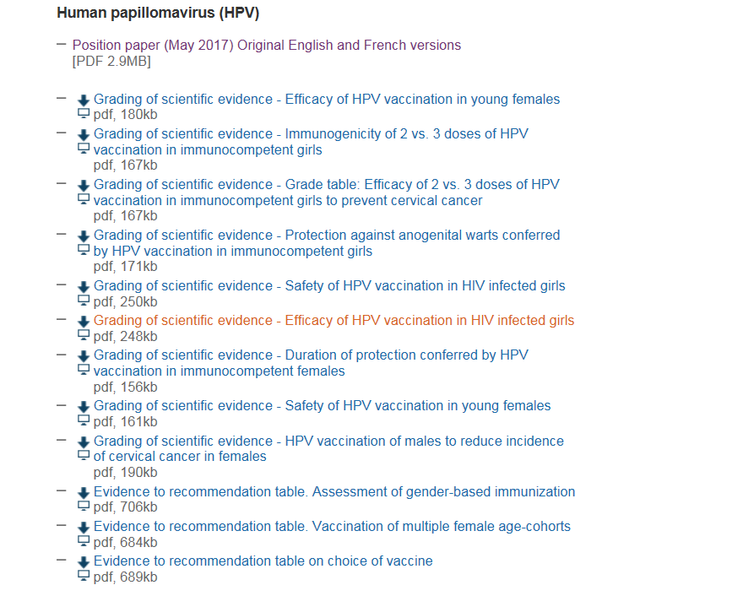
Evaluation of quality of evidence— http://www.who.int/immunization/documents/positionpapers/en/
Notes:
Here is where you can access SAGE evidence profiles for HPV vaccines.
SAGE evidence profiles are available for many vaccines and PICO questions.

Slide 86
How to use SAGE evidence profile
Review the evidence profile to understand how SAGE rated the quality of the evidence for a particular PICO question
Remember how they were generated – using the GRADE approach to determine quality and result in score displayed in the profile
If the PICO question is the same or similar enough to yours, your NITAG can choose to use the evidence profile as support for your recommendation
Insert Scores in your Criteria Tables/Evidence to Recommendation Framework regarding the Benefits & Harms section
Notes:
How would you use the SAGE evidence profiles?
Note that we will explain the Evidence to Recommendation Framework shortly
At the end of the next section, we will go through an example.
Remember – the rating of quality of evidence (also referred to as the evidence profiles) are only to be used for vaccine effectiveness and safety (referred to as Harms and Benefits on the SAGE ETR). The grading of quality of evidence is NOT used for any other part of the data collection/literature reviews.

Slide 87
Group exercise E—Reading SAGE tables on GRADE quality assessment
Break out into 4 groups
Use the computer provided
Link to the SAGE evidence table in exercise packet (or provide hardcopy):
Using the template slide provided, discuss the following questions, and enter the consensus answer directly into the slide:
What is the PICO question
How many studies were reviewed?
What is the starting Evidence Type?
What factors were noted?
What is the final Evidence Type?
Comment on the conclusion
Be prepared to present the slide during the plenary.

Slide 88
From policy question to recommendation
Step 1
Formulate policy question
Focus policy question
Step 2
Specify evidence to be collected
Step 3
Gather, analyze evidence
Step 4
Discuss recommendation
Decide on recommendation
Assess quality of evidence
Synthesize evidence
Prepare background documents
Rank outcomes
Who does?
Secretariat or Work Group
Notes:
Now, we will focus on the last step, that of synthesizing evidence to draft a recommendation.
Click—Again, This is done by the Secretariat or a Work Group—In the next session, we will discuss how to establish a work group.

Slide 89
Synthesize evidence to draft a recommendation.
Recommendations are judgments based on:
Extent of public health problem
Trade off between benefits and harms
How much people value the outcomes
How acceptable is the vaccine to key stakeholders
How reasonable is resource use for the vaccine
How feasible is the vaccine to implement.
Tool for synthesizing evidence:
Evidence to recommendation framework
Notes:
We’ve spent time discussing how to gather evidence to use in making a recommendation. This may generate quite a bit of data. How does the NITAG synthesize all this evidence?
As you know, few decisions are absolute in that all the evidence points to one decision. Rather decisions are judgements based on the extent of the problem, trade offs between the benefits and the harms, read slide.
To synthesize the evidence, we will use a tool that SAGE uses called the Evidence to Recommendation Framework.

Slide 90
Evidence to Recommendation (E2R) Framework
Purpose of E2R framework
Assist NITAG in synthesizing large amounts of evidence
Guide NITAG to make judgements based on evidence
Provide a standardized tool for transparency
Aid in communicating decision making
Notes:
The purpose of the E2R framework is Read bullets.
In the next section, we will go through the pages of the E2R framework. Then we will go through an example together

Slide 91
E2R Framework (adapted from SAGE)
PICO question
Background
ISSUE | CRITERIA | JUDGEMENTS | EVIDENCE
Problem | Is problem of PH importance?
Benefits & harms of options | Are desirable anticipated effects large? Are undesirable anticipated effects small? Balance between benefits and harms. What is the quality of evidence for critical outcomes?
Resource use | Are the resources required small? What is the cost-effectiveness
Values & preferences | Does target population feel the desirable effects are large relative to undesirable effects?
Equity | What would be the impact on health inequities?
Acceptability | Which option is acceptable to key stakeholders? To target population?
Feasibility | Is the intervention feasible to implement?
Balance of consequences—desirable vs undesirable
Recommendation
Implementation considerations, Monitoring and evaluation, Research priorities
Notes:
This is the Evidence to Recommendation Framework adapted from what SAGE uses. It is based on the criteria that we have reviewed in this workshop.
The framework starts with the PICO question and then background.
The next section contains a synthesis of the evidence in the tables we’ve been reviewing. A number of these will need to be tailored to fit your country context.
The problem or issue that the recommendation is intended to address. The gold color here aligns with the gold table we reviewed on PH problem or disease. This area covers presentation of information regarding why the issue is considered a public health priority. It will often include information regarding burden of disease and other considerations that contributed to the need for a recommendation to be developed.
The Benefits and Harms. The orange color aligns with the orange table we reviewed on vaccine and immunization characteristics. This area includes both presentation of the available evidence for benefits and harms of the vaccine option as well as the certainty in this evidence. The preparation of GRADE evidence profiles will typically be part of this section, or in circumstances where evidence tables were not prepared, a description of the rationale for the decision not to prepare tables. Finally, the evaluation and determination of the balance of the benefits and harms is also a key component of this criterion.
Resource use—The green color aligns with the table we reviewed on Resource use. It encompasses the health economic analyses that are conducted.
The Rows in blue align with the table on health policy and programmatic issues
Values and Preferences. This includes both how potential vaccine recipients and their families feel about the balance of benefits and harms, and captures whether there is significant variation in this perception among the population.
Equity describes how well the option will be accessible to all.
Acceptability describes how acceptable the option is to key stakeholders such as providers, professional societies and as such may vary according to the vaccine.
Feasibility involves consideration of the implementation considerations that factor into decision making.
An understanding of all these criteria are used to develop the last 3 rows.
—After considering all the evidence, the NITAG would make a judgement on the balance of the consequences
-- And then develop recommendation options are described.
--Lastly, the NITAG should offer input on implementation, monitoring and evaluation, and research priorities.
In the next exercise, you will study the SAGE E2R framework.

Slide 92
Using evidence collected to fill E2R Framework
ISSUE | CRITERIA
Problem | Is problem of PH importance?
Benefits & harms of options | Are desirable anticipated effects large? Are undesirable anticipated effects small? Balance between benefits and harms. What is the quality of evidence for critical outcomes?
Resource use | Are the resources required small? What is the cost-effectiveness
Values & preferences | Does target population feel the desirable effects are large relative to undesirable effects?
Equity | What would be the impact on health inequities?
Acceptability | Which option is acceptable to key stakeholders? To target population?
Feasibility | Is the intervention feasible to implement?
Burden of disease
Clinical characteristic
Use and costs of health care
Alternative preventive and control measures
Regional and international considerations
Disease or Public health problem
Vaccine characteristics
Safety
Efficacy and effectiveness
Vaccine indirect effects
Vaccine and immunization characteristics
Health policy and programmatic issues
Interactions with existing interventions and control strategies
Feasibility
Vaccine registration and regulations
Impact on resources
Ability to evaluate
Acceptability
Equity
Social considerations
Vaccine related costs and resource use
Vaccine availability
Vaccine affordability
Economic impact of intervention on NIP as well as health sector
Resource use
Notes:
This is the Evidence to Recommendation Framework adapted from what SAGE uses. It is based on the criteria that we have reviewed in this workshop.
The framework starts with the PICO question and then background.
The next section contains a synthesis of the evidence in the tables we’ve been reviewing. A number of these will need to be tailored to fit your country context.
The problem or issue that the recommendation is intended to address. The gold color here aligns with the gold table we reviewed on PH problem or disease. This area covers presentation of information regarding why the issue is considered a public health priority. It will often include information regarding burden of disease and other considerations that contributed to the need for a recommendation to be developed.
The Benefits and Harms. The orange color aligns with the orange table we reviewed on vaccine and immunization characteristics. This area includes both presentation of the available evidence for benefits and harms of the vaccine option as well as the certainty in this evidence. The preparation of GRADE evidence profiles will typically be part of this section, or in circumstances where evidence tables were not prepared, a description of the rationale for the decision not to prepare tables. Finally, the evaluation and determination of the balance of the benefits and harms is also a key component of this criterion.
Resource use—The green color aligns with the table we reviewed on Resource use. It encompasses the health economic analyses that are conducted.
The Rows in blue align with the table on health policy and programmatic issues
Values and Preferences. This includes both how potential vaccine recipients and their families feel about the balance of benefits and harms, and captures whether there is significant variation in this perception among the population.
Equity describes how well the option will be accessible to all.
Acceptability describes how acceptable the option is to key stakeholders such as providers, professional societies and as such may vary according to the vaccine.
Feasibility involves consideration of the implementation considerations that factor into decision making.
An understanding of all these criteria are used to develop the last 3 rows.
—After considering all the evidence, the NITAG would make a judgement on the balance of the consequences
-- And then develop recommendation options are described.
--Lastly, the NITAG should offer input on implementation, monitoring and evaluation, and research priorities.
In the next exercise, you will study the SAGE E2R framework.

Slide 93
Interactive Exercise:
MoH has asked that your NITAG review the evidence on the use of PCV10 vs PCV13 for your routine childhood program
Options:
Review WHO materials from SAGE
GRADE tables: https://www.who.int/immunization/sage/meetings/2017/october/5_PCV_WG_MERGED_GRADE_Sept26.pdf?ua=1
E2R Table: https://www.who.int/immunization/policy/position_papers/recommendation_table_PCV_product_choice_impact.pdf?ua=1
Notes:
Going back to this scenario. SAGE has considered this question– let’s go through the GRADE table created by SAGE and the E2R tables.
-for speaker – doing this as a live demo is really the best option. Highlight that GRADE table is for the evidence, therefore should not need to be modified. The E2R table – needs to be considered within the country context and therefore will need to be modified by country.

Slide 94
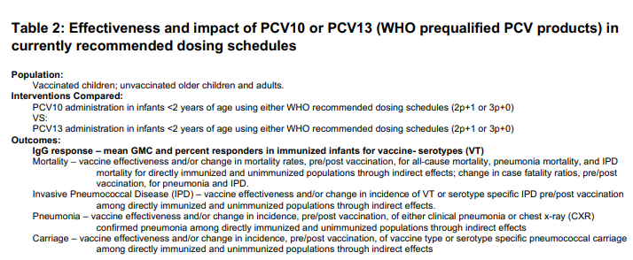
Notes:
Here is the PICO question being reviewed in this GRADE Table.
-before going onto the body of the table – is this the question your NITAG wants to answer?

Slide 95
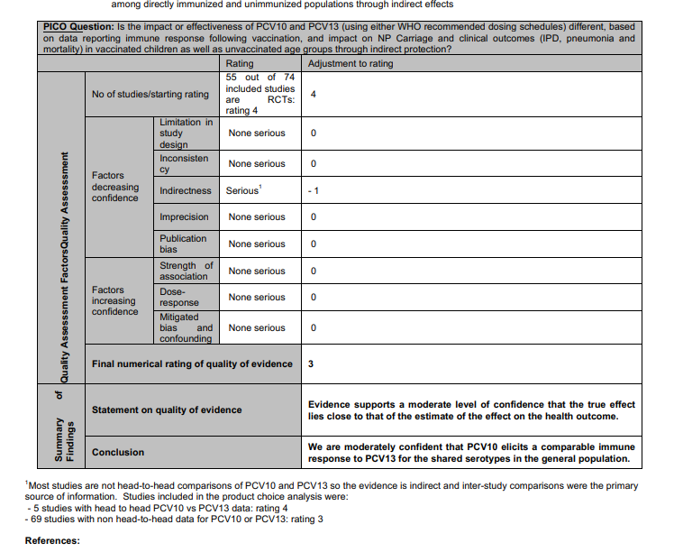
Notes:
Walk group through how table was generated and what the numbers mean, how the footnotes are used to explain downgrading

Slide 96
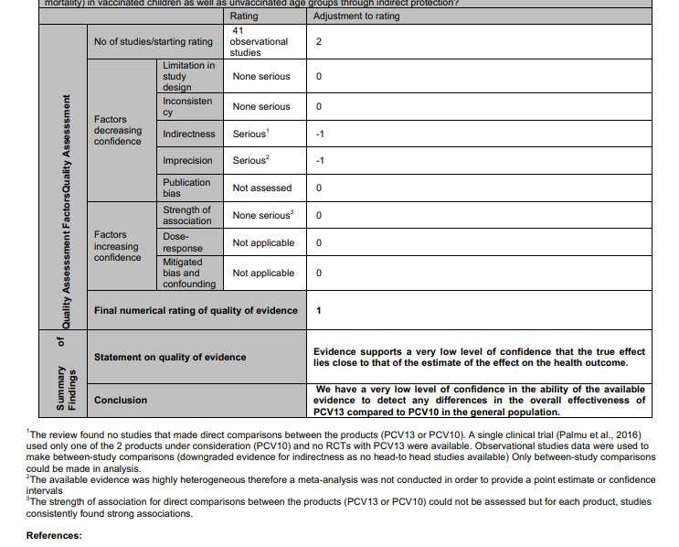
Notes:
This is the second table for this GRADE question, it is for observational studies.
Go through this table (note how it is different than the previous one – ie more footnotes/comments)
GRADE score cannot be lower than 1

Slide 97
Evidence to Recommendation Tables
Notes:
As we already looked at – there are a number of criteria that will need to be tailored to your country context. For the PCV example we are using – here is the background section. And the first issue, the PH Problem. Each NITAG should review the criteria questions in the E2R table and identify the areas that need to be tailored to your country context.

Slide 98
E2R Table: Benefits and Harms of the Options
Notes:
The next section pertains to benefits and harms of the options. The criteria column consists of a series of questions (harms, benefits, the balance of these and the quality of the evidence) to ask and a space for the evidence used as well as additional comments that would help anyone that was not in the room when you were making your recommendation.

Slide 99
E2R Tables: GRADE and Values and Preferences
Notes:
In the section on overall quality of the evidence – this is where GRADE related information is added in.
Values and preferences refer to the importance of the desirable outcomes and the undesirable outcomes as well as the effect sizes anticipated.

Slide 100
E2R Tables: Resource Use
Notes:
This section looks at resources required and cost effectiveness

Slide 101
E2R Tables: Equity
Notes:
This section looks at the impact on equity

Slide 102
E2R Tables: Acceptability and Feasibility

Slide 103
E2R Tables: Balance of consequences, Type of recommendation and Recommendation
Notes:
This section includes a judgement on the balance of the consequences.
– once you have considered all of the above criteria, what type of recommendation (in this instance since either product could be recommended – both boxes are checked) and the actual recommendation.

Slide 104
E2R Tables: Implementation considerations, Monitoring and Evaluation and Research Priorities
Notes:
Finally, any implementation considerations, issues that should be monitored and evaluated and research priorities can be added here.

Slide 105
From policy question to recommendation
Step 1
Formulate policy question
Focus policy question
Step 2
Specify evidence to be collected
Step 3
Gather, analyze evidence
Step 4
Discuss recommendation
Decide on recommendation
Assess quality of evidence
Synthesize evidence
Prepare background documents
Rank outcomes
Notes:
So to summarize, in this session, we have gone through steps 1, 2, and 3 which prepare the NITAG for discussion and decision-making which comes in step 4.

Slide 106
Thank you!
Questions?

Slide 107
Using evidence collected to fill E2R Framework
ISSUE | CRITERIA
Problem | Is problem of PH importance?
Benefits & harms of options | Are desirable anticipated effects large? Are undesirable anticipated effects small? Balance between benefits and harms. What is the quality of evidence for critical outcomes?
Resource use | Are the resources required small? What is the cost-effectiveness
Values & preferences | Does target population feel the desirable effects are large relative to undesirable effects?
Equity | What would be the impact on health inequities?
Acceptability | Which option is acceptable to key stakeholders? To target population?
Feasibility | Is the intervention feasible to implement?
Disease or Public health problem
Burden of disease
Vaccine related costs and resource use
Health policy and programmatic issues
Interactions with existing interventions and control strategies
Vaccine characteristics
Clinical characteristic
Use and costs of health care
Alternative preventive and control measures
Regional and international considerations
Safety
Efficacy and effectiveness
Vaccine indirect effects
Vaccine availability
Vaccine affordability
Economic impact of intervention on NIP as well as health sector
Feasibility
Vaccine registration and regulations
Impact on resources
Ability to evaluate
Acceptability
Equity
Social considerations
Resource use
Vaccine and immunization characteristics
Notes:
This is the Evidence to Recommendation Framework adapted from what SAGE uses. It is based on the criteria that we have reviewed in this workshop.
The framework starts with the PICO question and then background.
The next section contains a synthesis of the evidence in the tables we’ve been reviewing. A number of these will need to be tailored to fit your country context.
The problem or issue that the recommendation is intended to address. The gold color here aligns with the gold table we reviewed on PH problem or disease. This area covers presentation of information regarding why the issue is considered a public health priority. It will often include information regarding burden of disease and other considerations that contributed to the need for a recommendation to be developed.
The Benefits and Harms. The orange color aligns with the orange table we reviewed on vaccine and immunization characteristics. This area includes both presentation of the available evidence for benefits and harms of the vaccine option as well as the certainty in this evidence. The preparation of GRADE evidence profiles will typically be part of this section, or in circumstances where evidence tables were not prepared, a description of the rationale for the decision not to prepare tables. Finally, the evaluation and determination of the balance of the benefits and harms is also a key component of this criterion.
Resource use—The green color aligns with the table we reviewed on Resource use. It encompasses the health economic analyses that are conducted.
The Rows in blue align with the table on health policy and programmatic issues
Values and Preferences. This includes both how potential vaccine recipients and their families feel about the balance of benefits and harms, and captures whether there is significant variation in this perception among the population.
Equity describes how well the option will be accessible to all.
Acceptability describes how acceptable the option is to key stakeholders such as providers, professional societies and as such may vary according to the vaccine.
Feasibility involves consideration of the implementation considerations that factor into decision making.
An understanding of all these criteria are used to develop the last 3 rows.
—After considering all the evidence, the NITAG would make a judgement on the balance of the consequences
-- And then develop recommendation options are described.
--Lastly, the NITAG should offer input on implementation, monitoring and evaluation, and research priorities.
In the next exercise, you will study the SAGE E2R framework.

